Slide 1
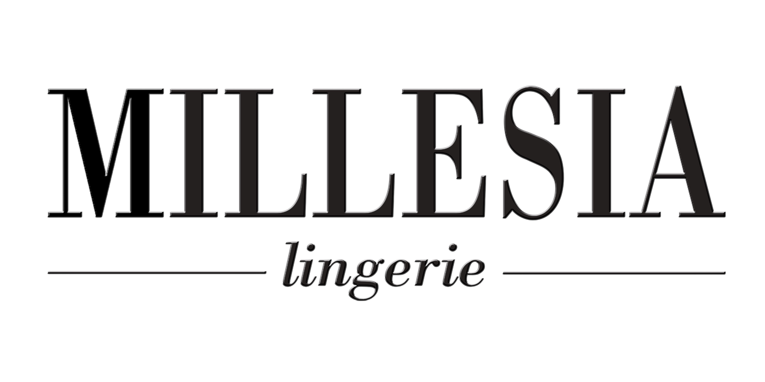
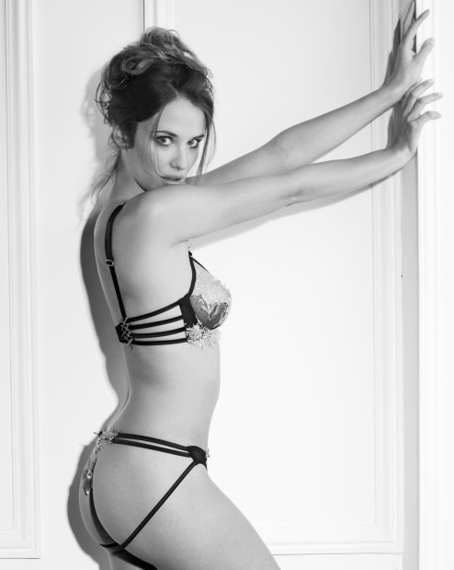
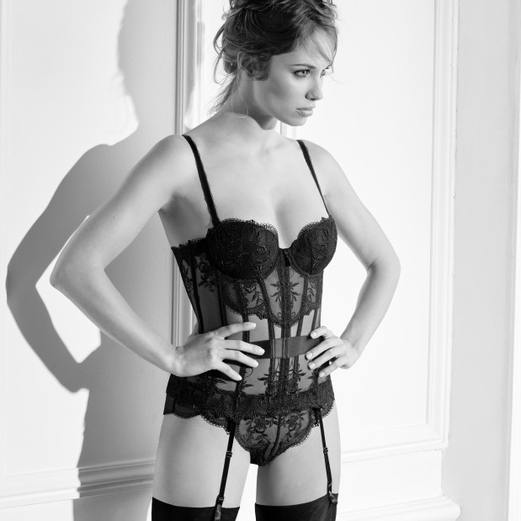

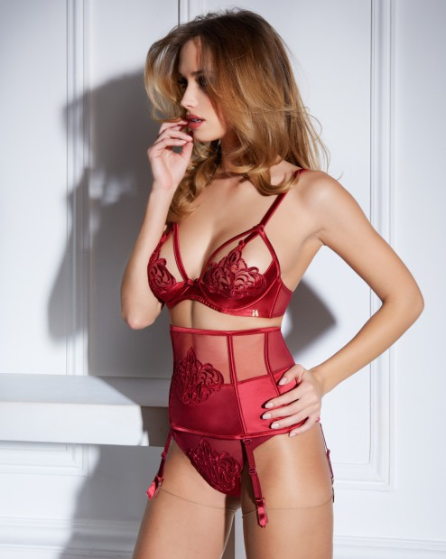
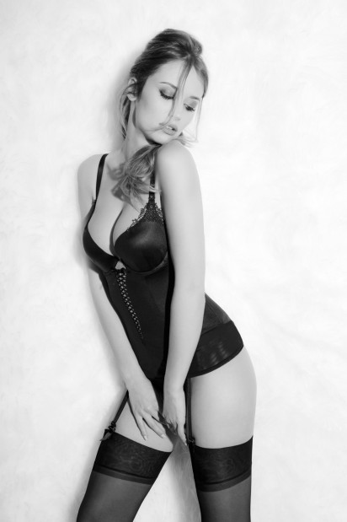
LUXURY LINGERIE INVESTMENT SA
THE POWER OF A LUXURY LINGERIE BRAND

Slide 2
OUR TEAM
Board members
  Pascal De Freyne (BE): CEO & designer (back ground supply chain and restructuring)
  Sofie Goris (BE): Sales Director (background sales & sourcing)
  Michel Machart (FR): consultant & world expert in fabrics especially lace and embroderies, owner of embrodery productions (45 years expertise), former MILLESIA associate
  Daniel Perret (FR): consultant & founder of the brand MILLESIA , world expert in lingerie (50 years expertise)
Team
  Pascal De Freyne (BE): CEO (25 years expertise)
  Sofie Goris (BE): Sales Director strong contract negotiator (20 years expertise)
  Véronique Perret (FR): Director of collections including related communication (25 years expertise)
  Edith Balandras (FR): former modelist and designer of the MILLESIA (20 years expertise)
  Fabienne Bouilhol (FR): expert modelist and designer in deep cups (25 years expertise)
  Nathalie Dubois (BE): customer service (20 years expertise)
Shareholders
  Pascal De Freyne (BE): 61,5%
  Sofie Goris (BE) :12,83%
  Xavier Cloquet (BE): (CFO Nicols Group) - supporting the project on the financial aspects: 6,42%
  Luc De Smet (BE): (former production director at Nicols, Cadbury Schweppes, AB-Inbev): 6,42%
  Van Mieghem Logistics (BE): 12,83%

Slide 3

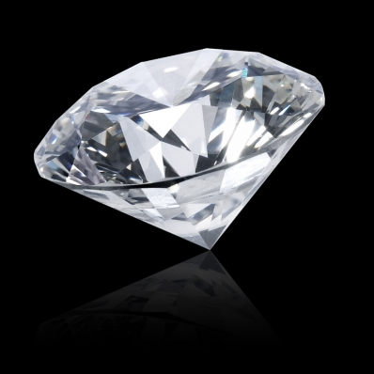
MARKET NEEDS
A strong & alternative premium Brand
Innovations
New distribution channels
Diamant : 25 years of success

Slide 4
OUR OFFER
A strong & alternative premium Brand
  Relaunch MILLESIA’s brand known as “THE” sexy & chic lingerie brand over the world
  Extended range of beachwear, stockings or necklace
Innovations :
  Sexy deep cups
New distribution channels
  Develop E-commerce in EU to boost traditional channels B2B & B2C
  Synchronize e-commerce promotions with the field (stores) through:
      With our partners VP.com and Showroomprivé.com
      Own e-commerce outlet stores

Slide 5
BUSINESS MODEL
        We design, create & fit
        We source quality
        We market and value our brand
        We sell through stores, luxury distributors and e-commerce
        We focus IT and customer service
              WE ARE OUTSOURCING
                Production
                Field sales force
                Distribution

Slide 6
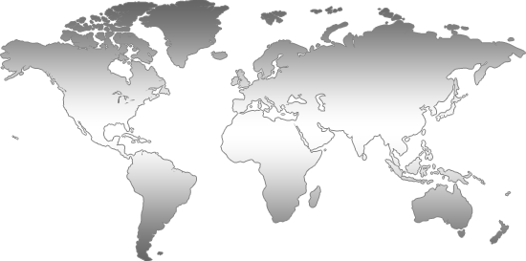
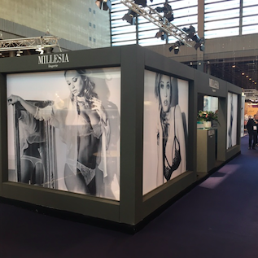
A GLOBAL PRESENCE
Russie
Ukraine
Kazakstan
Europe : more than 20 agents and
distributors
Canada
USA
Japan
Australia
Distributors
Agents & Distributors

Slide 7
COMPETITORS
(FR): Similar price positioning but more traditional Turnover 100M€
(Group Van de Velde-BE): dominant player on the deep cups in Europe
Turnover 200M€
Strong brand
Glamourous sexy & traditional
Deep cups & former lines
(IT): same price positioning but weaker brand and less creativity
(FR): focussed on classical deep cups but mainly in France
(FR): focussed on classical deep cups
Turnover 15M€

Slide 8

STATUS OF THE PROJECT
2016-08 : Take over of MILLESIA brand
2017-01 : Presentation of our Winter 2017-2018 collection at the annual International Fair SIL in Paris.
2017-02 : Confirmation of the value of the brand equity and recognition
2017-02 : Various capital increases to reach the level of 295k€
On going : funds raising to finance next season working capital
Further development of the deep cup project: expected to be ready latest by end of Q3, 2017

Slide 9
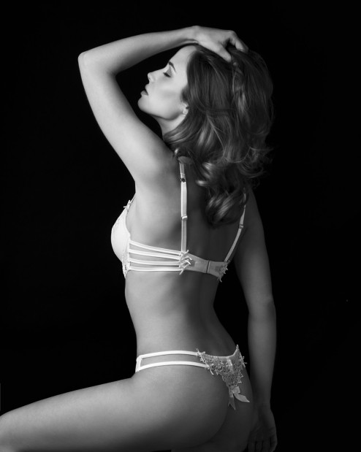
STRATEGY
Continuation & optimisation of MILLESIA brand strategy.
Focus on friendly e-commerce tool to create interactivity between B2B & B2C
Use the leverage the brand to extend our offer (deep cups, beachwear, stockings)
Focus on innovation in the deep cups segment
  BECOME A TREND LEADER
  IN THE SEXY LINGERIE
  FOR ALL WOMEN

Slide 10
FINANCE
FINANCE NEEDS :
2017: additional cash search 600k€ (partially Equity max 20% of shares)
2018 : min. 600k€ (on stock or factoring) – working capital

Slide 11
STENGHTS AS VALUE FOR THE FUTURE
A clear strategy in line with market demand
Owner of expertise
A strong brand
High added value products & margins

Slide 12
Strengths of the project
Limited risk because potential of sales is existing (versus a start up)
Equity is pretty high for a new project and allows good ratios
Very high market recognition worldwide (interest of the markets and industries)
Expertise in deep cups which is a fast growing market and limited players in this segment
Margins are quite high (even by sell off actions like VP.com).
Potential of growth in our segment
Clear sales vision.

