Slide 1
INVESTORS PITCH DECK
https://evbant.com

Slide 2
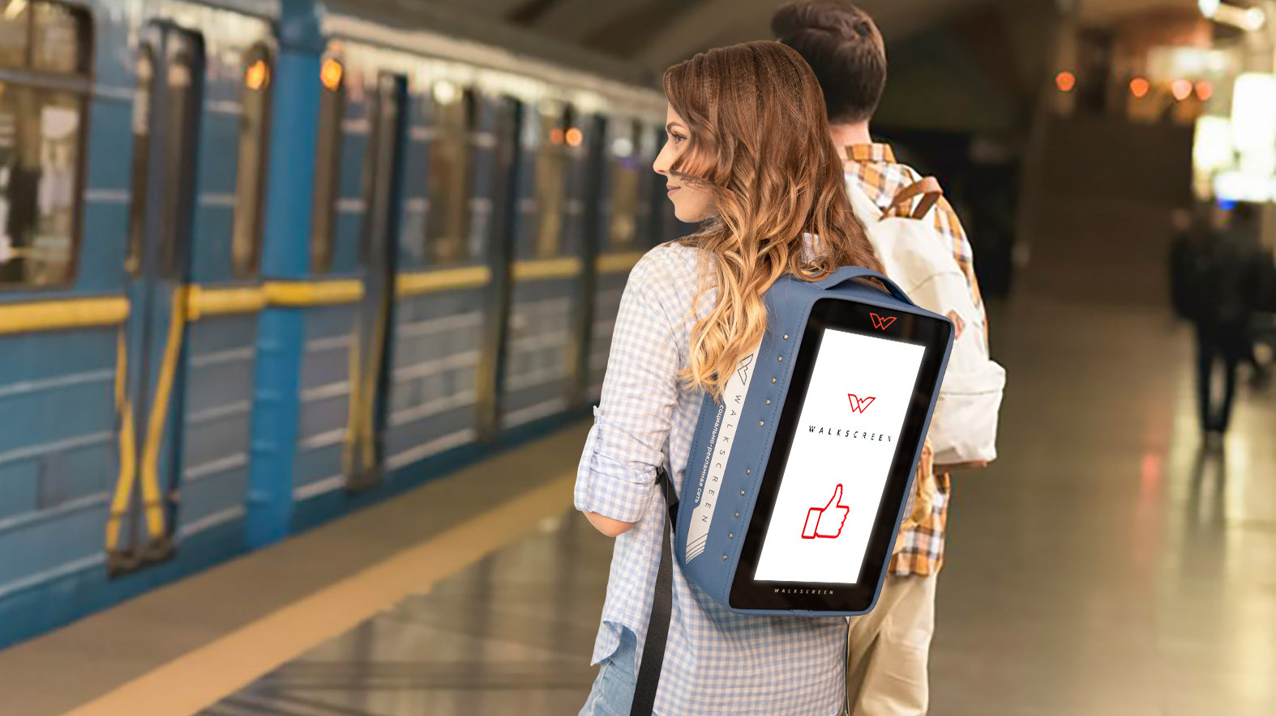
AN ADTECH AND RECYCLING ENABLED SAAS FOR FOOD DELIVERY SERVICES
https://evbant.com
Notes:
BANTgo has created an adtech enabled SaaS platform that works with any food delivery app and provides restaurants and delivery drivers with passive income for mobilizing brands in real-time. We also offer our blockchain-enabled GO-Cycle app that provides discounts, clean coins, and other tokens to eaters who recycle their takeaway containers, packaging and utensils.

Slide 3
CONTENT
01
Title page
11
Solution
02
Team
12
Technology
03
Summary
13
Top-level Architecture
04
Sustainability
14
Competition
05
Pitch
15
Business model
06
Dynamics (traction)
16
Pricing
07
Company history
17
Customer acquisition
08
Market: Description and Size
18
Market Entry Strategy
09
Customer Segment
19
Goals
10
Problem and Alternative Solutions
20
Investment/Request

Slide 4
// TEAM
Founders
Siarhey Zhiltsov
Joseph L. Patterson
Sergei Ivanov
Founder
Co-CEO (EU), CTO
Co-Founder
Co-CEO (US), CMO
Co-Founder
CHRO, CRO
Role: Overall tech stack, software & product development and management
History: Sergey Zhiltsov is an engineer-entrepreneur and programmer who has organized 3 startups previously around micromobility. He previously served as the CEO of the start-up "Classic Electro“ – an electric vehicle conversion/retrofitting service provider.
Role: AdTech stack development, go-to-market tactics, and marketing automation processes
History: Joseph L. Patterson is a tech and data-centric marketing professional who has served as a CMO of several successful tech companies in the past. Before joining BANTgo he was a senior executive a Claritas – a data technology company and served as the founding CMO of Premonition.ai – a big data, machine learning and AI startup that mined the world’s largest litigation database for insights.
Role: Research, product development, product position, talent acquisition
History: Sergei Ivanov was previously a researcher and lecturer at Grodno State University, as well as a business coach, organizational consultant, and was Human Resources Manager in manufacturing, retail, logistics, HoReCa, and IT. Sergey Ivanov is a developer of high technology products and publisher of more than 25 scientific publications.
Notes:
Our team currently consists of 3 Co-Founders and 4 Advisory board members.
Sergey Zhiltsov is an Engineer-entrepreneur and programmer who has organized 3 startups previously around micromobility.
I am a tech and data-centric marketing professional in the Martech/Adtech space and I’ve served as a CMO of 4 different tech companies.
Sergey Ivanov is a scientist & developer of high technology products and publisher of more than 25 scientific publications.

Slide 5
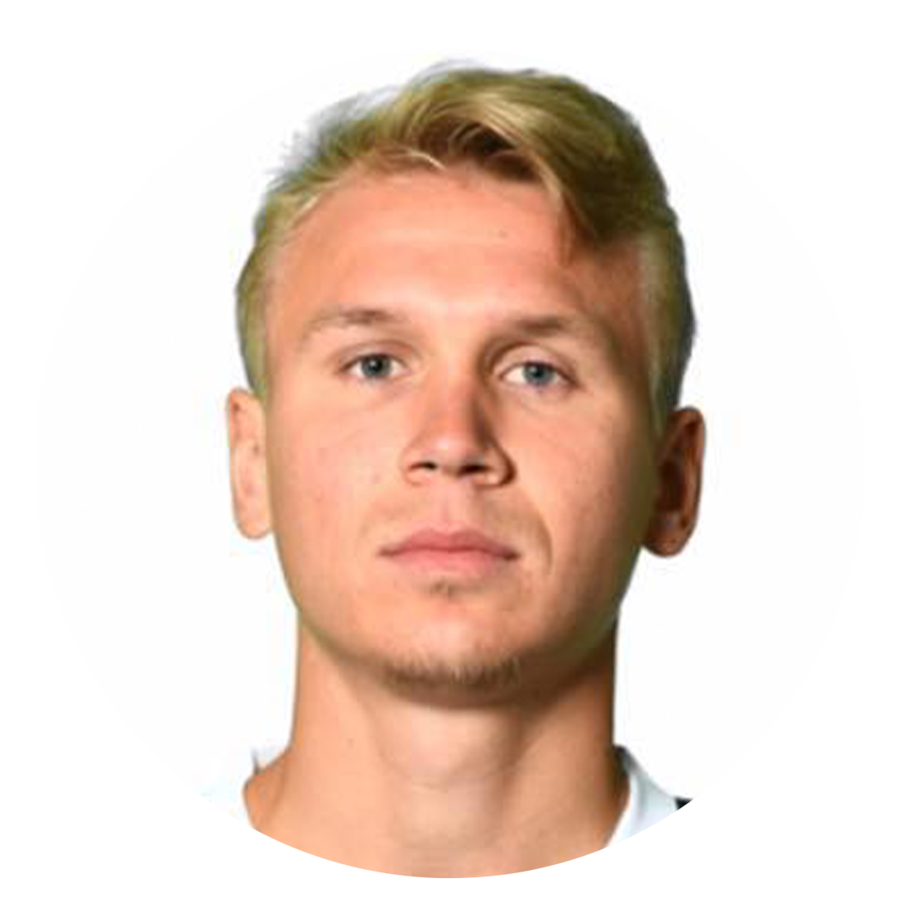
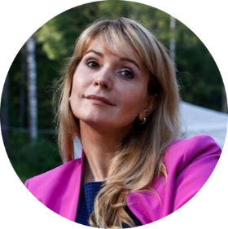
// TEAM
Mentors/Advisors
Vladimar Vassilevsky
Verneri Välimaa
Iya Gordeeva
Pavel Sivayev
Role: Help with financial strategy
Experience: Founder of https://uniter.by/
Role: VC and ecosystem catalyst focused on sustainability
Experience: http://iliosventurecatalyst.com/
Role: Assistance with micro mobility and EV
Experience: Founder of http://www.aeti.su/
Role: Helps with SW & HW development
Experience: CTO & Board member of https://aetsoft.net/
Notes:
Our advisory board consists of a Venture Capitalist from Finland, a Financial Consultant, a Chairman of a micromobility and EV organization and a technical advisor from an international IT company.

Slide 6
// INTRODUCTION
Summary
CATEGORY/ BUSINESS MODEL | Sector: Martech/Food Delivery/Recycling/Metaverse Customers: SMB, mid Enterprise Monetization model: Subscription/Ad supported Pricing: from $10 to $70/mo. | up 50% from ads time
GEOGRAPHY | Current: Belarus, Estonia In 1-3 years: U.S./NORAM In 3-7 years: EU and APAC
STAGE | Revenue: less than $100K/month Recent Investments: PRE-SEED lead investor $50K (September 2021) Belarus post-revenue, Estonia pre-revenue
REQUIRED INVESTMENTS | Required amount: $350k SAFE discount 20%, CAP $4.5m. Landing to Estonia, marketing, salary, partner network development, R&D
TEAM | Founders: 3 (co-CEO US/CMO, co-CEO EU/CTO, CRO /CRHO) Composition: Marketing - 1, Tech - 1, Sales - 1, Other – 2 4 Advisory Board Members
OTHER | Startup foundation date: August 2020 Legal entity BANTgo OÜ (Estonia reg 16296764 ) : August 2021
THE VISION | Create an adtech enabled SaaS platform that works with any food delivery app and provides restaurants and delivery drivers with passive income for mobilizing brands in real-time. Create a blockchain-enabled recycling app that provides discounts, clean coins, and other tokens to eaters who recycle their takeaway containers, packaging and utensils. Increase SMB revenue through AdTech and Recycling by 20%. Open the gateway to the metaverses for the supply chains of ready-made food and goods.

Slide 7
// SUSTAINABLITY
SDG Impact
Standards
Our business and our mission contribute to the achievement of 3 of the 17 Sustainable Development Goals.
Explore more about our ESG strategy

Slide 8
// INTRODUCTION
Pitch
For whom | Food delivery & SMB HoReCa
Who are dissatisfied | Uber-Eats food delivery model and in-house couriers that give low Net Profit Margin for business
Our product | Our product is an Internet site and mobile application
Which allows | Creates a passive income stream for the growing online food delivery market with our GO-OOH app which mobilizes brands and advertising. Also, our recycling app GO-Cycle allows for eaters to recycle and engage in sustainable behaviors in exchange for a discounts, clean coins and other tokens.
In contrast | Unlike stationary ad placements, we break through banner blindness and attract customers out-of-home which can be cheaper than existing advertising channels. Unlike stationary recycling collection points, we make it easy for eaters to return recyclables into the value chain.
We did | We have a platform for advertisers, a website and a mobile app with personal accounts that can be integrated with the food delivery and HoReCa software, and a token-based personal eco-positivity account for the eater. Our integration with food production and delivery marketers allows us to serve as a gateway to real food from virtual metaverses.

Slide 9
01
Pilot Launch
// TRACTION
Launched our adtech platform and have partnered with Carte.by, the largest marketplace for restaurants and food delivery services in Belarus, with 36 cities countrywide, 8000+ orders daily. Not only has BANTgo partnered with Carte.by, we also have agreements with several other restaurants.
Traction
02
Accelerators and Competition
BANTgo partners
Newchip Pre-seed Accelerator, TechMinsk Bootcamp feat. FiBAN, Digital SDG Accelerator EAEU feat EDF/EIFER, Civic-Tech Hackathon feat USAID
03
Recognition
Top 50 Nordic-Baltic promising Impact Startups 2021
Notes:
We are currently in our pilot launch of our adtech platform with technological partners Car-board.ru, Pixel-bag.ru, and Walkscreen.ru for the food delivery market in Belarus.
For this launch, BANTgo has partnered with Carte.by, the largest marketplace for restaurants and food delivery services in Belarus, with 36 cities countrywide, 8000+ orders daily. Not only has BANTgo partnered with Carte.by, we also have agreements with several other restaurants like Go-GO Pizza and the list goes on
We were also recently accepted into the Newchip Pre-Seed Accelerator program and have been recognized by Impact 1 at one of the top 50 Nordic Impact Startups of 2021.

Slide 10
// ABOUT US
Company History
August 2020
Founded
Investors and investments
Winter-Spring 2021
MVP MaaS
Total amount | $60.5k
Company name | Business Angels: Poland, Lithuania, Belarus, Estonian company Umika Seiza OÜ
January 2021
First paying customer
July 2021
First Angels investment (SAFE)
Summer 2021
Focus on SaaS
Company Structure
August 2021
Legal entity BANTgo OÜ in Estonia
Founders | Zhiltsou 60%, Ivanov 10% Patterson 10%, Total 80%
Option Pool | 20%
Investors | SAFE with discount 20%, CAP $4.5M
September 2021
PRE-SEED lead investor on $50k SAFE
October 2021-Now
Pilot (Belarus)
Now
Landing Estonia
Notes:
BANTgo was founded in August of 2020.
We acquired our first paying customers and Angel Investments in the first half of 2021.
And in the second half, we finalized the creation of our legal entity and raised $50 thousand from our lead investor.
Now we are actively in our first pilot launch in the Nordic/Baltic region.

Slide 11
// BUSINESS MARKET
Market Opportunities
TAM
SAM
SOM
$0.7B
$35M
$3.7B
CAGR – 10.5%**
Global Food Delivery Market for BANTgo
In total, 192.4* million food orders are delivered to the USA per month by 0.7 million couriers daily
The cost of displaying ads is up to 5 cents per impression
192.4 million food orders = $ 9.6 million per month, 500,000 BANTgo subscriptions at $70 = $49 million/month
The top 5-10 US Uberoids will cooperate with us, which is 5% of the market***
*https://www.affde.com/ru/doordash-users.html
**https://www.expertmarketresearch.com/reports/united-states-Online-food-delivery-market
***https://www.mckinsey.com/industries/technology-media-and-telecommunications/our-insights/ordering-in-the-rapid-evolution-of-food-delivery
Notes:
Our Total Addressable Market of $3.7B, with a Serviceable Available Market of $700M and a Serviceable Obtainable Market of $35M.

Slide 12
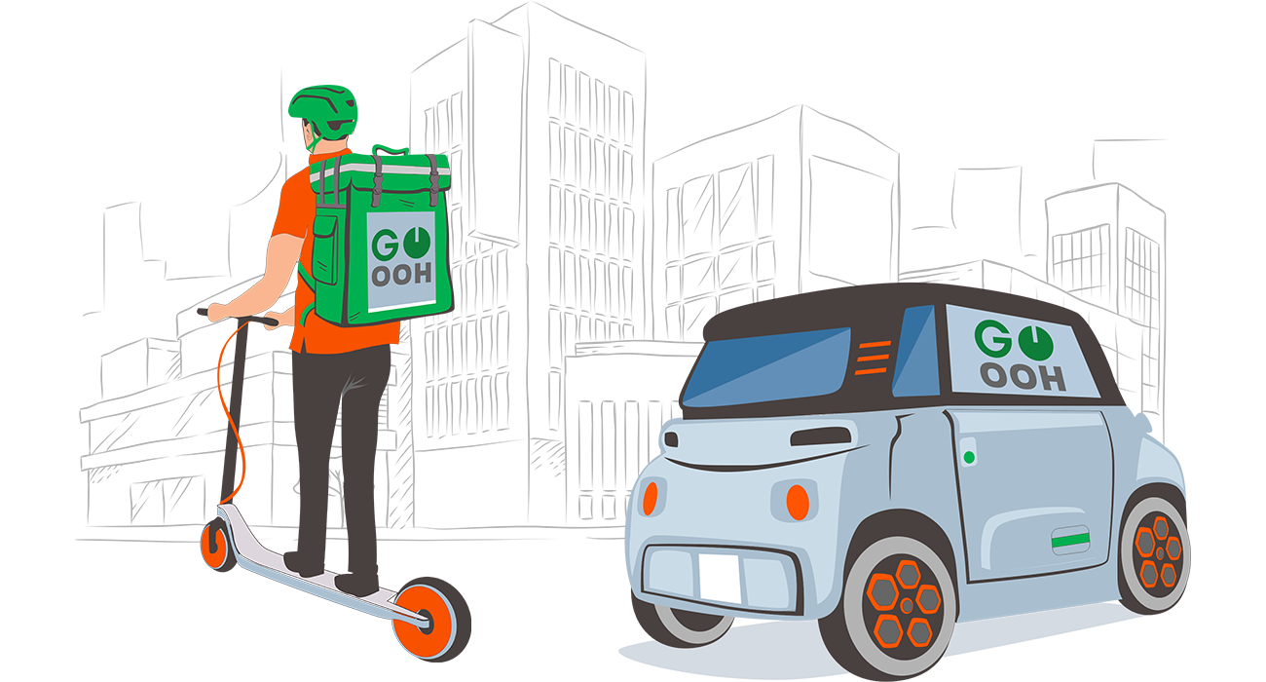
// CUSTOMER SEGMENTS GO-OOH
Customers and Segments
01
Uberoids, Restaurants and Couriers
Food delivery services and restaurants with inhouse delivery simply pair the BANTgo GO-OOH apps with their current food delivery apps and receive passive income from display the branding of the order being delivered as well as advertising
02
For Advertisers
Advertisers utilize BANTgo to launch Out-Of-Home digital advertising campaigns in real-time to specific audiences.
03
Portrait of an early GO-OOH adopter
A new player such as dark kitchens, food and grocery delivery services who needs a non-competitive advantage to capture market share and spends significant sums on marketing channels from the budgets received from VC

Slide 13
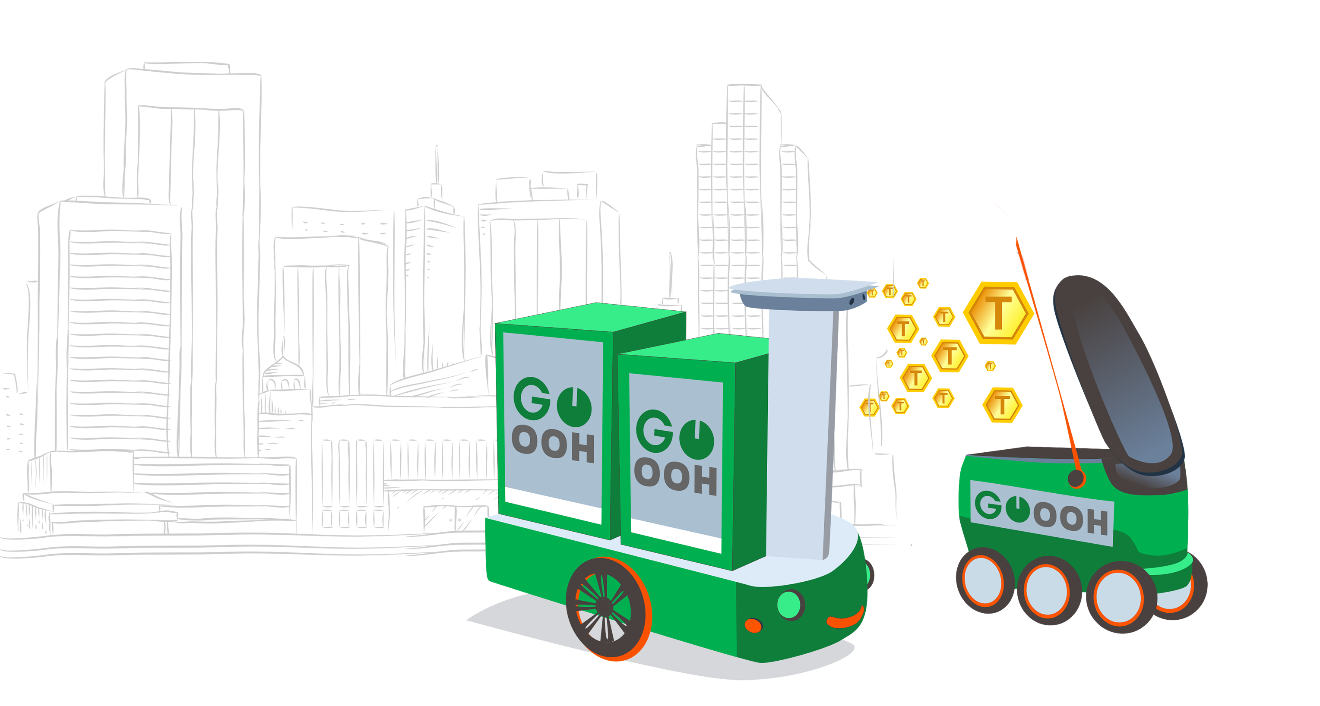
// CUSTOMER SEGMENTS GO-CYCLE
Customers and Segments
03
For Eaters
BANTgo’s GO-CYCLE app is a blockchain enabled recycling app that monetize responsible behaviors. Users can claim their cleans coins, discounts and other tokens in sections.
04
Portrait of an early GO-CYCLE adopter
An eater who wants to be rewarded for his responsible behavior without leaving home, instead of going to a stationary point for receiving recycling or throw valuable recyclables into ordinary garbage

Slide 14
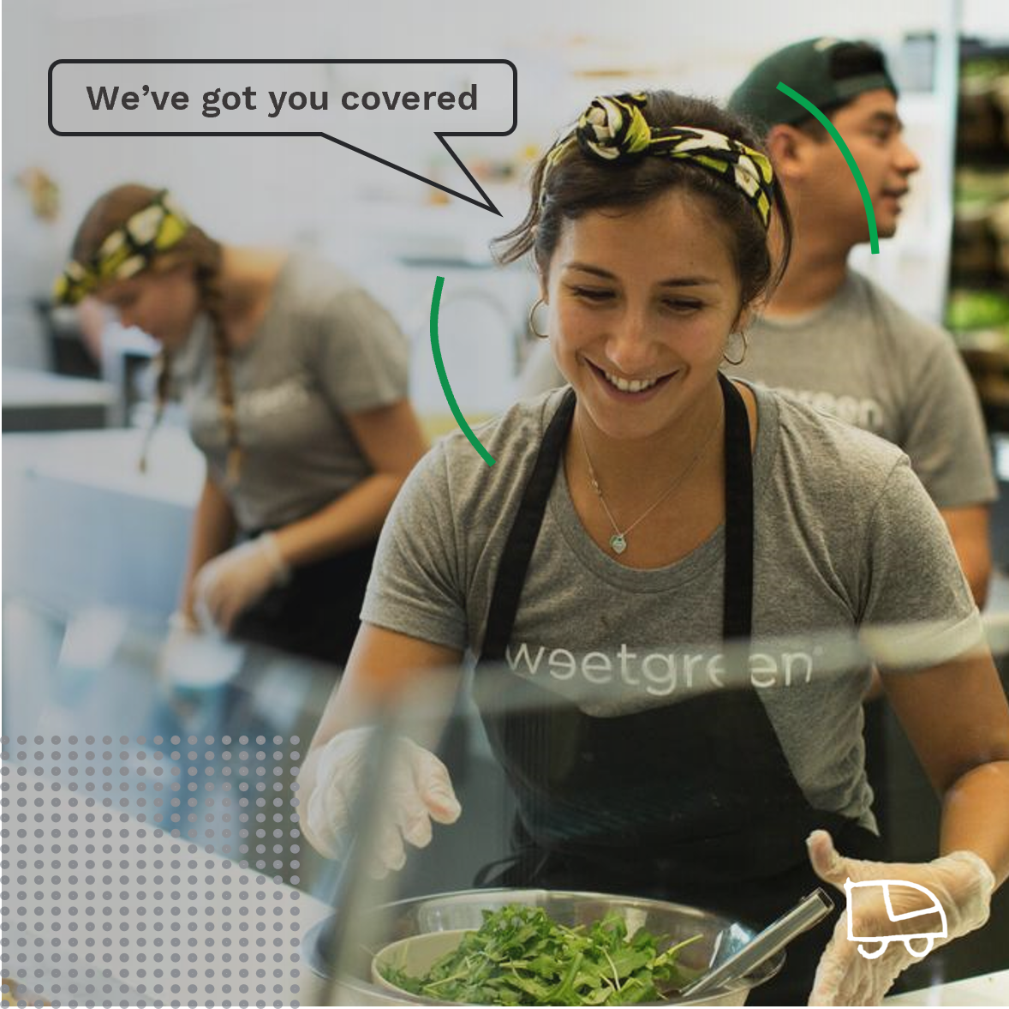
// INSIGHTS
Problem/alternative
solutions
The Problem
GrubHub, DoorDash and UberEats continue to hold restaurants and courier's hostage with fees that hover around 30%. This results in long-term negative profitability of the business.
Alternative (existing) solutions
Third-party-apps for online food delivery put their brand ahead of the brand of the restaurant. In fact, 43% of restaurant professionals said they believe third-party apps—many of which withhold data—interfere with the direct relationship between a restaurant/bar/pub and its customers.

Slide 15
// INSIGHTS
Problem/Alternative solutions
Conclusion
Under the influence of the pandemic, the market for food delivery has grown rapidly and continues to grow and has become highly competitive. There is an opportunity for us to create a customer acquisition business based on the OOH LBA and the environmental demand of eaters. In the near future, gateways to link real food and product delivery to virtual metaverses.

Slide 16
// SOLUTION
Our Product/Solutions
01
02
03
Value Proposition
Decision
Storytelling
43% of people recall noticing the digital ads, 22% of people recall the actual brands advertised. This is up to 10 times more effective than static OOH advertising and up to 30 times more effective than online advertising*. This saves clients at least twice the marketing costs for the same number of leads.
We make fast branding out of delivery couriers and their transport to promote restauranteurs, aggregators and display advertising, and we take hard-to-recycle recyclables from consumers with the return cargo (binds eco-positive consumers to restaurateurs, a significant increase in LTV).
We came to a large Uberoids in Belarus to test our hypotheses and after 15 minutes received its consent for a pilot launch. It also worked with a large Belarusian pizzeria.
*https://vc.ru/marketing/54286-kak-naruzhnaya-reklama-pozvolila-uvelichit-ctr-v-digital-kanalah-bolee-chem-na-40

Slide 17
// SOLUTION
The Secret Formula
01
02
03
Recycling takeaway food delivery items for clean coins and other eco-tokens can grow into its own business
The eco-tokens in the delivery system will be the gateway between the real world and the metaverses
A powerful team and the ability to attract highly qualified personnel cheaply by organizing R&D in Europe (Estonia)

Slide 18
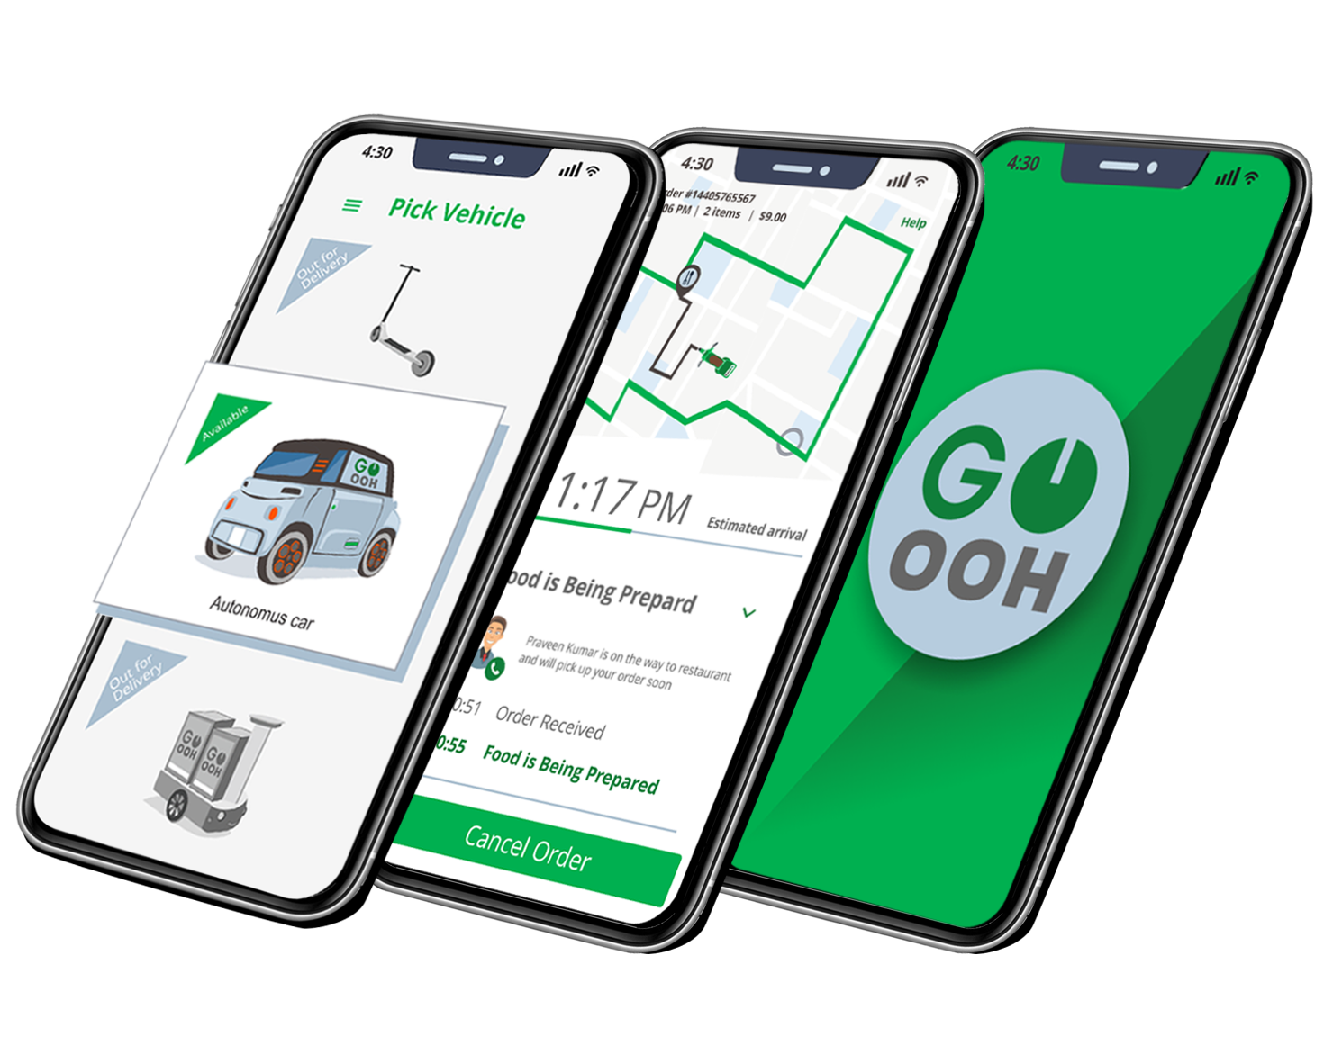
// TECHNOLOGY
Our Technology
GO-OOH App
For Food Delivery Operators and Restaurants
Pair your current food delivery app with our SaaS platform for OOH location-based advertising and receive passive income from each successful display.
01
For Advertisers
This platform serves as a new type of advertising medium that attracts and holds the eye due to the novelty of the format.
02
BANTgo partners

Slide 19
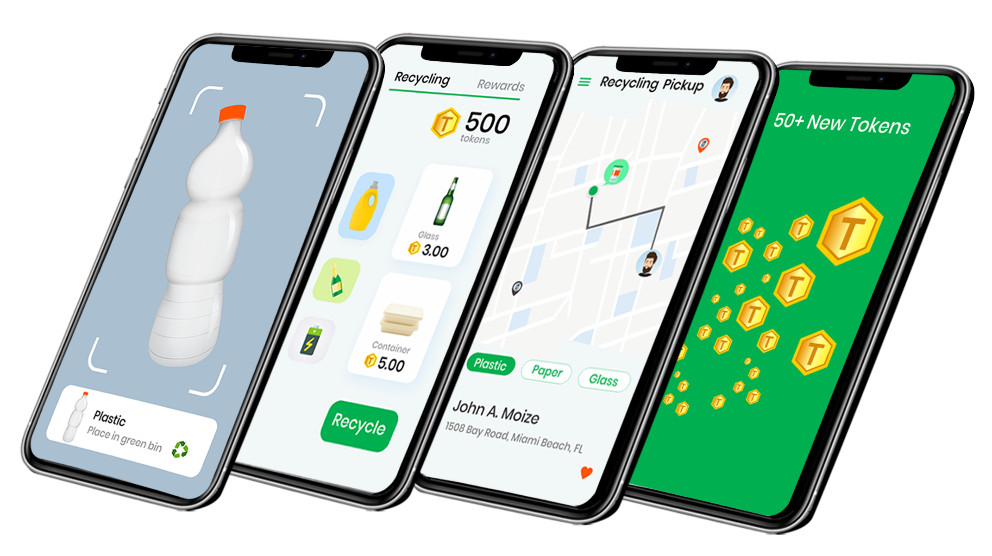
// TECHNOLOGY
GO-Cycle App rewards consumers for recycling their containers, packaging and utensils.
Increases redemption rates and promotes sustainable practices
GO-cycle is our mobile app that provides users with financial rewards for recycling, gamifies sustainable behaviors to encourage user engagement, and allows users to direct their funds to sustainable development projects.
Download Now
Notes:
BANTgo also offers our GO-cycle app which provides discounts, clean coins, and other tokens to eaters who recycle their takeaway containers, packaging and utensils.

Slide 20
// THE MARKET
Top-Level
Architecture
Ads
Loyalty
Recycling
Manufacturers In Need of Recycling
Advertisers In Need
of Targeted Leads

Slide 21
// THE MARKET
Competitive Analysis
High Availability
BANTgo
GO-OOH
Online Advertising
LBA OOH
Low Conversion Rate
High Conversion Rate
Offline Advertising
Influencers
Low Availability
Eco Request is Ignored
Loyalty of Individuals
Eco Request is Satisfied

Slide 22
// THE MARKET
Why Now?
PANDEMIC | Restaurants and Independent delivery drivers are suffering
ECO | Demand for eco-friendly solutions from users, companies and governments
DELIVERY | Delivery is multiplying (the number of couriers is increasing)
TECHNOLOGY | Cheap and reliable flexible LED screens up to 256*256 pixels
METAVERSES | The main technology and trend of 2021-2022

Slide 23
// ECONOMICS
Business Model
SaaS Subscription
Model
Flexible individual
pricing
Minimal capital
outlay (less than
10% of revenue)
UNIT economy
converges when landing
in Miami in 2022
Payment occurs on
a hybrid basis
(upfront + postpaid)
Expected conversion
to paying customer
from 20%
Expected ARPU of
$1000 per year
from one courier
LTV B2B over
3 years

Slide 24
// PRICE
Our Pricing Plan
 | Uberoid | Restaurant & Dark Kitchen | Independent courier | Eaters
Price | $30 per courier/month 50% advertising fee | $50 per courier per month | from $70 per month 50% advertising fee 50% processing fee | $0.30 per order Free
Target segment | UBER EATs and similar food delivery | Restaurants and dark kitchens with their own couriers | Independent couriers working with restaurants and Uberoids | Eaters
CAC/LTV | CAC: $10000 LTV: $900K | CAC: $2000 LTV: $9000 | CAC: $300 LTV: $1000 | CAC: $5 LTV: $100
Offer | A freemium model of advertising sales for Uberoid clients | A freemium model for Restaurants and dark kitchens Monthly subscription fees and advertising their specials Environmental grants/funding Using independent couriers | Work for several Uberoids and restaurants on demand | Eco-friendly Eco-Coins
Notes:
Our business targets the smaller-to-medium sized online food delivery companies that utilize Uber Models with their own delivery fleet and courier services, as well as restaurants with their own fleet and independent couriers and eaters.

Slide 25
// MARKET
Customer Acquisition
Launch
Growth
Maturity
Online Channels, Influencers, Referral Codes and Direct Sales
ONLINE CHANNELS
Search Engine Optimization
Search Engine Marketing
Presence on Social Media
Creating Repository of Content
Paid Advertising
Blogs + Forums
News + PR
DIRECT AND REFERRALS
Get marquee clients
Strategic partnerships to enhance distribution channel
One way referrals
Two way referrals
Social pay for inviting friends

Slide 26
// MARKET
Market Entry Strategy (GTM*)
Channels
Sales Cycle
Scalability
Client Costs
Key Partnership
Marketing Expenses
We show how the unit economy of our clients is improving by each channel (see previous slide)
1 month for restaurateurs. 2-3 months for food delivery services
Through our customers, food delivery market growth of 10%, OOH LBA market growth of 48% Y2Y
Uberoids CAC: $10,000
Restaurant CAC: $2,000
Food delivery services and restaurateurs through their couriers
Up to 40% of the projected annual income growth
* – Go to Market Strategy

Slide 27
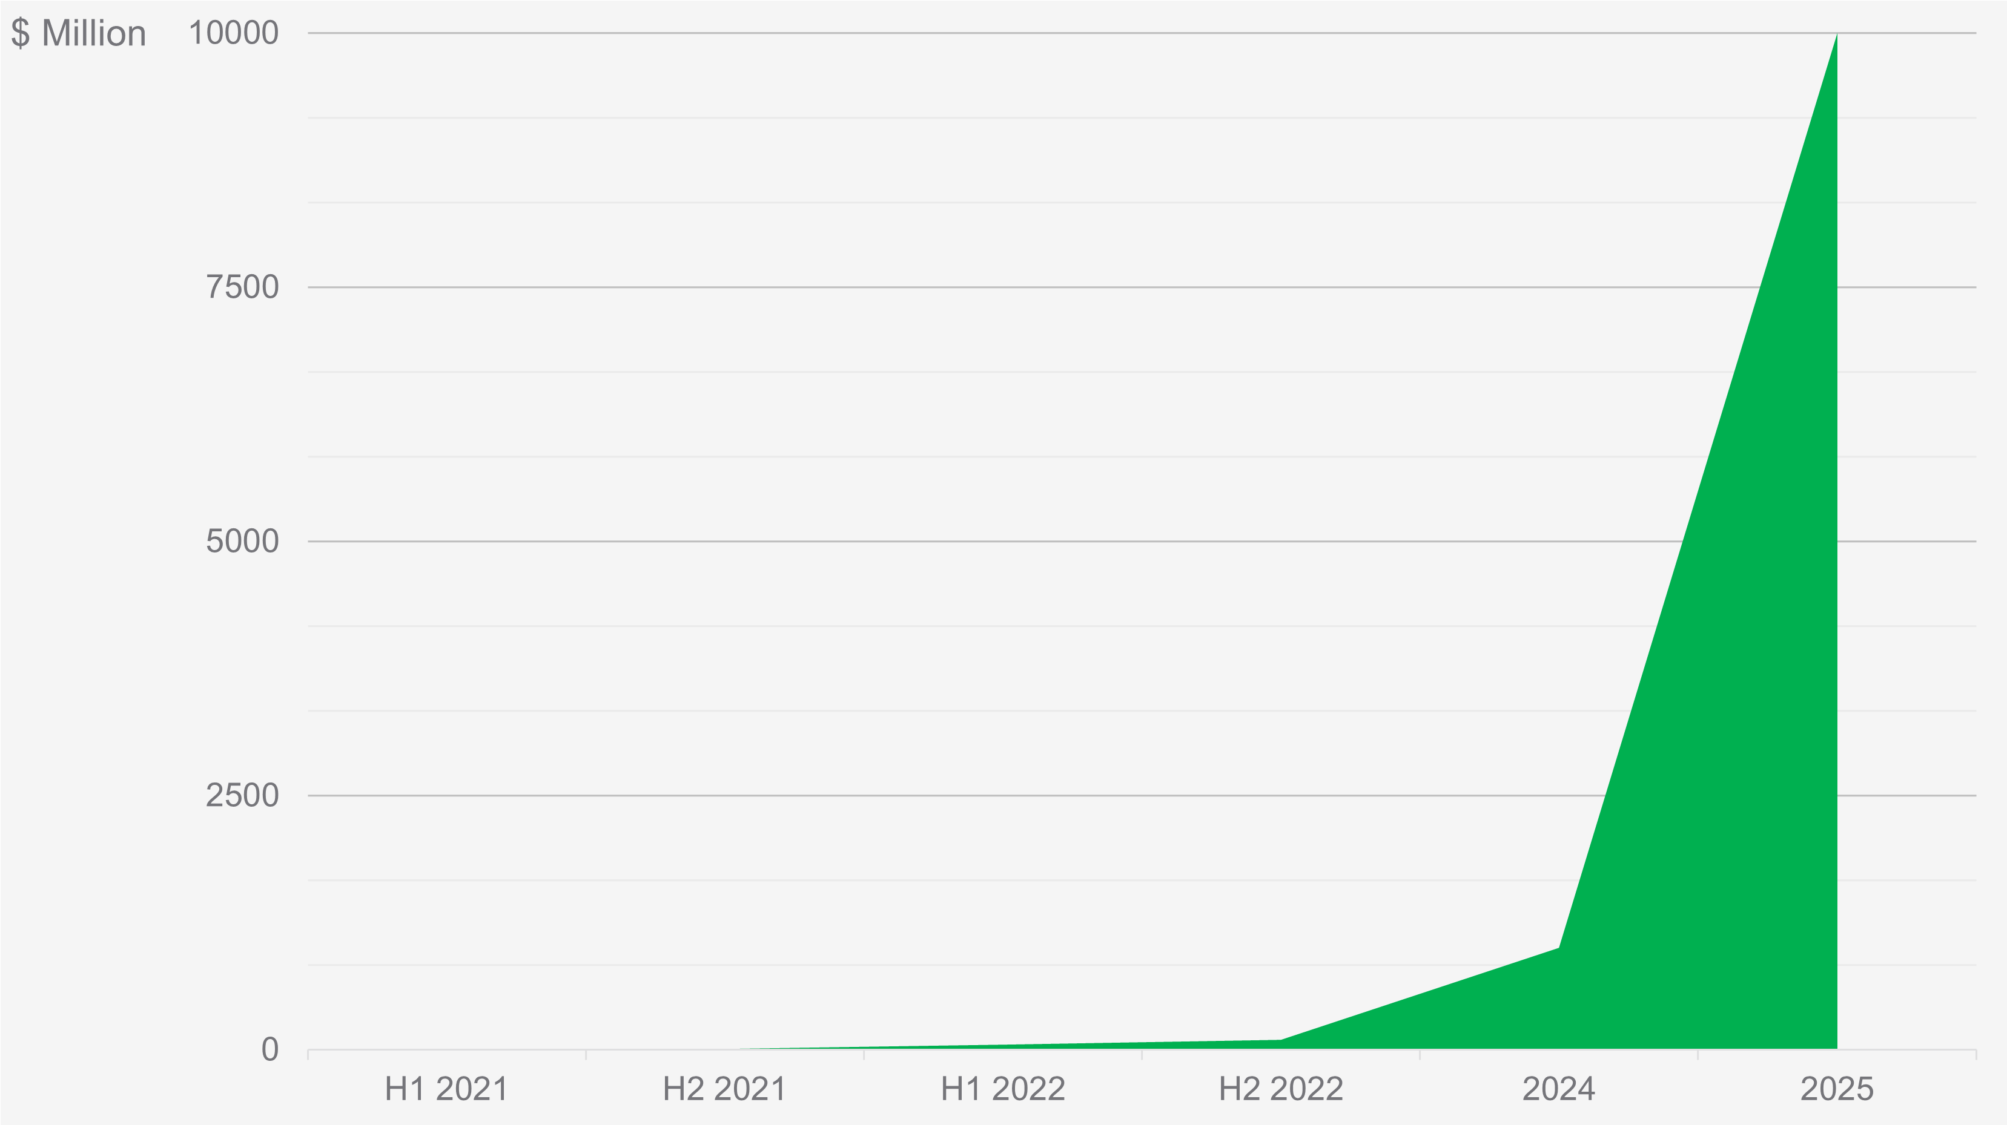
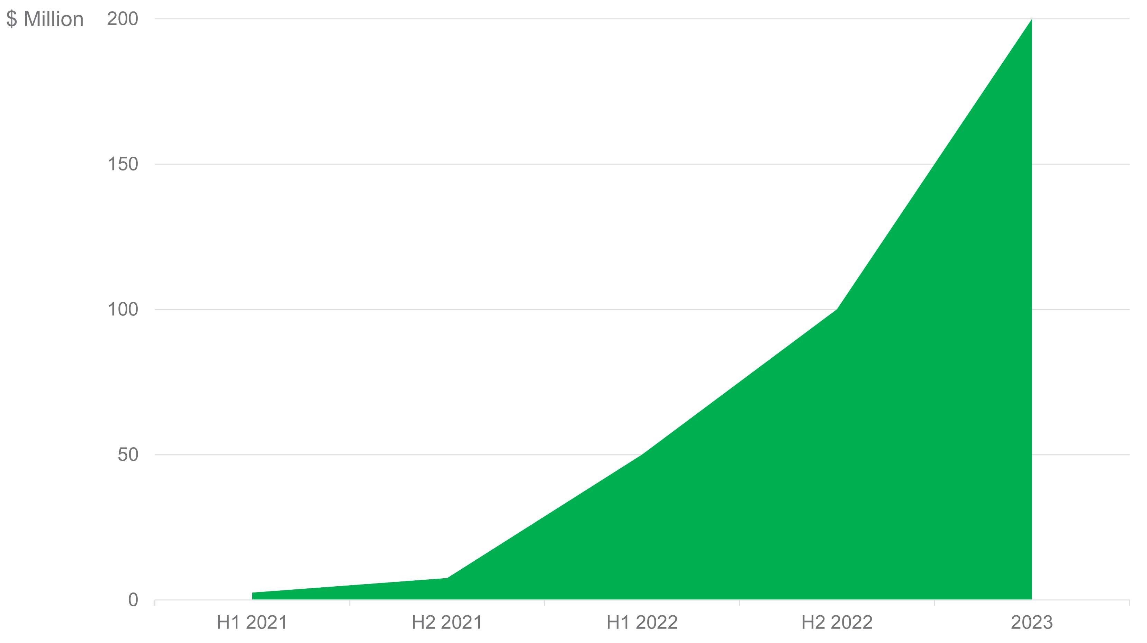
// MARKET ANALYSIS
Goal
Round A
Scale to USA
work with top 5-10 Uberoids
EXIT > $ 10 B
Facebook (Meta)
Amazon
Google
Seed
50 clients FL (US)
Pre-Seed
pilot 4 clients Belarus
R&D 10 clients Estonia
Angel Investment
1 partnership
sales funnel
BANTgo creation
MPV
IPO/Digital IPO
Scale to EU
Tokenomics
gateway for metaverse

Slide 28
// BUSINESS SCHEDULE
Product/Valuation Roadmap
PRODUCT/VALUATION | Q4’2021 | H1’2022 | H2’2022 | H1’2023 | H2’2023 | H1’2024 | H2’2024 | 2025
SaaS: AdTech+Recycling
SEED: $50m val
Blockchain: SaaS+Recycling with Tokenization
Round A: $200m val
MaaS: SaaS+ microEV
IPO/Digital IPO $1b val
Metaverse Gateway
S&P 500

Slide 29
// INVESTMENT
Investment
Request
SAFE agreed with the lead investor Aleksander Stefanowicz - Poland
$350k
$50k
20%
$4.5M
Amount to Complete
Pre-Seed Round
Investment
Minimum
Discount on SAFE
CAP
$50K - raised
$50K - agreement of the first angel investors
Total Pre-Seed $450k opened Sept 2021

Slide 30
// CONTACT US
Miami, USA
Central Office
US HQ
MVP Estonia 2021
If you have any questions, please feel free to reach out to us directly.
Email
Info@evbant.com
Phone
+1 (888) 636-4829
DATA ROOM Check out our team info and BANTgo growth metrics
https://evbant.com/dr

Slide 31
THANK
YOU
INVESTORS PITCH DECK

Slide 32
MATERIALS
ADDITIONAL

Slide 33
// EXIT
Date | Oct 2021
Assumptions
Cost basis | 150 000 USD (3*$50k)
Ownership
CAP UP | 4%
Exit
 |  |  | PRE SEED
 |  |  | VC cost basis | 150000 | Without dilution*
 |  |  | CAP UP | 4% | *Pre-emption right
Outcome Scenario | Exit Value | Probability | Return to VC | Multiple | Year | IRR
VC cuts its losses after launch failure, flameout | $ 0M | 1 | $ 0.0M | 0.0x | 1 | -100%
Company unable to ramp user base; sold for product/technology | $ 5M | 28 | $ 0.2M | 1,3 | 2 | 15%
Company builds a loyal Uberoid/restaurant base, and his initial revenues through advertising, but is unable to rise above competitors | $ 50M | 33 | $ 2M | 13,3 | 3 | 156%
Sizable user community of hundreds of thousands eaters and several hundreds restaurants and top-5…10 Uberoid, and reaches a $ 1M monthly revenue run rate which can sustain the company and allow for growth; sold to large operator like UBER, DoorDash, JustEat Takeaway or AdTech corp. | $ 300M | 20 | $ 12M | 80,0 | 4 | 245%
Becomes a Leading Niche Adtech in the USA | $ 3.5B | 16 | $ 140M | 933,3 | 5 | 340%
Becomes leading AdTech on US & EU and leading LBA market on OOH LBA, they sell franchises to Russia, the Pacific region market, India and Latin America & Africa | $ 30B | 2 | $ 1.2B | 8000,0 | 7 | 410%
 |  | 100 | $49.5B |  |  | 166.5%
BANTgo neutral outcome scenario

