Slide 1
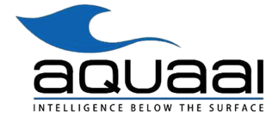
Fishlike Drone
Web Dashboard
Data

Slide 2
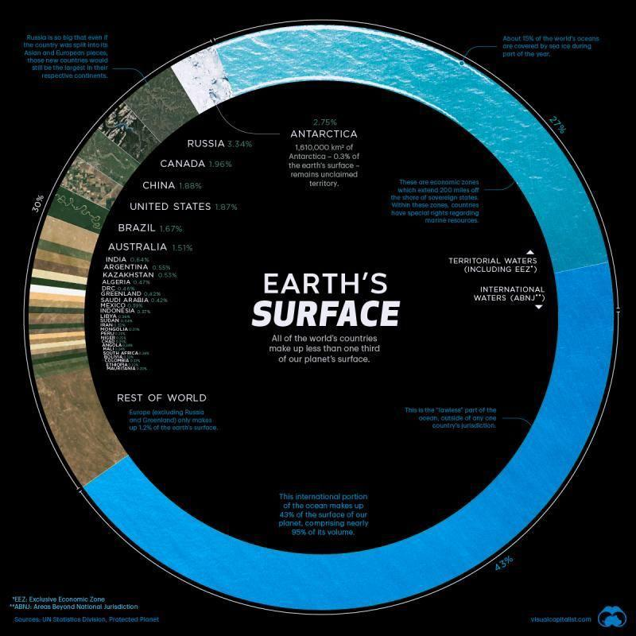
To fight the Climate Crisis we must protect our life source WATER!

Slide 3
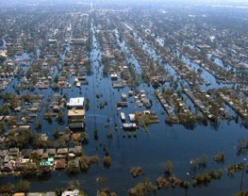
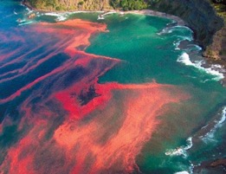
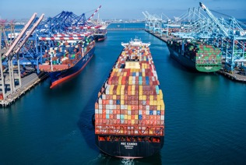
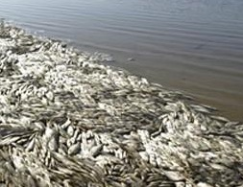
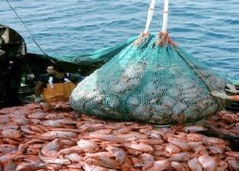
Disaster in Waterways is Daily
Flooding
Algae Blooms
Demands of a Growing Population
Nutrient Imbalance
Overfishing

Slide 4
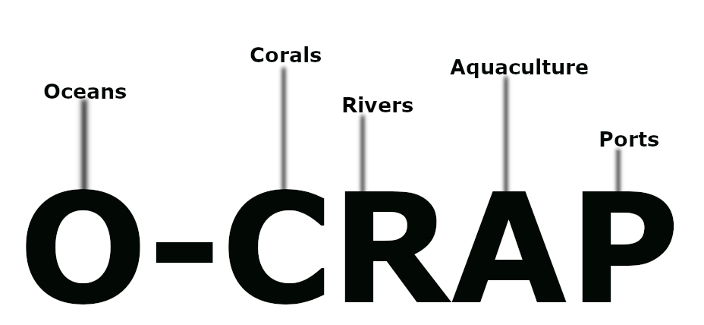
Data helps decrease risks, but there are NO affordable
autonomous data gathering tools.

Slide 5
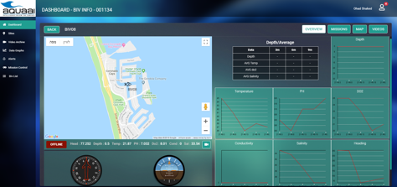
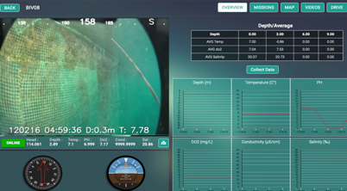
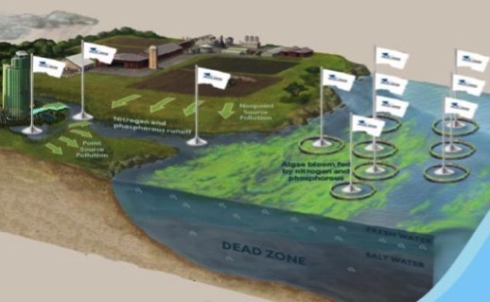
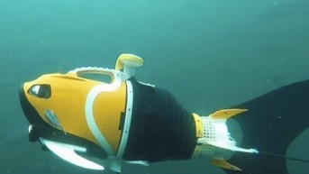
Until NOW!
Fish-as-a-Service (FaaS™) provides affordable data to Blue Economy business, scientific research & governments.
Optimized web dashboard
Patented fishlike drone
Data (raw & predictive)

Slide 6
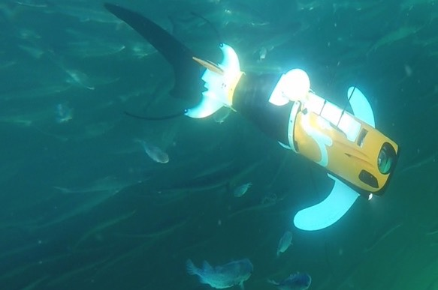
Why a Fish?
Biomimetic PATENTED Design
NATURE
Got It Right!
Manoeuvrability around Objects
Modular
Collects Data Better
Recyclable
Energy Efficient
Immerse with Habitat

Slide 7
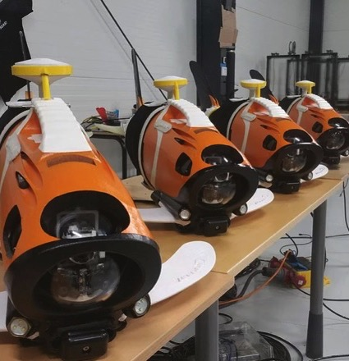
Value Proposition
Affordable and advanced technologies - Aquaai is the first to utilize the growing 3D printing technology market to build innovative solutions while keeping the costs affordable.
Keeps habitat calm - Our unconventional solution of using a fish body as the platform in turn creates a calming environment for the natural habitat during data collection.
FaaS smart monitoring – Aquaai serves as a risk mitigator and 1st alert system for the client, tracking and back-end monitoring all fishlike platforms in the field anywhere around the world 24 hours a day.
Small, powerful, all-in-one system - The single carrier drone is the first to combine the powerful capabilities of small and medium Autonomous Underwater Vehicles (AUVs) into a light and transportable unit.

Slide 8
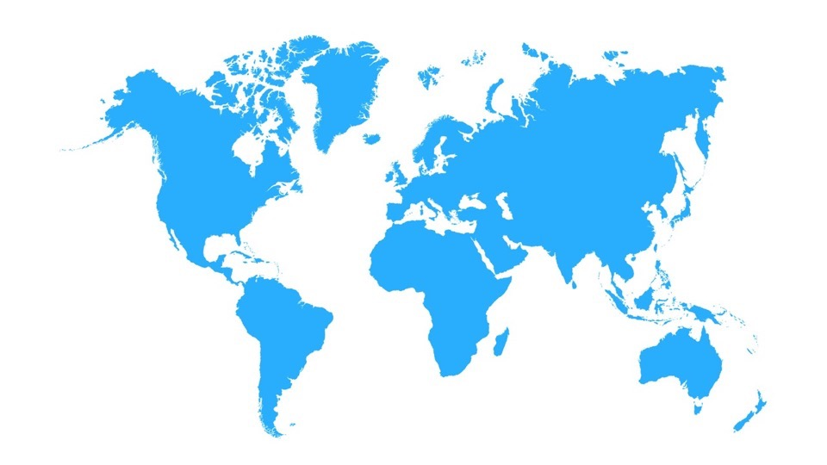
Modular for Multiple Use Cases
Commercial
Scientific Research
Government
Flooding - Insurance
Monitoring Oceanographic Temp
Flooding - FEMA
Smart Water Management
Smart Water Management
Scientific Exploration
Hull Inspection
Illegal Fishing Deterrent
Coral Reefs / Marine Species Preservation
Sustainable underwater farming
Marine Protected Areas
Autonomous Shipping
Dams, Ports & Harbors
Ports & Harbors
Shark Net Monitoring
Illegal Fishing Deterrent
Monitoring Oceanographic Temp

Slide 9
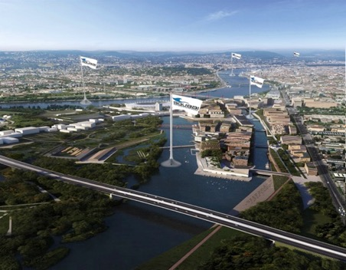
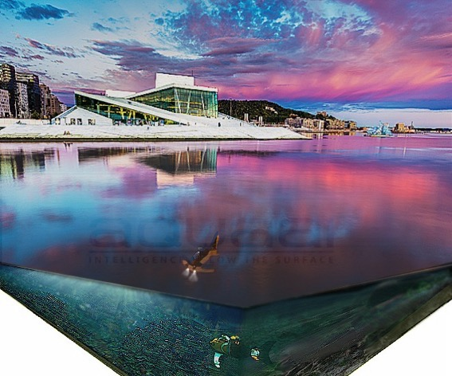
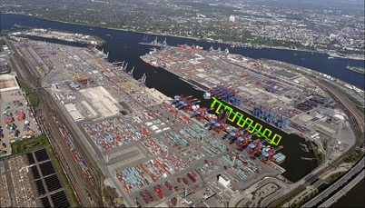
Water Management - Cities, Ports & Harbors
Autonomous technology for visual and environmental data monitoring water quality, traffic and more.
Real time Data
HQ

Slide 10
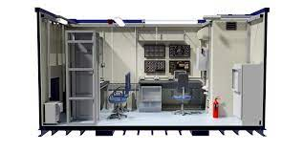
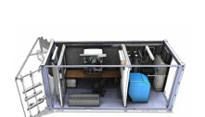
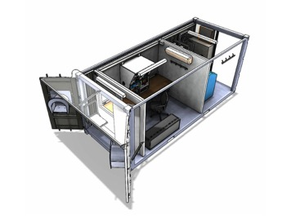
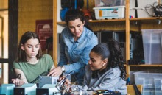
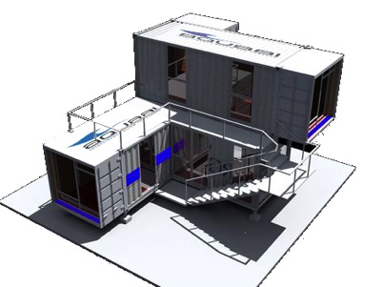
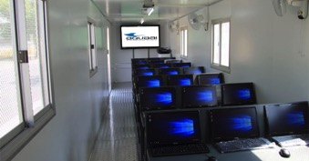
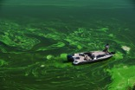
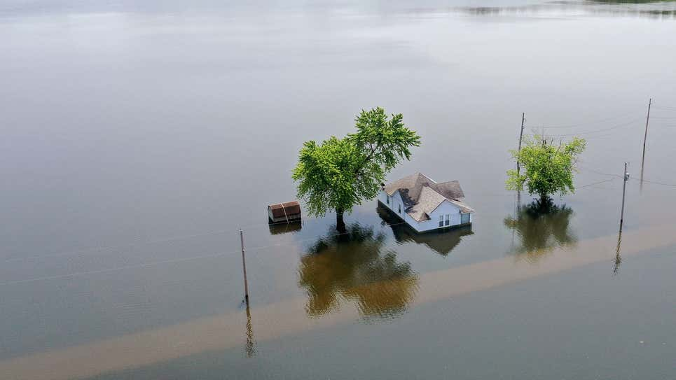
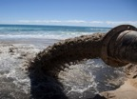
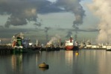
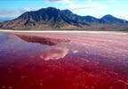
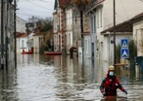
Disaster Response / Community Rebuilder During & Post Event
Control Room Monitoring
Boosts Economy thru Light Manufacturing and Rapid Assembly Jobs
Education and community empowerment teaching deep technology skillsets
Rapid Deployment for Risk and Disaster Management

Slide 11
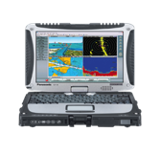
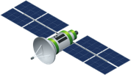
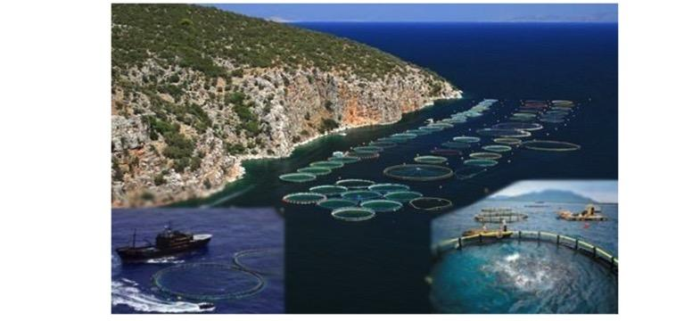
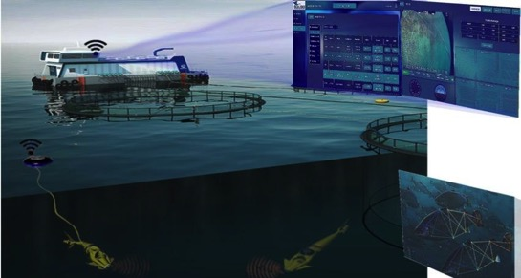
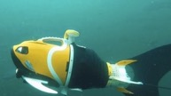
Precision Underwater Farming
Intelligent Decisions
Autonomous
Perform Tasks Remotely
Full Insight
Real Time Metrics
HQ

Slide 12
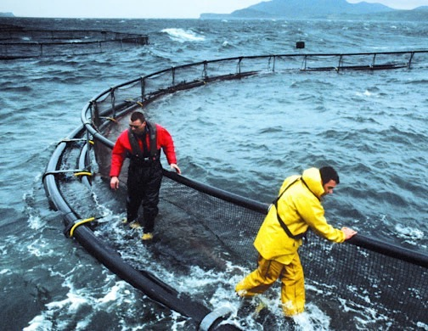
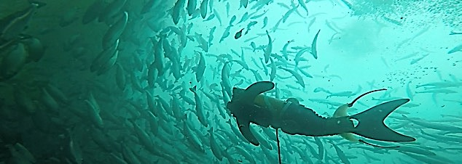
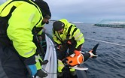
Arctic Circle Trials
24/7 for 8 months
Aquaculture ($209bn market) supplies 51% of seafood consumed with lowest carbon footprint as a source of protein.
Farmers need state of the art data to meet demands of an increasing population.
Food Security calls for sustainable measures that boost yield & protect the waterways as oceans are depleted of wild stock due to overfishing and the climate crisis.
Harsh Environment Tested

Slide 13
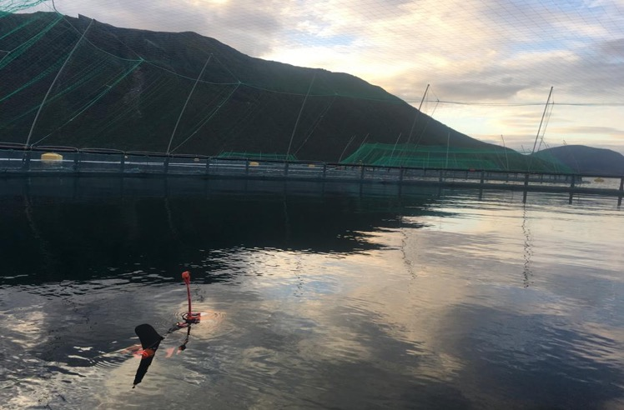
Click for Video

Slide 14
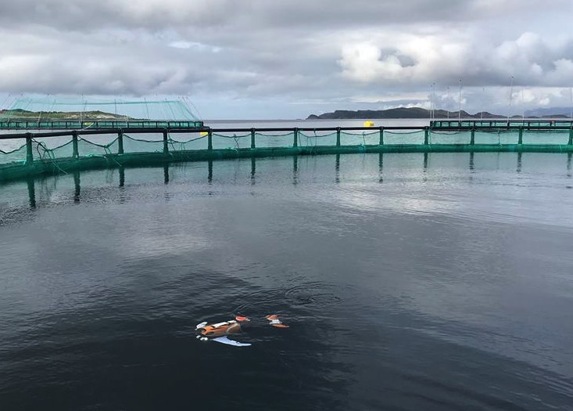
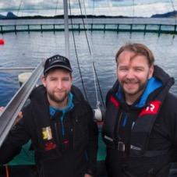
Trial Partner Turned Customer
$750,000
Aquaai will save us more than $750,000 annually.
Alf-Gøran Knutsen,
Managing Director Kvarøy
Best Aquaculture Practices (BAP) Certified
Produces 8000 tonnes of sustainable salmon for Michelin Chefs & Whole Foods grocer (Amazon owned)
World Changing Ideas 2021 - Fast Company
3 Generation
Family Farm

Slide 15
Customer Case Study – Kvarøy Fishfarm Cost Savings
Current Cost
Cost Reduction using Aquaai
Current feeding cost is 50-60% of total cost
Aquaai will reduce by 5%
1
1
Overfeeding is nearly 1%
Saves $128,500 per year mitigating overfeeding
2
2
Many vendors for camera ($23,500) + 02 sensor ($12,900) + salinity ($300) TOTAL = $36,700
Aquaai AUV $20,000 / year incl. net inspection, feed check & alerts = precision insight
3
3
Medicine and mechanical de-licing is around $1 billion in Norway
Aquaai’s early detection reduces cost drastically
4
4
Labor cost counting lice is nearly $181,500 / year
Aquaai eliminates this cost
5
5

Slide 16
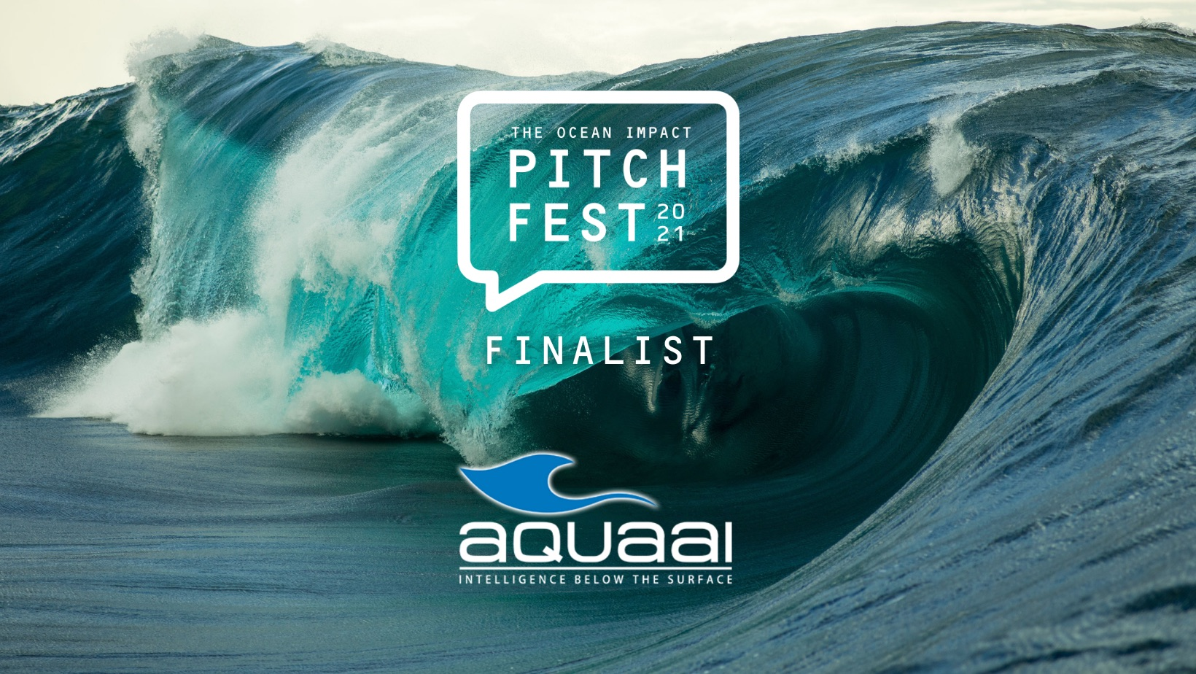
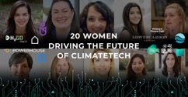
Key Achievements
October 2021
August 2021
Trial partners -subsurface plastic detection
2021 Hardware Cup Clean Tech Semi-Finalist
ECs Seal of Excellence Impact, Quality & Efficiency
2020 Grant Recipient
2019 Top Aquaculture Innovation Award Stanford Global Forum

Slide 17
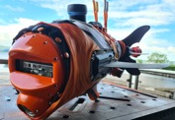
Journey to Date
Technology maturation to untethered Mazu, integration, and development for multi use-case. Obtained purchase orders, plan trials
Silicon Valley Founded overlooking Monterrey Bay; unveiled clownfish prototype at Think BIG; mimics movements of a fish & tweets picture
2016-
2017
R&D; 8 Nammu platforms loaded with cameras & sensors 3D printed & assembled in 6 weeks on Kvarøy Island; 8-month pilot in fish cages 24 / 7
2019 - 2020
2022-
2023
2014
Founded
Prototype BIV; One week pilot at Kvarøy in Norway’s Arctic Circle. Successful acceptance test with live fish.
Research, Proof of Concept
2015
Aquaai Norway AS founded, customer purchase orders obtained
Scale
2018
2021
Aquaai Corporation Investment and Funding Milestones 2014-2021
Debt-Angel $515k raised on $5m Cap
Debt-Angel/VC $225k raised on $11m Cap
Debt-VC $520k raised on $12.5m Cap
Debt-Angel/VC $200k raised Uncapped

Slide 18
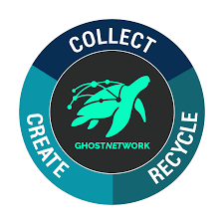
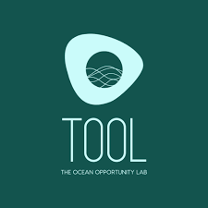
Future Growth Strategy
Business model
Fish-as-a-Service (FaaS™):
Hardware: leases - $20,000 / year Software: subscription - $250 / month
2021-2022 2023-2025 2026-2027
Sustainable underwater farming
Subsurface ocean plastic
Ghostnet detection
Oceanographic and scientific research
Ports and harbours
Shipping
Insurance
Marine species preservation
Prevention of illegal fishing
Marine archaeology investigation and rehabilitation
Volume
Current Customers, Trial Partners, Supporters
Time

Slide 19
Experienced International Team
Liané Thompson
CEO & Founder; 3x entrepreneur; Quick growth skilled; Frmr global reporter & New York Times executive; Management of 200+ personnel: 3 PrimeTime Emmy Nominations; German / American
Simeon Pieterkosky
CVO & Founder; Inventor; 2x owner of robotics company; 25 yrs. In robotics, animatronics, mechanical design, bio-mimicry & climate change technologies. South African / Israeli
Filipe Pinto
Senior Robotics Engineer; Automation expert; Fond of a good challenge; MSc, Electrical & Computer Engineering, Automation & Robotics; University of Coimbra, Portugal. Portuguese
Matteo Borri
Hardware, firmware Engineer and autonomous vehicle specialist having worked with systems for land, space and sea; 20 yrs. in automation; NASA Mars Rover engineer. Italian
Mohammad Asif
Financial Strategist, MBA, Certified Management Accountant, & Mechanical Engineer; Financial Analysis and Business Modelling; 10+ years experience in building and promoting Startups; Indian
Mickie French
Global Marketing & Sustainability Director; 18+ years driving growth; MBA, Creator of Tate & Lyle’s sustainability strategy; Multi-lingual, leading teams in 40 countries. American
Michel Arditti
Head of Security; IT expertise securing cloud / big data solutions; VP of Circle for Strategic Security Studies - int’l network of tech innovation experts promoting sustainable practice. French
Dr. Craig Cavanaugh
Materials Scientist. Applied physicist;
Ion expert; skilled in Micro-Electromechanical systems, analytical chemistry and project management. PhD material science. American

Slide 20
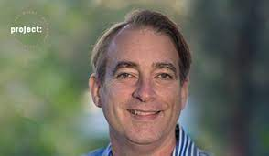
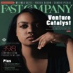
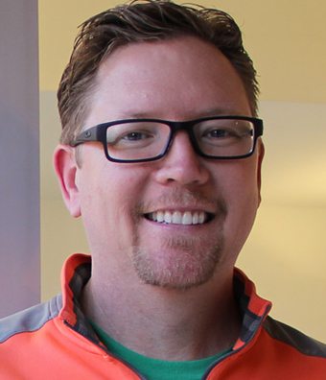
Partners & Advisors
Arlan Hamilton
Backstage Capital
Adam Draper
Boost VC
Vidya Dinamani
Allison Long Pettine
Silvia Mah
Ad Astra Ventures
Will Bunker
Sean Sheppard
GrowthX
Pálmi Pálmason
Phil Straw
Guy Fraker
Alf-Gøran Knutsen
Serial entrepreneur; Strong int’l M&A,
global finance & deal structuring background;
20+ years in global Ag-tech, aquaculture, renewable energy & real estate;
Icelandic
Frogman; CEO SoftIron, 5x Silicon Valley CTO; Product development of 50% of SCUBA diving electronic market. Tooling & Manufacture expert,
British
Insurance sector & insurtech expert; 15 launches &/or turn-arounds in private, nonprofit & gov’t. 2 market creations, 13 insurance product inventions & $400m in capital created.
US (Florida Keys)
Aquaculture Expert; Economist; Managing Director Kvarøy Fiskeoppdrett AS & CEO Kvarøy Arctic,
Norwegian

Slide 21
Aquaai
Media

Slide 22
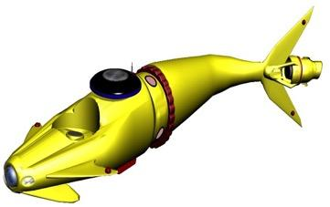
ONLY Drone for Surface & Subsurface, 1/3 the Cost of Closest Competitors
Company | Name of product | Industry | Battery life(hrs) | Shape | Size | Kg | Depth (Shallow, medium and deep)
Aquaai | MFAAS | Commercial, Scientific | 8-12 |  | 1.5m x 20cm x 30cm | 30 | Shallow, Medium, Surface
Teledyne | Gavia | Commercial, Defense | 5-6 |  | 1.8-4.5m x 200mm | 50-130 | Medium
Boston Engineering | GhostSwimer | Defense | Tethered / battery |  | 1.52m x 0.36m x 0.46m | 40.80 | Shallow
Bluefin Robotics | Bluefin-12 | Defense | 24 |  | 4.83m x 32cm | 250 | Medium
L3 Harris | Iver3 | Defense, Commercial | 8 |  | 2m x 147mm | 26-40 | Shallow
Hydromea | VERTEX™ AUV | Commercial, Scientific | 6-8 |  | 70cm | 6.7 | Shallow
Eelume | Eelume snake robot | Commercial, Scientific | NA |  | 6m | NA | Shallow, Medium

Slide 23
Market
The Blue Economy - asset valuation = $25 trillion, annual GDP = $2.5 trillion
$3.7bn autonomous underwater vehicle (AUV) and remote operated vehicle (ROV) market (TAM) is projected to reach $15bn by 2027 (CAGR 18.2%)
$570m AUV market is projected to reach $2bn in 2024 at a CAGR of 22.8%
Future growth in commercial market applications for AUVs is expected to be driven by rapid growth (6% per year) in the aquaculture industry
The Global unmanned underwater vehicles market size is projected to reach $7.96 bn by 2026, exhibiting a CAGR of 12.8% during the forecasted period (2019-26)
Ocean $2.5T
TAM
AUV / ROV $3.7bn
SAM
AUV
$570mn
SOM
AUV aquaculture $392m

Slide 24
Financial Highlights
Use of Funds Year 1
Purchase Orders
$2.5m value
Purchase Orders
$2.5m value
Summary (USD Million) | 2022 | 2023 | 2024 | 2025 | 2026
Total Revenue | 3.08 | 12.24 | 26.72 | 73.46 | 151.59
Gross Profit Margin | 33% | 42% | 48% | 55% | 57%

Slide 25
Raising: $3,000,000 Liane@aquaai.com
NEW untethered MAZU

