Slide 1
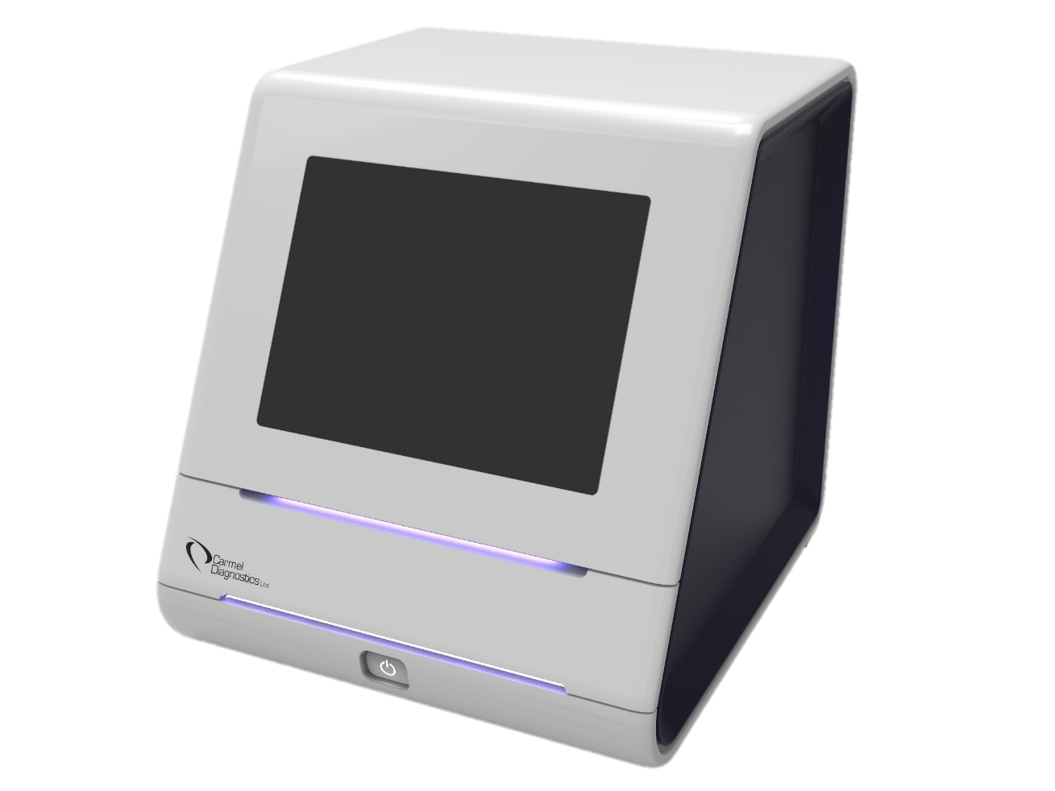
FertissimoAI:
AI-driven Point-of-Care diagnostics exploiting a new biomarker for non-invasive embryo selection in IVF

Slide 2
The infertility pain
Up to 15% of couples
of child-bearing age suffer
from infertility
The Solution:
IVF – In Vitro Fertilization

Slide 3
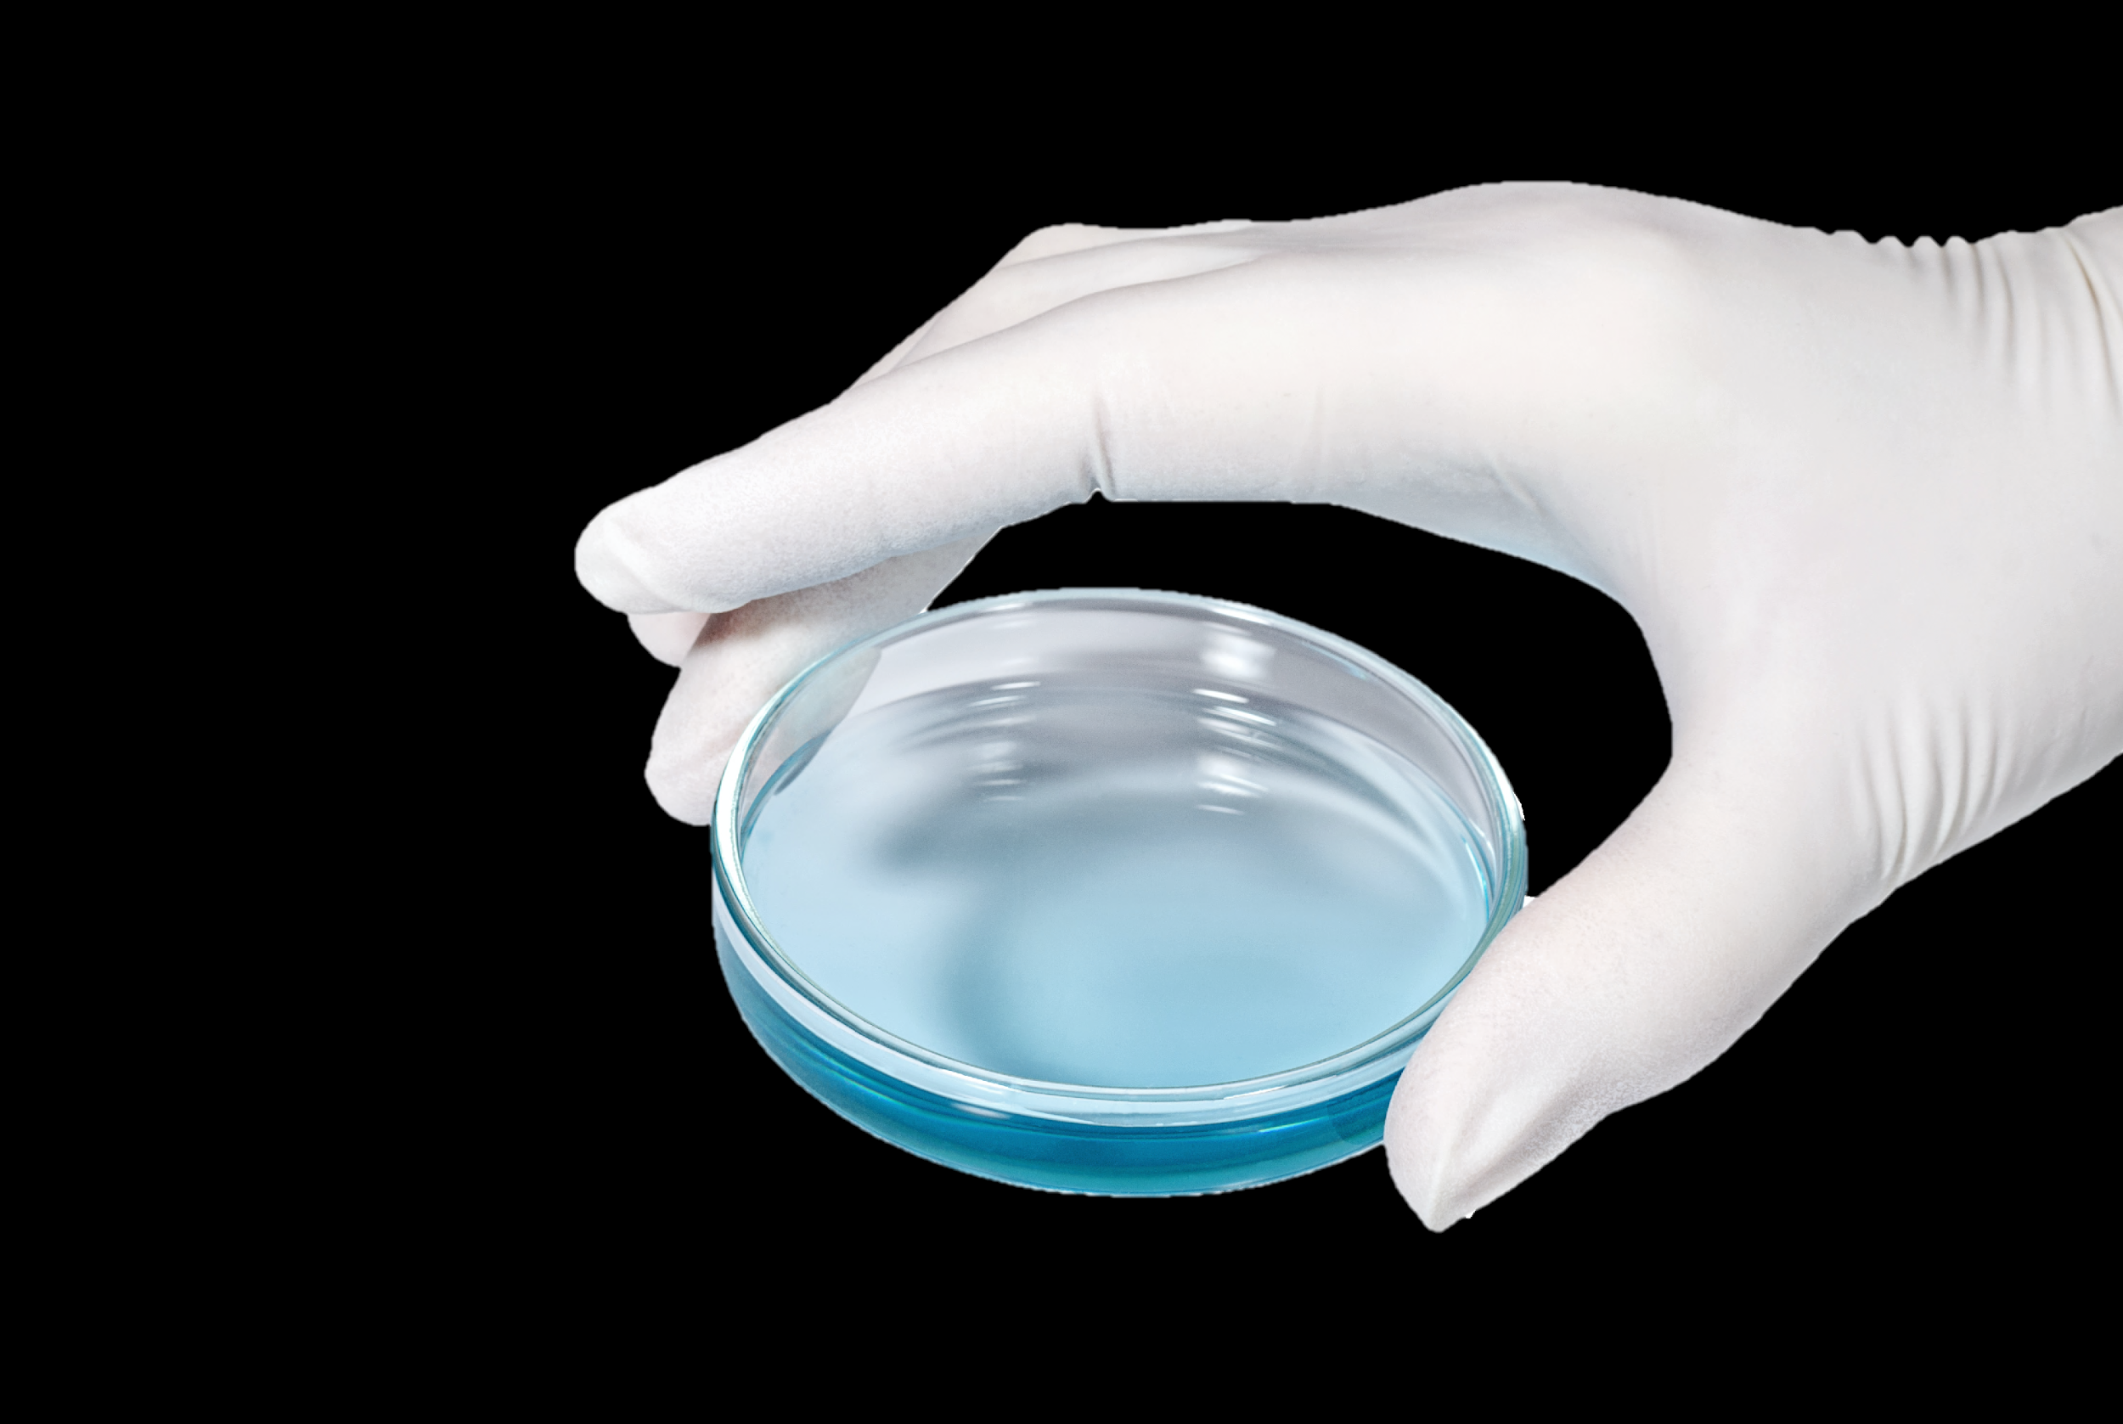
Only 27% of IVF cycles lead to a live birth
Multiple
cycles
Multiple
embryo transfer
€15,000 per cycle
Clinical
depression
higher risk of comorbidities
20% higher risk of complications
Multiple cycles can become a financial burden
30% of women undergoing IVF

Slide 4
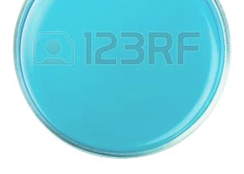
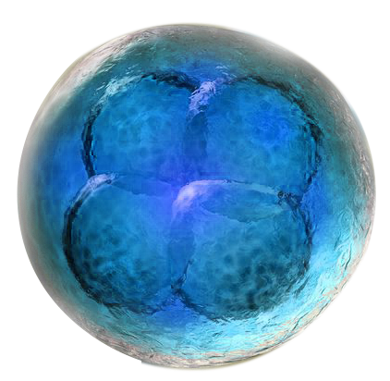
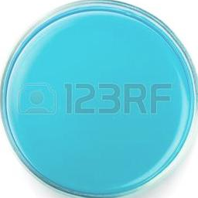
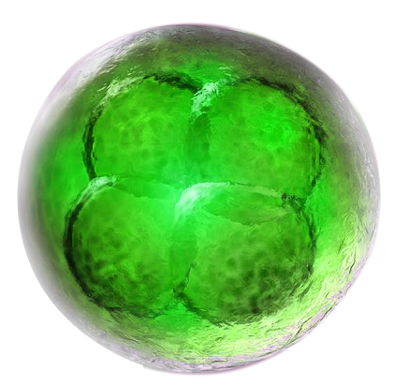
The challenge: To find the embryo with a HIGHER CHANCE to achieve PREGNANCY
The holy grail of IVF is embryo selection

Slide 5
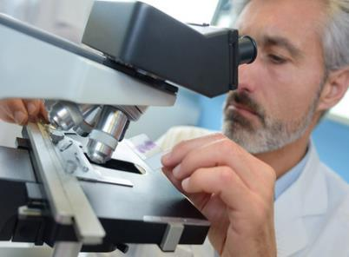
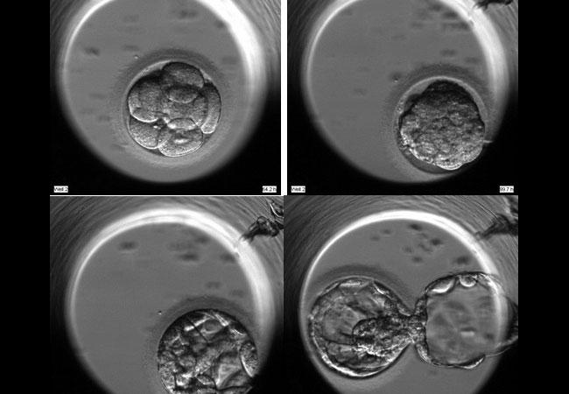
Current methods are subjective due to the LACK of BIOMARKERS
Morphology
Time-lapse monitoring
Tests embryo symmetry and cleavage rate through microscopy
Subjective and prone to human error
Zoomed pictures taken at fixed intervals within the incubator
Digitally calculating the cell-rate cleavage time
AI-driven data analytics
Support time-lapse analysis
No standardization
Limited to patient data & image analysis
Pre-market stage
No real practical results
Outcomes improved by
less than 10%

Slide 6
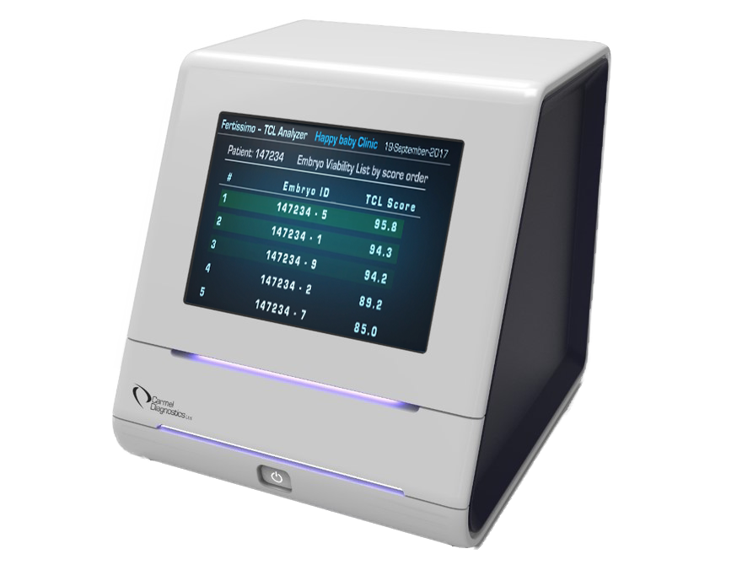
FertissimoAI: the new gold standard for embryo selection
WO2020031185A2 in national phase
Oxidative stress as new biomarker of embryo metabolism
Non-invasive: analysis of embryo culture medium
AI-driven: scoring of the best embryos for transfer to support clinical decisions
Point-of-Care

Slide 7
Core technology: TCL
Measurement of photon emissions caused by heat induced oxidation
Sample taken
15μl of media is drawn from well and placed on cuvette
Stirring
Sample stirred to create uniform layer
Drying
Sample dried in vacuum
Heating Scanning
Sample heated.
Device measures photons emitted
Results
Results analysed to indicate best embryos for transfer
8 MINUTES FROM START TO FINISH

Slide 8
And it fits simply into current IVF protocols
1. Ovarian stimulation
2. Egg retrieval
3. Egg fertilization
4. Embryo incubation
5. Most viable embryo selected using FertissimoAI
6. Embryo transfer
7. >25% increase in successful pregnancies
Notes:
The emphasis here is to show versus tell. Investors often want to see products, not to hear about products.
By taking a user’s perspective, the demo relates more to your audience. The easier it is for the audience to imagine using the product, the more positively they will evaluate it.
By contrasting micro problems with solutions features, investors gain a clear understanding of how the solutions solves the problem.
If there are other use cases, you can finish the slide by listing them.
For any comparisons/descriptions of the solution always use KPIs and data.

Slide 9
Stakeholders & benefits
Clinics
25% increase in successful IVF pregnancies
Couples
Reduced health risks for mother and child
€15,000 net savings per procedure
Healthcare systems
Allows for single embryo transfer
Notes:
Features tell; benefits sell. Features are what you put into the product; benefits are what those features mean to users. Benefits win customers and ultimately investors.
Ideally the benefits should solve the micro problems listed.

Slide 10
A growing market
3,500
Global IVF expenditure
fertility clinics in the world (800 in Europe)
+6.5%
CAGR
€23.5bn
2.5M
IVF cycles per year
2027
500,000
€14.2bn
IVF babies every year
2020
Growing by
per annum
5-7%

Slide 11
We have a platform technology for oxidative stress analysis
Traumatic Brain Injury
Early diagnosis of Alzheimer’s,
Parkinson and ALS
Age Related Macular Degeneration (AMD)
Risk stratification for Heart Failure patients (Proof of concept study published)
Renal Failure
Early identification of
pre-eclampsia (pilot running) + Diagnosis of Endometriosis

Slide 12
Targeted market & trends
Demand
2.5M IVF cycles worldwide
€500M
TAM
Supply
2M IVF cycles annually in EU, US and China
€420M
SAM
Increasing infertility
Older moms
Increased access to IVF
12M potential cycles
Manual clinic processes
Limited capacity
Poor results
2.5M cycles
953,000 tests sold in 2027
€31.4M
SOM
12

Slide 13
Current embryo selection methods are poor
 | Vitrolife | Merck Serono | ESCO | Morphology | FertissimoAI
Increase in IVF success | <10% | <10% | <10% | 🗶 | >25%
Basis for selection | Image analysis | Image analysis | Image analysis | Image analysis | Biomarker
Easy to use | 🗶 | 🗶 | 🗶 | ✔ | ✔
AI Driven Analysis | 🗶 | 🗶 | 🗶 | 🗶 | ✔
Cost per device | >€80k | >€80k | >€60k | Microscope | €15k

Slide 14
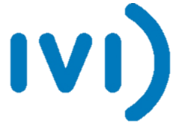
Commercialisation plan
Manufacturers Medical grade manufacturer with European logistics
Customers Fertility clinics
Suppliers Optical & mechanical components
FertissimoAI Marketing, AI optimization, testing, R&D, assembly
Distributors Country specific medical device commercial partners
End-users Embryologists, reproductive endocrinologists in IVF clinics
Beneficiaries Infertile couples
Manufacturers Test cuvette manufacturer

Slide 15
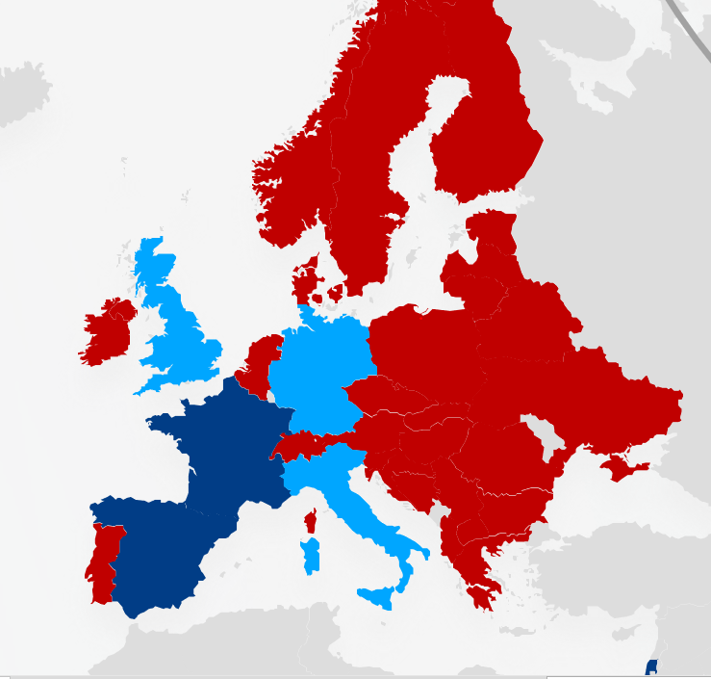
Geographical expansion
2023
France
Spain
Israel
2024
US
2025
Germany
Italy
UK
China
Japan
2026-2027
Gradual expansion

Slide 16
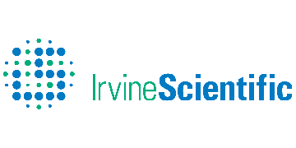
Business model & financial projections
PAY-PER-TEST model
Device at € 15k
Test cuvettes at €30/test
Sales through specialist distributors
Employees
9
12
16
20
21
24

Slide 17
Company history and roadmap
Seeking 5M€ Investment
EXIT/ACQUISITION
GRANTS
€3m
BREAK EVEN POINT
TRL8
TRL9
2017
2020
2021
2022
2023
2024
2025
2030
-AI/ML Implementation
- Clinical Validation
- Chinese Approval
- New Market: Pre-eclampsia
- CE Mark
- IVDR Certification
- Market Launch
- H2020 SME Instrument
- Market Entry Preparation
- FDA Approval
17

Slide 18
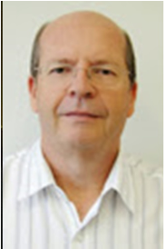
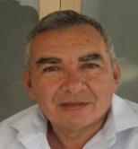
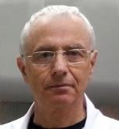
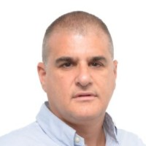
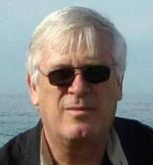
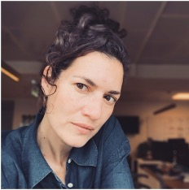
Team & hiring plan
20% ESOP to attract management and new hiring
José Celso Rocha
AI expert for IVF
unique combination of experience in AI applied to embryo classification
Tzali Cnaani,
CEO
Wide expertise in product development and implementation, business development, general management and operations
Hiring Plan
2
Software Engineers
Michael Zibulevsky
AI/ML expert
150+ publications on AI applied to medical devices
1
Hardware Engineer
Sergei Shnizer
CTO
The inventor of the FertissimoAI technology. Vast experience in R&D and clinical studies
Amnon Weichselbaum
Director of product development
20+ years of business development experience in the healthcare industry
1
VP Business Development
2
Sales Managers
Moni Shavit,
COO
25+ years of experience in business and technology development, R&D, engineering of medical devices
Amit Knaani
Product Manager
Vast experience in IT product development
1
QA Engineer

Slide 19
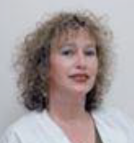
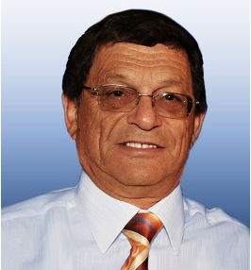
Advisors & strategic partners
Prof Aaron Ciechanover
Head of Advisory Board
Nobel Prize 2004 in Chemistry
Marcos Meseguer PhD
Clinical Advisor
Scientific Director IVI Valencia
Zofnat Wiener-Magnazi MD Clinical Advisor
IVF treatment expert
Prof. Abraham Z. Reznick,
Scientific Advisor
global expert in oxidative stress research
Clinical development
R&D, hardware & software development
IVI Valencia is the largest IVF clinics network in the world run by the world-renowned Dr Marcos Meseguer
With more than 150 employees, Aran is one of the leading engineering firms.

Slide 20
Better Embryo Selection:
Giving Birth to IVF Success with FertissimoAI

