Slide 1
Key videos SimpleCloud easy answer to the future of work, creation and education most demanding needs September 23rd, 2021

Slide 2
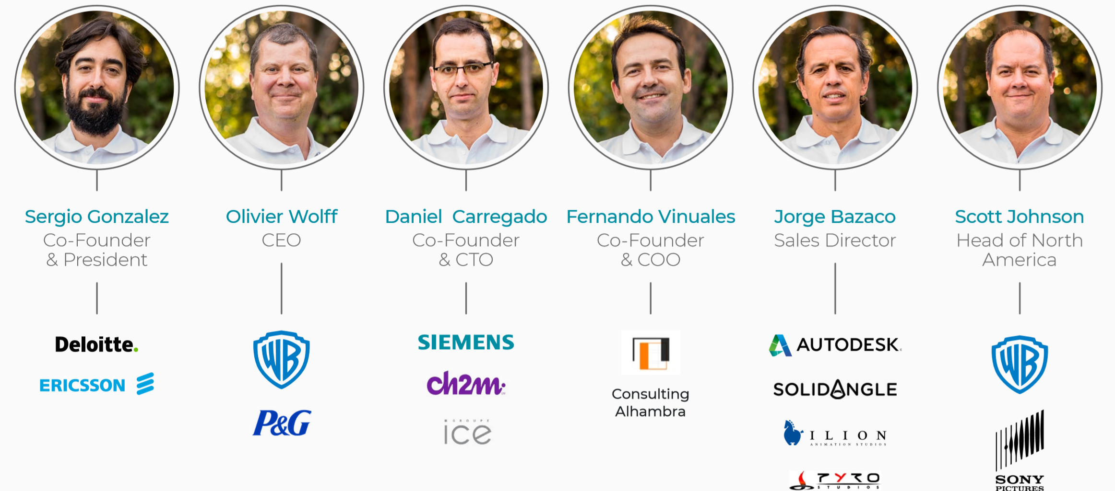
A professional, international and passionate team !

Slide 3
Our Pitch Video
Our Pitch
https://www.youtube.com/watch?v=09JHJkYeWTA

Slide 4
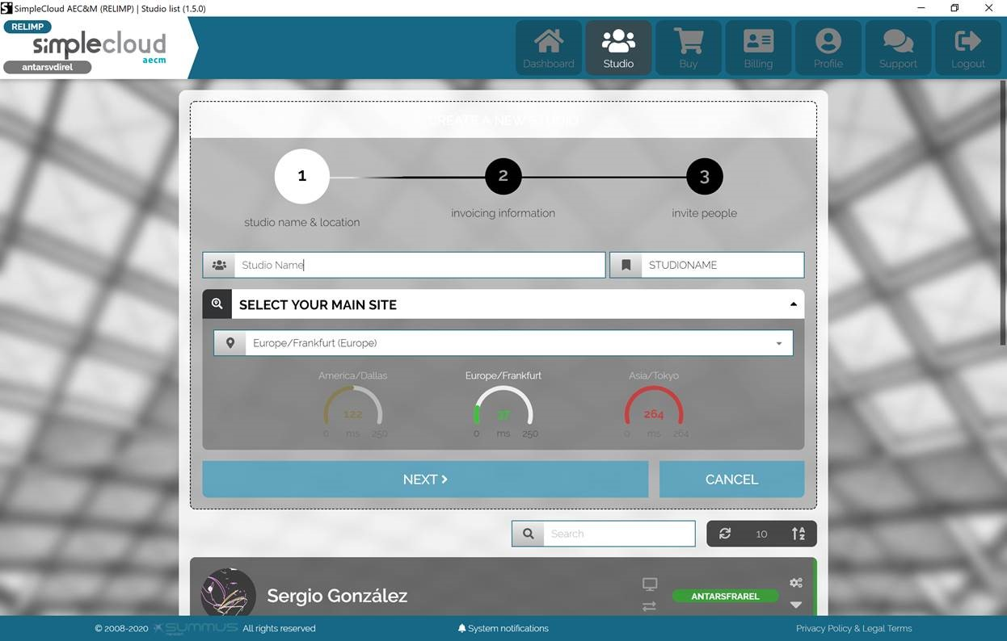
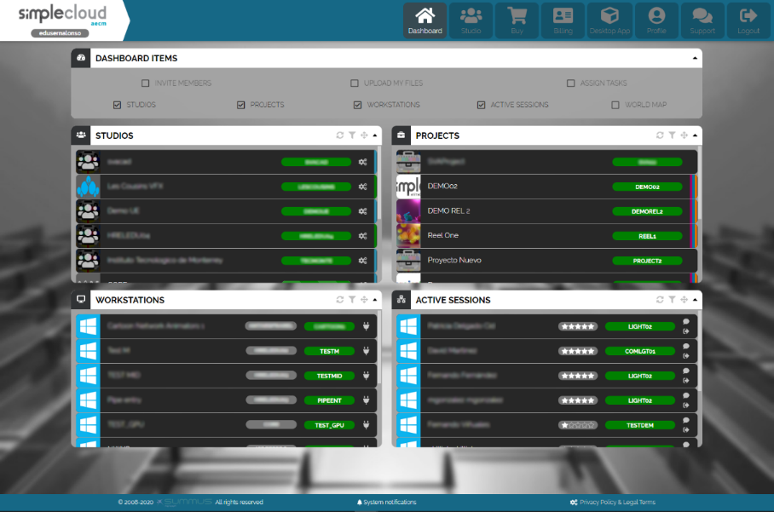
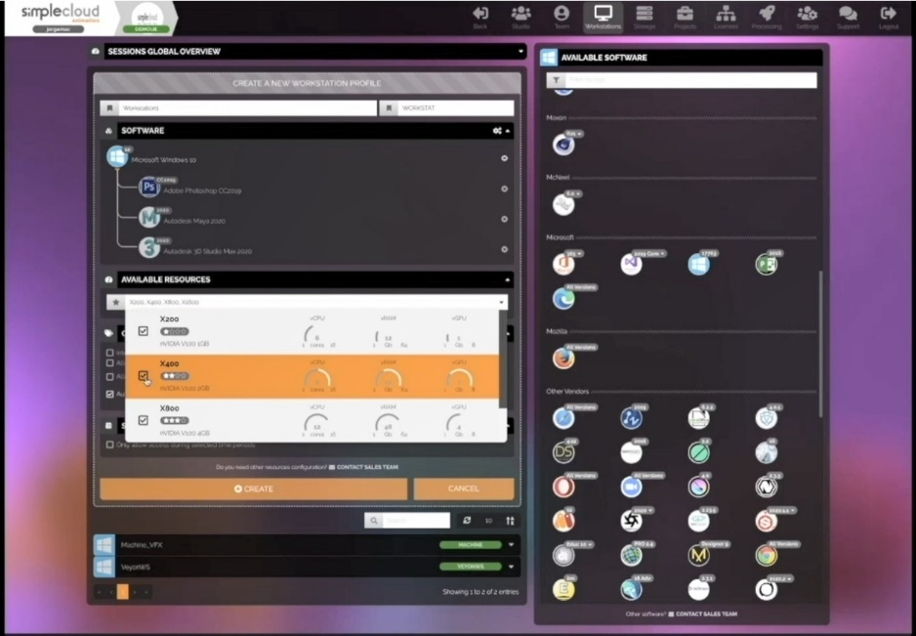
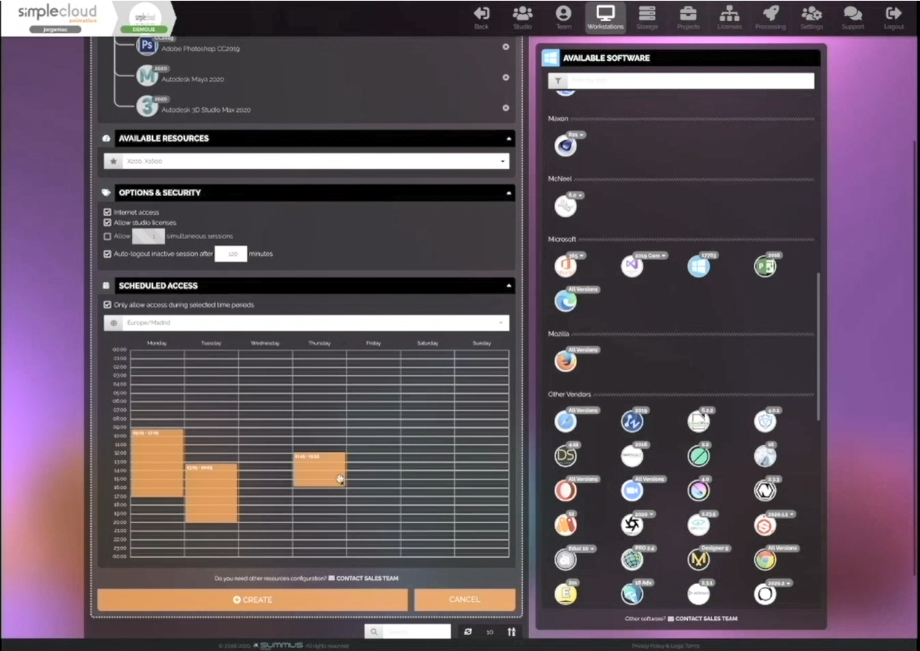
SimpleCloud is end-user focused thanks to a unique UI/UX
See video links on initial set up
https://youtu.be/5FDYzbpFoLo
And on special collaboration tools
https://youtu.be/p-0SluDFeEc

Slide 5
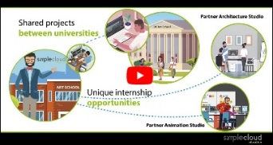
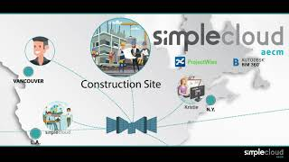
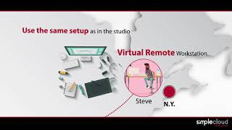
Selected videos on SimpleCloud
Concept Videos on key verticals
Education
https://youtu.be/3yPLAgghxcg
AECM
https://youtu.be/aaslHsy73Es
Animation & M&E
https://youtu.be/fn_GDStc90Q
Videogames
https://youtu.be/cdYdOokUh54
Unique UI/UX and Collaboration videos
Initial set up
https://youtu.be/5FDYzbpFoLo
Special Team Management and collaboration tools
https://youtu.be/p-0SluDFeEc
Selected Education case studies
ITN / ITV program – the Future of Learning Technologies event, UK, Sept 2021:
https://vimeo.com/593270237
Butic The new School with IBM : https://youtu.be/kUtA8Rk2ycg
IBM website https://www.ibm.com/case-studies/butic-the-new-school-cloud-simplecloud
Selected Animation case studies
Esdip Animation Studio, winner of the GOYA award of Best Short Animated, developed on SimpleCloud: https://youtu.be/GvHjUAtT1uE
IBM Website: https://www.ibm.com/case-studies/esdip-animation-studio-cloud-aspera
Selected AECM case studies
IBM website: https://www.ibm.com/case-studies/elecnor-cloud-aspera

