Slide 1




DAMAVAN MEDICAL
The Space X of radiation imaging : We see what other can’t
A real time imaging & dosimetry for radiotherapy treatments: α, β , γ , Hadrons
30/06/2021

Slide 2
Radiotherapy : a large healthcare market
2
Radiotherapy is n°1 cancer treatment (60% of all cancer)
Equipment Market: > 10Md$
> 15 000 units
Dose delivery control is the key issue in radiotherapy
6 cm
  Where is radiation absorbed?
  How much has been recieved?
Better dose : better patient survival & less side effects
Bragg Peak 70 MeV protons
Hadron-therapy (CAL / Nice)
Our promise: we’ll see in real time the dose deposition imprint!

Slide 3
Since 2015 we’ve re-ingeneered compton γ imaging
in 2021: breakeven in sales
2024: First imager qualified for radiotherapy (α,β)
3
Today’s γ imaging technology (SPETC& PET) are not suited for Radiotherapy
Résolution spectrale (mm)
20
15
SPECT (50’s)
X
Y90(100)
10
V Compton 3D (now)
X
X
X
X
5
PET (80’s)
NRJ (keV)
50
250
500
750
> 1 000 keV

Slide 4
Why is our 3D Compton imaging disruptive?
Patient access
During therapy
Good spatial resolution (<1cm)
We see what other can’t
(300 keV to >3 MeV)
3D possible with 3 static views
The cost killer imaging technology by far
4
Today: PET (3M€)
& no radiotherapy
Tommorow: DAMAVAN (300 k€)

Slide 5
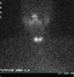
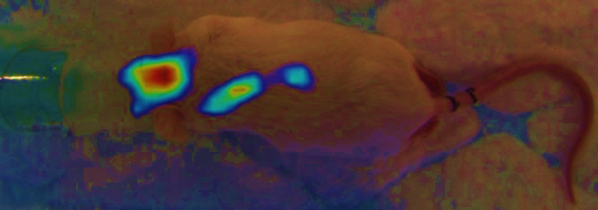
Today (SPECT) vs Tommorow (3D compton):
Image quality (¹³¹I)
Etat de l’art
DI
5
Imagerie SPECT thyroïde (2D)
120 mm
Imagerie Compton (3D) souris : 80mm

Slide 6
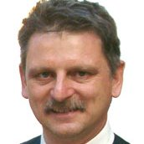
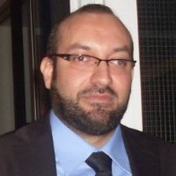
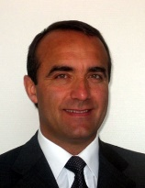



Roumen
NAIDENOV
Président
Alain ILTIS
Président
Damavan Today: Nuclear sales
4 different skils: 68% of shares
6
Alain ILTIS
Président & Physicist
Hichem SNOUSSI
Applied mathematics & IA
15 years in medical imaging detectors at St Gobain crystals
University Pr exceptional class
Roumen NAIDENOV
Sales Manager
Jérémy RAMPILLON
Marketing
Our first product: Temporal camera
Key figures
    Profitable from 2018 to 2020
    Sales 316 k€ total (2021= breakeven)
    8 patents famillies
    Won highly competitive R&D calls

Slide 7
We’re searching for a partner, not just Money
for a 2 phases approach
7
Phase I: 2022-2025: 600k€ vs 10% of capital (1M€ public funding) :
  Purpose: Finance our first Healthcare product (2025)
  Clinical trials on liver cancer with UC Louvain
  Low risk investment but critical step
Phase II: 2023-2027?: 2-5 M€ : Targeting the main market
  Building a medical prototype for High Energy clinical trials
    Hadrontherapy
    Gamma radiotherapy
Target Exit: 2027 trade sale to an OEM

