Slide 1
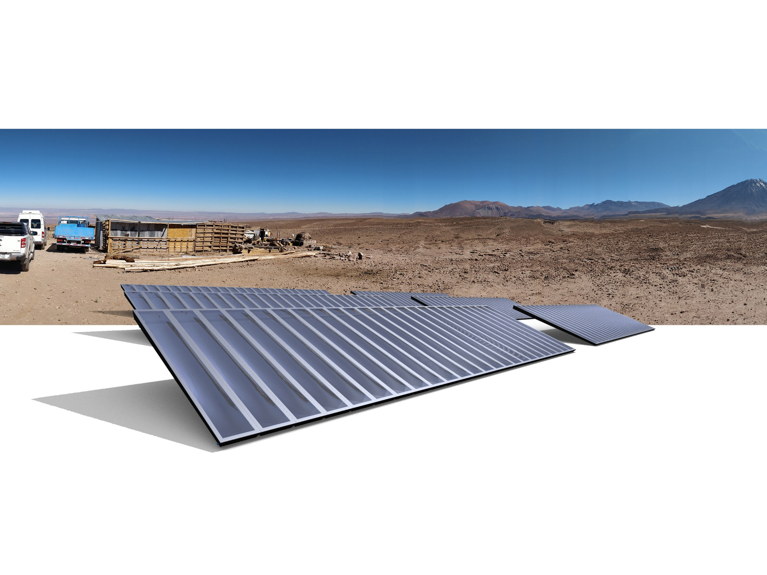
Confidential SolarDew Clean Water B.V. 2021
Providing clean drinking water to 1 million people by 2030
Pitch Deck – Investors (May 2021)
Alexander van der Kleij

Slide 2
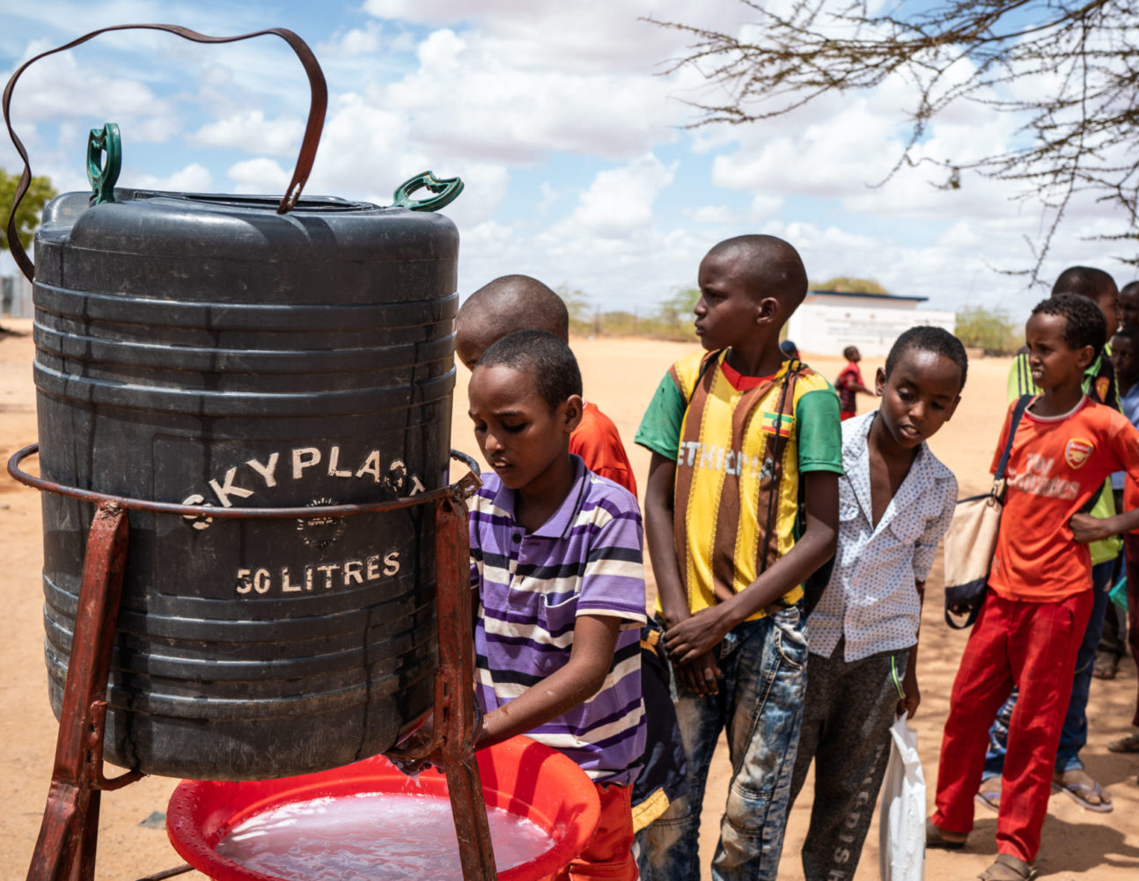
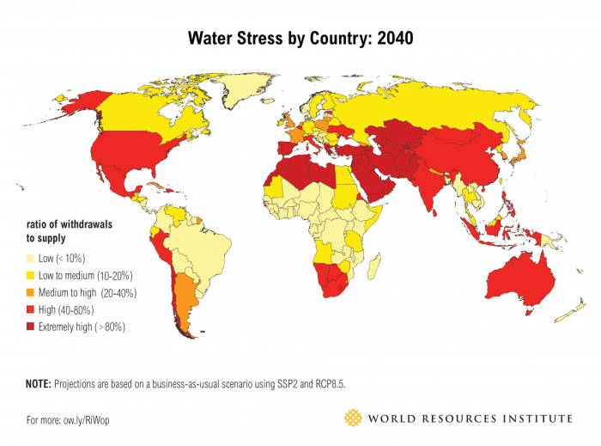
there will not be enough drinking water for us all!
Clean drinking water is a global problem
785 million people lack access to clean drinking water.
Water scarcity affects 700 million people today
This will increase to 4 billion in 2030
This will lead to more conflict in water stressed ares
Source: www.diarioeldia.cl
Confidential SolarDew International B.V. 2020
Confidential Solar Dew Clean Water B.V. 2021
Source: www.i09.com
Notes:
https://www.google.com/url?sa=i&url=https%3A%2F%2Fwww.unicef.org.uk%2Fpress-releases%2F1-in-3-people-globally-do-not-have-access-to-safe-drinking-water-unicef-who%2F&psig=AOvVaw18Ey0MNWwEeqDMIYOj4heK&ust=1620243418664000&source=images&cd=vfe&ved=0CAIQjRxqFwoTCOjS_aPjsPACFQAAAAAdAAAAABAD

Slide 3
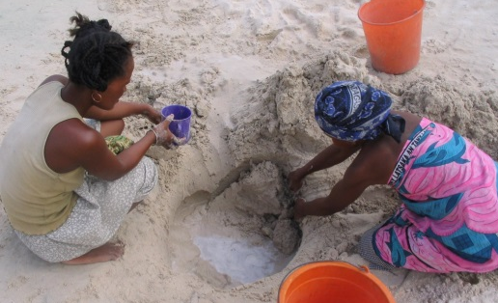
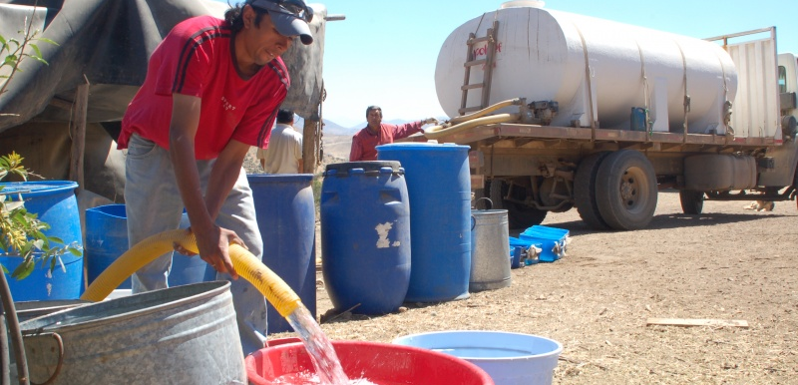
there will not be enough drinking water for us all!
Where water sources are contaminated or saline, communities can only obtain drinking water
By fetching water themselves
Through transport by tankers or…
By buying bottled water; which results in 60 million discarded plastic bottles per day
THIS IS EXPENSIVE, TIME CONSUMING, UNSUSTAINABLE & UNACCEPTABLE!
Source: www.diarioeldia.cl
Confidential SolarDew International B.V. 2020
Confidential Solar Dew Clean Water B.V. 2021
Source: www.i09.com
Notes:
climate change, over consumption and pollution
Bottled water (expensive, resource intensive, wasteful)

Slide 4
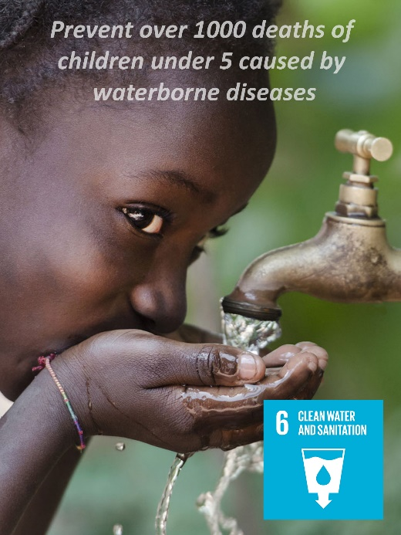
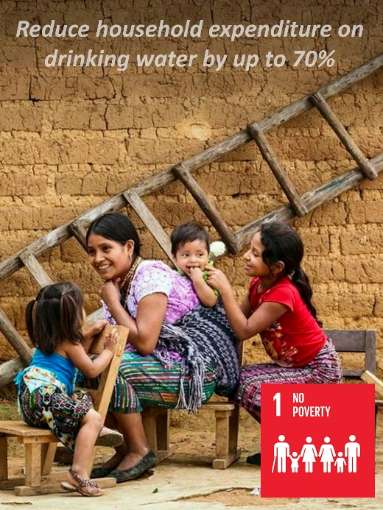
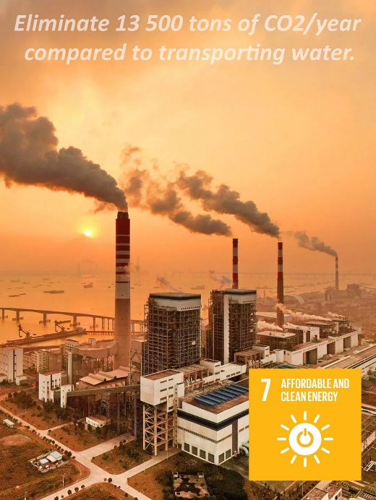
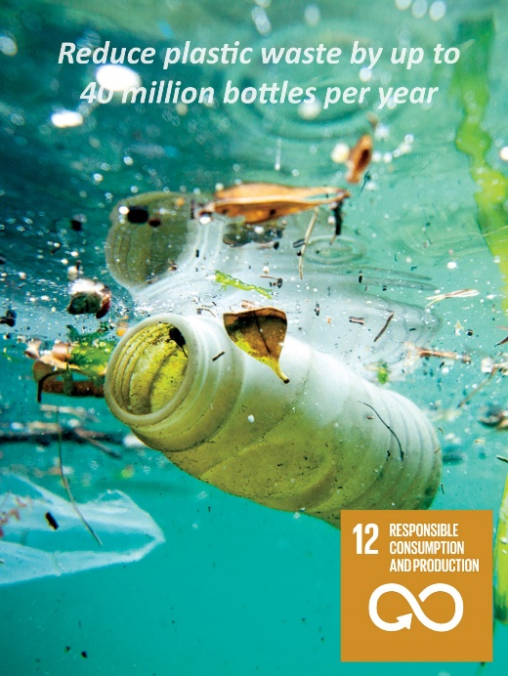
Creating an Impact
By 2030, we aim to provide at least 1 million people with clean drinking water!
Our vision is that:
“The growing water crisis is not only a global problem to be solved, but in doing so, it is also an opportunity for creating new and sustainable businesses and inspire local entrepreneurship”
www.solardew.com
Confidential Solar Dew Clean Water B.V. 2021
Notes:
Status SolarDew

Slide 5
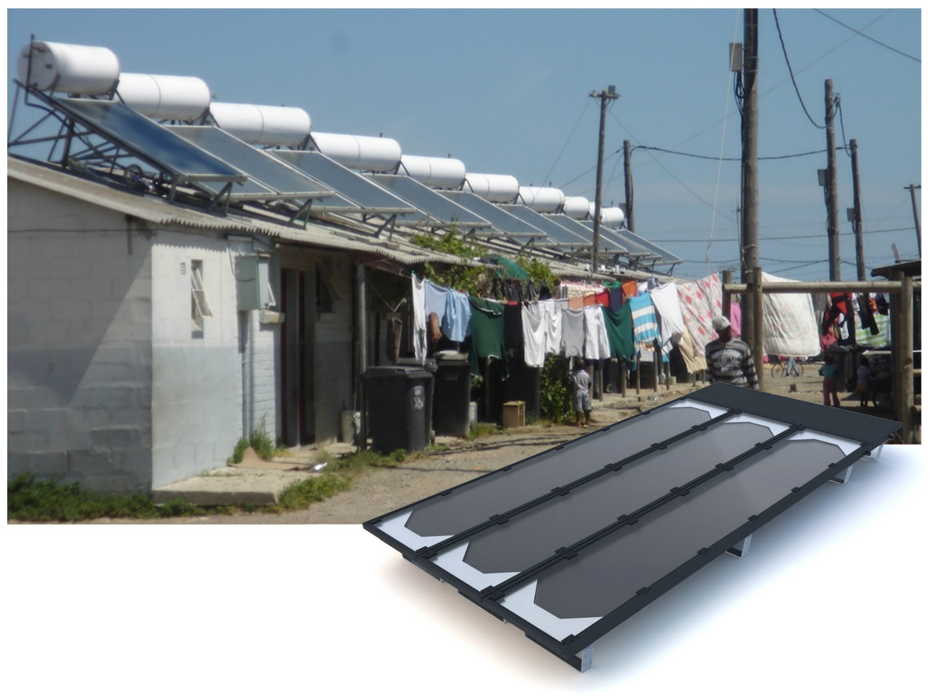
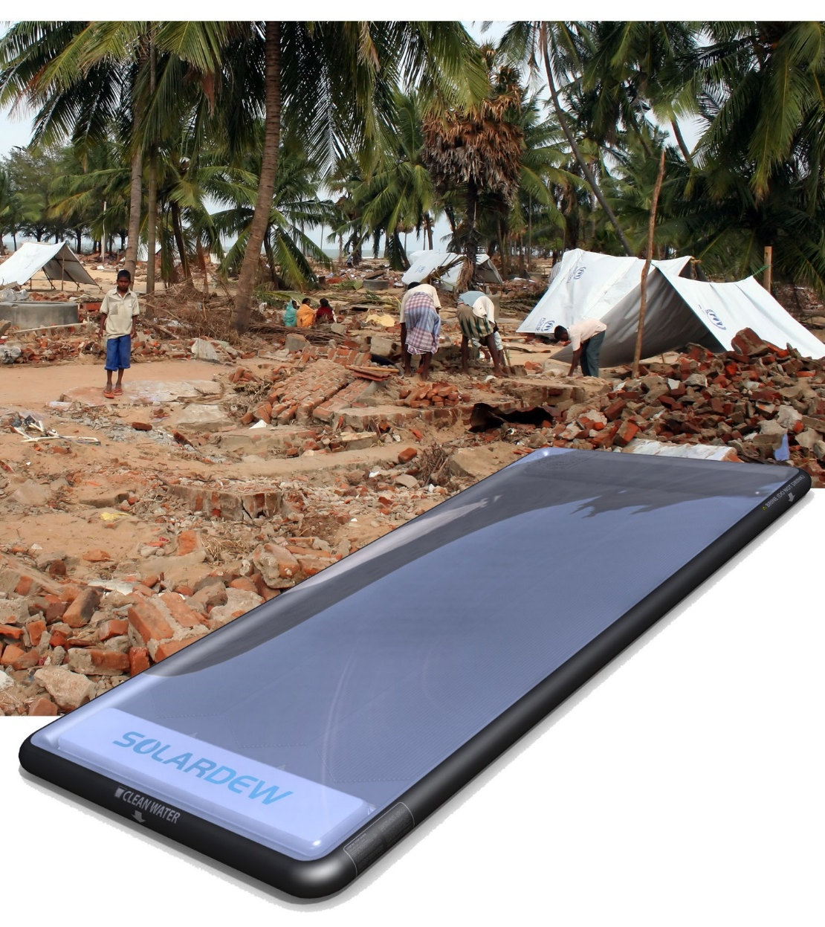
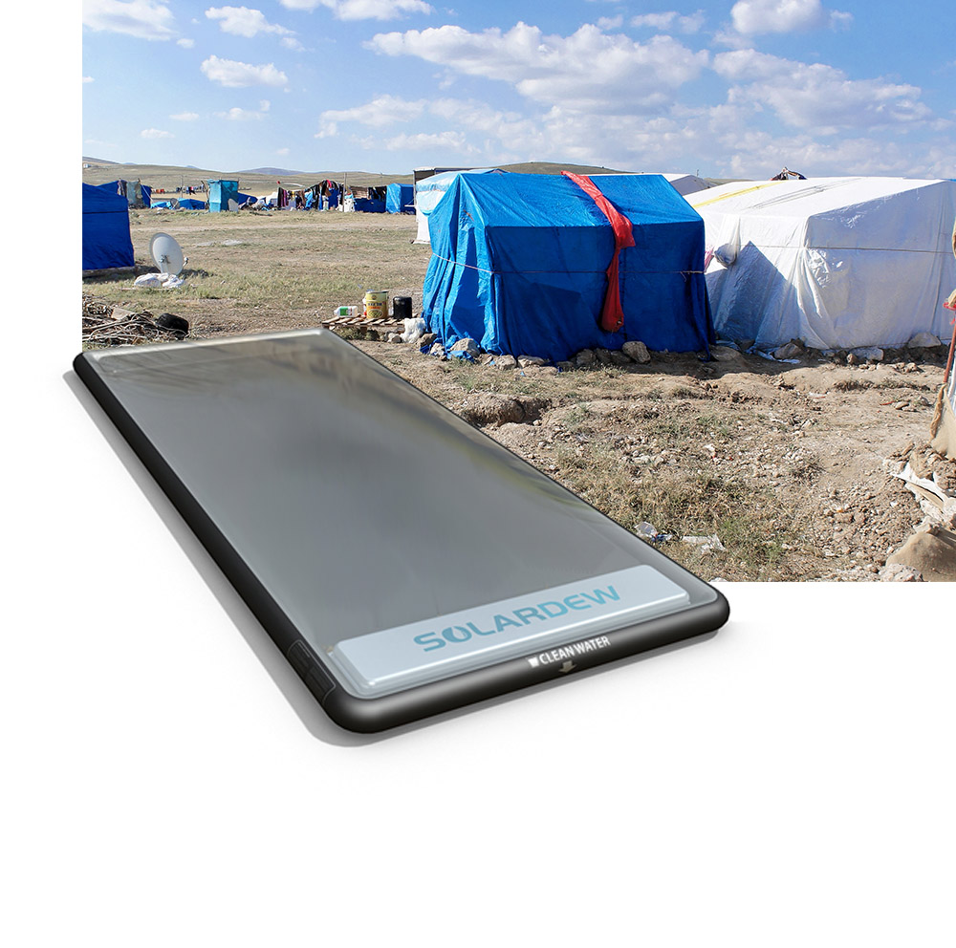
Confidential SolarDew International B.V. 2019
SolarDew offers the only effective solution for
households, communities and in emergencies
Confidential Solar Dew Clean Water B.V. 2021

Slide 6
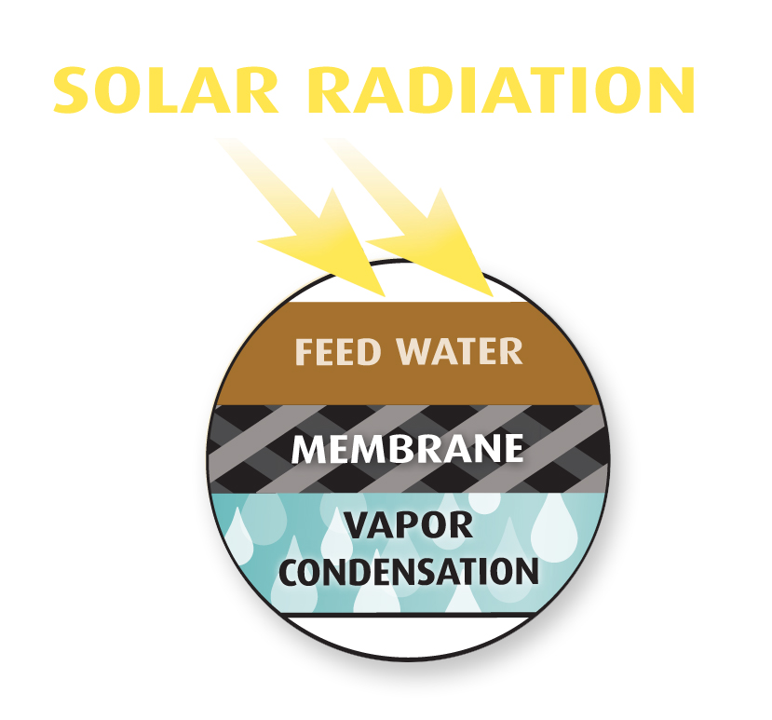
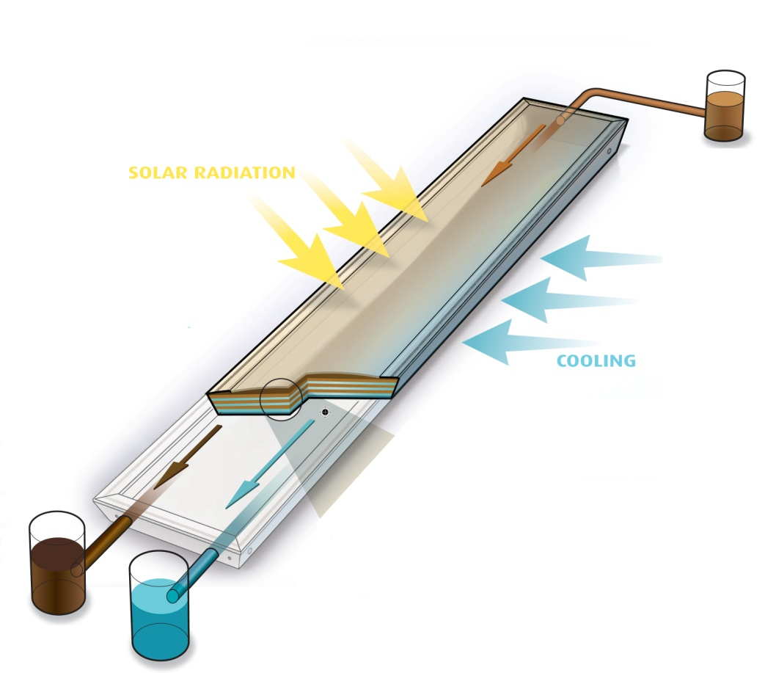
Drinking water using only the sun’s energy
The process is called membrane distillation
Heating - The sun’s energy is used to heat contaminated water.
Evaporation – Water vapor passes through SolarDew’s membrane leaving all contaminants behind.
Condensation takes place on the other side and re-mineralized to produce pure drinking water.
Production – 4 l/day/module (0.5 m2) which exactly what one person needs
Modular - Interconnected modules can produce anywhere from 4 to 5000 l/day
Confidential SolarDew Clean Water B.V. 2021
Notes:
The product we have developed looks like a solar panel but instead of electricity produces clean drinking water

Slide 7
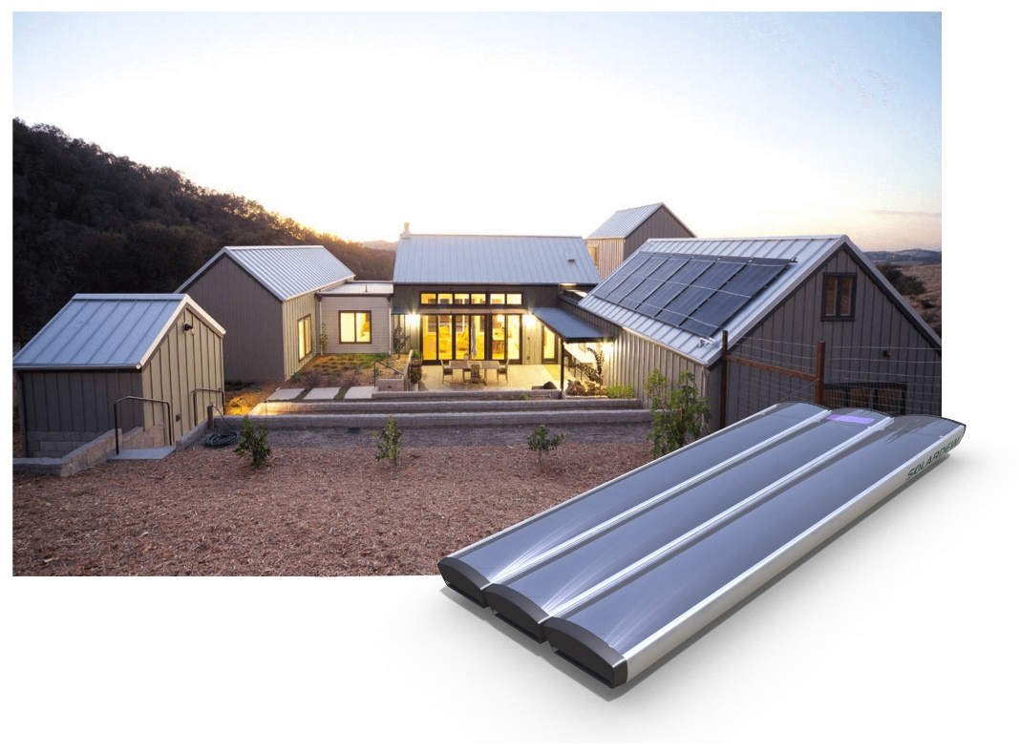
Reliable and Robust
*The products in the background are solar heaters and not the actual product.
SolarDew provides households and communities with simple, point of use, desalination products:
High quality drinking water from contaminated and/or saline sources
Autonomous – solar thermal powered
Plug and play – Simple and robust
Low maintenance and easy to service with no moving or electrical components
Low Water Price - less than €0.02 per liter compared to €0.04 for trucked water and €0.20 for bottle water
1 @ 100,000 units/year. Cost Price determined with Philips Innovation Services .
Confidential SolarDew Clean Water B.V. 2021

Slide 8
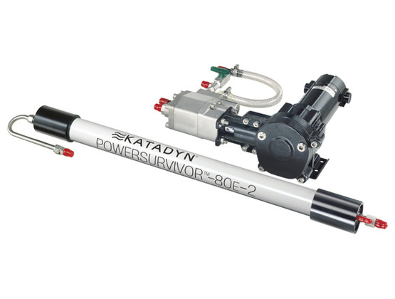
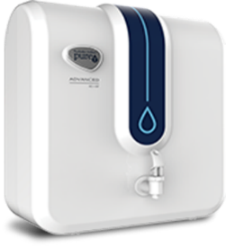
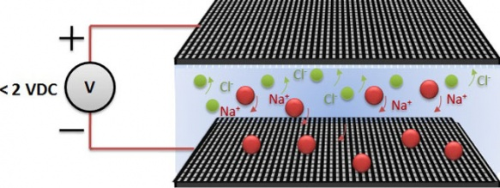
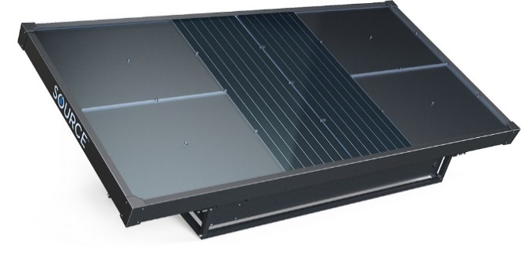
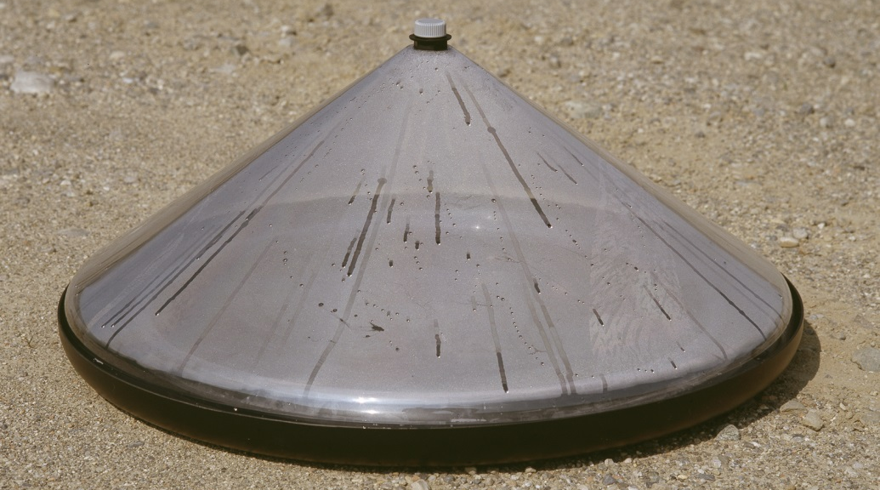
no affordable solutions for Point of Use Desalination!
Source: www.katadyn.com
Source: www.pureit.com
Standard water purification solutions do not remove salts
Reverse osmosis is maintenance intensive and prone to failure
Other Solar Desalination Technologies are complex, expensive (>4 cents/liter) and difficult to scale.
Air2Water Technologies are expensive (10 cents/liter) and not efficient.
Source: www.reginnovations.org
Source: www.watercone.com
Source: www.zeromasswater.com
Source: www.reginnovations.org
Confidential SolarDew International B.V. 2019
Confidential Solar Dew Clean Water B.V. 2021
Source: www.watercone.com
Notes:
Just imagine, that if the glass was salt molecule, the smallest virus would be roughly 5m in diameter and a bacteria 100 m
Virus range in size from about 20 to 400 nanometres in diameter (1 nanometre = 10⁻⁹ meters). By contrast, the smallest bacteria are about 400 nanometres in size.
Na and CL atoms have a size in the rance of 0.1-0.2 nm - https://chemed.chem.purdue.edu/genchem/topicreview/bp/ch7/index.php

Slide 9
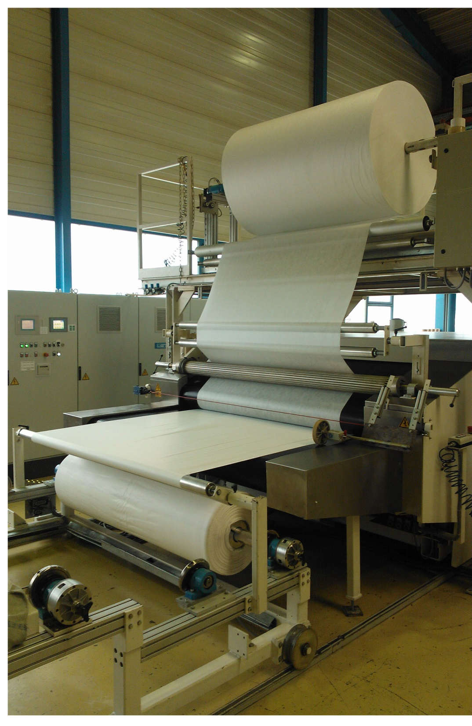
Why is SolarDew Unique?
SolarDew’s unique water purification bag ensures that our products are
More robust – solar and water purification processes in a single unit
Less maintenance due to the membrane’s high fouling resistance
1.5x more water efficient than Reverse Osmosis
Low Cost – 90% reduction in membrane cost
Designed to scale using manufacturing technologies from the packaging industry to further reduce costs
*The products in the background image are not the actual product.
Confidential SolarDew Clean Water B.V. 2021
Notes:
EW: Interesting to develop together with the manufacturing partner for production and scaling up
Patent
Membrane production process
Bonding Technology
Design water bag
Brine Removal

Slide 10
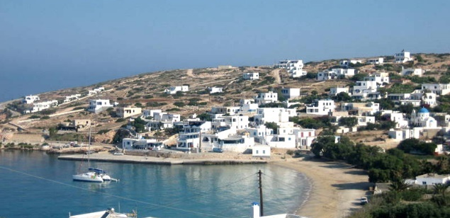
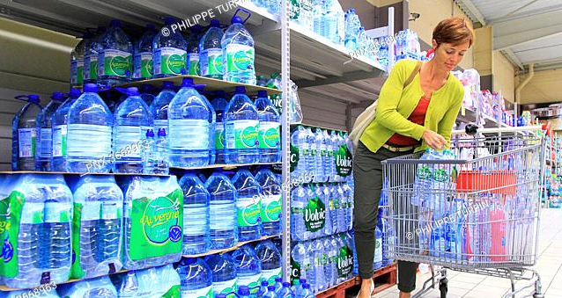
Growing opportunities
The global market size for point of use desalination is:
TAM – 85.8 mln people (€13.0 bln)
SAM – 32.3 mln people (€6.5 bln)
SOM –1 mln people (€120 mln)
Target customers include:
Rural communities
Households who want a sustainable alternative for bottled water
SolarDew’s will initially focus on:
Stepping stone markets in Australia and Chile with a good business climate, politically stable and higher paying capacity to reduce the time to market.
Focus on B2B or B2G clients with high unit sales (100-1000 modules) per client to ensure effective use of resources
Confidential Solar Dew Clean Water B.V.
Confidential SolarDew International B.V. 2020

Slide 11
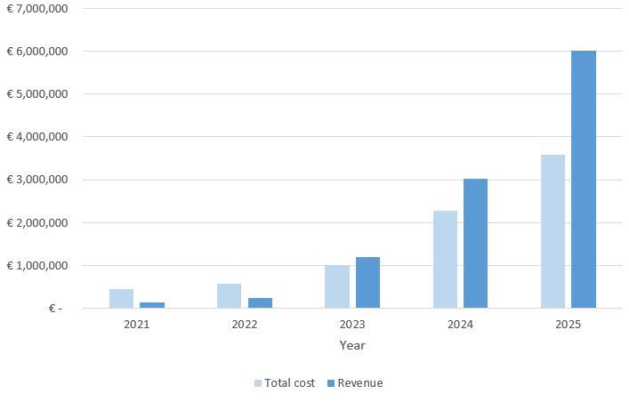
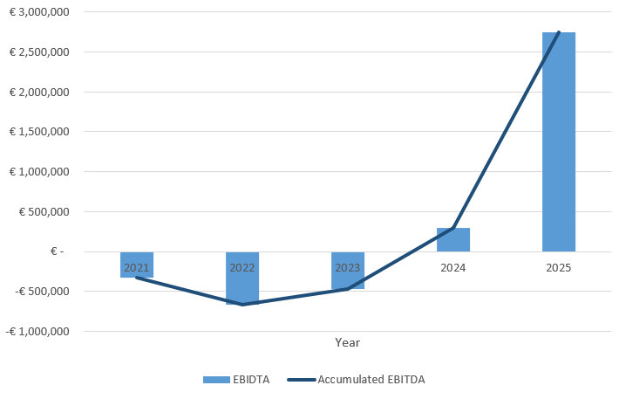
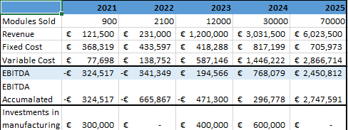
Financial Calculations
SolarDew will breakeven in 2024. By then we will have achieved:
Manufactured and sold 48,000 modules
Total revenue of €4.5 million
11 FTEs
Active in 5-6 countries
Confidential SolarDew Clean Water B.V. 2020
Notes:
EW: And you charge 130 euros?
EW: And what is your COGS?
EW: If they money comes in what is your production capacity?
AK: bag in one day more than we can produce
And the panel itself?
AK: we are looking for the right assembly partner. We start producing and assembling in EU/NL, we ant to be close for the ‘kinks’’ in the cable?. SD only producing and exporting the bag
EW: EW fundraising plans, what is the progress?
Total 2.4 mio, 700K first series for launching partners, second stage 1.7 mio to scale up team and production, series A-EIC accelerator, EU-subsidy, we applies last year, the last badge we made it -> recommendation
EW: we have strong mandate for vulnerable communities -> where do you see the biggest clients -> to what extend to serve SD the vulnerable communities
AK: we started with the sole aim to serve the end vulnerable end-user. We started with AUS and Chile for both vulnerable but also because of kick-start the business -> end goal are the vulnerable people and the bottom of the pyramid -> SA, India, Pakistan, off grid communities
AK: hardware product is a good analogy ‘Box Power’, modular solar power facilities for remote communities. Not in hardware before in the field
EW: loi talking to partners/clients
EW: size of the raise is appropriate and the scaling is appropriate, question
EW: product, need
AK: potential post investment support? Look at the website and the team on the website, they give the support and serve you on the board, work closely to build the capacity to scale up: see the 6 pillars on their website! Extend the 3 year hopefully to give the board service

Slide 12
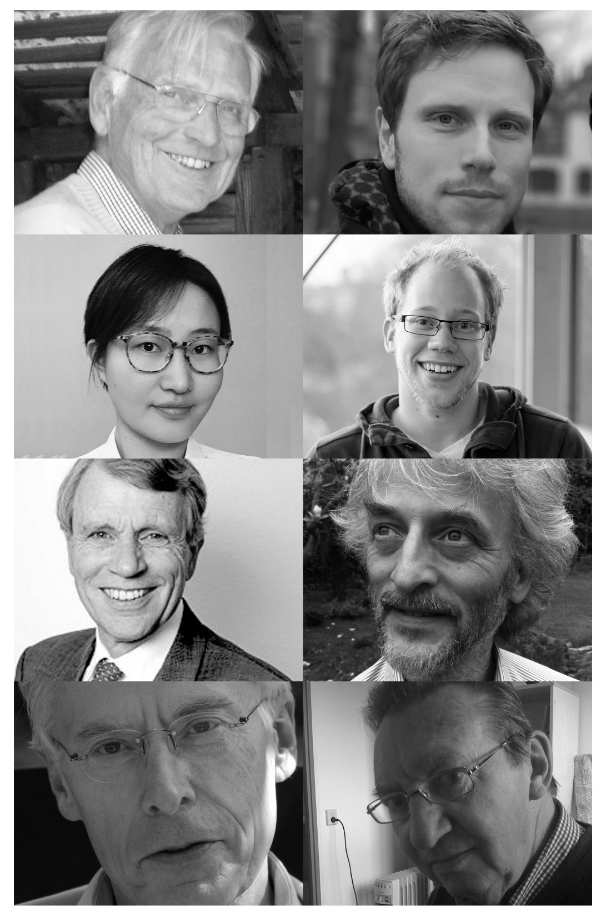
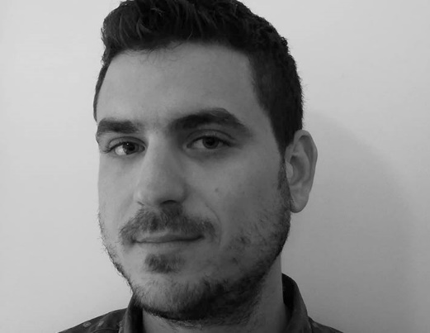
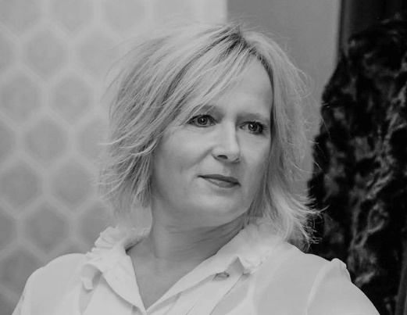
SolarDew
Frank Croon
Alexander van der Kleij
Experienced team in technology, manufacturing, business development:
A. van der Kleij MSc: CEO/Founder (Industrial Design, Sustainability)
Drs. F.A. Croon MA: Founder (Invest in Future, Scale Up Lab, various startups)
Ir. F.W. Croon MSc: Founder (Euro-Consult, 30 years developing countries)
Prof. D. Sikkema: Membrane Technology (TU/e, Teijin, MX Polymers)
Dr. J. van Berkel: Solar Technology (startup Solesta, TU/e, Entry Technology)
T. Bleeker BSc: Engineer (Industrial Design)
M. Potter MSc MBA: Patents (Akzo Nobel, United Nations)
S. Lameijer: Financial Administration (Mollie, FastNed)
Thomas Ntiniouris
Tim Bleeker
Floris Croon
Jacob van Berkel
Doetze Sikkema
Sandra Lameijer
Confidential SolarDew International B.V. 2019
Confidential SolarDew International B.V. 2020

Slide 13
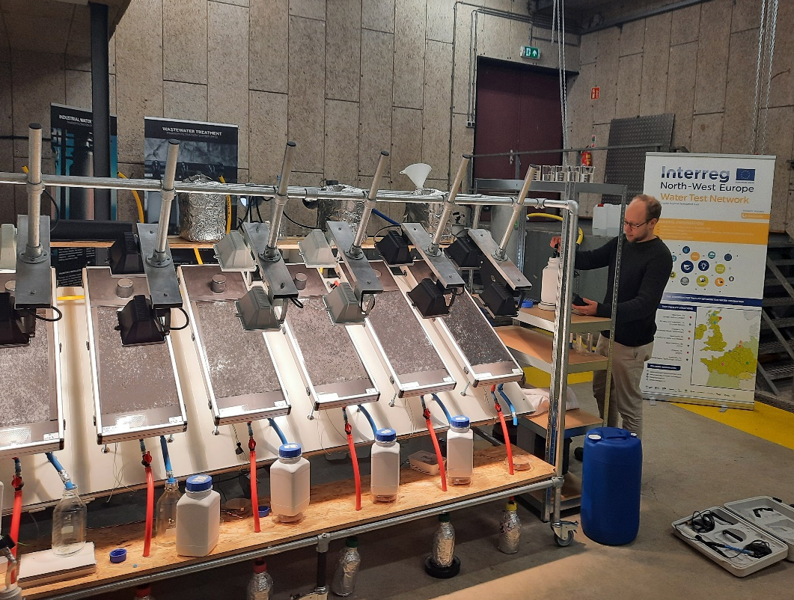
SolarDew’s Product Status
SolarDew is currently at TRL6 with:
Proven technology - Successfully tested internally and with Water Test Network (NL), Plataforma Solar de Almeria (Spain) and local partners.
4 patent opportunities - Developed the membrane, the water purification bag and relevant manufacturing technologies
Ready for production - Design for the 1st production series, manufacturing plan and cost price analysis (PIS).
SolarDew has established a proprietary supply chain with specialized European companies.
Confidential SolarDew Clean Water B.V. 2021
Confidential SolarDew International B.V. 2020

Slide 14
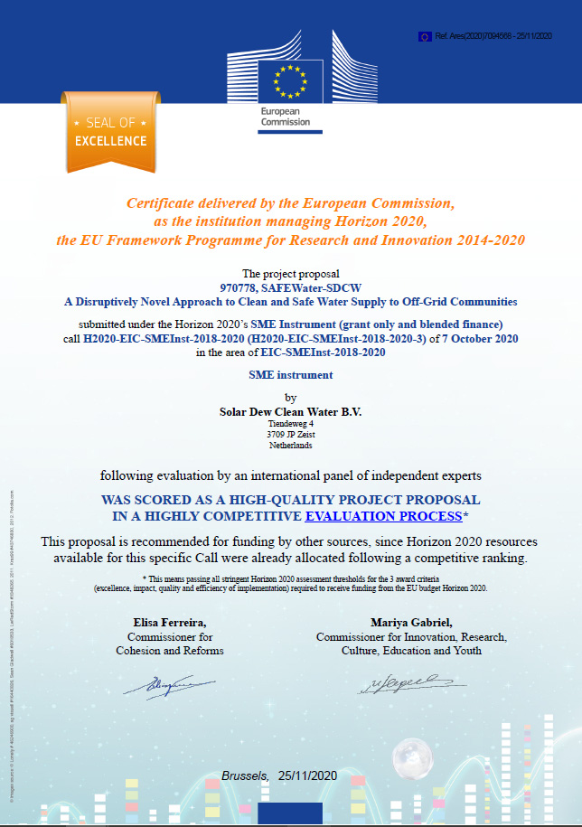
SolarDew’s Market Status
SolarDew is commercializing:
Signed cooperation agreements with local commercial partners.
Signed Letter of Intents:
Female led cooperative in Northern Chile to provide 1000 l/day for a hydroponics project.
Waste water recycling from sesame seed production for company in Northern Australia.
Received the Seal of Excellence in the October 2020 EIC Accelerator.
Confidential SolarDew International B.V. 2020
Confidential Solar Dew Clean Water B.V. 2021

Slide 15
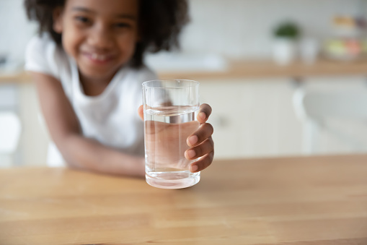
Required investment for SDCW
A total of €2.5 million is required in 2 stages to make effective use of (impact) capital:
Stage 1 (Mid 2021, €700 K) - Growth capital to manufacture and install 2 projects for launching customers.
Stage 2 (Mid 2022, €1.8 million) - to scale up production, expand team and for working capital to expand the market. Via Series A or the EIC Accelerator.
We are looking for (co-)investors with
The necessary experience, knowledge and network.
The enthusiasm to accelerate the market development and create impact!
Confidential SolarDew Clean Water B.V. 2020
Confidential Solar Dew Clean Water B.V. 2021

Slide 16
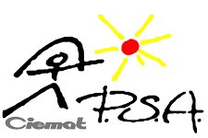
Confidential SolarDew Clean Water B.V. 2020
Thank You!
please contact - a.vanderkleij@solardew.com
Weerstation Veenkampen
Meteorologie en Luchtkwaliteit
This project has received funding from the European Union’s Horizon 2020 research and innovation programme under grant agreement No 822273

Slide 17
Scaling Up - Technology Risk Mitigation
The following technological risks have been identified and mitigated:
Long term durability – extensive lab and field testing under different conditions to simulate end user use and operating conditions.
Scaling Up – close cooperation with manufacturing partners since the start of the product development to minimize issues when scaling up.
Certification – test together with 3rd parties (Plataforma Solar Almeria, Waterschap Vallei & Veluwe) to ensure water quality matches future (local) certification requirements.
Confidential SolarDew International B.V. 2020
Confidential Solar Dew Clean Water B.V. 2021
Notes:
EW: Purifies water 4 liter per day, when are you producing and consuming? -> you are producing tomorrow
EW: What is the contemination solution you are using?
EW: Am curious about the modules resistance against national disasters? Australian partner test against hurricanes. Remove the panels in case

Slide 18
Scaling Up - Business Risks Mitigation
*The products in the background are solar heaters and not the actual product.
The following business risks have been identified and mitigated:
Slow business growth – selecting markets with a good business climate, politically stable, higher paying capacity and an urgent need will reduce the time to market.
Local business culture – working with local partners with established networks in relevant sectors as well as local/ international business experience which will bridge the gap to local customer.
COVID19 – alternative market (households) and launching customer (energy company) have been identified in Spain to develop a “home” market.
Confidential Solar Dew Clean Water B.V. 2021

