Slide 1
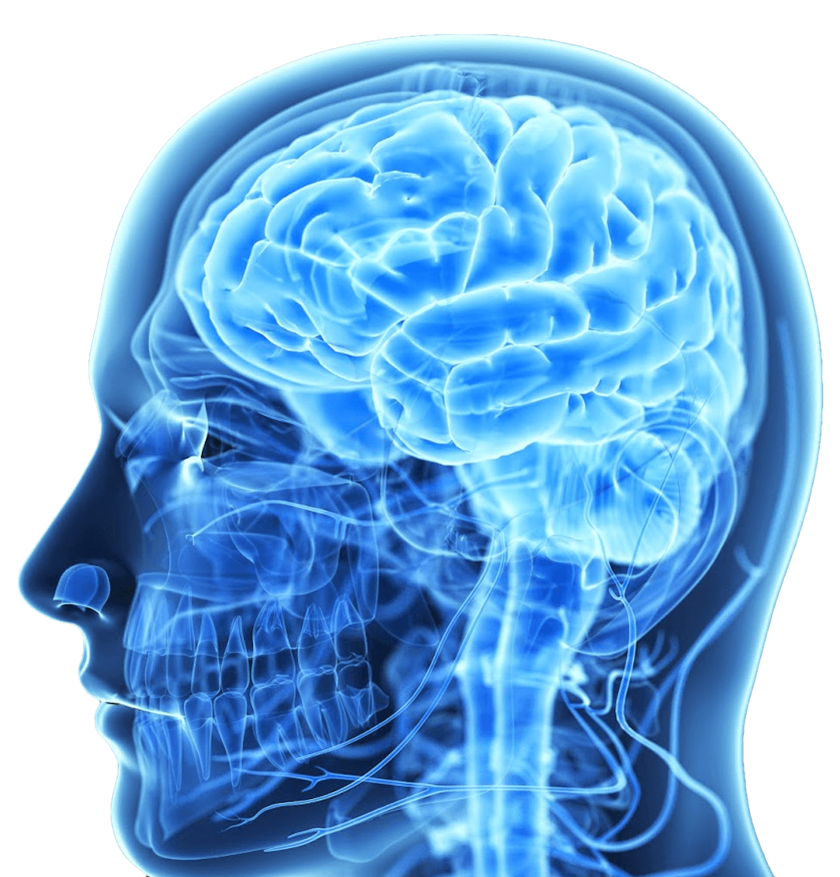

Medical Metal Extraction

Slide 2




Executive summary
MEXBRAIN is a spin-off from the University of Lyon created in November 2017.
MEXBRAIN’s disruptive technology is able to extract efficiently and specifically metals from the body.
Metal extraction is a new promising treatment in Sepsis, a large and severe infection-related disease.
The first indication will be the treatment of Wilson’s Disease, an orphan genetic indication.
MEXBRAIN is raising 5 M€ to reach First in Man and PoC validation.
MEXBRAIN’s ambition is to be the leader in metal extraction treatments for critically ill patients.

Slide 3

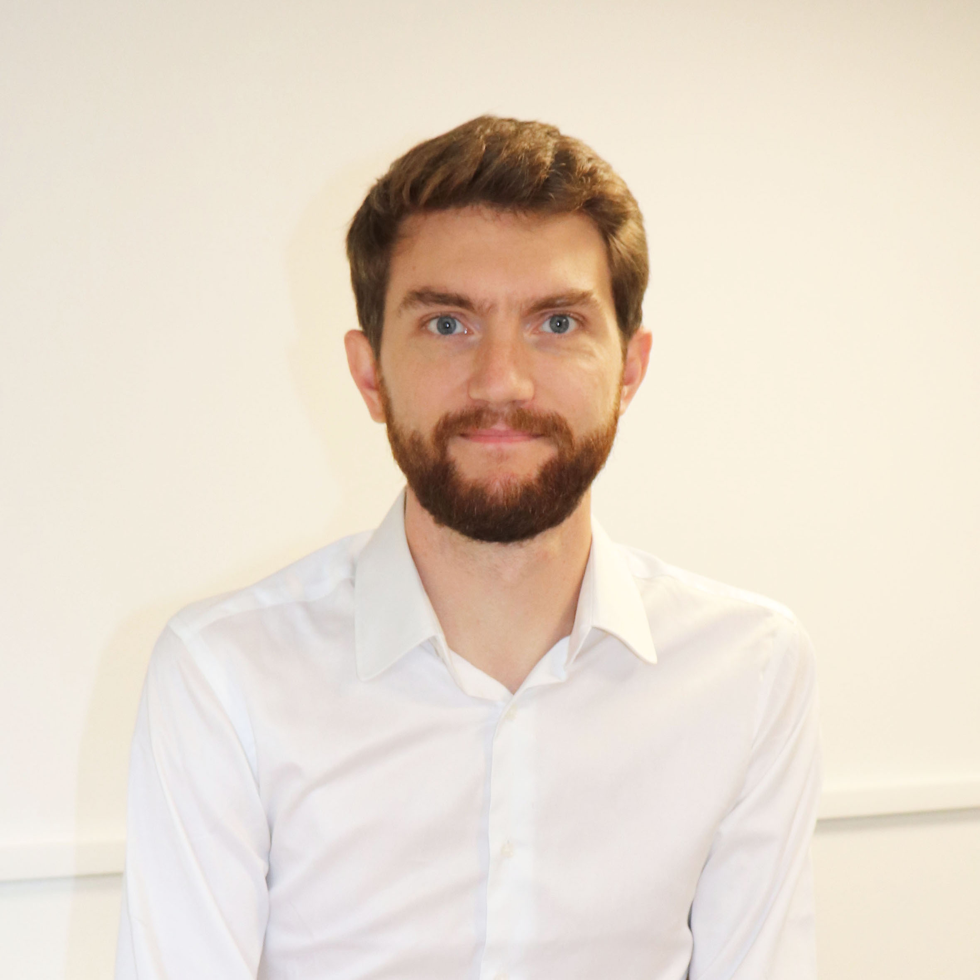


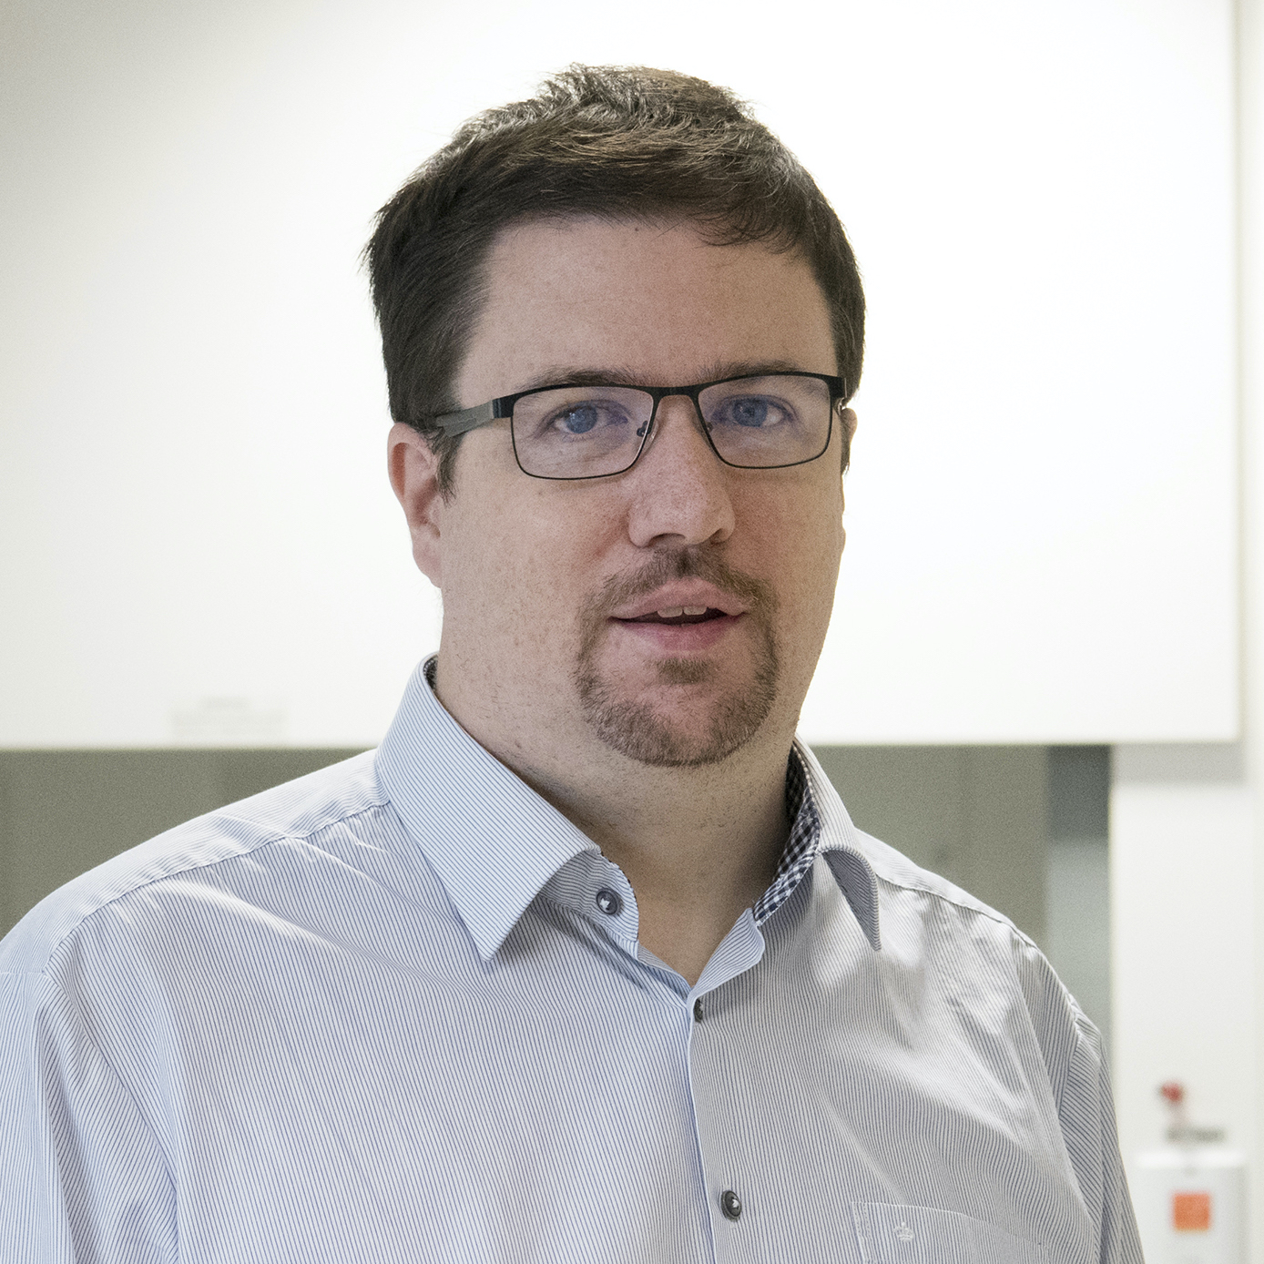

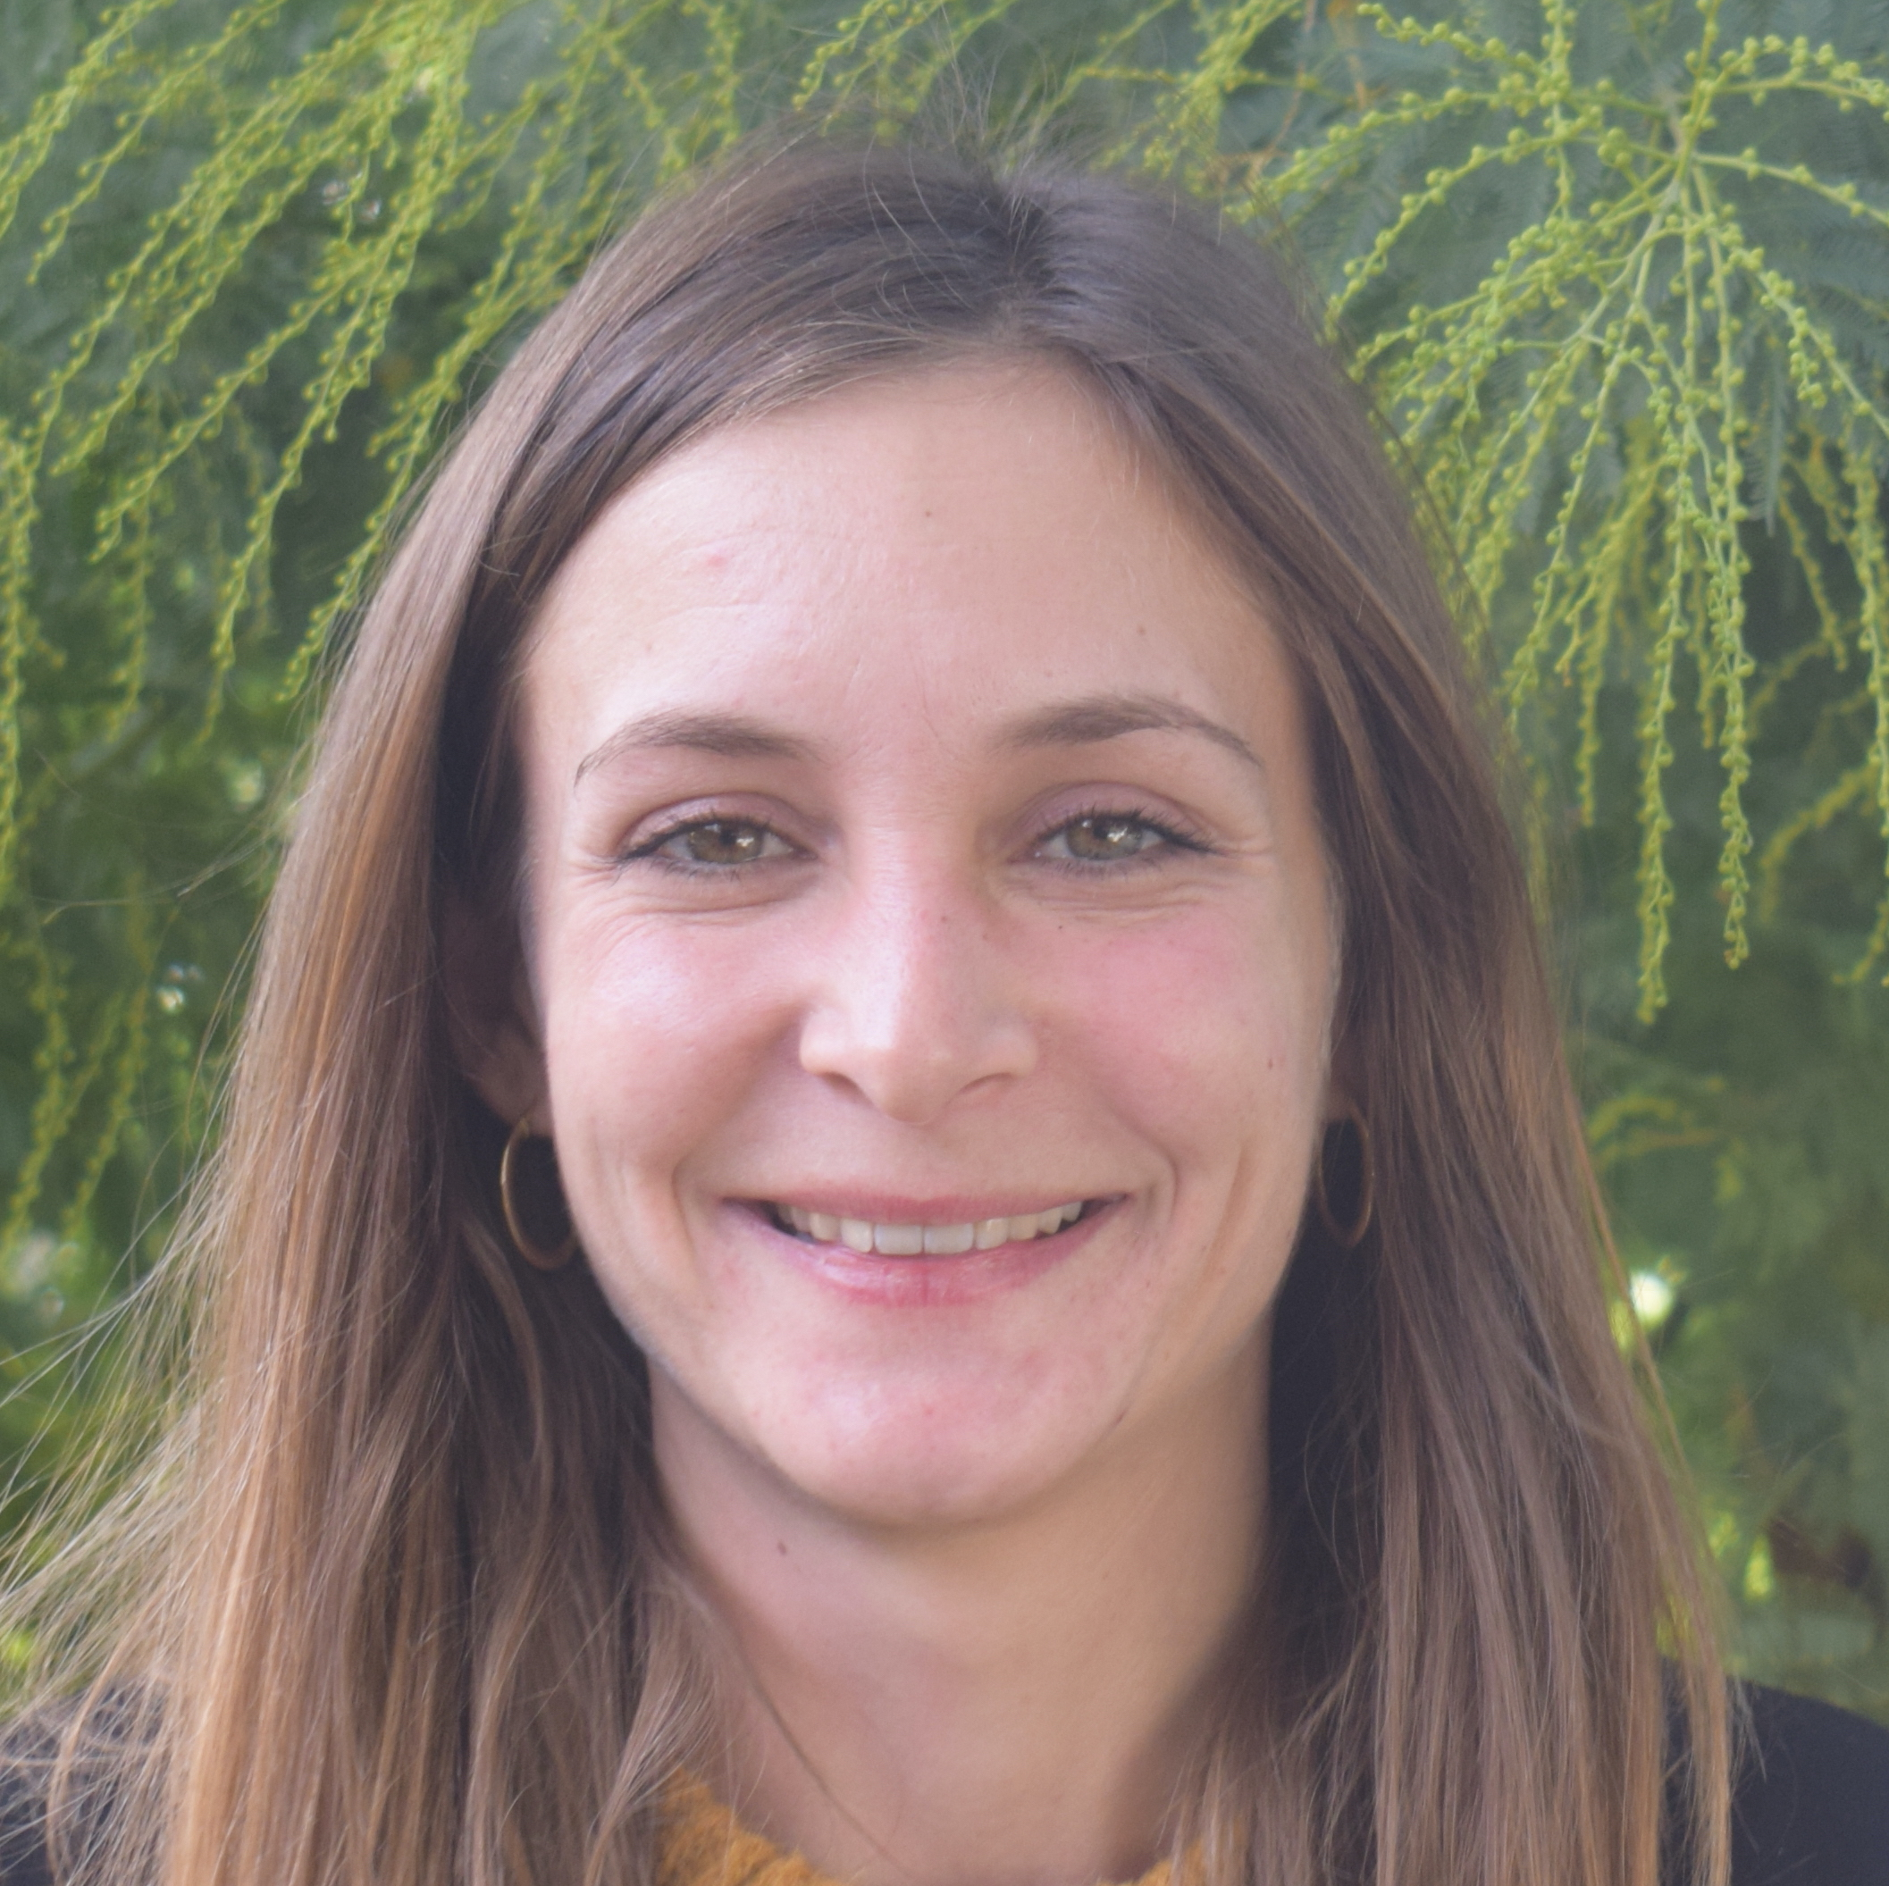


Team
Scientific comitee
President
O. Tillement, PhD
CSO - Founder
Strategy
S. Groyer, PhD
Business/Strategy - Founder
T. Brichart, PhD
CEO - Founder
Members
Pr. A. Lachaux
Chief CRMR Wilson – HFME/CHU Lyon
TBA
Head of quality assurance
TBA
Head of clinical affairs
IP
F. Lux, PhD
IP - Founder
Pr. S. Palfi, M.D.
Pr. Henri Mondor Hospital
Michel Thomas
Medical director - Physidia
Pr. Y. Bertrand
IHOP director
R&D
Preclinical & regulatory
CMC
Clinical
O. Tillement, PhD
CSO - Founder
A. Aigle, PhD
Preclinical & regulatory
M. Natuzzi, PhD*
CMC project manager
P. Gillet, PhD
EPFL, ENS, etc.
TBA
Clinical studies
F. Lux, PhD
R&D project manager - Founder
TBA
Young researcher
C. Grange, PhD student
Scale-up & technology transfer
TBA
Young researcher

Slide 4
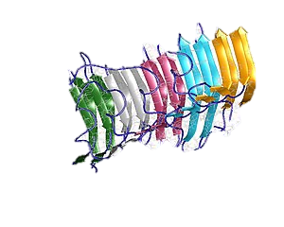
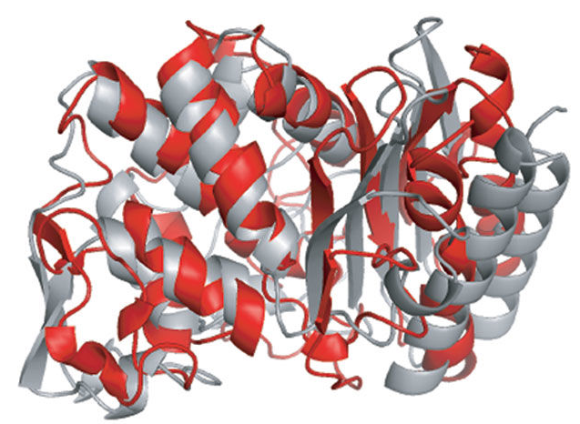
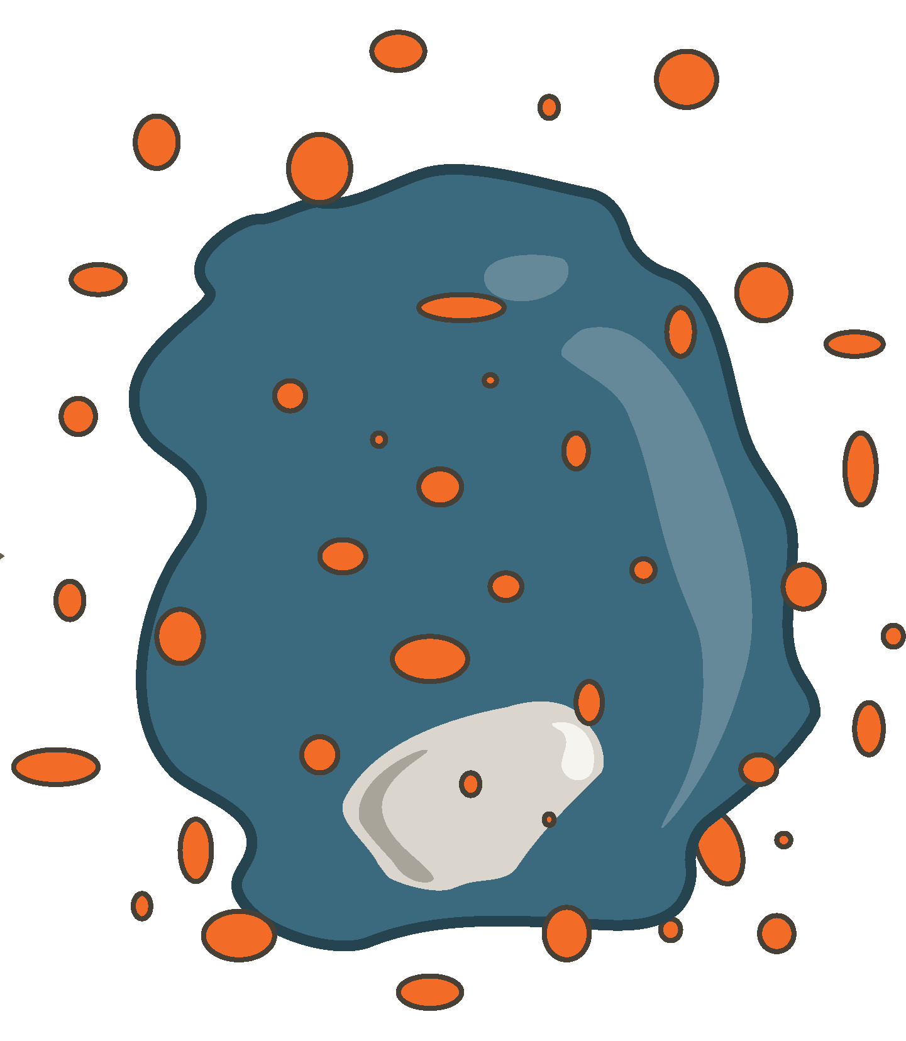
Metals are essential to life but …
Biometals are essential for the normal functioning of human body
Essential to proteins (metalloproteins) and enzymes as co-factors
Numerous metal homeostasis: Fe^{3+/2+} - Cu²⁺ - Zn²⁺ - Mn²⁺ - etc.
Proteionopathies
Abnormal Protein-Solid depositions
Decrease of some protein solubilities
Amyloid depositions, fibrils, plaques, Lewy’s body, aggregates…
Environmental
exposure
Proteins inactivation
Chelating Competitions
Modification of Proteins Conformations
Neutralization of some metalloproteins.
Activation of protein kinase C and binds to PKC inducing problem with neurotransmitter
Dyshomeostasis
Biometal ions
Genetic
factors
Heavy metals toxicity
Pb²⁺, Cd²⁺, Hg²⁺, …
Oxidative stress
Glutathion inactivation
ROS formation
Metals interact in the ROS production (for example Fenton’s reaction).
Aging
Notes:
Metal ions are essential for life, playing important roles in the human body. In nature, nearly half of all proteins are metal-binding proteins called metalloproteins. Protein-bound metal cations such as copper (Cu2+, Cu+), iron (Fe3+, Fe2+), magnesium (Mg2+), manganese (Mn2+), calcium (Ca2+), and zinc (Zn2+) are key elements for maintaining cell structure, regulating gene expression, mediating cell signaling as a second messenger, and catalyzing enzyme activities. The brain, in particular, requires high levels of free metal ions in synaptic clefts as a modulator of synaptic transmission. Accordingly, metal dyshomeostasis directly causes neuronal dysfunction, leading to neuronal cell death

Slide 5
MEXBRAIN Metal Extraction
Proved
Metal toxicities
Hypothesis
High metal levels
Evident metal toxicity
Organ accumulations – Acute crises
Mandatory metal extraction
Flash free oligo-metals releases
Severe clinical situation
Intensive Care Units / surgical block
Hemolysis – Cell death
Better Care with specific metal extraction
Altered metal homeostasis
Environment - Aging
Heavy metal accumulation
Metal hypothesis in the course of disease
Pb | Hg | Fe | *M
Acute toxicity
Pollution
Accident
Suicide
Poisoning
Radioactive leaks
Fe | Cu
Metal accumulation
Genetic disorders
Wilson
Low Cu elimination
Hemochromatosis
High Fe absorption
Fe
Iron overload
Hemolytic anemia
Regular transfusions
Genetic or Acquired
Beta-thalassemia major
Sickle cell anemia
Diamond-Blacfan anemia
Myelodysplastic syndromes
AIHA, …
Fe | Cu
Sepsis
ROS/RNS induction
Impact on:
Oxidative stress
Endothelial dysfunction
Pathogen developments
Coagulation system
Fe
Cardio-Pulmonary Bypass (CPB)
ROS/RNS induction
Impact on:
Oxidative stress
Immune response
Kidneys
Pb
Co-factors
Specific diseases
Cardiovascular
Diabetes
Kidneys
Fe | Cu | Zn
Neurologic disorders of aging
Proteinopathies
Alzheimer’s
Parkinson’s
Amyotrophic lateral sclerosis
SoC : direct elimination
Chelation therapy
Possible dialysis for critical cases
Control/elimination of toxic exposition
SoC : direct elimination
Chelation therapy (Cu, Fe)
Phlebotomy (Fe)
Food / low metal content nutrition
SoC : direct elimination
Transfusion
Chelation therapy
SoC : possible
No specific metal extraction
Dialysis: 10-20 %
Cytokines targeting
SoC : possible
No specific metal extraction
Oxidative stress management
Cytokines targeting
SoC : some trials
No specific metal extraction
Some EDTA infusion clinical trials
SoC : some trials
No specific metal extraction
Some chelation therapy (Fe) trials
Small proteins targeting
👤 ☆☆☆☆☆
💉 ★★☆☆☆
🕐 ★★☆☆☆
💰 ☆☆☆☆☆
👤 ★☆☆☆☆
💉 ★☆☆☆☆
🕐 ★☆☆☆☆
💰 ★☆☆☆☆
👤 ★★☆☆☆
💉 ★★☆☆☆
🕐 ★☆☆☆☆
💰 ★★☆☆☆
👤 ★★★★☆
💉 ★★★☆☆
🕐 ★★★★☆
💰 ★★★★★
👤 ★★★★☆
💉 ★★★★★
🕐 ★★★☆☆
💰 ★★★★☆
👤 ★★★☆☆
💉 ★★☆☆☆
🕐 ★★★★★
💰 ★★☆☆☆
👤 ★★★★★
💉 ★☆☆☆☆
🕐 ★★★★★
💰 ★★★★★
👤 = Patients | 💉 = Iatrogenicity tolerance | 🕐 = Development time | 💰 = Market

Slide 6
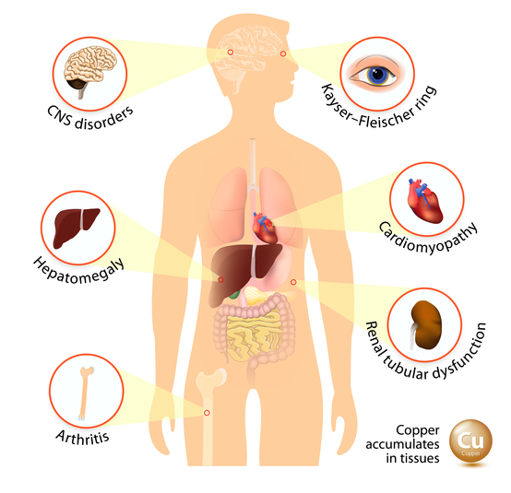
Wilson’s disease
20 000+ patients in US and Western Europe
Wilson disease is a potentially treatable, inherited disorder of copper metabolism that is characterized by the pathological accumulation of copper.
WD Patients
Children, pregnant and elderlies – 25%
75 %
65 %
neurologic/hepatic
5 %
hepatic only
30 %
asymptomatic
Chelators
contraindicated
50 %
Chelators failure or
Patients worsening
55 %
acute liver failure
45 %
no acute liver failure
Chelators ok until
symptomatic or worsening
Weiss et al. In: Wilson Disease. GeneReviews (1999) [updated 2016]

Slide 7



Stages & needs of Wilson’s disease
Non-ceruloplasmin bound copper in plasma:
Healthy subject: 50-150 µg/l
WD patient: > 200 µg/l
WD prevalence rate: ~ 4 / 100 000 persons
Incidence rate: ~ 0.3 / 100 000
15-25 % of WD patients
Discovery
Young patients
Discovery
Family tests
& other signs
Acute liver failure
Primo-treatment
Maintenance
Escape
ICU admission
Complicated metal treatment
High-dose treatment
1-3 years
Slow metal treatment
Neuro aggravation risk
Regular treatment
3-6 times/day – 10-50 years
Treatment normally efficient
Progression risk
Various lines of treatment
Hepatic aggravation
Neurological aggravation
⚠️ Life-threatening ⚠️

Slide 8

MEXBRAIN in Wilson’s disease
 | D-penicillamine | Trientine | MexBrain
US | > 80 k€ / an | > 200 k$ / an | 80 k$ / an
EU | < 2 k€ / an | > 80 k€ / an | 40 k€ / an
Acute liver failure
Primo-treatment
Maintenance
Escape
ICU admission
Complicated metal treatment
High-dose treatment
1-3 years
Slow metal treatment
Neuro aggravation risk
Regular treatment
3-6 times/day – 10-50 years
Treatment normally efficient
Progression risk
Various lines of treatment
Hepatic aggravation
Neurological aggravation
⚠️ Life-threatening ⚠️
Liver transplant
High dose chelator treatment
Chelating treatment
Limited by chelator’s posology
50 % of patients:
Chelator failure or patient aggravation
ICU
Limited by chelator’s posology
50 % of patients:
Chelator failure or patient aggravation
Bring back the liver to acceptable conditions for transplant
Palliative care
OR
Save the liver
New line of treatment

Slide 9
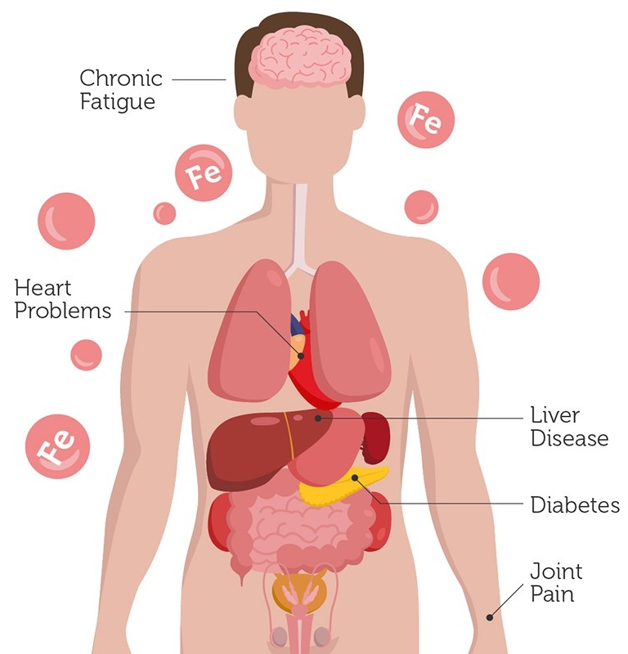
Hemochromatosis (II) – Hemolytic anemias
> 800 000 patients in the US and western Europe
Treatment of the worst cases
Secondary hemochromatosis are pathologies linked to excess iron intake due to red blood cell production and maturation disorders or metabolic diseases
Hemoglobinopathies (sickle cell disease, thalassemia, sideroblastic anemia)
Congenital hemolytic anemias
Myelodysplasia (bone marrow)
Primary hemochromatosis that evolved
Desferrioxamine (subcutaneous injection)
Contraindications: anaemia, children, major thalassemia
Deferiprone (oral)
Deferasirox (oral)
Side effects (more than 10%): kidney problems, intestinal problems
Iron overconcentration in organs
liver, heart, kidneys

Slide 10
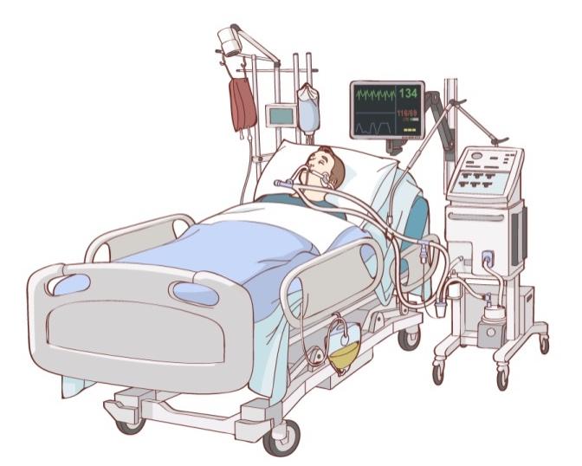
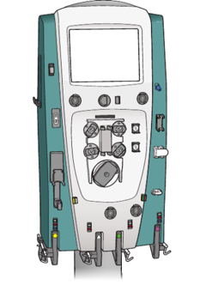
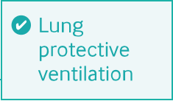
Sepsis
Treatment options
Antibiotics
Vasopresors
Fluid management
Organ support
Lifetime consequences
49 million cases per year
20% of deaths worldwide
11 million deaths each year
8% mortality/hour of delay in treatment
$24 B (up 3.6%/year) in health care spending (US)
Thérapie cible moléculaire
Metal extraction
Dialysis
Prevention of systemic inflammation is essential: dialysis for the elimination of LPS, cytokines and metals
If started too late, multi-organ failure treatment to try to save patients
> 300,000 patients (US - EU) on dialysis

Slide 11
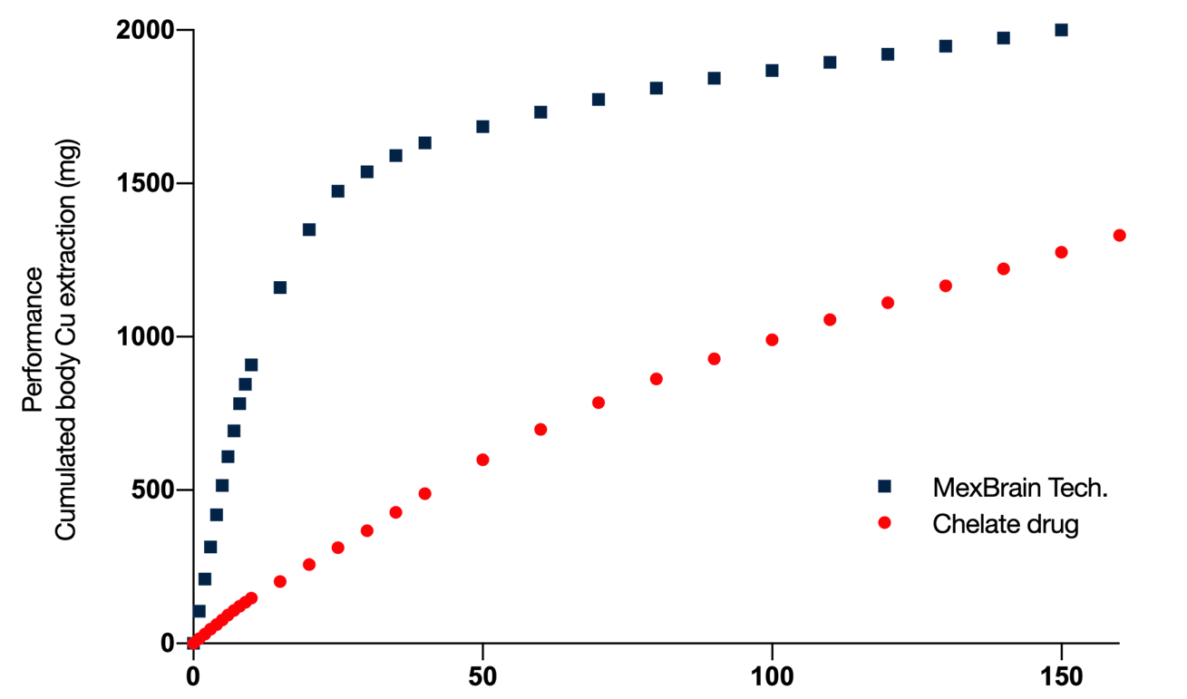
Disruptive technology: rapid and safe toxic metal extraction
Example of theoretical copper extraction in Wilson’s disease
+ 1 safe life-year
Sparing from Cu-damages
Therapeutical
target
Weeks
MEXBRAIN’s treatment in Wilson’s will cure the liver and protect the brain

Slide 12
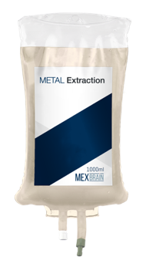
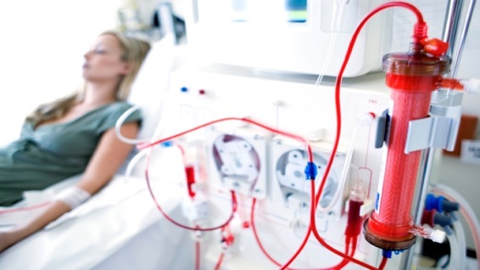
Product: Dialysate for specific metal extraction
Blood dialysis to specifically and precisely extract toxic metals
Product
4 treatments / year / patient (moy.)
EU : 10 k€/bag
US : 20 k$/bag
For acute treatment
100+ k€ / patient
Continuous dialysis
Many bags used to save patients' lives.
Metal extraction fluid
Use of regular dialysis monitor
Compatible with no modification
Compatible with all dialysis membrane up to 100 kDa cut-off
Possible combination with existing treatment

Slide 13
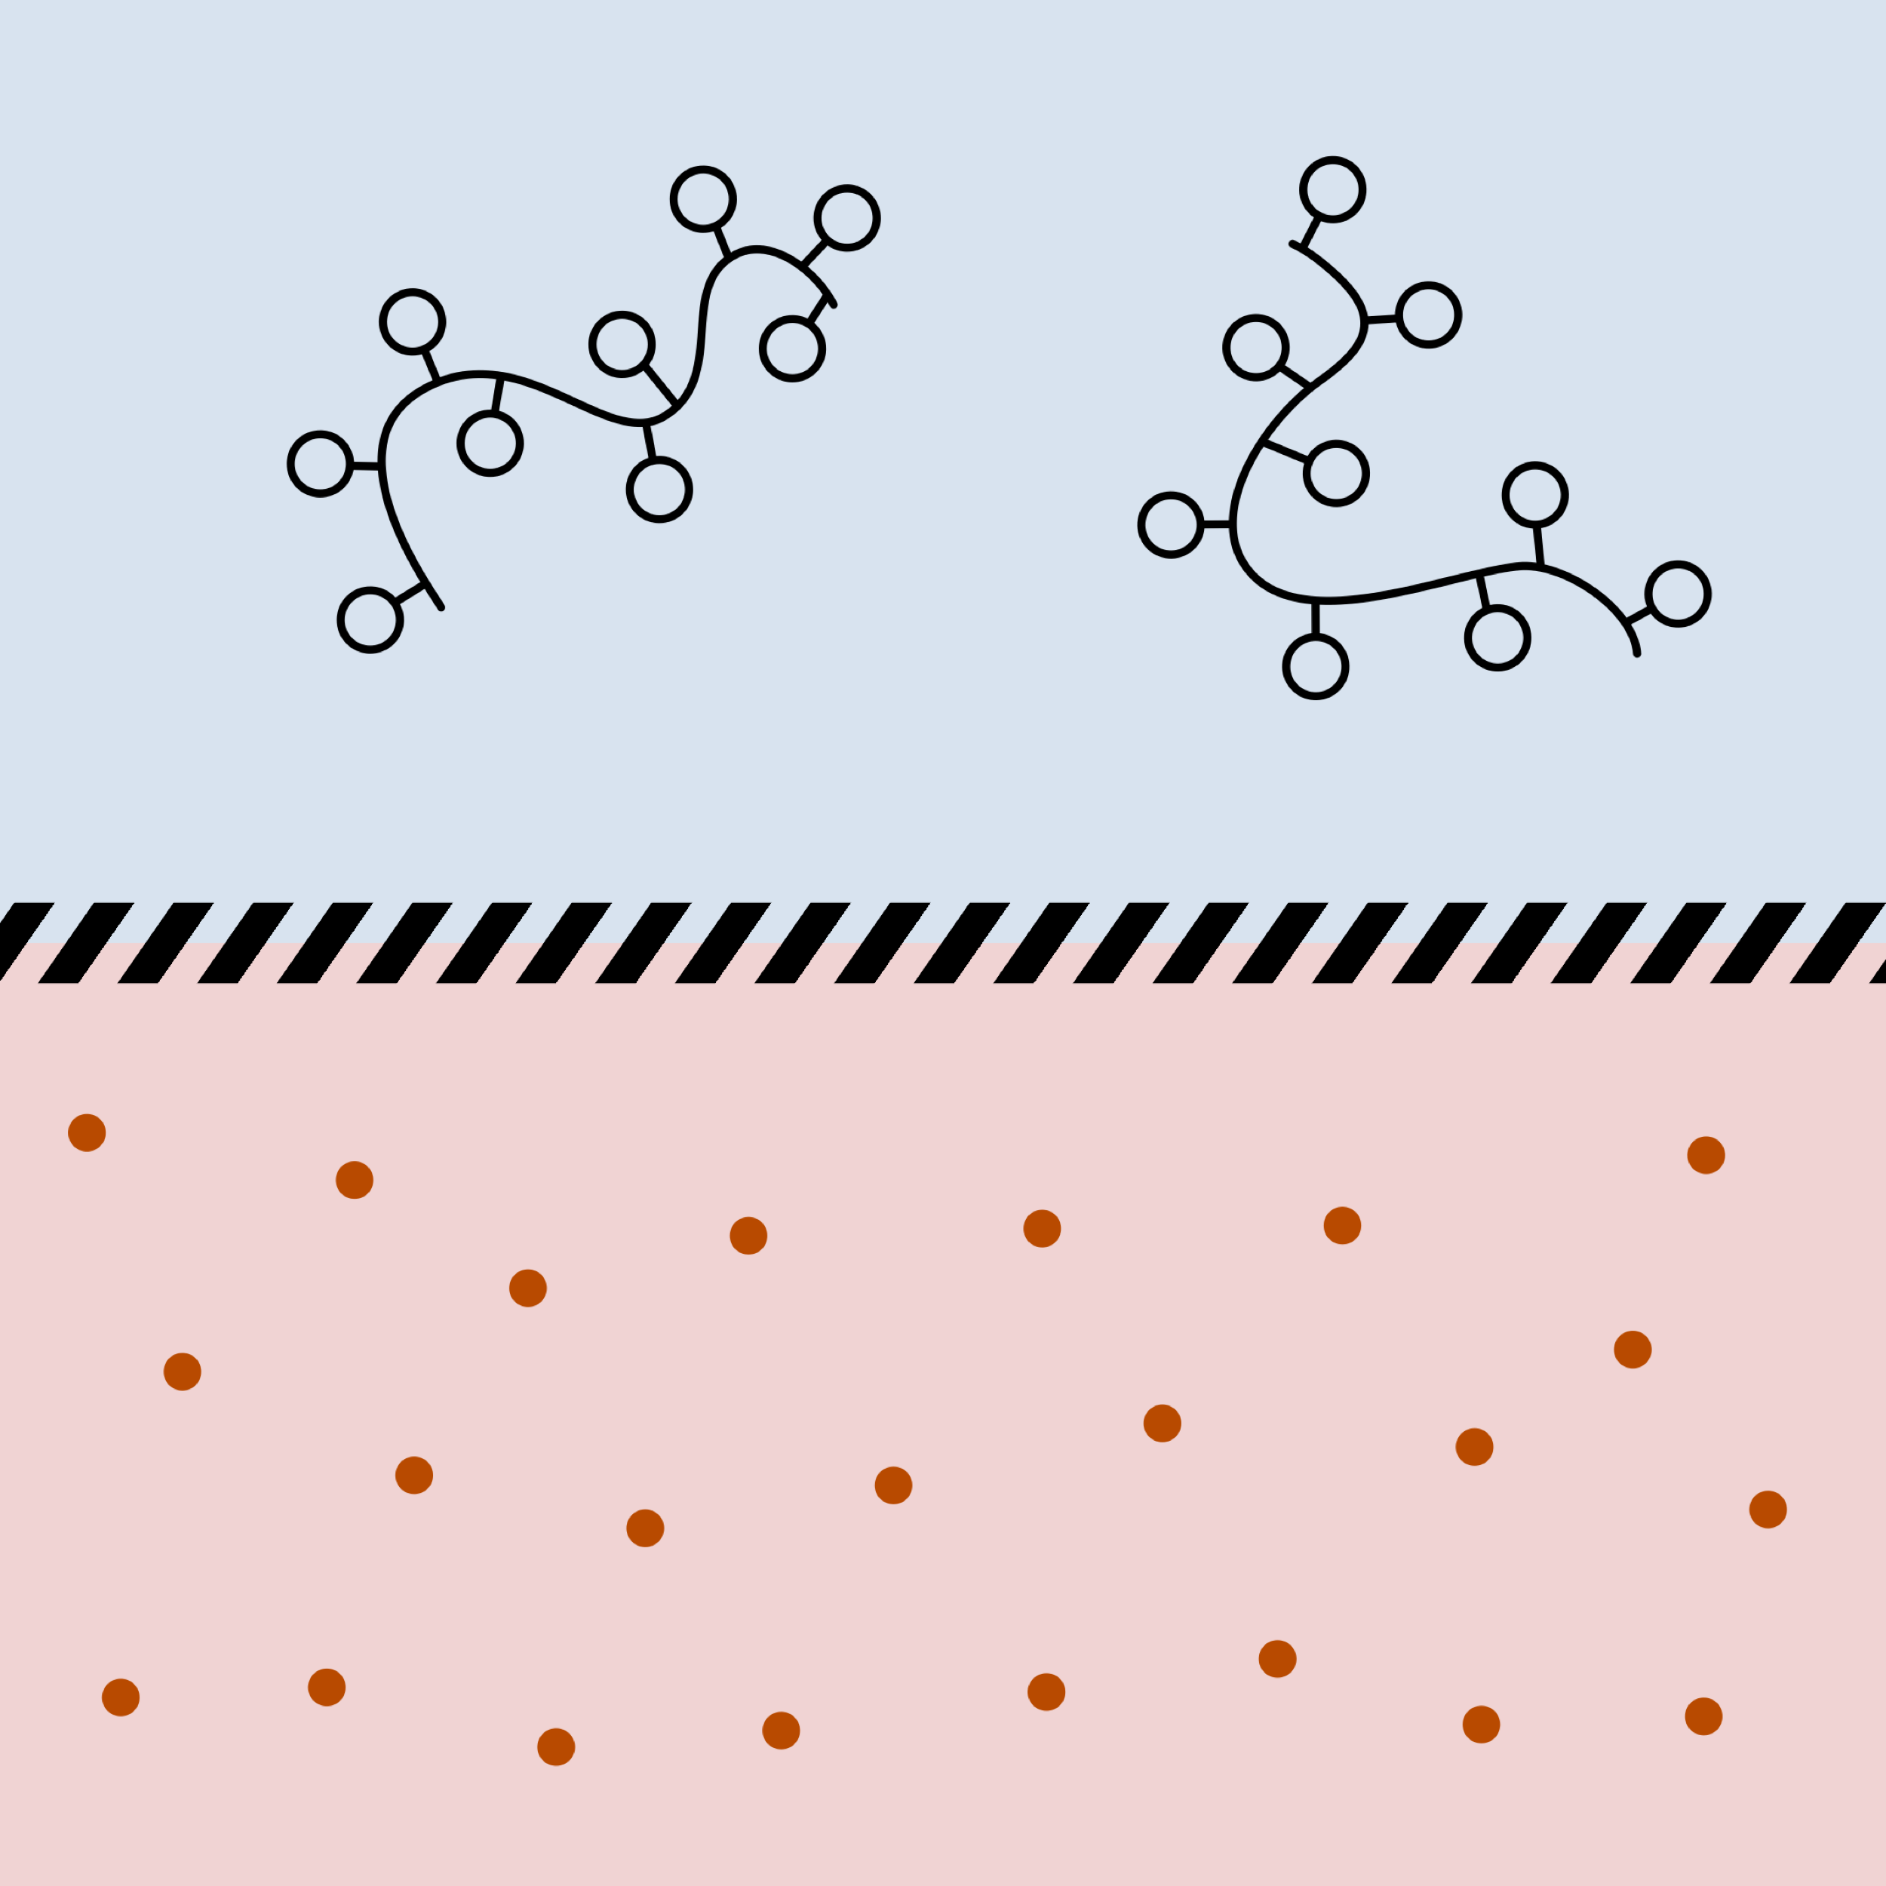
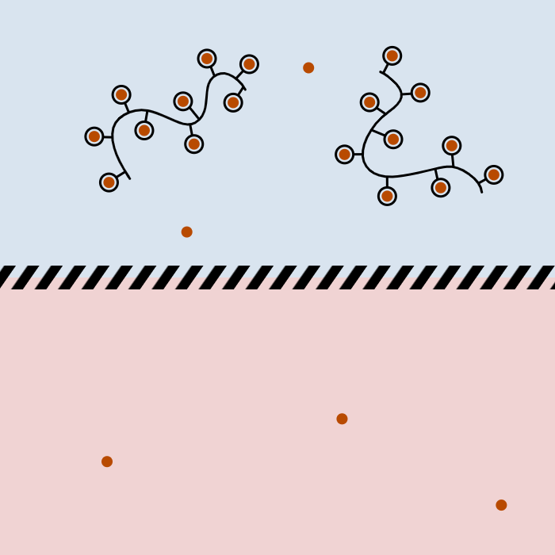
Scientific rationale: use of chelating colloidal perfusion fluid
Association of biopolymer and ultrachelating compounds
Advantages
MEX-CD1: Chitosan-DOTAGA
Before dialysis
After dialysis
Low toxicity: No direct contact
Nanohybrids are too large to cross the membrane
_____________________
High efficiency
Recognized chelates
High surface/volume ratio
_____________________
Safe nanohybrids
Platforms already used in clinic
_____________________
Versatility
Perfusion fluids adapted to different types of dialysis and different metals
No diffusion large molecules
Dialysate
Diffusion small molecules
Membrane
Blood

Slide 14
IP: solid protection and freedom to operate
5 patents filed
Patent | Priority | Title | International publication
MX1: FR 17 63090 | 22.12.2017 | Device for maintaining metal homeostasis, and uses thereof | WO2019/122790 27.06.2019
MX2: FR 19 00699 | 25.01.2019 | Dispositif d’extraction conjointe d’un cation métallique et d’une molécule cible | WO2020/152426 30.07.2020
MX3: FR2004406 | 04.05.2020 | Dialysis system for the treatment of sepsis | /
MX4: FR2008022 | 29.07.2020 | Implantable dialysis device for extracting circulating molecules from cerebrospinal fluid and/or interstitial fluid | /
MX5: FR2007997 | 29.07.2020 | Polysaccharide with a physiological pH-soluble chelating group, and uses thereof | /
Positive FTO MEXBRAIN - 2019 – Plasseraud IP

Slide 15
Proofs of Concept
Ex vivo experiments and Human Blood PoC
Extraction of specific trace metals
Small animals: In Vivo rats experiments
Metal purifications in brain
Large animals: In Vivo Sheep experiments
PoC haemodialysis with MexBrain dialysate
Excellent safety
Evidences of specific Cu, Fe, Pb metal extraction

Slide 16
Competition
CHELATING DRUGS
MEXBRAIN TECHNOLOGY
Toxicity and side effects
Simultaneous extraction of essential metals
Paradoxical neurological deterioration
Slow and limited extraction
High dose toxicity limits extraction potential and speed
Not recommended to 25+ % of patients
Children, elderlies, pregnant women, Chronic Kidney Disease, low compliance
Not adapted to low metal exposure
Specificity and benefit/risk ratio are too low
High specificity
No effect on other essential oligo-metals
No limitation to fast quantitative extraction
No toxicity, continuous extraction possible without side effects
Higher extraction speed
Solution adapted to low metal exposure
Purification and prevention treatments, lead detoxification
Eligible for all patients
Safe for elderlies, children and pregnant women
Vital for Chronic Kidney Disease
Decades of use
Relative administration convenience
Pills, IV, subcutaneous treatments
Dialysis device needed
But only small dialysate volumes are required

Slide 17
Development plan
2019
2020
2021
2022
2023
2024
Formulation
Dialysate
Preclinical PoC
Production
CE Marking
Copper
Wilson
5 M€
Preclinical studies
First in Man (inc. PoC)
Formulation
Dialysate
Preclinical PoC
Iron clinical preparations
Iron
1 M€
Fe preclinical studies

Slide 18
Financing
With a 5 M€ capital raise
k€ | 2021 | 2022 | 2023 | 2024 | 2025 | 2026
Income | 40 | 50 | 0 | 3 370 | 7 660 | 10 040
Gross margin | 40 | 50 | 0 | 2 696 | 6 128 | 8 032
Expenses | 3 169 | 3 071 | 2 314 | 2 739 | 3 559 | 5 119
Incl. preclinical | 270 | 300 | 300 | 300 | 300 | 300
Incl. clinical | 1 415 | 850 | 255 | - | - | -
EBIT | - 3 129 | - 3 021 | -2 314 | -43 | 2 569 | 2 913
Tax credit / IS | 912 | 907 | 605 | 605 | - | -
Net income | -2 217 | -2 114 | -1 709 | 562 | 2 569 | 2 913
Op. Cash Flow | -3 129 | -3 021 | -2 314 | -43 | 2 569 | 2 913
Funding (incl. CIR and subsidies) | 3 195 | 4 579 | 1 407 | 605 | - | -
Cash | 396 | 1 854 | 947 | 1 508 | 4 077 | 6 990
MexBrain's ATU revenues begin in 2024 (EU only, acute indications)
No clinical expenses after Wilson's first clinical trial
5 million euros of equity in two tranches (2021 and 2022)
Cash burn of 190k euros per month (Q4 2023)

Slide 19
Funds
Company
Capital
MEXBRAIN S.A.S.
Created in 2017
4 FT employees
AK Love Money: 433 k€ (inc. 125 k€ invoice Pulsalys)
Confirmed grants and turnover : +300 k€ / 2A
OC BPI French Tech Seed : 240 k€
Expenses projection

Slide 20




MEXBRAIN in a nutshell
Patented technology
Proof of Concept
Breakthrough technology
5 patents (2017 & 2019 & 2020) 1 positive FTO
cGMP launch: first product MEX-CD1
Preclinical PoC established (sheep)
Clinical PoC study – mid-2021
Partnerships
Market / perspectives
CHU H. Mondor
INSA-UCBL-CNRS
CHU Lariboisière
CRMR Wilson-HCL
VetAgro Sup
U. Bordeaux
ENS Lyon
Becoming world leader in metal extraction
Strong societal impact
First quick and simple human Proof of Concept with Orphan indication: Wilson’s disease
Sepsis indication as largest market
Targeting billion-dollar market
Funding needs: 5 M€ over to reach First in Man PoC

