Slide 2
PROBLEMS DERIVED FROM INDUSTRIAL NEEDS
PROBLEM #1 SCALABILITY
Traffic needs are unpredictable
Current network technologies do not provide flexible scaling of resources, so mobile operators typically over-dimension their networks, which entails high upfront investments
SOLUTION:
Virtualized 4G/5G NGV with GW dynamic relocation to enable edge data processing to avoid congested links or network with constrained connections.
Notes:
IIoT traffic requires guaranteed network resources, but traffic needs are unpredictable. So it’s hard to estimate the capacity needed to meet the actual demand and deliver end-to-end traffic priorities. Besides, current network technologies do not provide flexible scaling of resources: adding extra capacity at the core network takes at least 3-6 months, so mobile operators typically over-dimension their networks for peak traffic and the growing traffic volumes, which means high upfront investments (€15 Million annually) and lower Return of Investment (ROI) because of the idle network capacity.

Slide 3
PROBLEMS DERIVED FROM INDUSTRIAL NEEDS (cont.)
PROBLEM #2 TRAFFIC SHAPING
IoT/IIoT, industrial Internet (Industry 4.0) and media delivery traffic entail different requirements of latency, bandwidth/data rate, time synchronicity, reliability and security, but current mobile network traffic shaping is not effective.
SOLUTION:
Network slicing for traffic isolation and enhanced Quality of Service

Slide 4
CUMUCORE
Unique 4G/5G mobile packet core that solves the problems imposed by IIoT and Industry 4.0 communication requirements: Rapid installation and low footprint requirements and ultra-reliable for industrial environments with limited network resources.
Mobile core 4G/5G
UDM
PCF
Public Internet
Or Private LAN
AMF
SMF, UPF
IoT app server
NB-IOT, CAT-M
SCF
Media Broadcaster
MBMS-GW
BM-SC
Media Server
DATANG
eMBMS

Slide 5
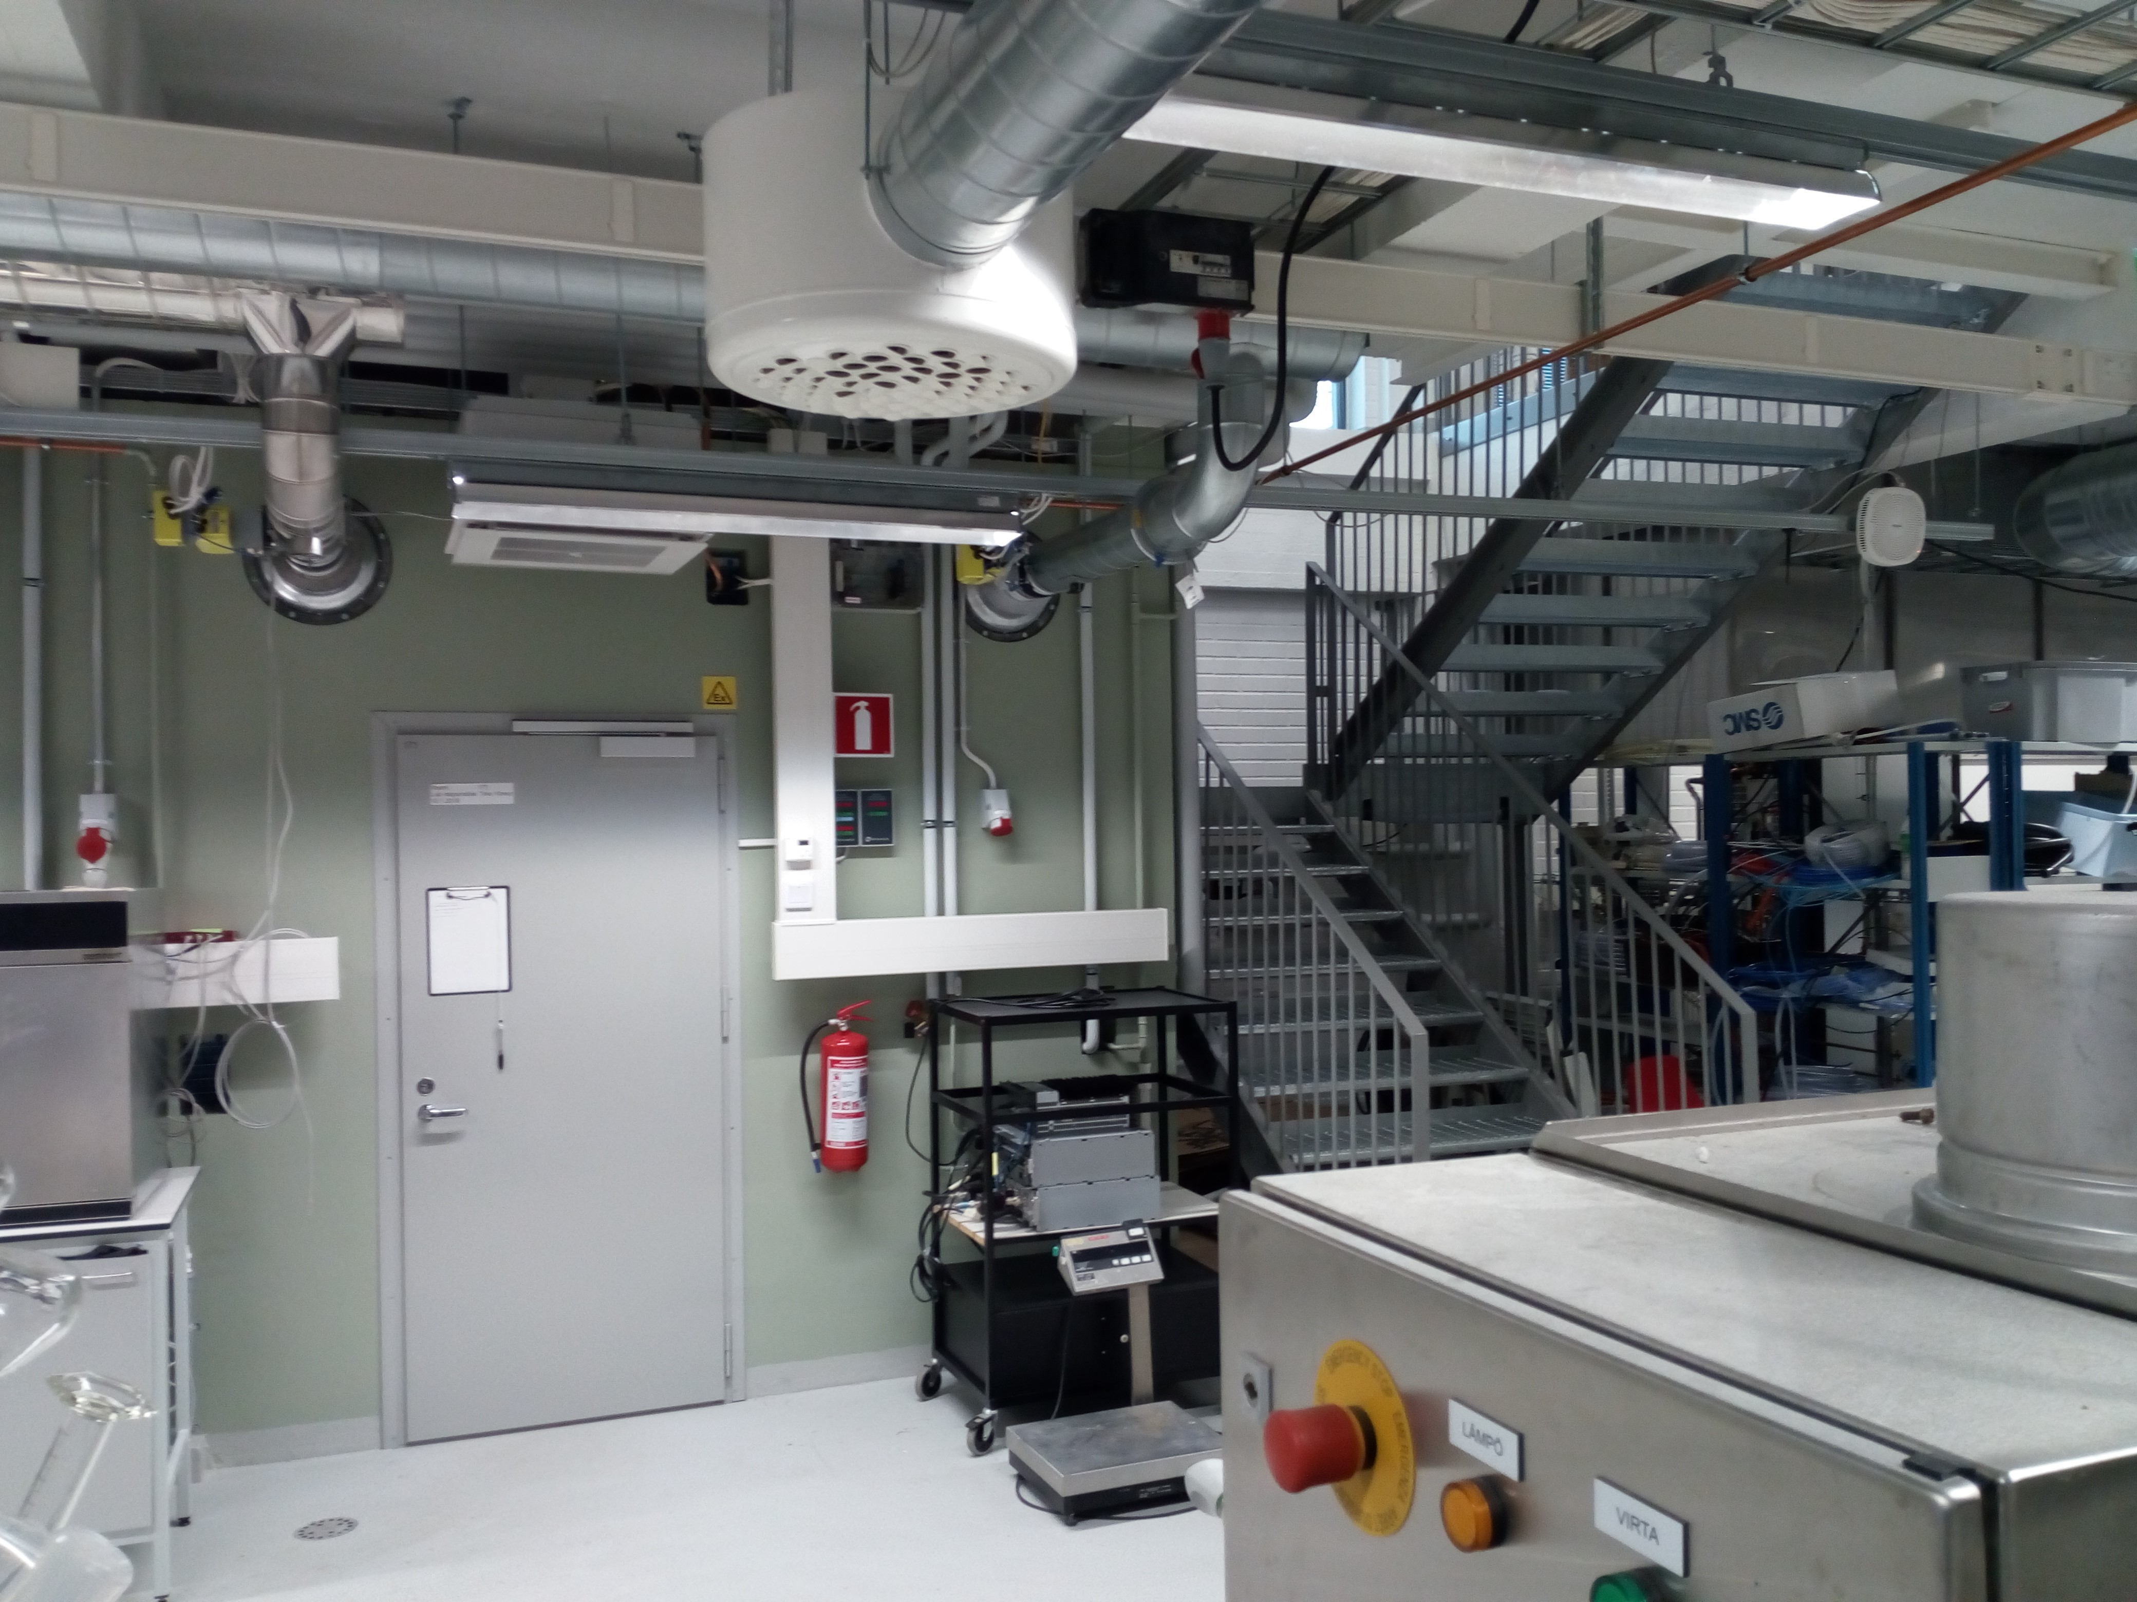
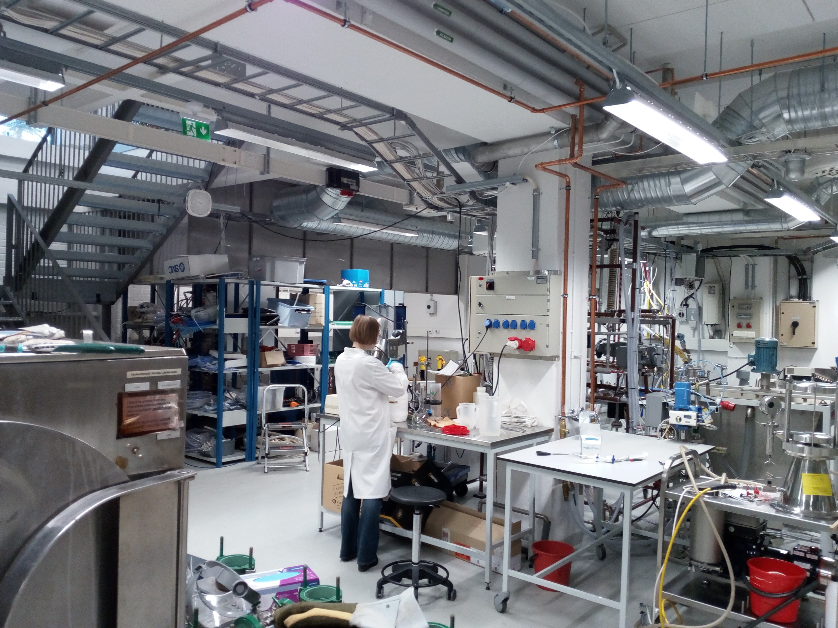
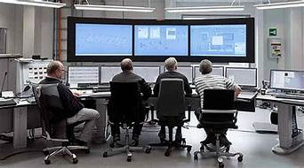
INDUSTRIAL FACTORY DEPLOYMENT

Slide 6
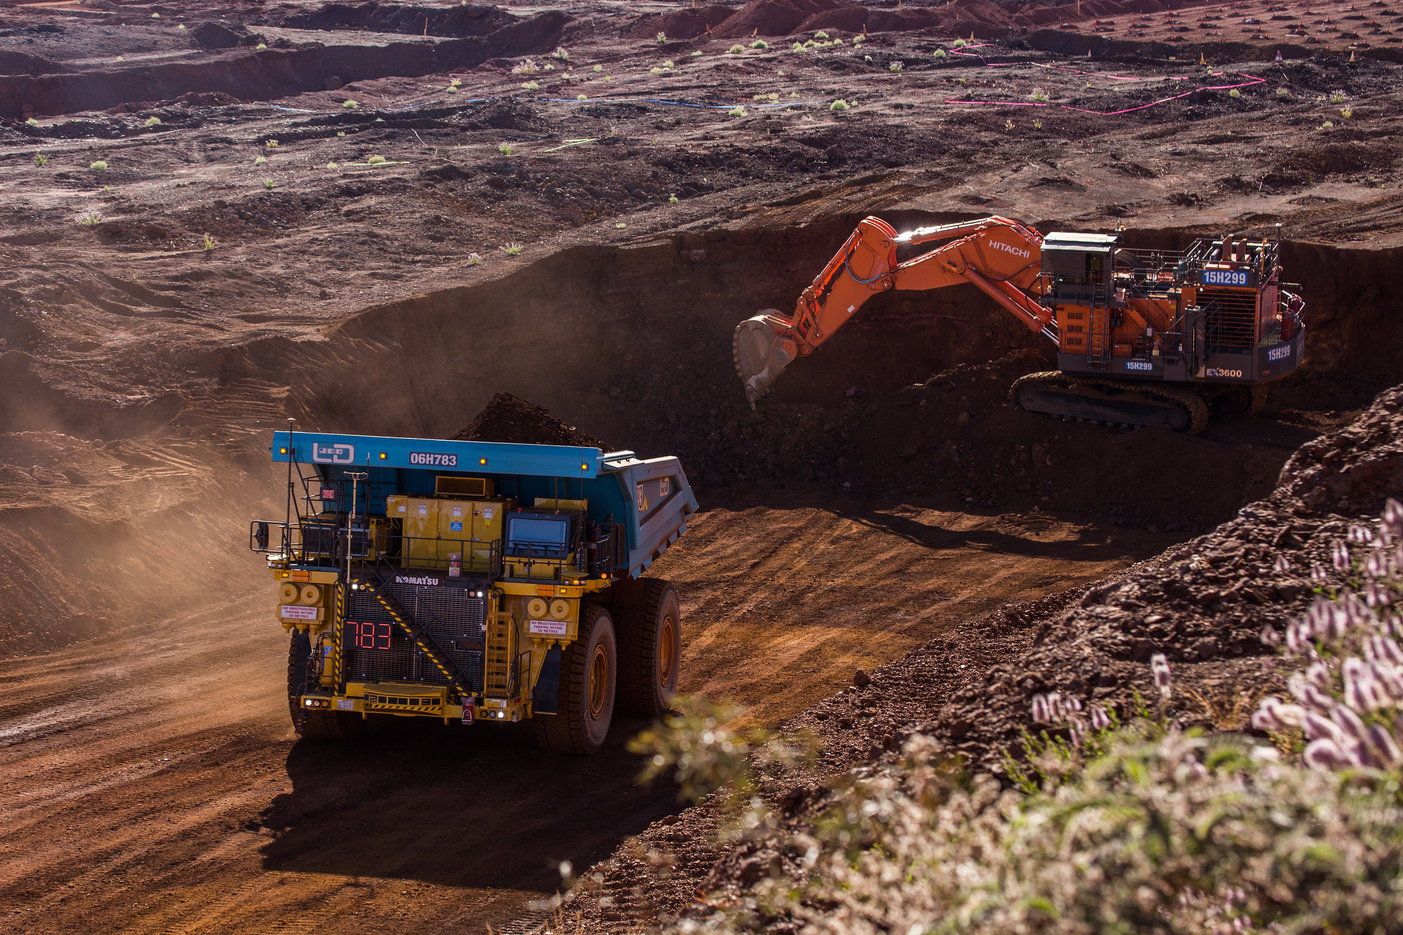
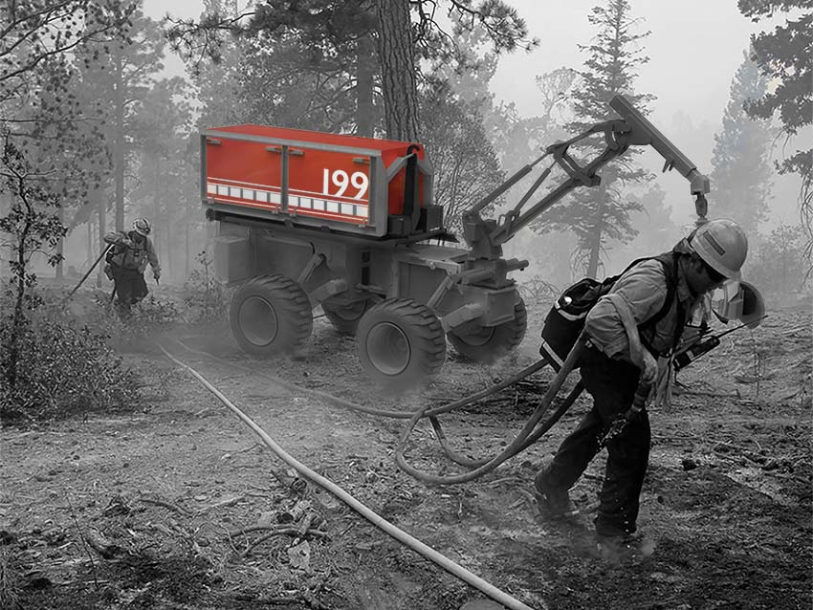
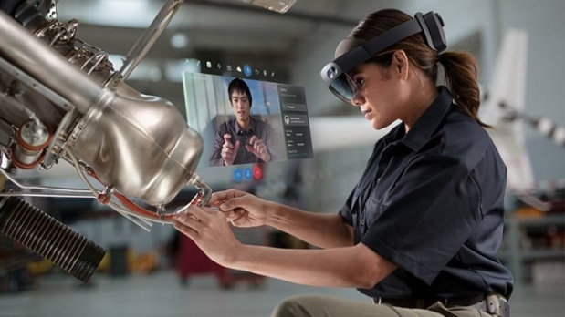
USE CASES

Slide 7
HOW CUMUCORE WILL DISRUPT THE 5G INFRASTRUCTURE MARKET
Features
Virtualized cores
Hardware cores
Scalability/Flexibility
High
High
Limited
✓
✓
~
SDN integration
SDN mobile backhaul and network slicer
Partial – Not complete for network slicing
No
✓
~
X
Traffic shaping efficiency
High (50% gain,
> 40 Gbps)
Medium
Low
✓
~
X
Uptime / Reliability
99.9999% / 20 years
99.9% / 5 years
99.9% / 1 year
✓
~
~
Industry 4.0 support
Yes
5G-TSN integration
Partial compliance with industrial comms.
No
✓
~
X
Notes:
Investment cost – no demuestra si es disruptivo – es un USP
Set up time – se hace solo una vez
Enable user-centric services - quitar

Slide 8
UNIQUENESS
Dynamic scaling of infrastructure resources
Efficient traffic shaping: > 40 Gbps
Optimal content delivery: 50% gain
Large audience mobile streaming performance
Affordable deployments: up to 75% reduction in CO₂ emissions
Flexible as a service/pay as you go model
Annual subscription fees
Notes:
Investment cost – no demuestra si es disruptivo – es un USP
Set up time – se hace solo una vez
Enable user-centric services - quitar

Slide 9
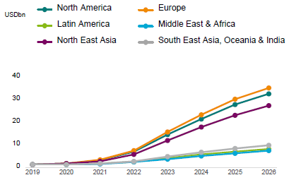
ADDRESABLE REVENUES PER REGION
TAM = €98.5 Bn
SAM = €3.3 Bn
SOM = €33 M

Slide 10
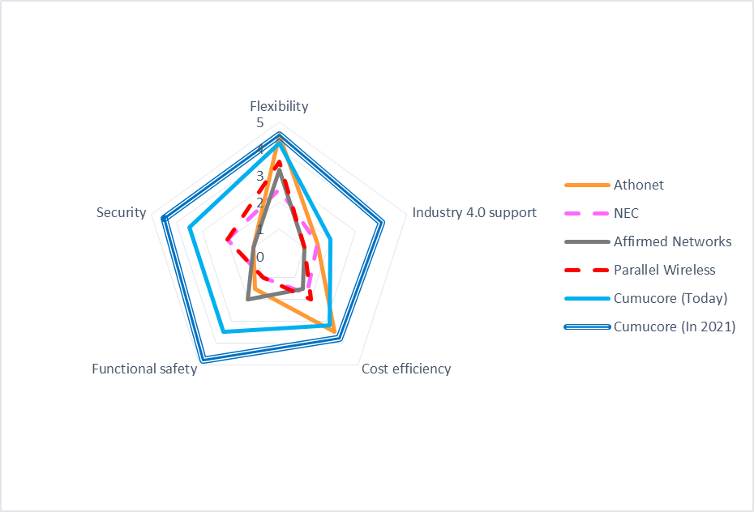
COMPETITORS LANDSCAPE
Notes:
Athonet, an Italian company that provides a complete software-based mobile packet core solution for centralised or highly distributed edge-cloud deployments in Private LTE, CBRS, Challenger Telcos, Tier 1 Operators, Governments and mission critical apps. Their BubbleCloud solution includes vEPC, LTE Broadcast (eMBMS) and NB-IoT. It is our biggest competitor, however they only support 4G virtual cores and we also provide a flexible pay-as-you-grow business model, which is quite appealing for operators to reduce CAPEX.
NEC is a company based in Tokyo (Japan) with more than 100 years of experience. The Telecom Carrier segment provides network infrastructure such as core network, including NFV and SDN solutions. However, their business strategy focuses on developing a Cloud-RAN to virtualize the functions of mobile base stations.
Affirmed Networks, founded in 2010 and headquartered in Massachusetts (US), they offer a cloud-native mobile core product (virtualized EPC and network slicing) deployed in 85 networks worldwide to reduce time-to-market and cut down operational costs of mobile operators. However, they lack our eMBMS architecture and thus they cannot develop optimized media broadcasting mobile use cases.
Broadcom acquired Brocade in 2016, an American technology company specialized in data and storage networking products that collaborated in the development of the OpenDaylight Project, an open source SDN and NFV project. After being spun off to Lumina, the project has seen the interest fallen off.
Lime Microsystems is a company founded in 2005 and based in UK specialised in field programmable RF (FPRF) transceivers, SDR solutions, IoT gateways and mobile base stations for the next generation of wireless broadband systems. Their focus is put on building boxed products that can be configured as wireless gateways, base stations and even entire wireless networks, including all global variants of 2G, 3G (CDMA, HSPA), 4G (LTE) and IoT (LoRa). However, they don’t support 5G and Industry 4.0 communication standards (TSN). Besides, their business model is based on crowdfunding campaigns and the open source movement for Software-Defined Radio, with limited clients (EE, part of British Telecom).
Parallel Wireless is an U.S.-based company challenging the world’s legacy vendors with the industry’s only unified ALL G (5G/4G/3G/2G) software-enabled and cloud-native OpenRAN network architecture, delivering substantial cost savings to mobile operators for building or maintaining their networks. Among their customers, they count on Telefonica, BT and Vodafone. Although they support a virtualized, distributed core solution for network sharing, no Industry 4.0 requirements and use cases are supported.

Slide 11
BUSINESS MODEL
HARDWARE PROVIDER
SYSTEM INTEGRATOR
MANUFACTURING
& SMART FACTORIES
MICRO AND SMALL
MOBILE OPERATORS
NETWORK PROVIDERS

Slide 12
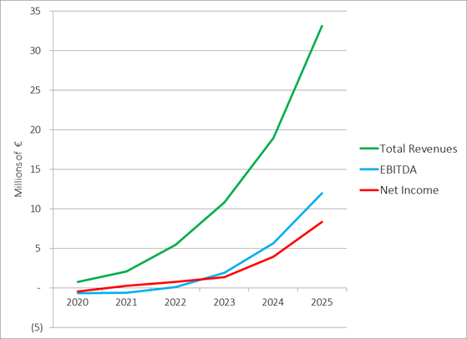
GROWTH PREDICTION
CLOUD LICENCING
Pay as you go
REVENUE
MODEL
Annual subscription
Consulting services

Slide 13
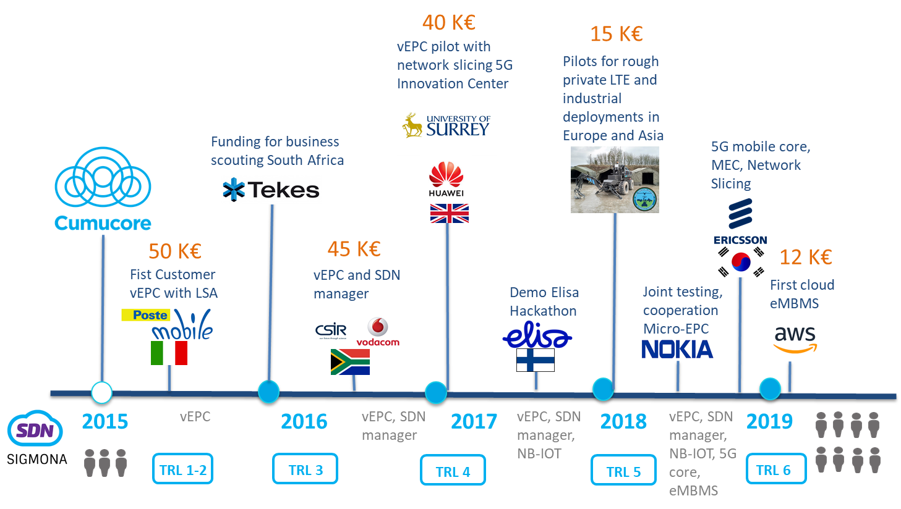
HOW WE GOT HERE

Slide 14
CURRENT FINANCING ROUND
PLATFORM ADAPTATION TO INDUSTRIAL COMMUNICATIONS
MVP EVOLUTION TOWARDS INDUSTRY 4.0
DEMONSTRATION AND VALIDATION WITH END USERS
REGULATORY COMPLIANCE, COMMUNICATION
AND MARKET UPSCALING
PROJECT MANAGEMENT
Notes:
This slide can be a combination of the financial forecast ( a graph) and the explanation of how the requested funding will be used, especially the grant in your case and also how you will attrack teh additional funding needed for teh commercialization strategy

Slide 15
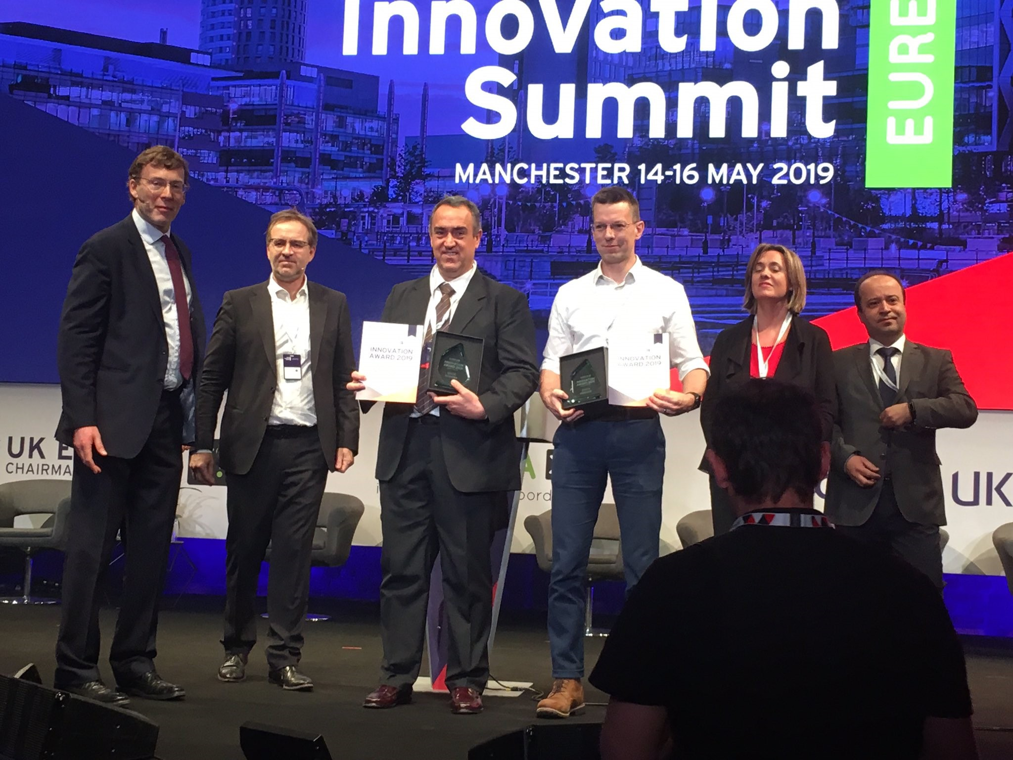
CUMUCORE TEAM
SDN Mobile Backhaul part of MEC and network slicing
5G compliant lice management (NRF, NSSF)
SDN backhaul: European Innovation Award
EXPERTISE AND INNOVATION
MORE THAN
15
YEARS OF
COOPERATION WITH INDUSTRY PARTNERS INCLUDING OWN PATENT
MEVICO.org
METRICS-itn.eu
SIGMONA.org
TAKE-5G.org
SDN backhaul for mobility management
(WO 2015150638 A1)
SSICLOPS.eu
Notes:
In this slide we shoudl present the team, highligting the strengs and capabilities to implement the project and also awards, achievements

