Slide 1
Redrose Developments Ltd
Sustainable, scalable supply chain to meet growing global demands

Slide 2
Global demands for seaweed is increasing
+10% annual increase
Food - Feed – Fertilisers - pharmaceutical – cosmetic - nutraceutical

Slide 3
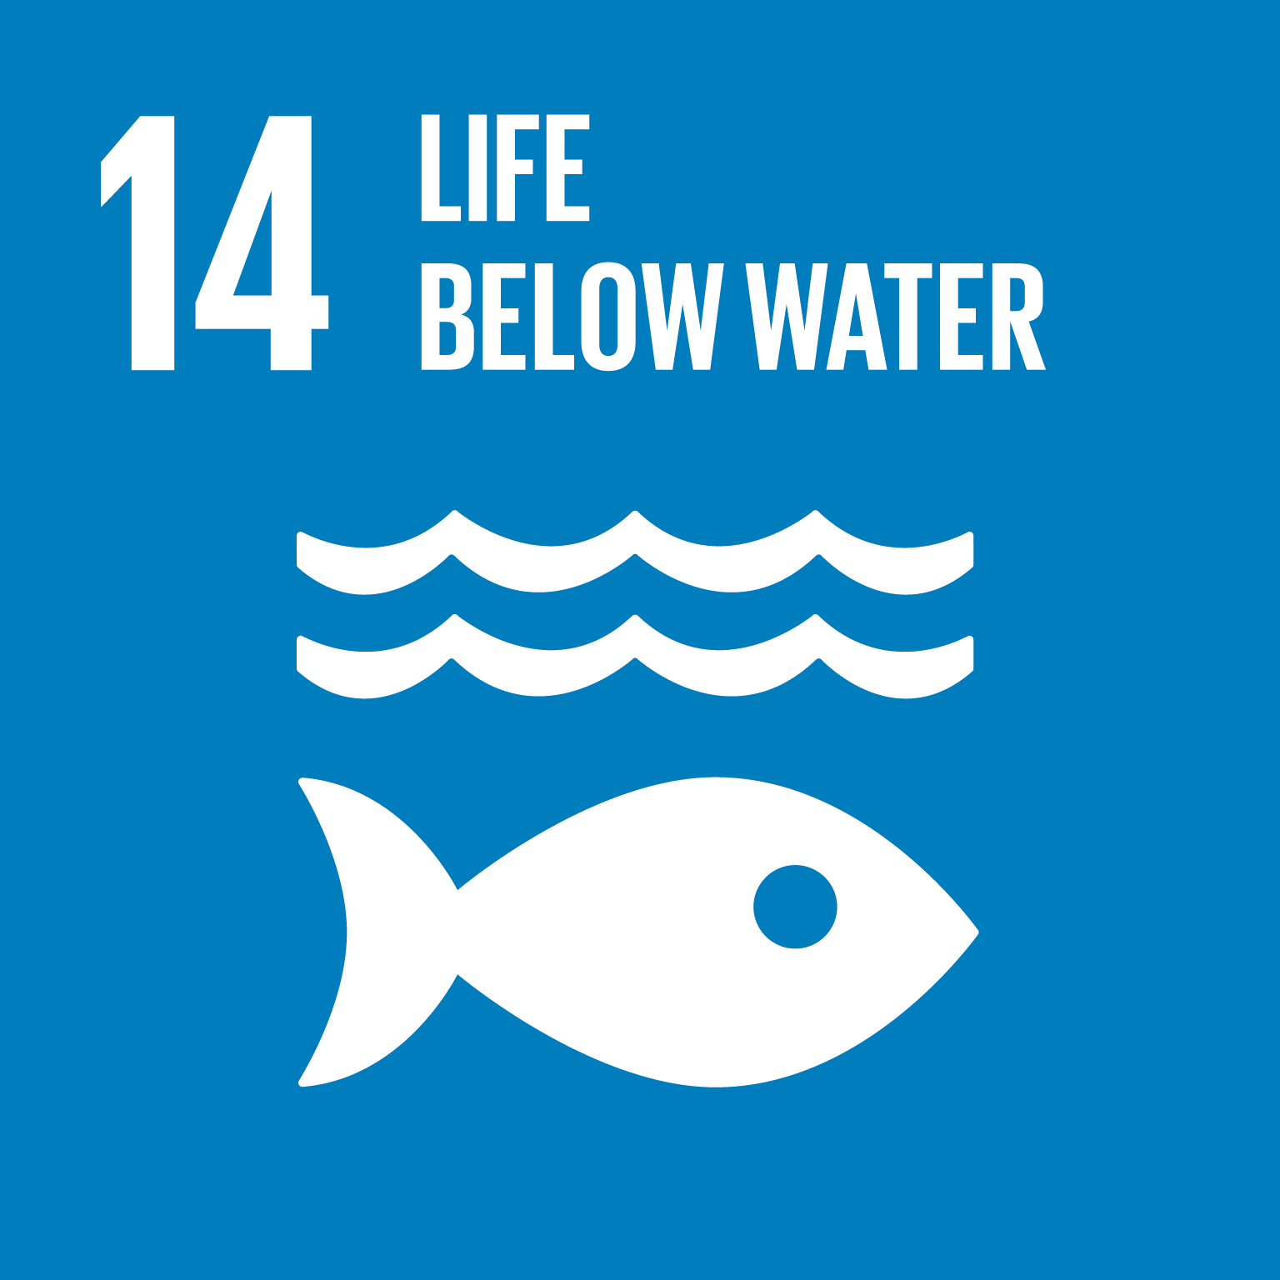
The Problem
Increasing demand means business as usual is unsustainable
Pressure on aging Harvesters
Over 90% of Irish Seaweed sales is wild harvest
Lack of resource management
Depleting wild stock

Slide 4
Considerations
Seaweed decays within hours
Todays production means 70 % loss of raw material
Cultivation is expensive
Processing Bottleneck

Slide 5
The Redrose Solution
Close to source processing retains Minerals and nutrients
Sustainable harvesting
Producing mineral and nutrient rich liquid and solid
Multiple extractions - Circularity
Franchise model offering scalability and flexibility
100 % raw material output through new production method

Slide 6
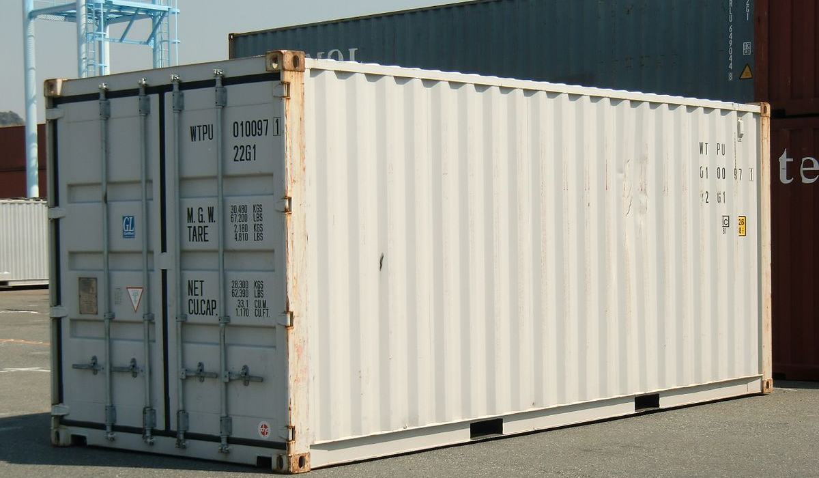
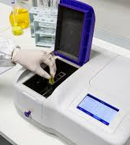
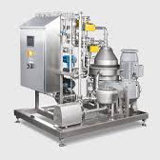
Modulated processing systems
This Photo by Unknown Author is licensed under CC BY-SA

Slide 7
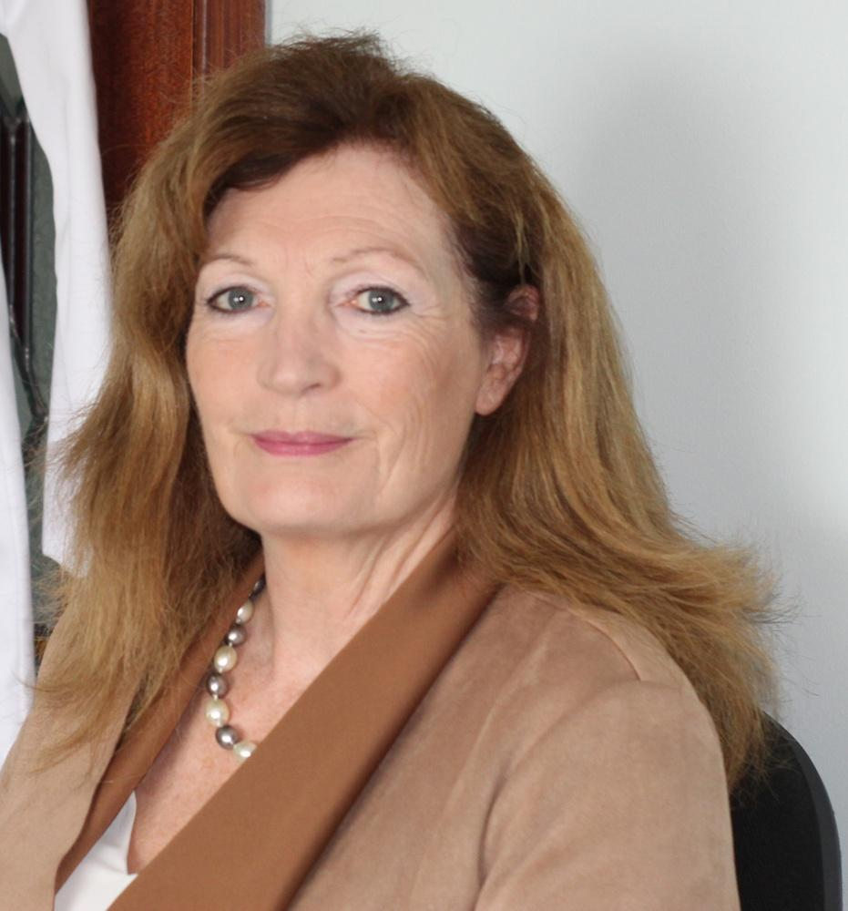
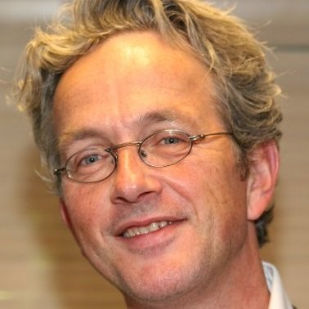
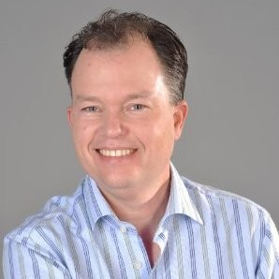
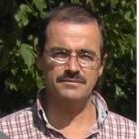
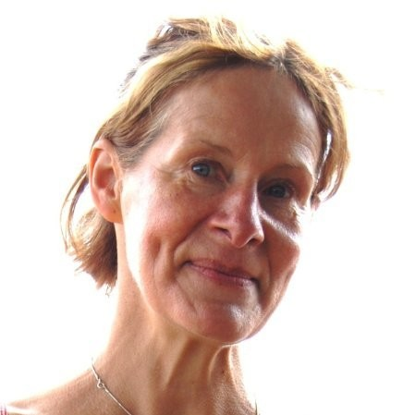
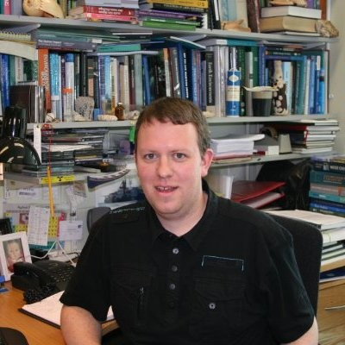
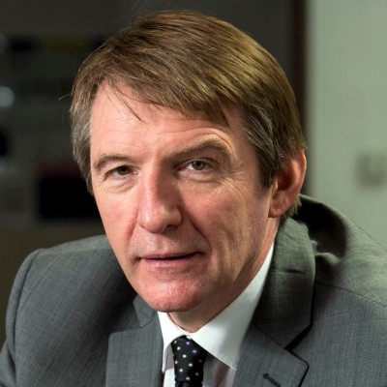
Founding Team
Ann Ruddy Founder & CEO
Knowledge and expertise of seaweed cultivation and processing
Sven Hars Partner CFO
Franchise Expert, Branding and
Marketing Expertise
Vincent Bijman Partner and Co-creator of Seaweed Fertilizer Product
Expert Advisors
Rn
Ross Campbell - Cybercolliods
Karin Dubsky – Trinty
Liam Morrison - NUIG
Andrew Smith - Greenbackers

Slide 8
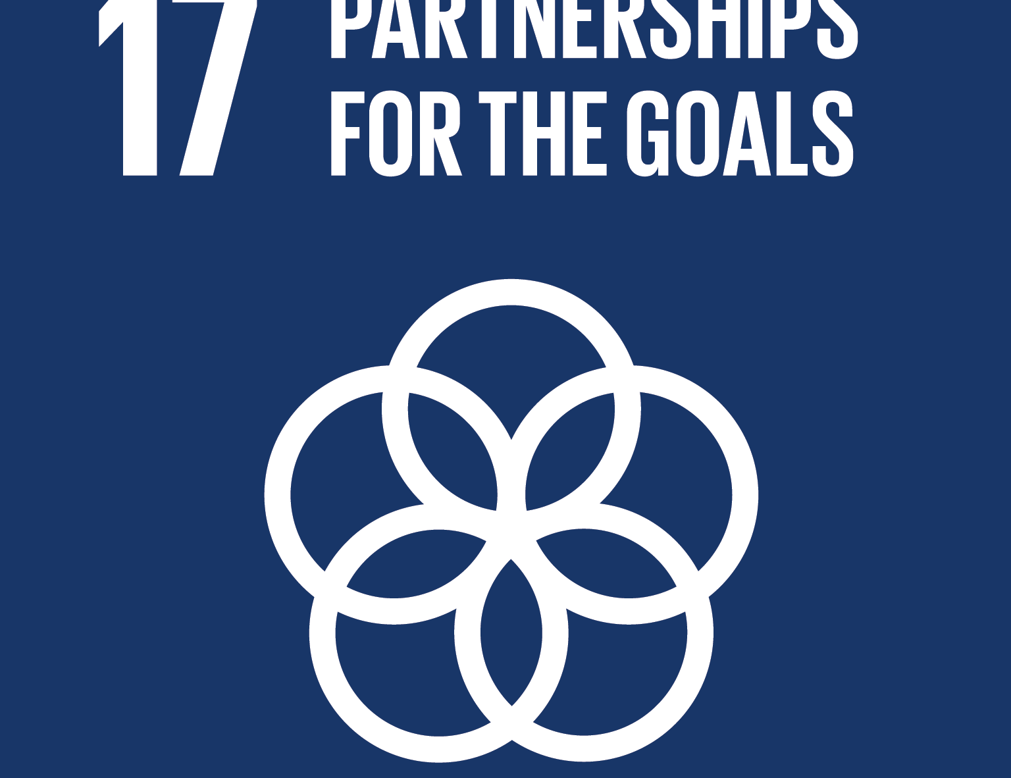
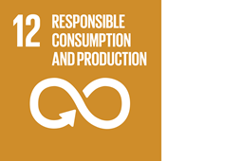
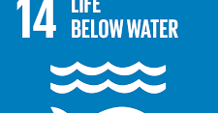
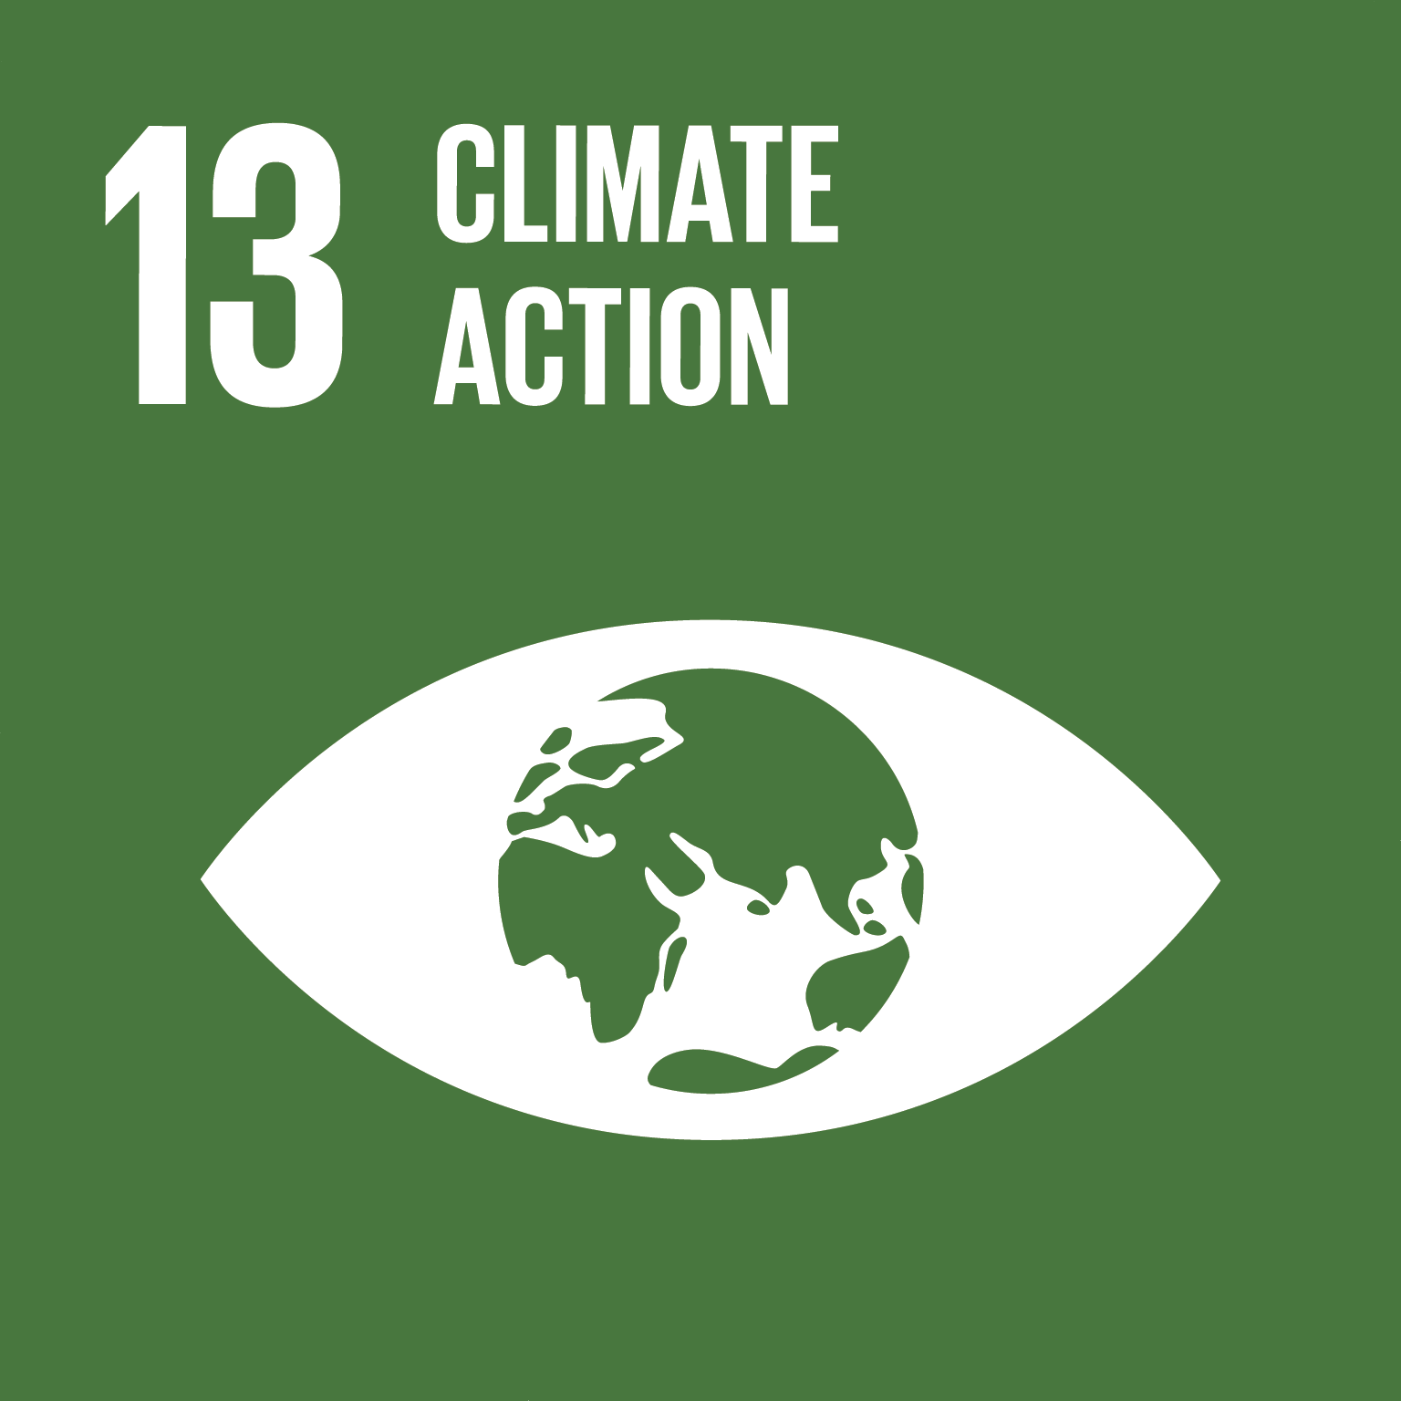
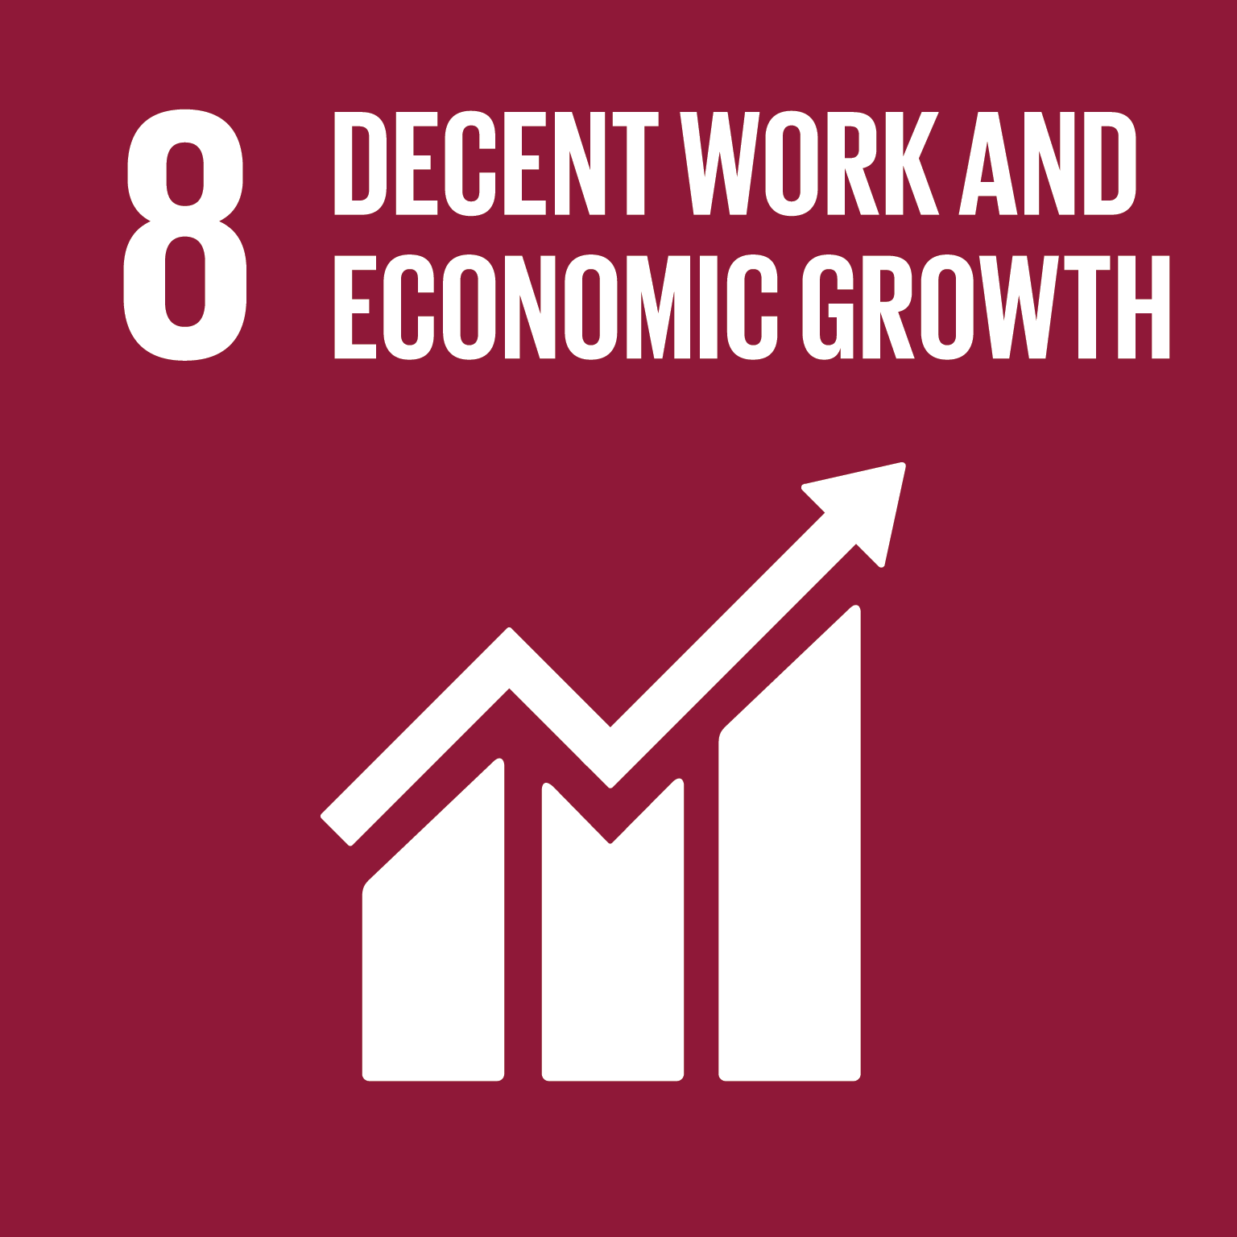
Seeing the Big Picture
Deep tech Industry 4.0 – supply chain for carbon neutral - compostable – 3D print friendly
Healthy – Organic – Sustainable – Profitable – Environmental –Social Responsibility –scalable – accessible-

Slide 9
Financial model for Franchisee
FRANCHISEE P & L
REVENUE | Euro | 364,500 | 455,625 | 506,250
Total operational costs | Euro | 364,500 | 455,625 | 506,250
Net income franchisee | Euro | 64,075 | 132,694 | 168,148

Slide 10
Revenue Streams
Franchise fees &
Stock sales
Number of franchisees
Y1: 1
Y2: 3
Y3: 8
Y4: 12
Y5: 20
Total capital expenses |  | 310000 | 610,000 | 10,000 | 10,000 | 10,000
Total Operating Expenses |  | 240,262 | 494,153 | 789,020 | 1,030,780 | 1,114,300
Net Revenue |  | 261,000 | 1,566,000 | 4,176,000 | 6,264,000 | 10,440,000
Net Earnings |  | -351,489 | -202,595 | 323,089 | 660,553 | 1,791,631

Slide 11
Go to Market Strategy
Liquid
Fertiliser
Soil conditioner
Solid
Animal Feed
Food
Low value
Biopolymer
Biofuel

Slide 12
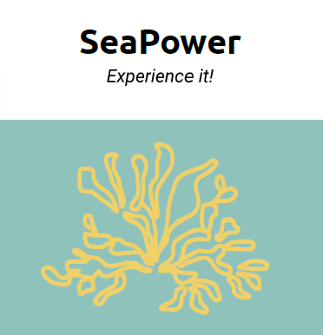
The Client
Expressions of Interest
Accelerator Programs
BlueBioValue

Slide 13
THE GLOBAL MARKET
Company | Sustainably processing wild stock | Seaweed cultivation | Creating multi products without harsh Chemicals | Sustainable processing methods
Cargill | X | √ | X | X
Dupont | X | √ | X | X
BioAtlantis | X | X | X | X
Acadia Group | X | X | √ | X
Marigo | X | X | √ | X
Leili Group | X | √ | √ | X
Redrose | √ | √ | √ | √
A

Slide 14
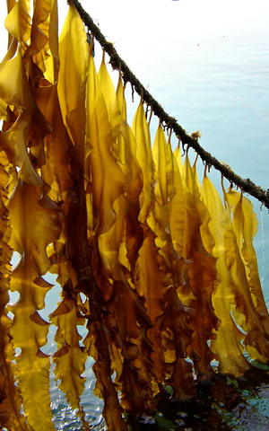
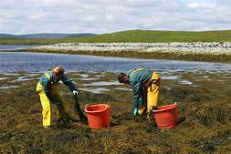
Key Milestones
Seaweed
Cultivation
Liquid Extraction Process
Pilot unit
30 units 2026
Two additional units
Roll out of Franchise
Seaweed aquaculture licenses
Granted in 2018
2020
2021
2022
2023
2026

Slide 15
Financial
Investment raised €250,000
Required to reach 2 units €1.8m
Profit forecast year 3
Return on investment year 5

Slide 16
€1.8m Spend over five years

Slide 17
Sustainable, scalable supply chain to meet growing demands
Thank you
Any questions?
annruddy.redrose@gmail.com
www.redrosedevelopments.com

