Slide 1
Water and energy efficiency in buildings
SDG11 e-pitch | Sustainable and Smart Cities
Rui Teixeira (CEO) | 8th October 2020

Slide 3
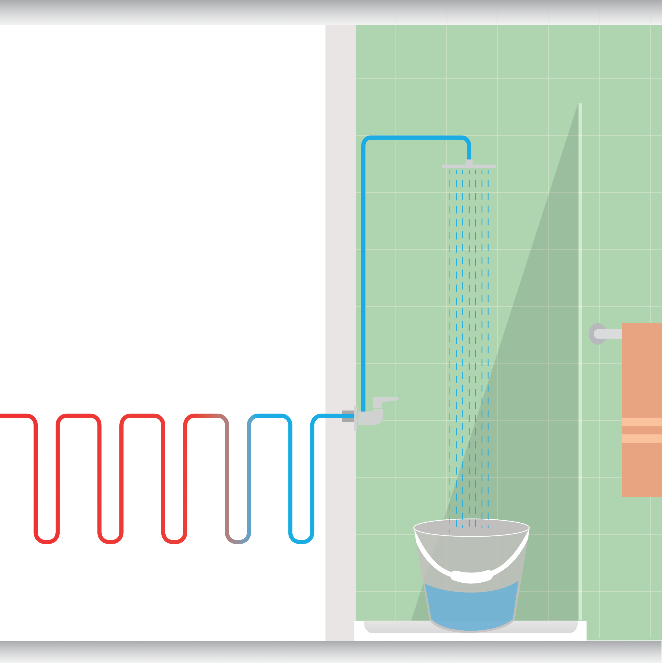
Why?

Slide 4
Problem!

Slide 5
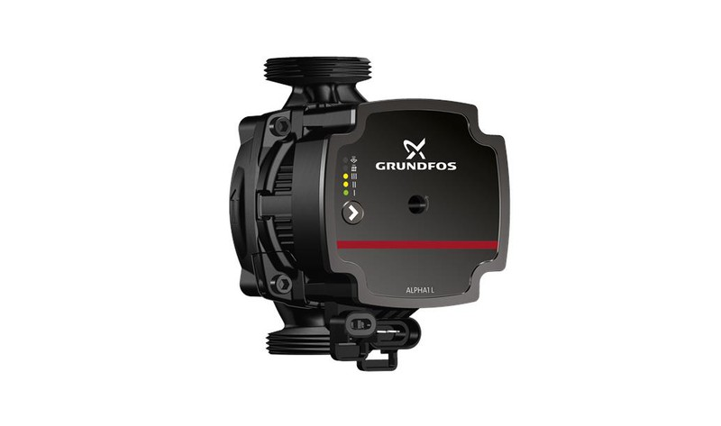

Slide 6
Problem!
WATER HEATING SYSTEM USE
50% MORE ENERGY

Slide 7
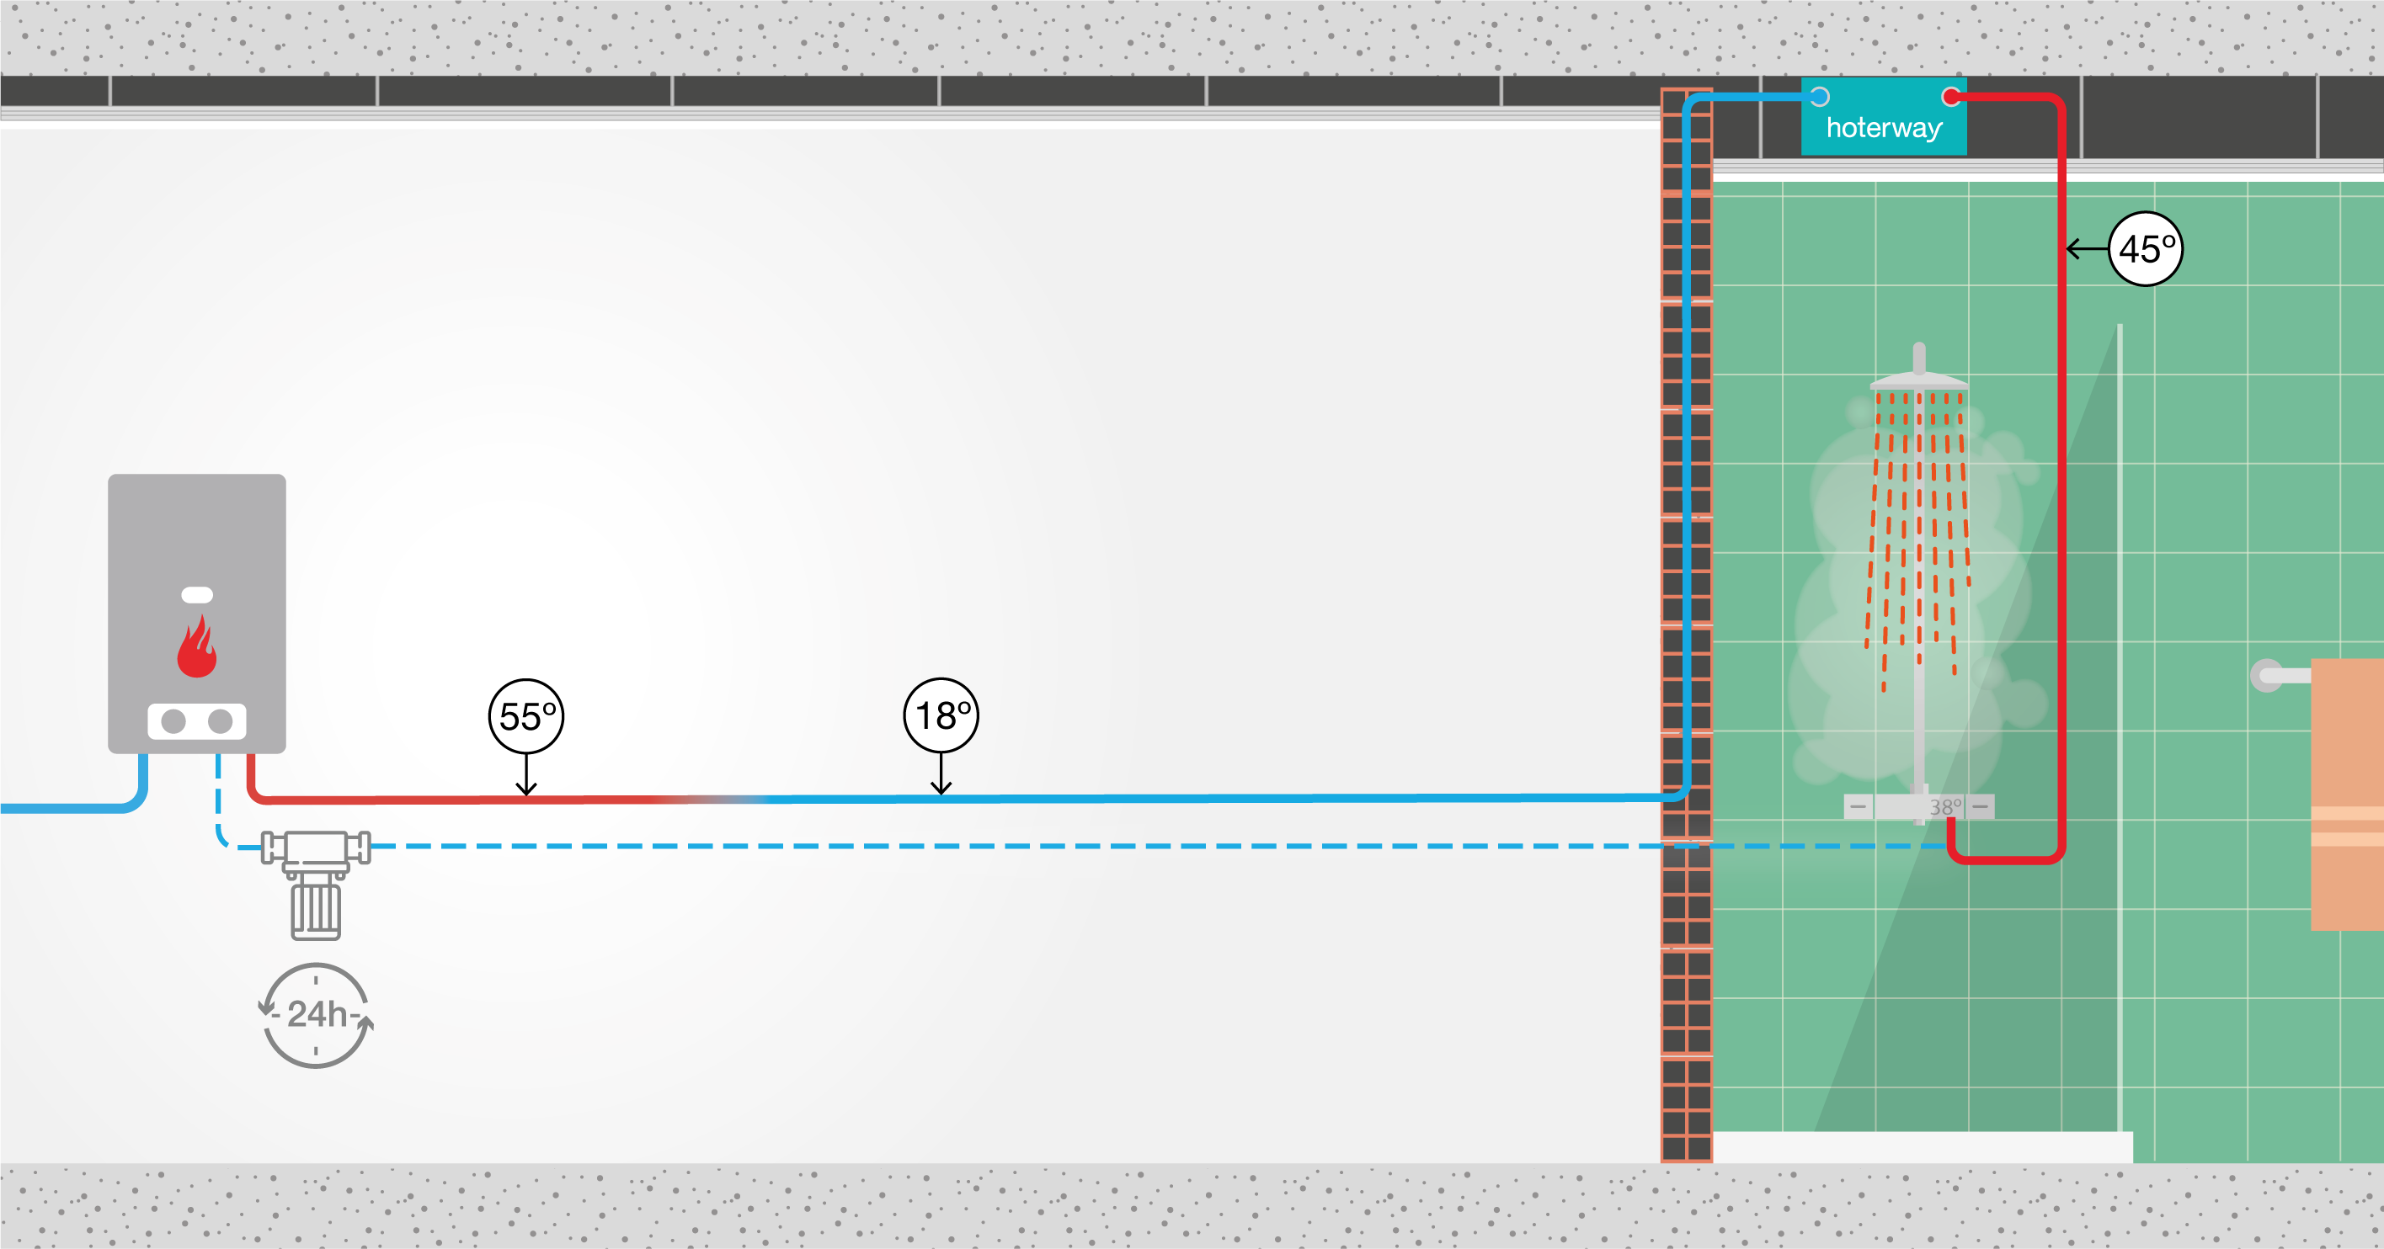
Solution!
Hoterway thermal battery

Slide 8
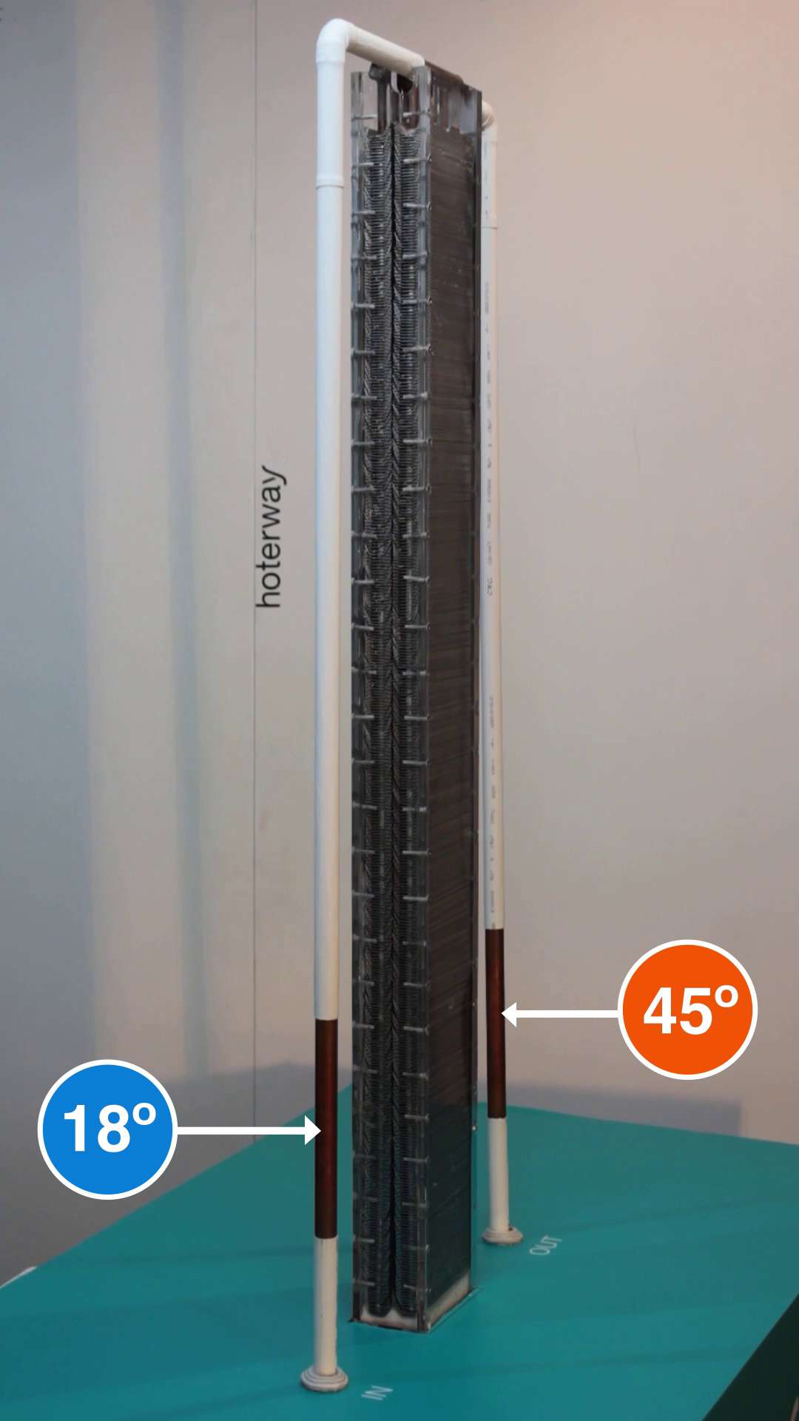
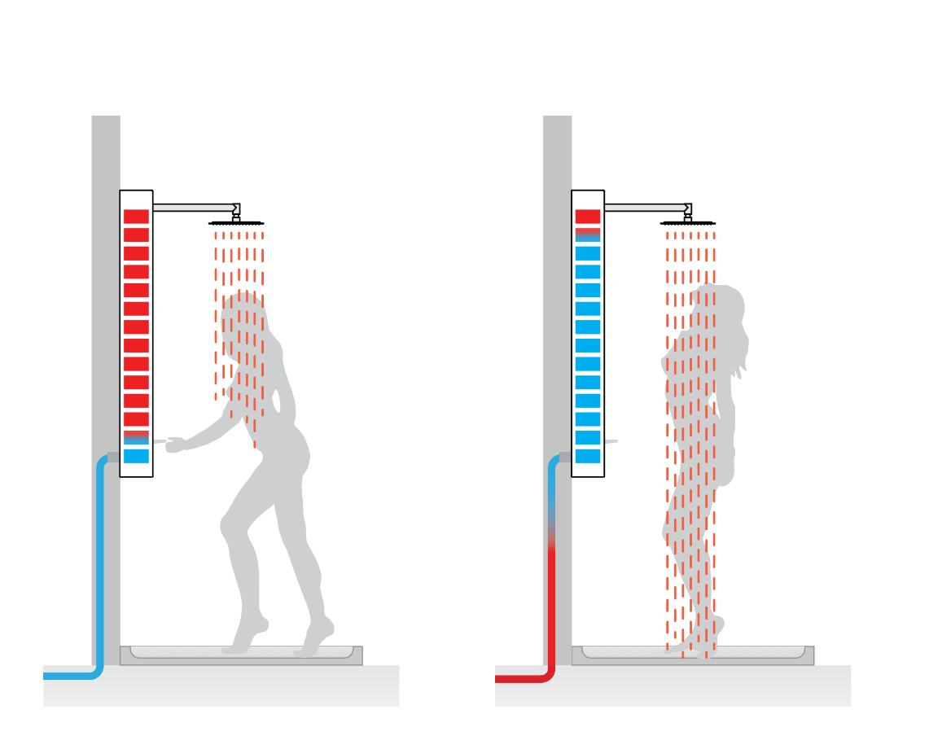
How does it work?
1
1) Instant heating phase
CONFIDENTIAL

Slide 9
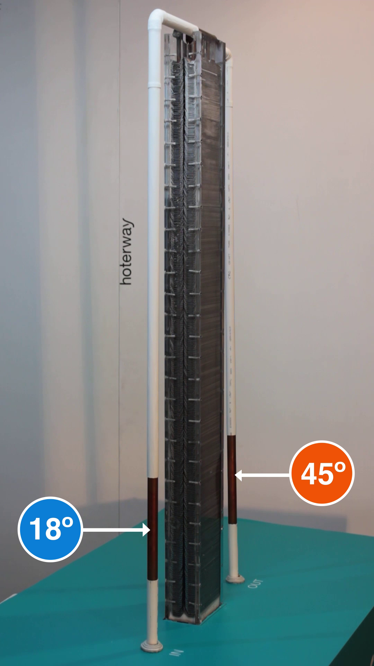
How does it work?
1
1) Instant heating phase
CONFIDENTIAL

Slide 10
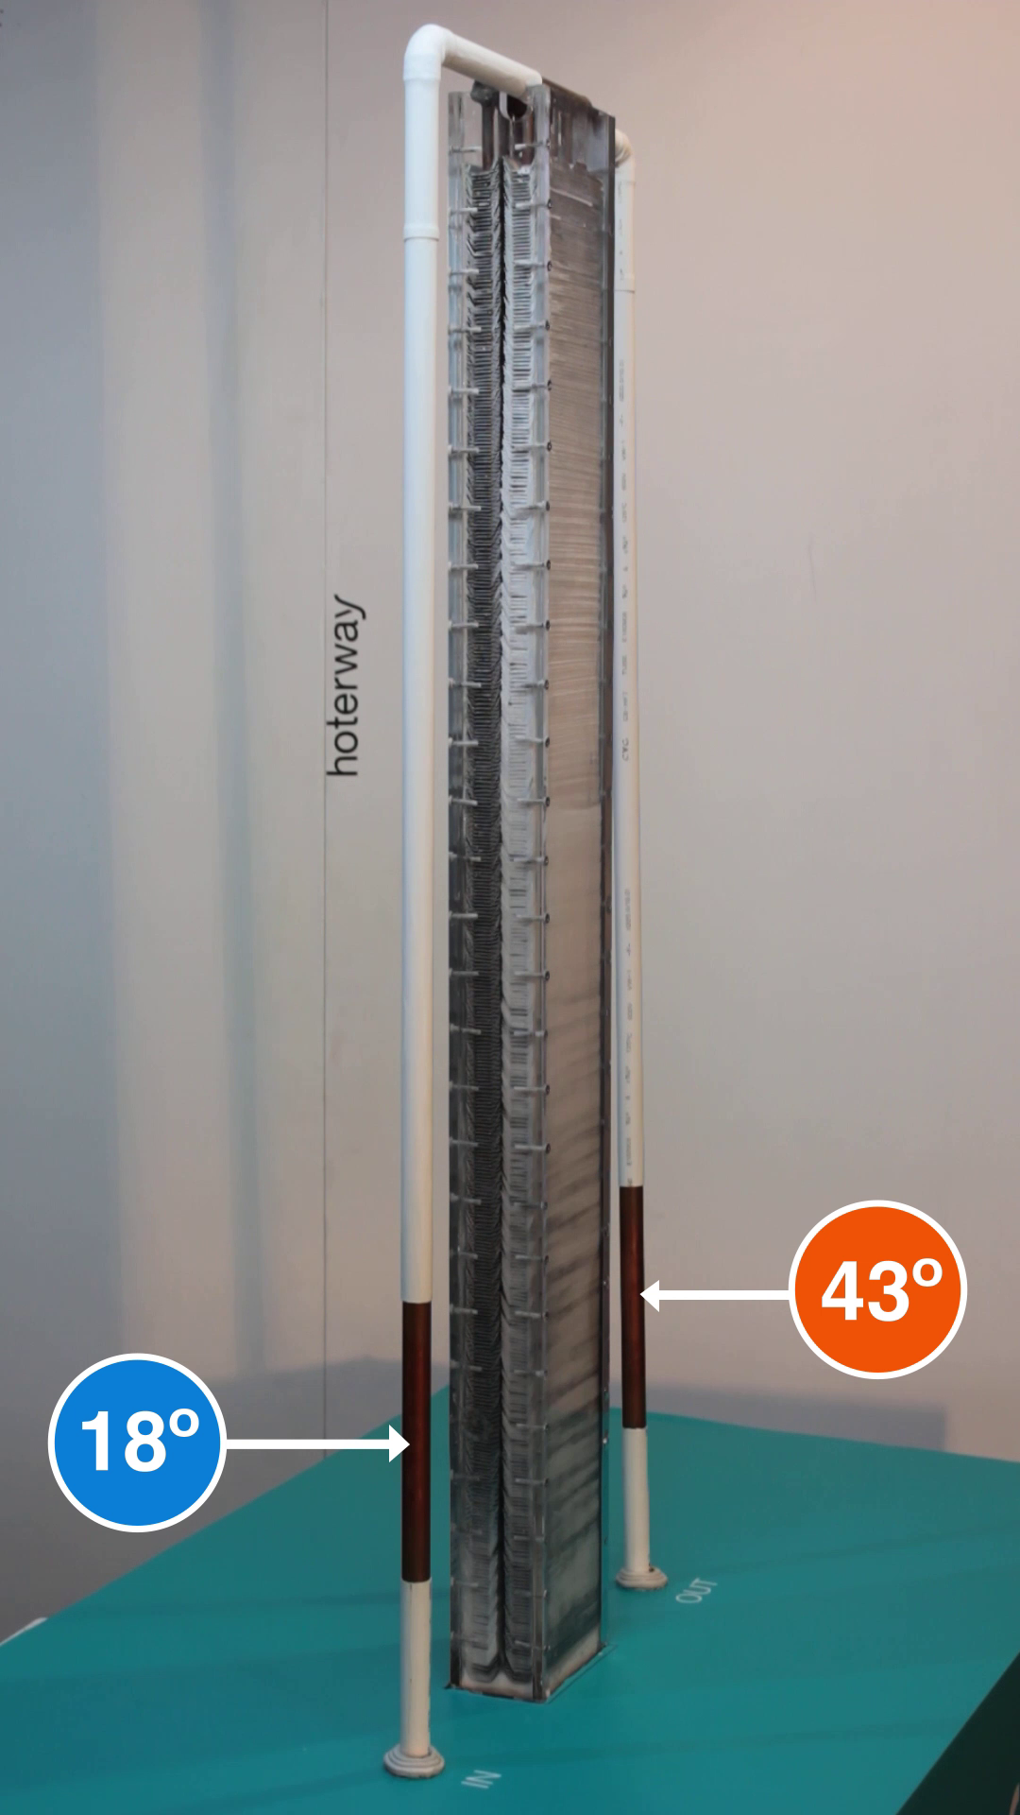
How does it work?
1
1) Instant heating phase
CONFIDENTIAL

Slide 11
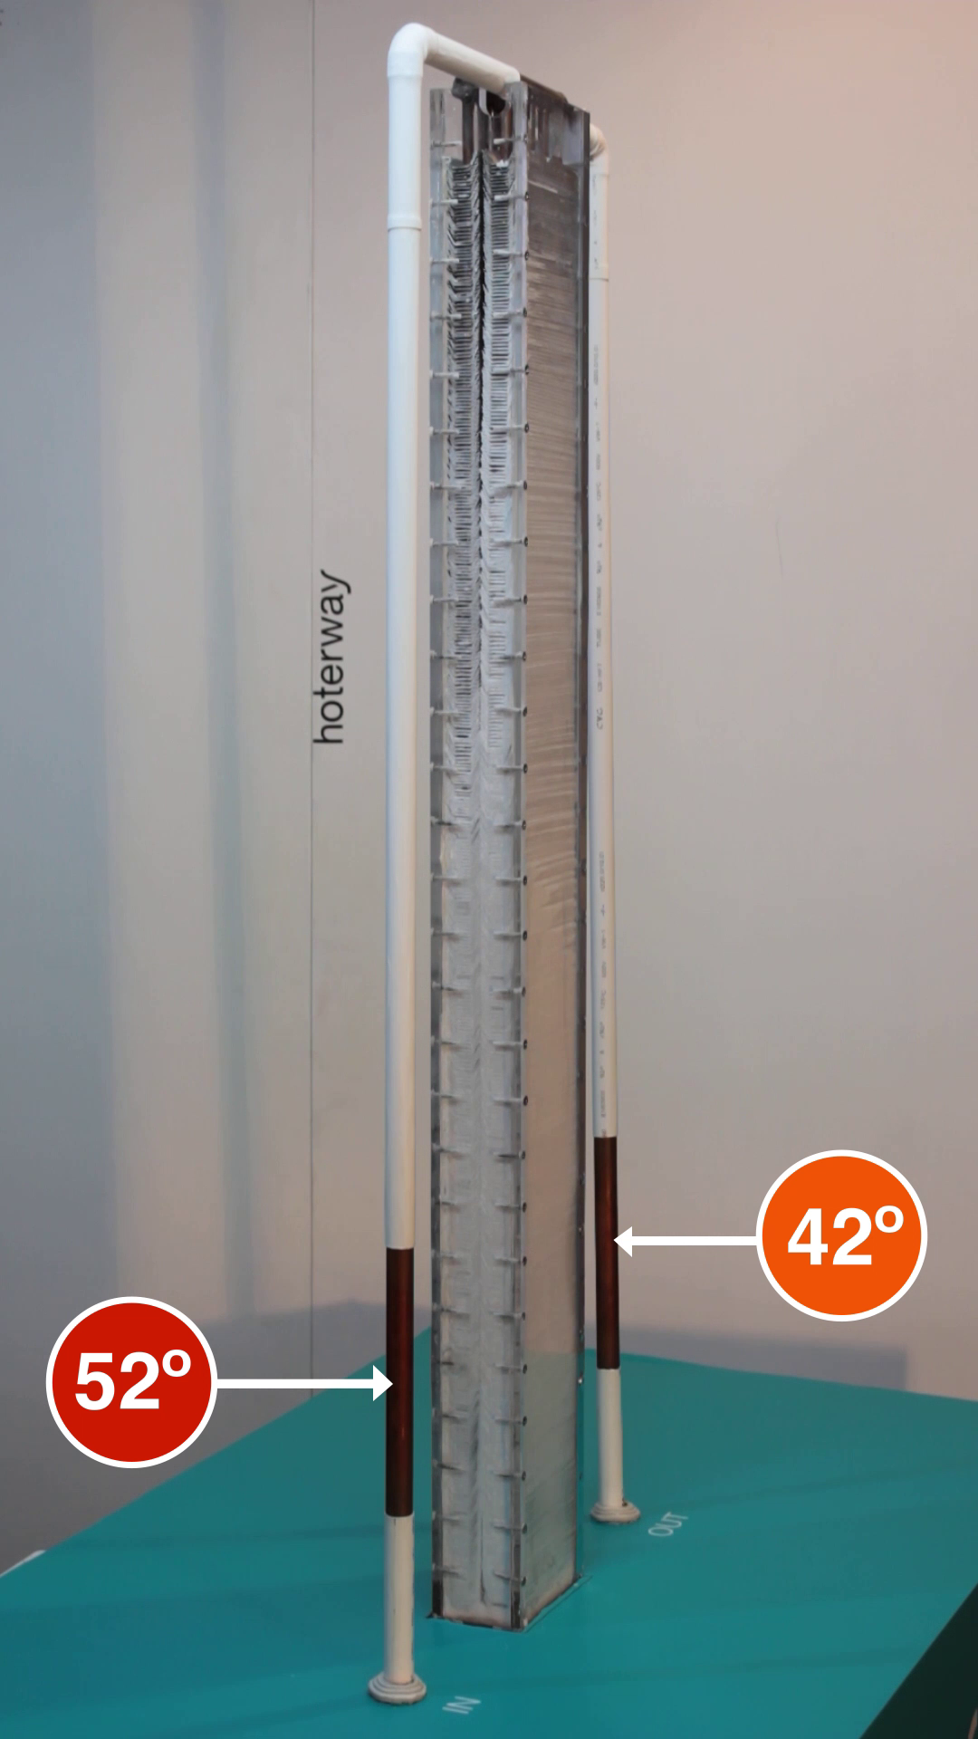
How does it work?
1
2) Thermal battery recharging
CONFIDENTIAL

Slide 12
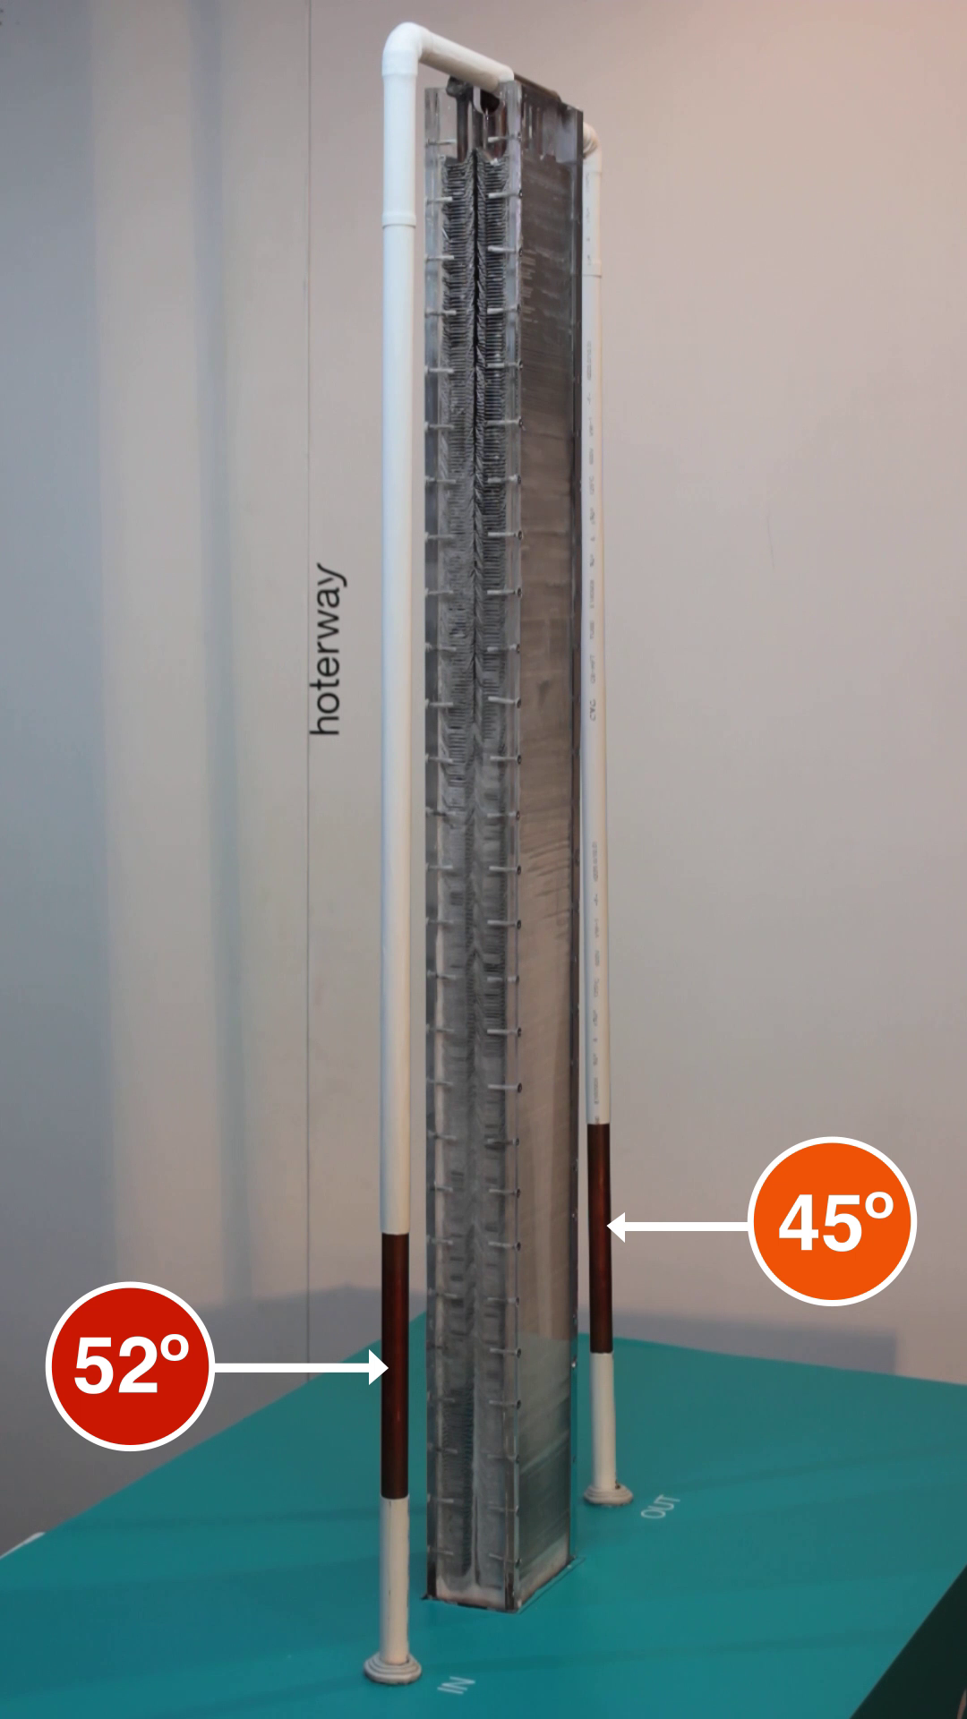
How does it work?
1
2) Thermal battery recharging
CONFIDENTIAL

Slide 13
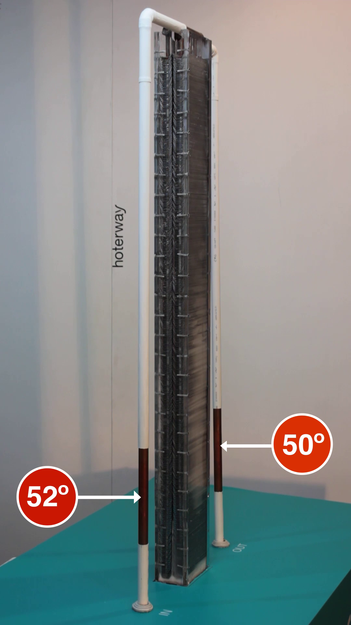
How does it work?
1
2) Thermal battery recharging
CONFIDENTIAL

Slide 14
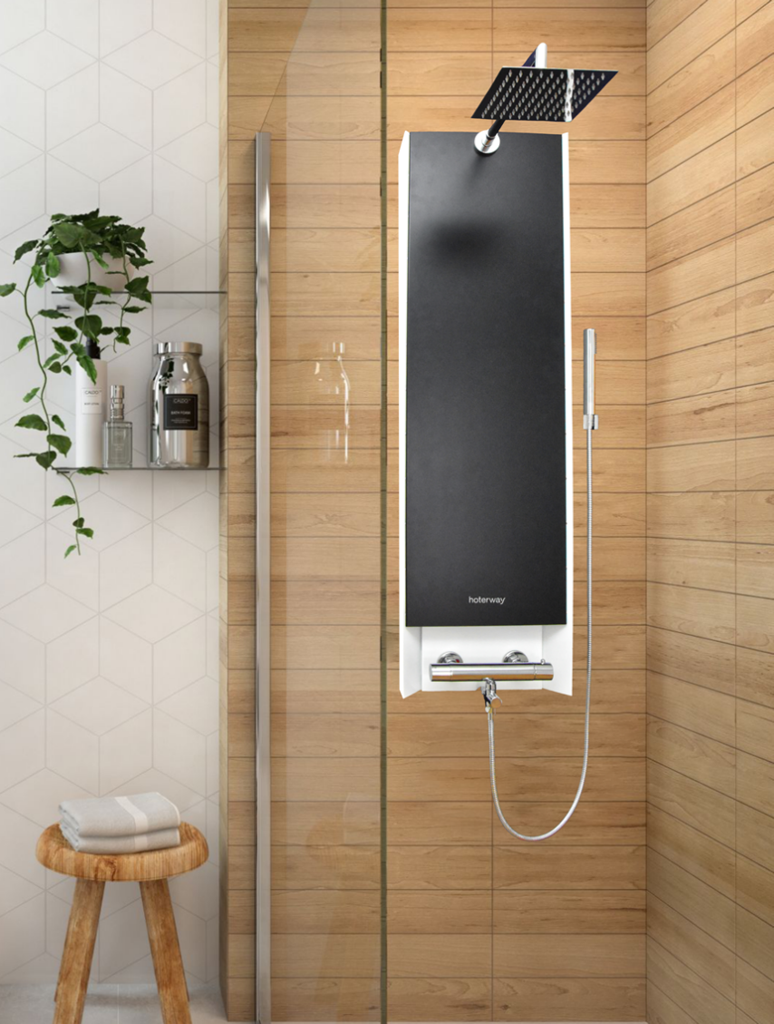
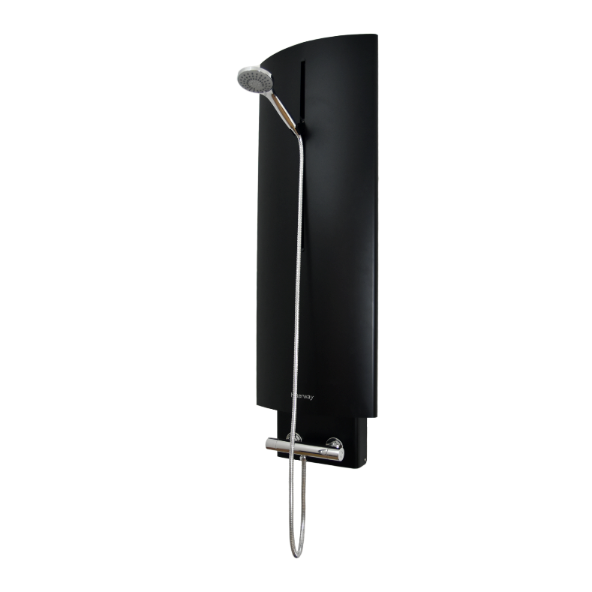
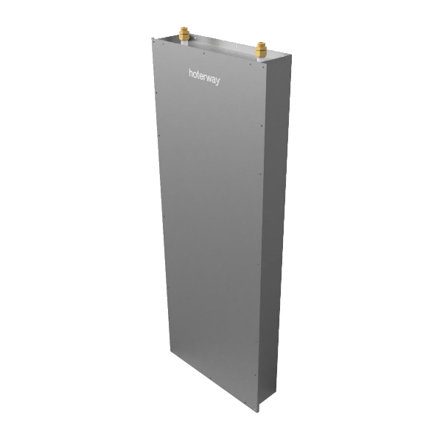
Product range
Shower columns
Buil-in solution

Slide 15
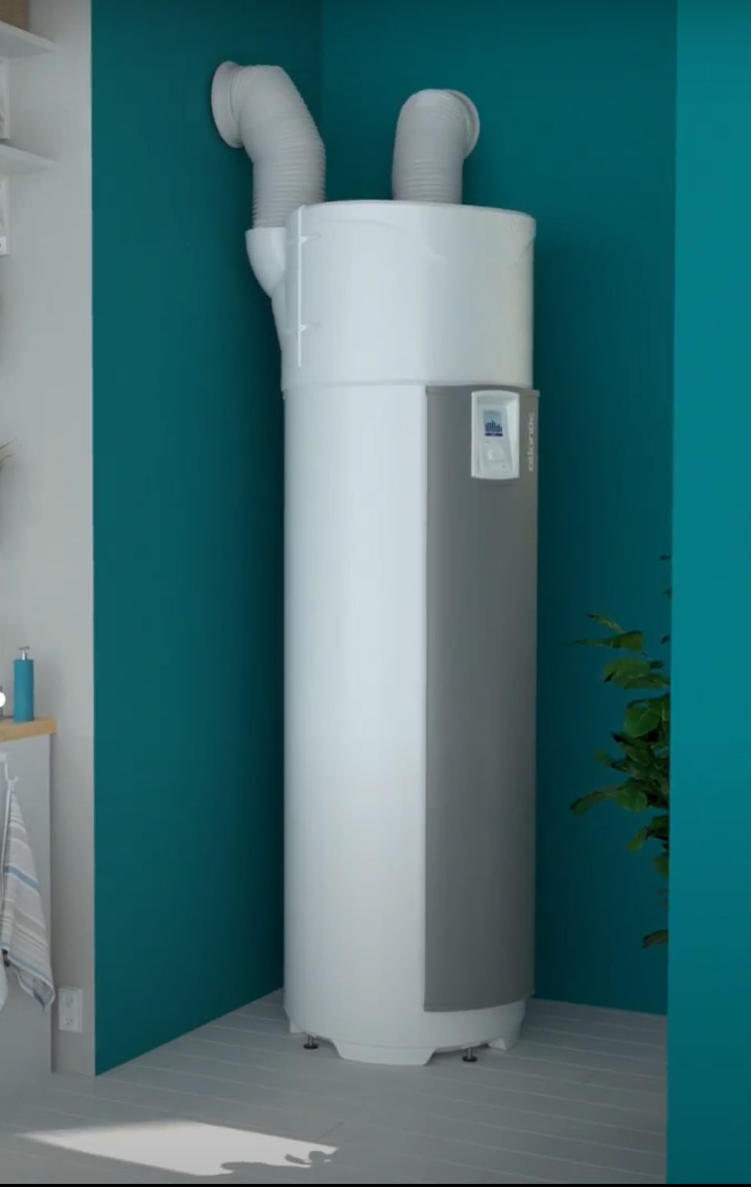
Smart Booster | maximized efficiency heat pump
CONFIDENTIAL

Slide 16
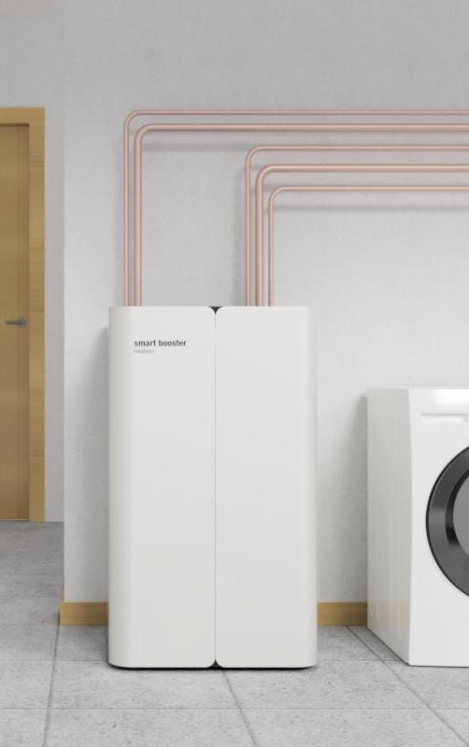
Smart Booster | maximized efficiency heat pump
CONFIDENTIAL

Slide 17
Smart Booster | maximized efficiency heat pump
Key features | Water tank (split) | Hot water (inertia) | PCM storage tank | Smart Booster
Market Share | ■■□□□ | ■■■■□ | ■□□□□ | □□□□□
Price tag | €€€ | €€ | €€€€ | €€€
Life-cycle duration | ■■□□□ | ■■□□□ | ■■■■■ | ■■■■■
Maintenance needs | ■■■■□ | ■■■■□ | ■□□□□ | ■□□□□
Additional sources integration | ■□□□□ | ■■■■□ | ■■■■□ | ■■■■■
Ratio capacity / Heat up time | ■■□□□ | ■□□□□ | ■□□□□ | ■■■■■
Ratio capacity / Volume | ■■□□□ | ■■□□□ | ■■■■□ | ■■■■■
Thermal losses | ■■■□□ | ■■■□□ | ■■□□□ | ■□□□□
Seasonal COP/EER impact | ■■□□□ | ■■□□□ | ■■□□□ | ■■■■■
 | Indirect competitors |  | Direct competitor | Smart Booster
CONFIDENTIAL

Slide 18
Smart Booster | maximized efficiency heat pump
Key features | Water tank (split) | Hot water (inertia) | PCM storage tank | Smart Booster
Market Share | ■■□□□ | ■■■■□ | ■□□□□ | □□□□□
Price tag | €€€ | €€ | €€€€ | €€€
Life-cycle duration | ■■□□□ | ■■□□□ | ■■■■■ | ■■■■■
Maintenance needs | ■■■■□ | ■■■■□ | ■□□□□ | ■□□□□
Additional sources integration | ■□□□□ | ■■■■□ | ■■■■□ | ■■■■■
Ratio capacity / Heat up time | ■■□□□ | ■□□□□ | ■□□□□ | ■■■■■
Ratio capacity / Volume | ■■□□□ | ■■□□□ | ■■■■□ | ■■■■■
Thermal losses | ■■■□□ | ■■■□□ | ■■□□□ | ■□□□□
Seasonal COP/EER impact | ■■□□□ | ■■□□□ | ■■□□□ | ■■■■■
 | Indirect competitors |  | Direct competitor | Smart Booster
CONFIDENTIAL

Slide 19
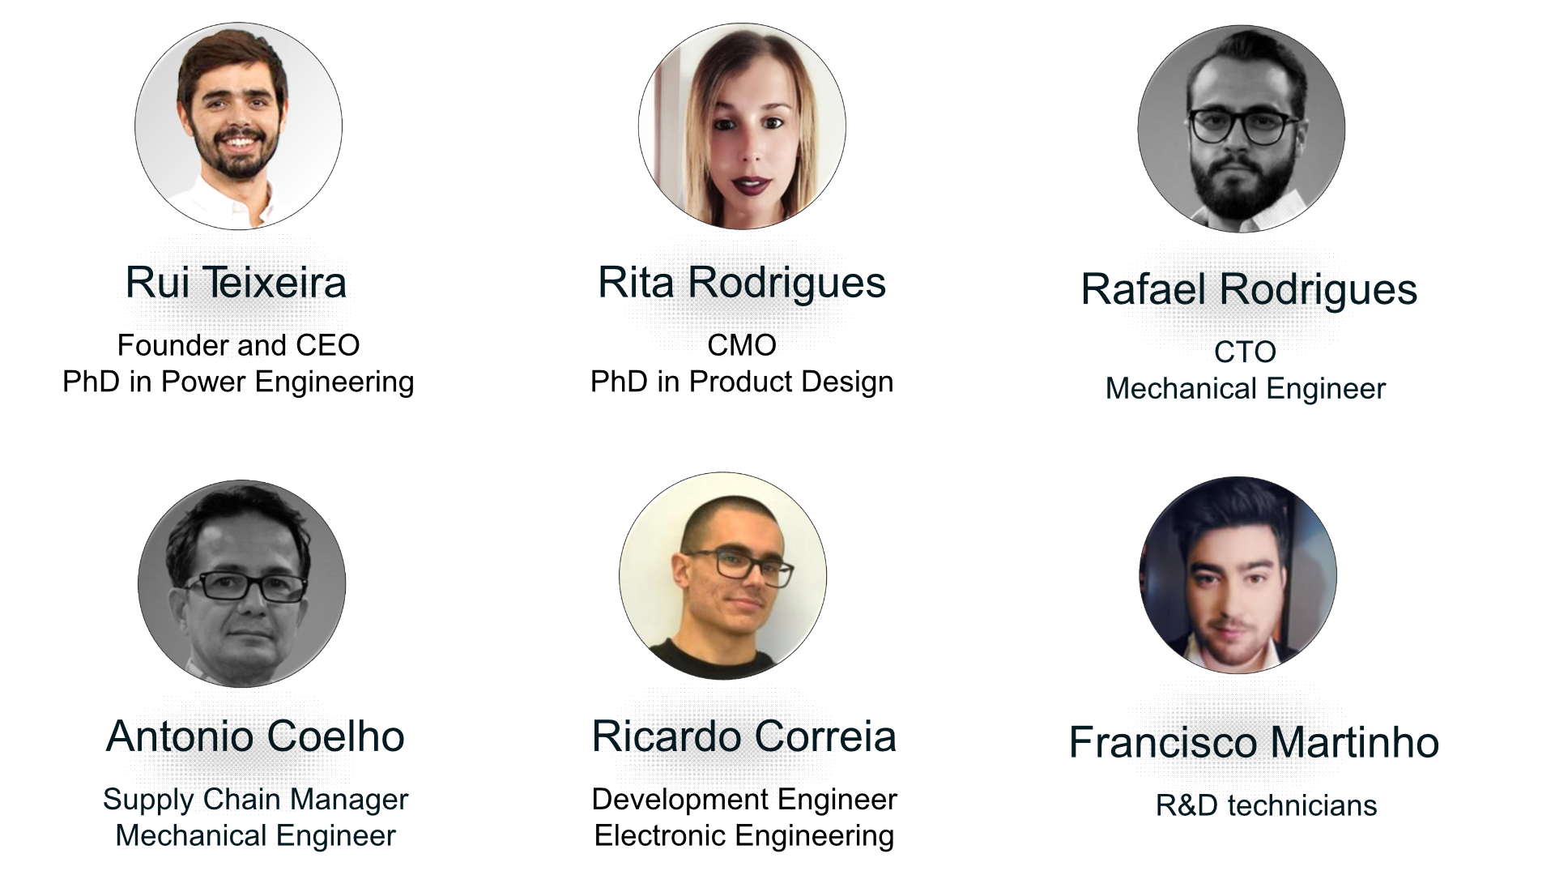
Our Team | creativity and experience

Slide 20
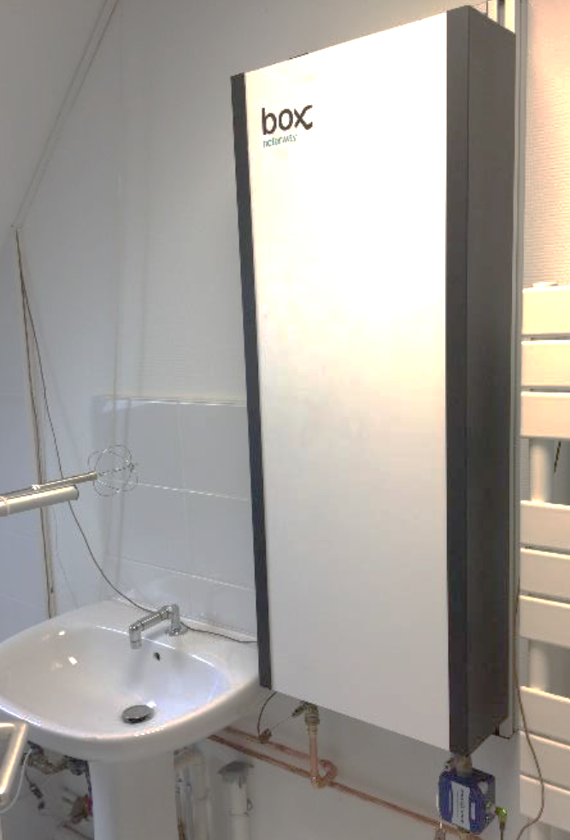
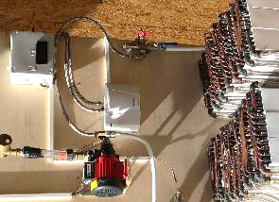
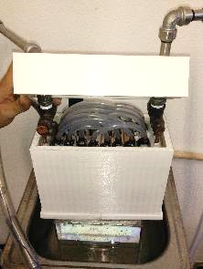
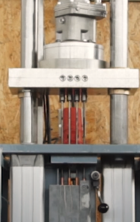
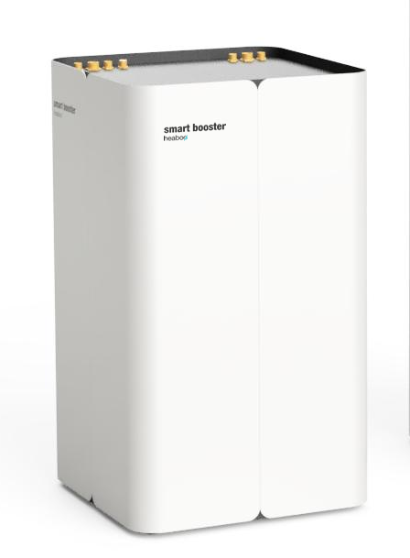
Smart Booster | Timeline
Successful validation of first thermal battery
New production technique (2nd generation batteries)
First product to install in trial costumers
2017
2018
2019
2020
2021
Performance tested by a global manufacturer
Successful validation of Smart Booster concept
CONFIDENTIAL

Slide 21
Price, Margin and Traction
2020
2021 (after scale-up)
>300 unit sold and installed
Retail price: 530€
Retail price: 400€
Negotiation for distribution in US with a market leader
Margin distribution: 35%
Margin distribution: 40%
Solar Impulse Label certification
Gross profit: 35%
Gross profit: 38%
Retail price: 400€
Retail price: 260€
Payback time <2 years
Margin distribution: 35%
Margin distribution: 40%
Gross profit: 38%
Gross profit: 36%
CONFIDENTIAL

Slide 22
Investment case
1.000.000 € - New investment
Total Addressable Market Size
20 Billion Euros
+
Production cost after scale-up
50% reduction from 2020 referential
670.000 € - State grant
(400.000 € already secured)
Sales forecast - 2025
100.000 Hoterway & 5.000 Smart Booster
Go-to-market 50%
Scale-up 30%
Medium-term strategic objective Compulsory use in sustainable buildings
R&D 20%
CONFIDENTIAL

Slide 23
Market forecast
Less than 1% of the SAM
Less than 1% of the SAM
CONFIDENTIAL

Slide 24
Thank you for your attention! Any question?
Rui Teixeira | rui.teixeira@heaboo.com | hoterway.com | +351 967 088 923

