Slide 1
Nanolike
VC Pitch @ BPI France

Slide 2
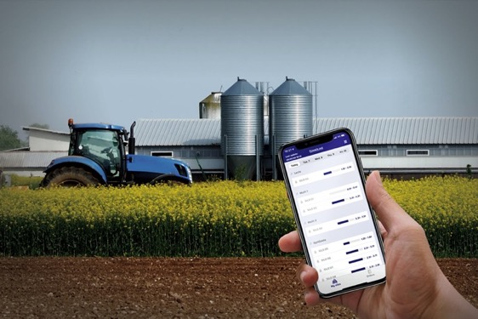
Our ambition
To become a digitalization leader for the supply chain of agriculture and chemical industry

Slide 3
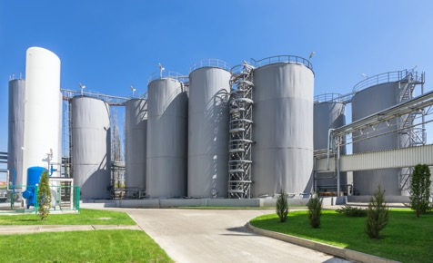
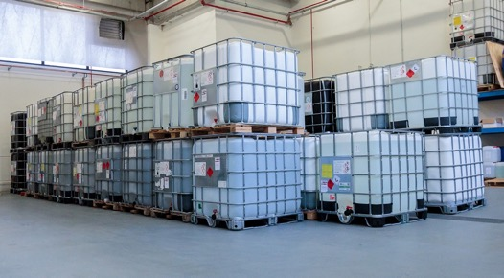
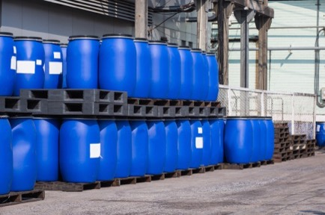
Context
Agriculture and chemical supply chain is about shipping raw products mostly by truck to fill smaller containers from larger ones… : TANKS, SILO, IBC, BARRELS…
10 000 - 100 000⁺ L
1 000 L
20 – 250 L

Slide 4
Problem
Truck deliveries are expensives and polluting
Running out of stock of raw materials means money loss and production troubles
Human check of materials stocks is costly
Plastic containers waste is dangerous for the planet
Chemical companies trucks are in average loaded with less than 80%
Out of raw materials stock occurs 1 to 10 times a year in production companies
Up to 10% of human time can be lost in check
697 500 000 kg of of plastic waste every year as less than 7% of IBC production is recycled
TOO MUCH COST + TOO MUCH POLLUTION !

Slide 5
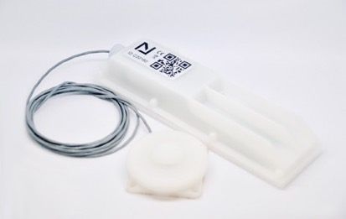
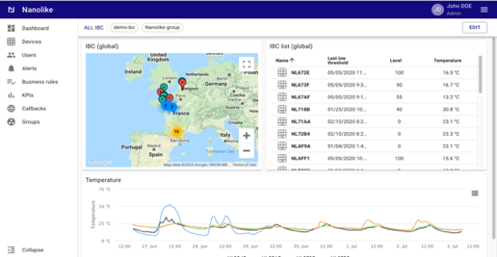
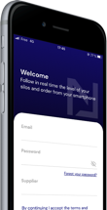
Our solution
OUR SENSOR
OUR SOFTWARE
A unique, patented and non-intrusive smart device cheapest than any other existing solution on the market.
It provides temperature, geolocation and fill level (based on a deformation sensor)
Raw data is processed by IA algorithms to provide more added value features (alerts, forecasts, delivery optimization…)
Data is available on web/mobile platform or via API for direct IT integration

Slide 6
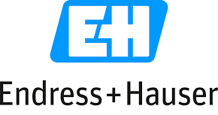



Positioning: to disrupt existing solutions
T.C.O.
incl. Installation, calibration and maintenance
Our unique positioning:
LOW TCO
&
LOW PRECISION
Logistics
Optimisation
Fab 4.0 / Metrology
Sensor precision

Slide 7
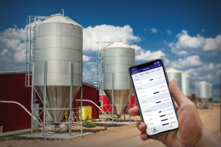
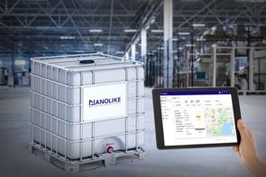
Market & business model
SILO
499€ + 49€/year
FR: 300 000 tanks
EU : 3 000 000 tanks
CAGR : 5.5%
TAM (15%) : 225m€ + 22m€ YRR
IBC
89€ + 49€/year
WW: 25 000 000 IBC every year
Total park size : 100⁺ millions
CAGR : 6.8%
TAM (5%) : 445m€ + 245m€ YRR
Sources:
- Global Plastic Rigid IBC Market 2018, QYResearch, July 2018
- The Global Remote Tank Monitoring Market, Berg Insight, Second Edition, 2019

Slide 8
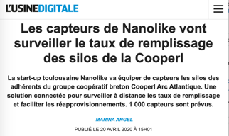
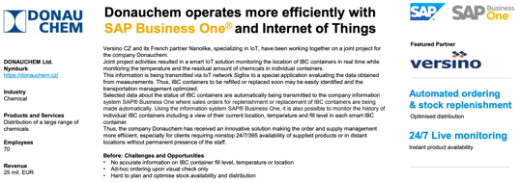
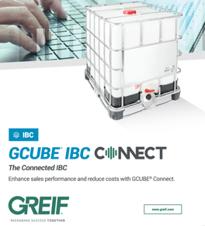
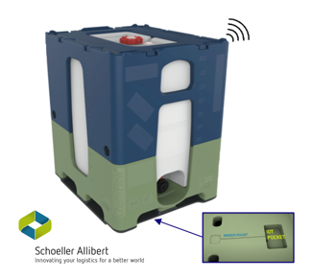
Key achievements
Business model & technology validated by the market
  3 top players in rollout phases: Gaches (IBC), Cooperl (silos), Even (silos)…
  6 pilots in Europe: Haffner (DE), Alicoop (FR), Linde (DE), Ventum (ES), Arterris (FR), Donauchem (CZ)…
  Key agreements with top IBC manufacturer
  to sell Nanolike as an OEM product:
Greif Gcube Connect (Global n°3 player)
    Schoeller Allibert: ChemiFlow
    Sotralentz: Multiway

Slide 9
Go to market strategy
Sales
  Scale silos market by replication
  Scale massively IBC with IBC manufacturers
➔
Tech
  Scale platform (backoffice management)
  Develop new IA-based features
  Open diversification segments
➔
1.5 m€ to build a sales network in Europe: 1 sales in Germany, Spain, Italy, Northern EU
Looking for:
2.5 m€
Strategic VC for growth
1 m€ to secure high scalability of the technology

Slide 10
Key figures
August 2018 : Company creation (by assets acquisition of a liquidated company also called “Nanolike” – brand name was also acquired)
2019 : 53k€ - 200 devices (12 employees)
2020 : 500k€ - 2 000 devices : 600⁺ k€ of orders to date
In 5 years ➔
  50% recurring revenues
  EBITDA = 40%
15⁺m€ - 200 000 devices (30 employees)

Slide 11





Team
Jean-Jacques Bois
COO and Co Founder
Samuel Behar
CTO and Co Founder
Benoit Perrin
Chairman and President (non exec.)
Former VP marketing at Alstom
Gilbert Gagnaire
Main Investor, Co-Founder of Easymile
Successful serial entrepreneur
13 employees
2 co-founders
3 sales & marketing
6 engineers
2 PhD (R&D)
BOARD

Slide 12
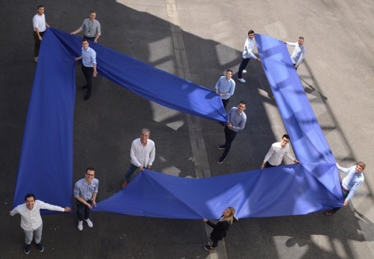
Key investment highlights
Product-market fit validated on 12 customers in 5 countries
Strong and experienced management team
Highly profitable business model : 50% of recurring revenues + 40% EBITDA

Slide 13
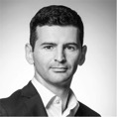
Nanolike
This project has received a funding of 2m€ from the European Union’s Horizon 2020 research and innovation programme under grant agreement N°945010.
Jean-Jacques BOIS
C.O.O. & Founder
jj.bois@nanolike.com
+33 649 17 58 86
Labège, France

