Slide 1
Rapid, High-Accuracy Covid19 RNA Screening Test Getting the world safely back to work

Slide 2
What we do
Lab quality results in the field in near real-time (minutes, not hours or days):
Patent and IP protected (4 patent families)
Existing profitable business in Anti-counterfeit and bacterial detection with:
Global alcoholic beverage producer
International hygiene supplier
Anti-Counterfeit
Small Molecule/DNA detection
Covert Security Taggants
Bacterial Detection
DNA/RNA detection
Pathogens/Viruses
Notes:
This slide is brand-agnostic – products shown are for illustration only!
Molecular-level trace-element detection
Existing profitable business in Anti-counterfeit
Molecules/chemicals
Covert security taggants
Growing business in Healthcare
DNA/RNA, pathogens, viruses
Patent and IP protected (4 patent families)
Strong existing business with leading multi-nationals

Slide 3
Covid-19 – A Deepening Global Crisis This is a marathon not a sprint
3 Billion tests/day globally (18th June)
https://ourworldindata.org/coronavirus-testing
Notes:
Many countries have implemented very effective lockdowns – they can’t go on.
A global economic collapse (5.2% contraction in 2020), driving 70-100 million people into poverty (World Bank).
To safely get back to work we need a huge increase in ‘field testing’ (The US is aiming for 30 million per day 6 months from now).
Second wave (especially when winter approaches) is a serious concern
Beijing

Slide 4
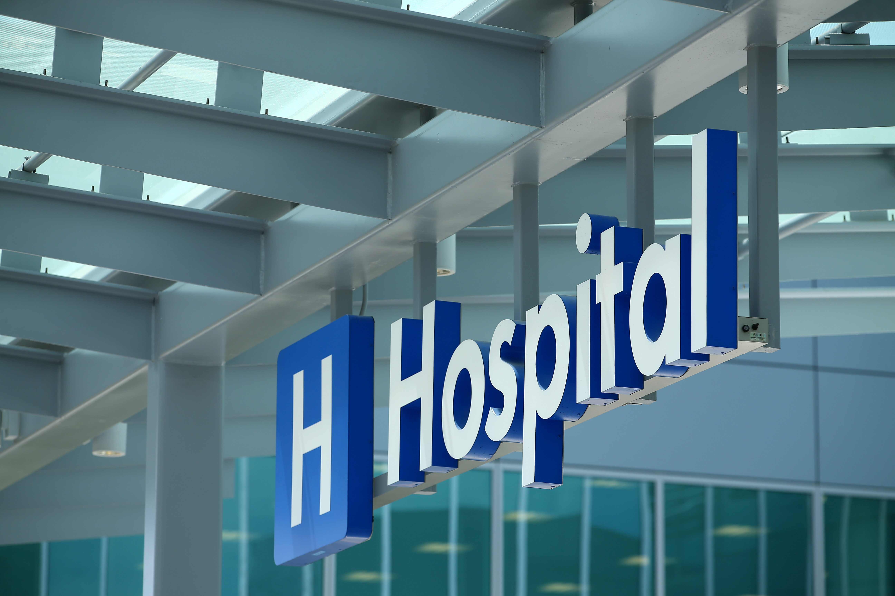
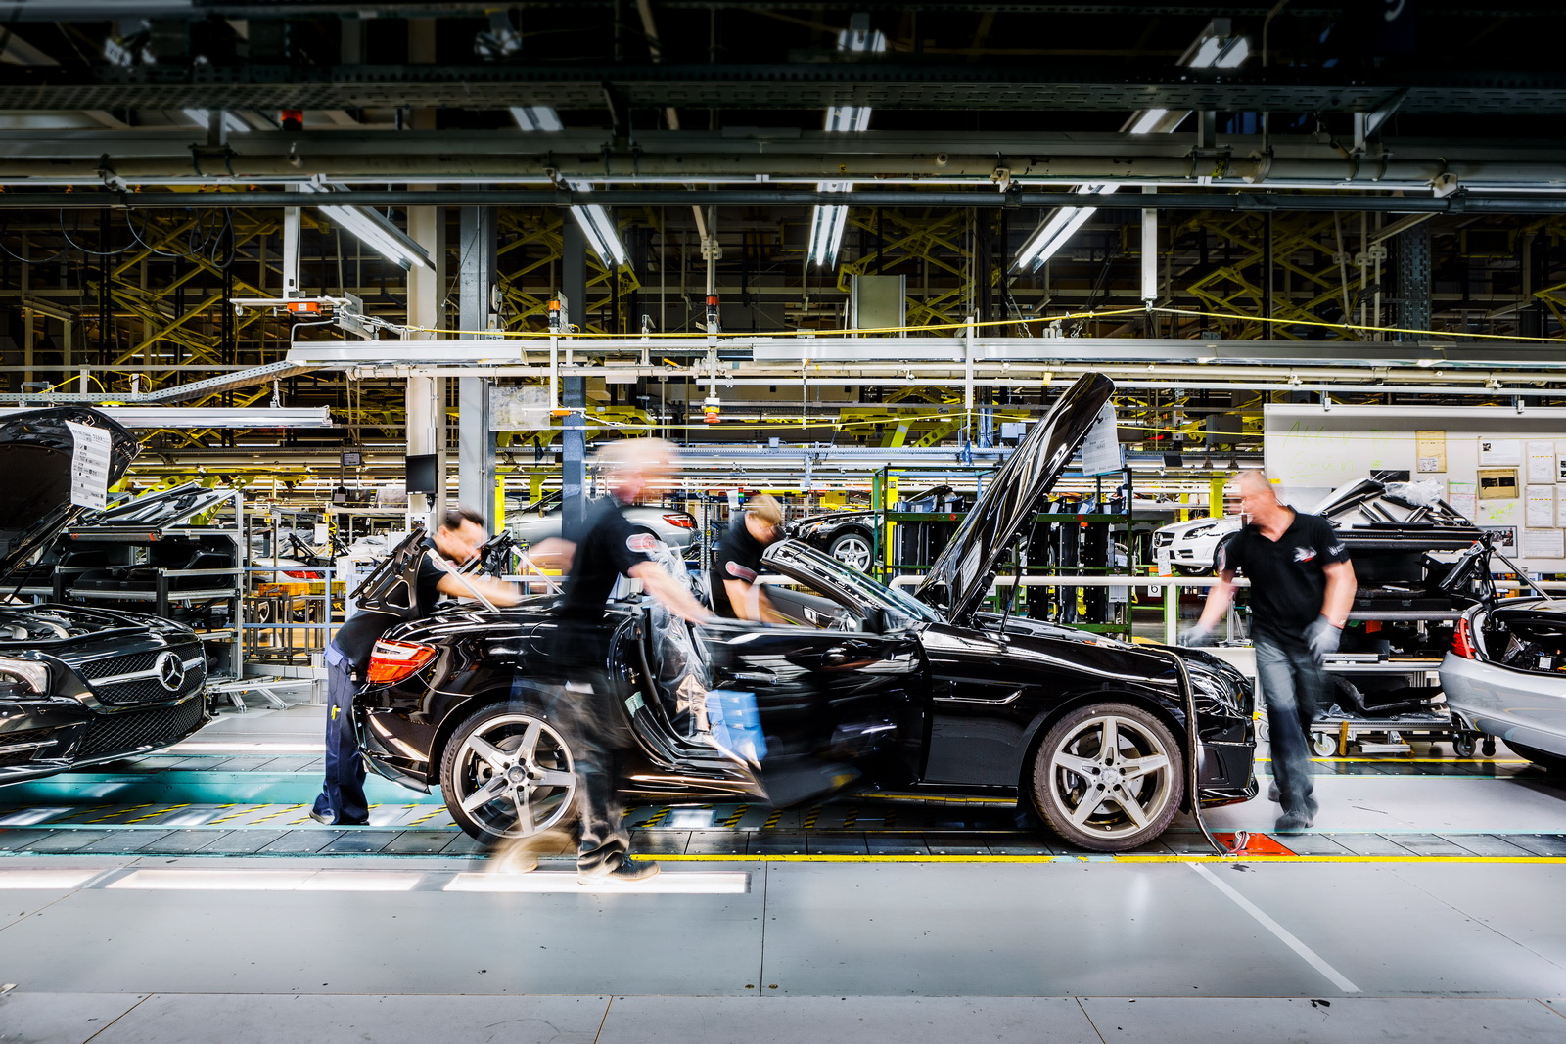
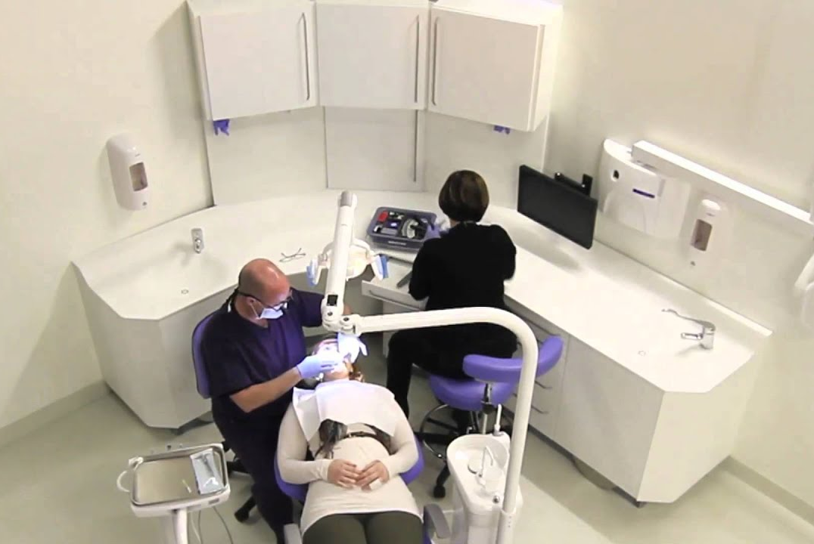
Covid-19 RNA Test – Target Markets
Eluceda objective – To provide hundreds of thousands of screening tests per day by winter 2020
Notes:
It’s probably worth pointing out straight away that this is an RNA ‘have you GOT it’ test, not the antibody ‘have you HAD it’ test.

Slide 5
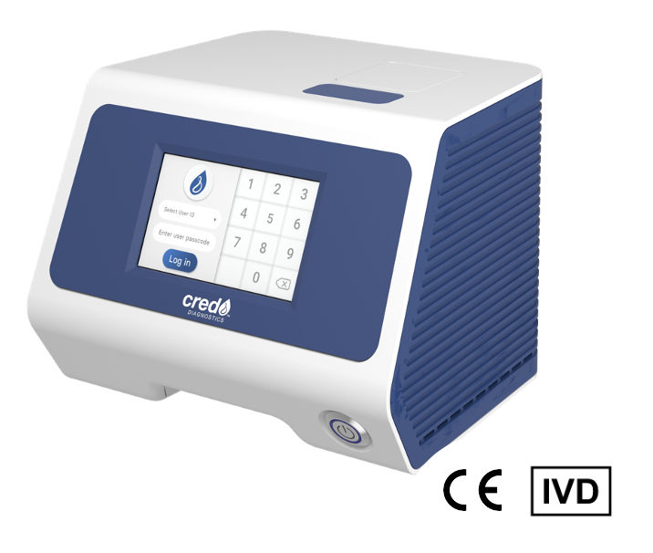
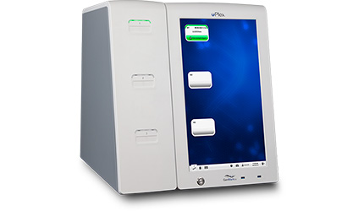
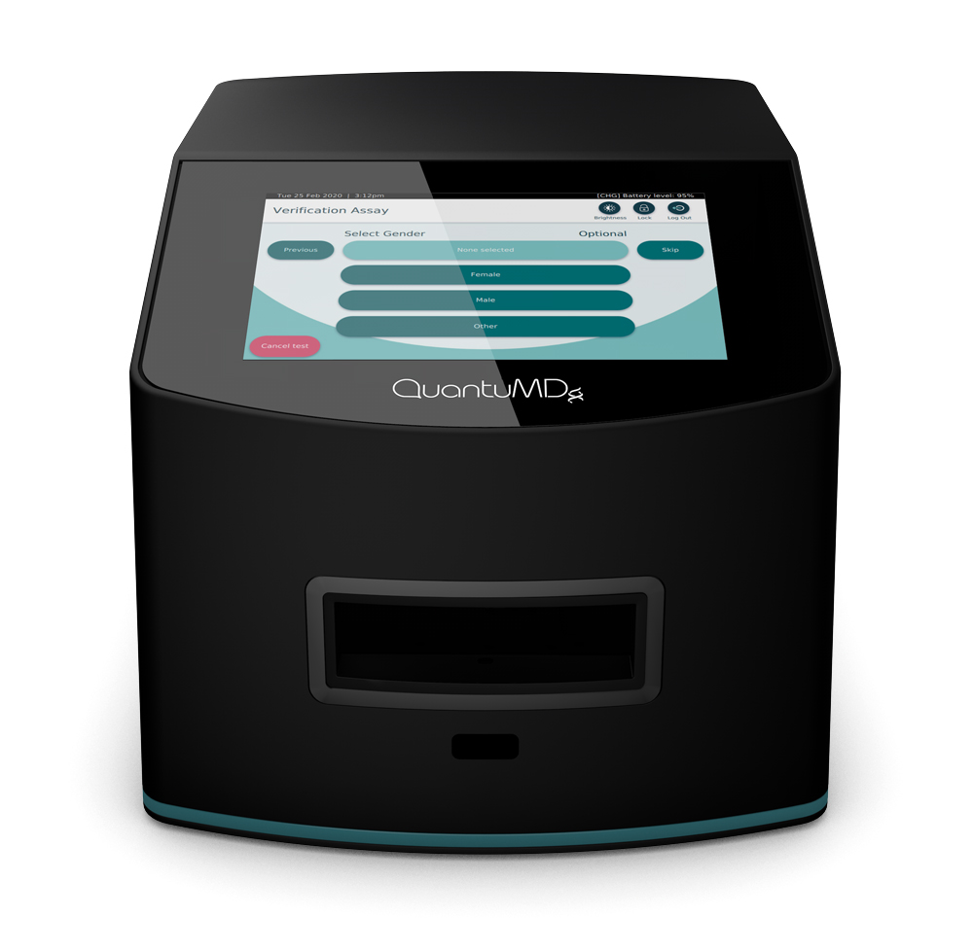
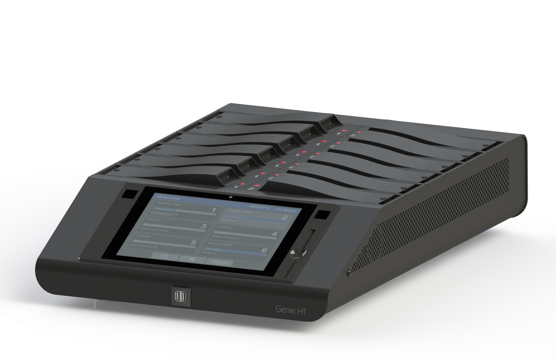
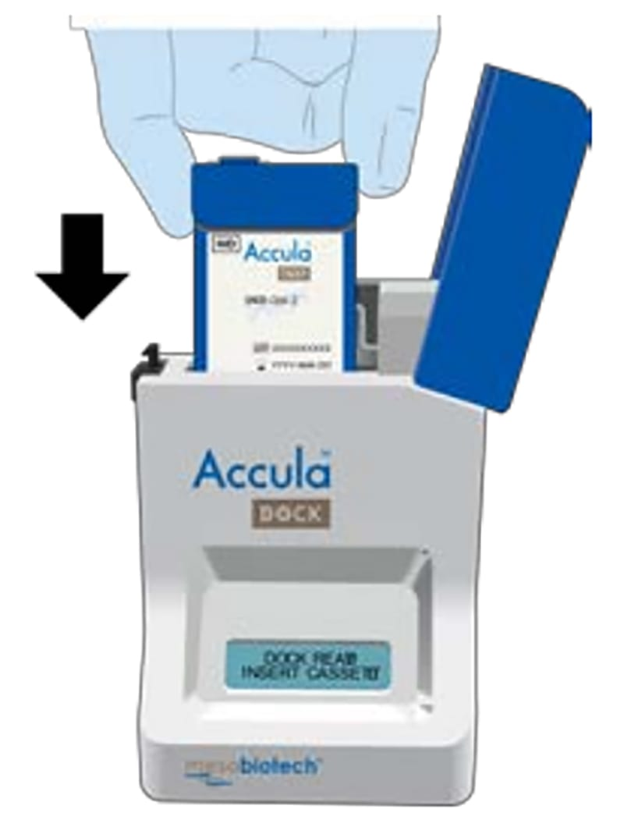
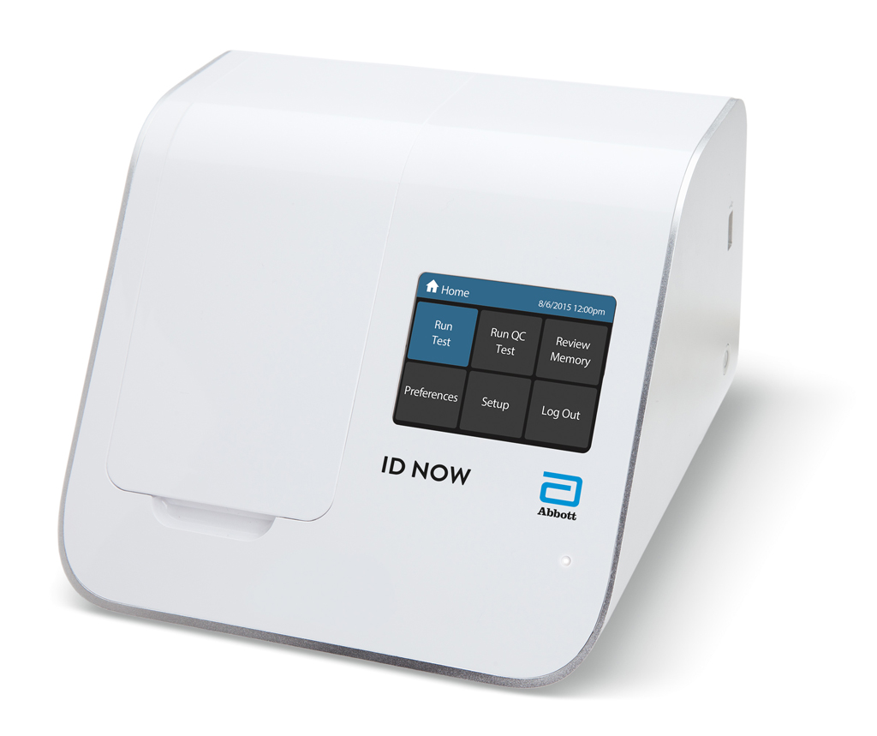
Competitor Assessment
Cepheid
GeneXpert
Credo
VitaPCR
GenMark
ePlex
QuantuMDx Group
QuantuMDx
Laboratory equipment (not portable)
Expensive to run
Expensive consumables
Abbott
ID NOW
OptiGene
Genie HT
Mesa Biotech
Accula
Notes:
Cepheid GeneXpert seems to be the device everyone wants – high accuracy.
Aim of this slide is to show that we’re aware of the competition, and crucially, that we’re different. This is all lab equipment – expensive, and with expensive kits.
The Accula is small and field-deployable, but it’s performance is highly questionable.
I showed the SENTINEL (don’t have to keep the name ☺) to provide an opportunity to talk about a product roadmap for higher throughput applications, where the current E-sens reader would be outgunned by the competition.

Slide 6
Eluceda Covid-19 RNA Test – Game changing
Fast
Cheap
Accurate
Resilient
Use Anywhere
Scalable
Notes:
All are pretty obvious, except ‘Resilient’ which is to point out that the Eluceda’s significant reduced requirement for consumables means it’s much less likely to be forced out of use by shortages.

Slide 7
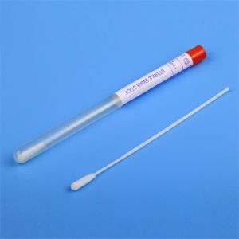
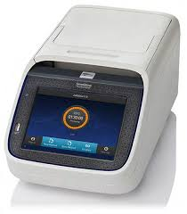
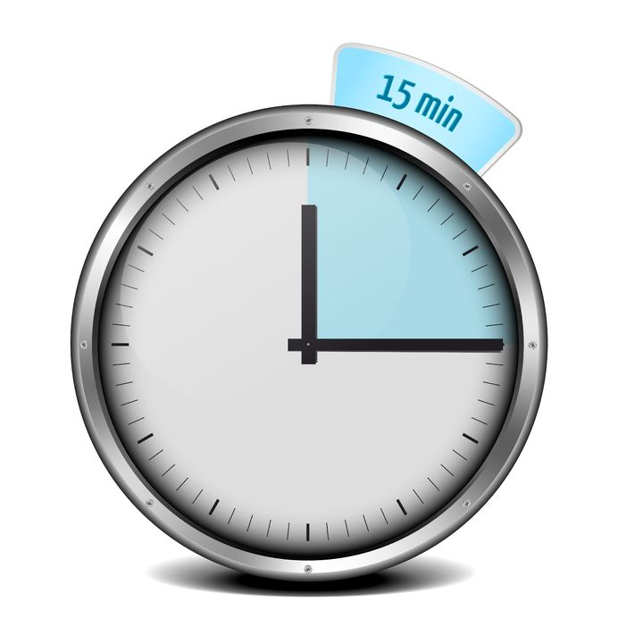
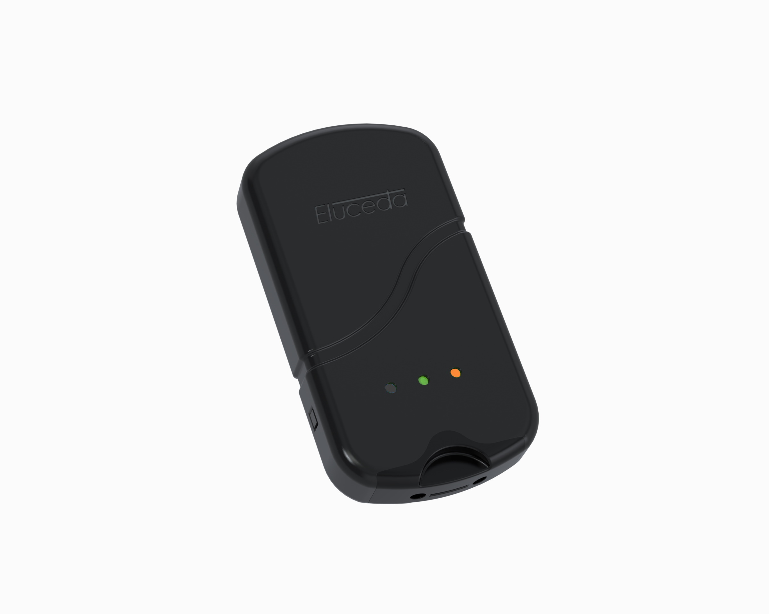
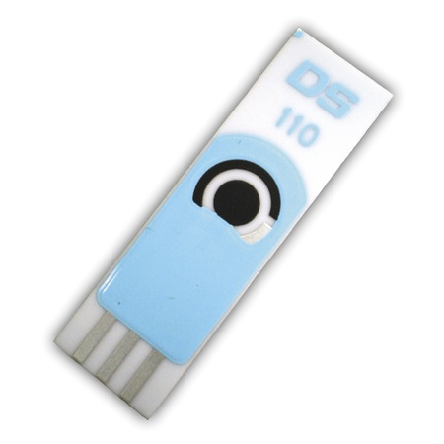
Covid19 RNA Detection System
Swab, amplify, apply and read
Swab
Short PCR
cycle
With PCR
Can be as fast as 15 minutes
Typical detection limit of 200 viral units
Multiple targets per virus possible
Uses standard preparation steps
Easily adapted to other targets
Multi-detection possible
E-Sens reader analysis
Electrode

Slide 8
Covid19 RNA Detection System
Swab, amplify, apply and read
Swab
Short PCR
cycle
Without PCR
We’re currently working on a
‘direct from swab to E-Sens’ method
which is showing early promise.
This would bring test time to <5mins.
Electrode
E-Sens reader analysis

Slide 9
Use of Funds
€2m
Development & Approvals
Capacity & Resources
Supply & Distributor Partnerships
Procurement
Existing relationships
UK Health Service contacts
Airline contacts in discussion

Slide 10
Organic Growth Revenue Model
Investment
Ongoing procurement, capacity development, expansion into new markets
€2m
€5m
Initial
Revenues
Devices
Sales of readers
Consumables
Sales of Electrodes (single test - £10-£15)
Notes:
It’s probably important to point out that these are extraordinarily cautious figures.
The Covid-19 numbers could be staggering.

Slide 11
Senior Leadership Team
Matthew Harte, Group CEO
High technology start-up experience
Previously MD at Biocote, a leading branded antimicrobial company and COO of Protomed, a medicine management business
Ian Eastwood, CTO
Technical Director of Biocode and subsequently the CTO of Authentix
He has developed security features that are present in several legal tenders around the world
Jim Murray-Smith, Chairman
Chairman and founder of The UK Manufacturing Accelerator
Founder of Versarien plc, taken from start-up through to IPO

Slide 12
Q & A
Eluceda Covid-19 RNA Test

Slide 13
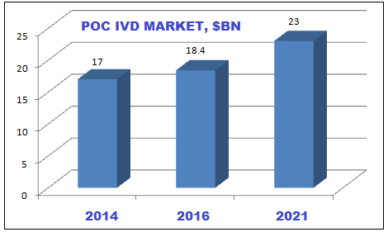
Market Trends Taking the ‘Point of Care In Vitro Device’ sector as a guide
Projected at USD50bn by 2026
CAGR 9.6%
Source: Reports and Data
Source: Kalorama Information
But of course, Covid-19 will massively increase the size of the market.

Slide 14
Beyond Covid-19
The Eluceda system creates a platform and a catalyst for ongoing opportunity
In Healthcare:
Deployment through existing Healthcare channel for environmental testing
Rapid Point-of-Care detection of a range of bacteria and viruses, MRSA, Sepsis, Norovirus etc..
Multiplex capabilities to test for multiple organisms in a single test
In wider markets:
Bacterial testing in the Food Industry for cleanliness and product QC
Water treatment and testing
DNA testing for counterfeit products
Notes:
The text on this slide speaks for itself, but….
..there are a some important “Beyond Covid” points:
It’s going to be around for a while. Some countries might beat it, but whilst there are still countries out there where it’s still an issue, our globalized society will remain at risk and on alert, with all testing and response capabilities remaining in place and at strength.
Even when it’s over, the lesson from Covid-19 will be that we MUST be better prepared for the next one (ie Bill Gates’ 2015 TED talk). Governments will build strategic stockpiles of equipment and consumables.
Plus, all that Eluceda test kit out there (particularly in healthcare settings) will create a huge platform for other pathogen testing which we can address. (The main original message of this slide)

Slide 15
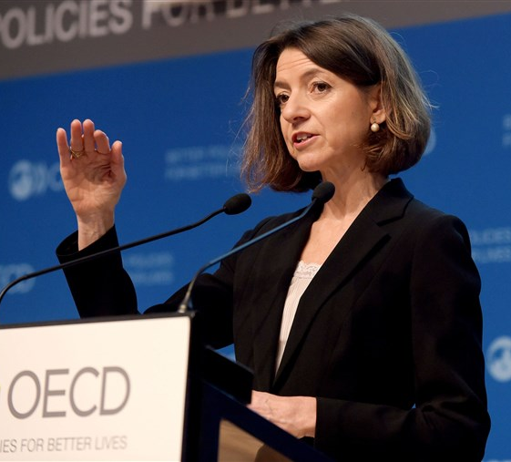
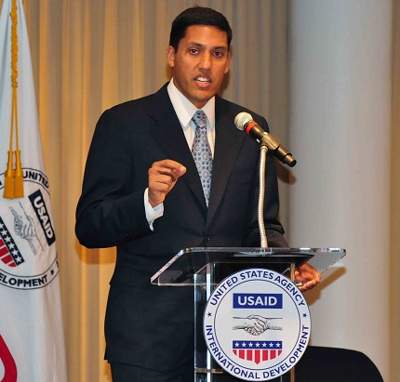
Covid-19 – A Deepening Global Crisis
The OECD expects global growth to rebound in 2021 by 5.2 per cent in the case the pandemic is controlled, but by only 2.8 per cent if COVID-19 flares up again.
“..the shock to the world economy and living standards is absolutely unprecedented and it will have long-lasting effects,”
Laurence Boone, chief economist OECD
“Testing is our way out of this crisis”
Dr. Rajiv J. Shah President,
The Rockefeller Foundation,
…in his introduction to the ‘National Covid19 Testing Action Plan’ to deliver
30 million tests per week in the US in the next 6 months.

Slide 16
Competitive advantage
IP
Patents enabling multiplexing and high sensitivity
USP
Unique DNA sequence and molecular detection
Fast, affordable, simple to use – Lab in your hand
Can upload results into database for action/analysis
Device capable of multiplexing
Proprietary software for devices
Trade secret taggant manufacturing
Currently in use in proprietary taggant and detection systems
Ink and electrode know-how – Biosensors

