Slide 1
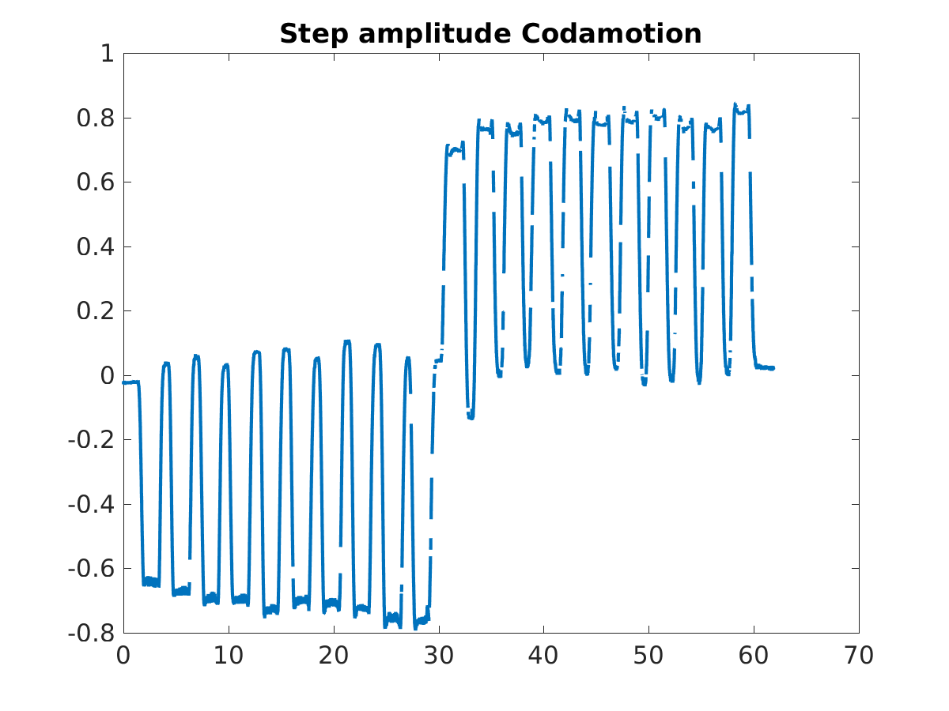
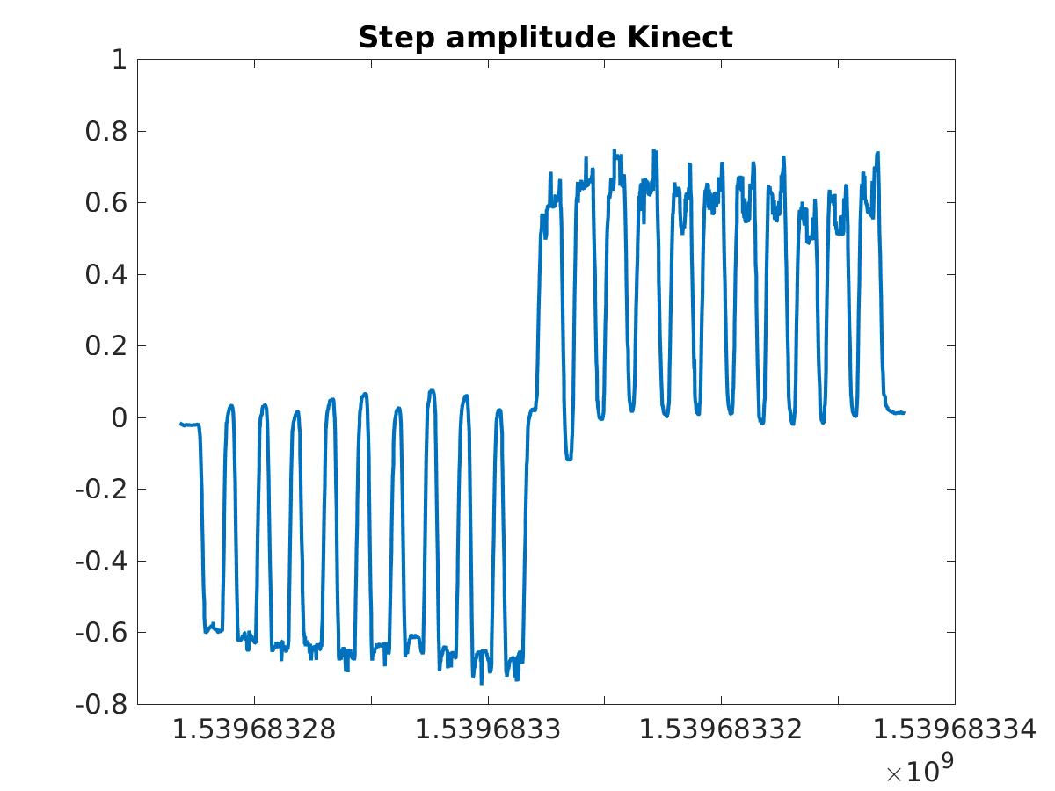
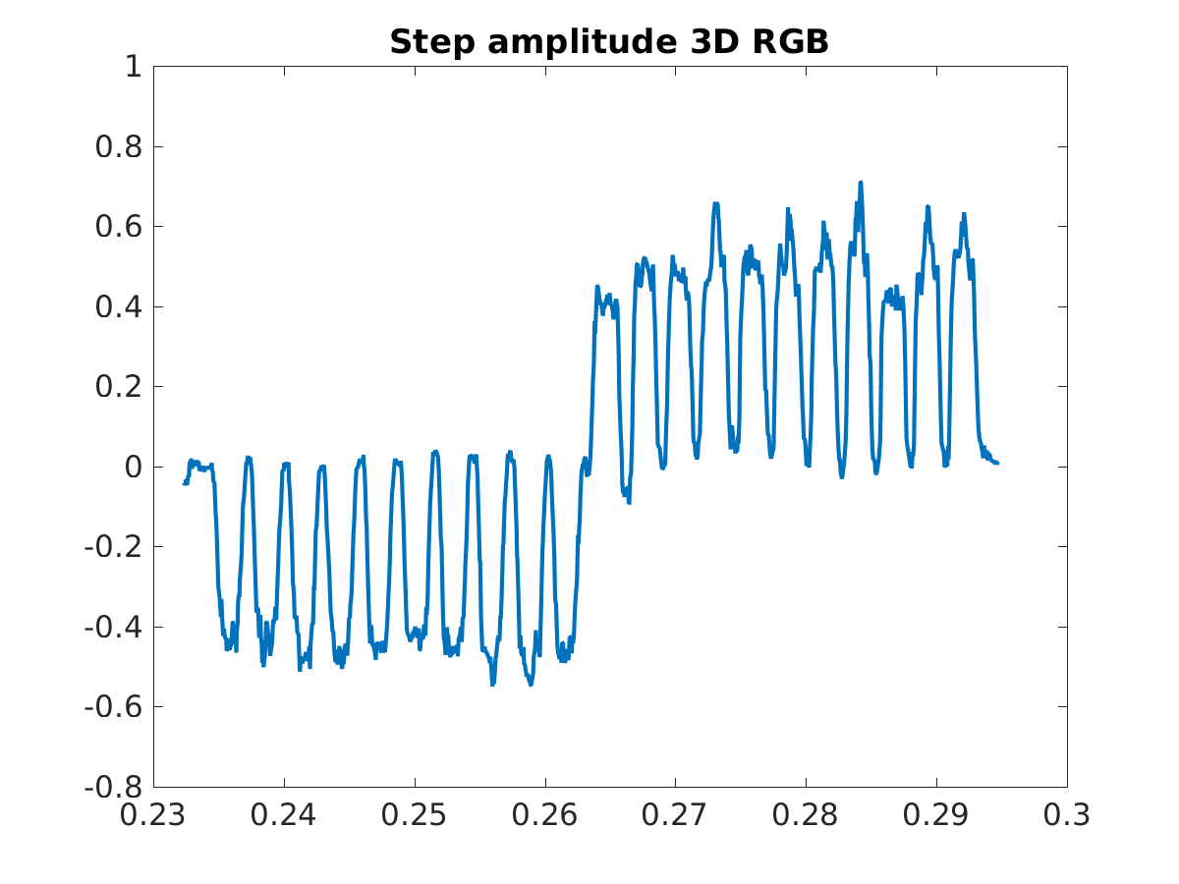
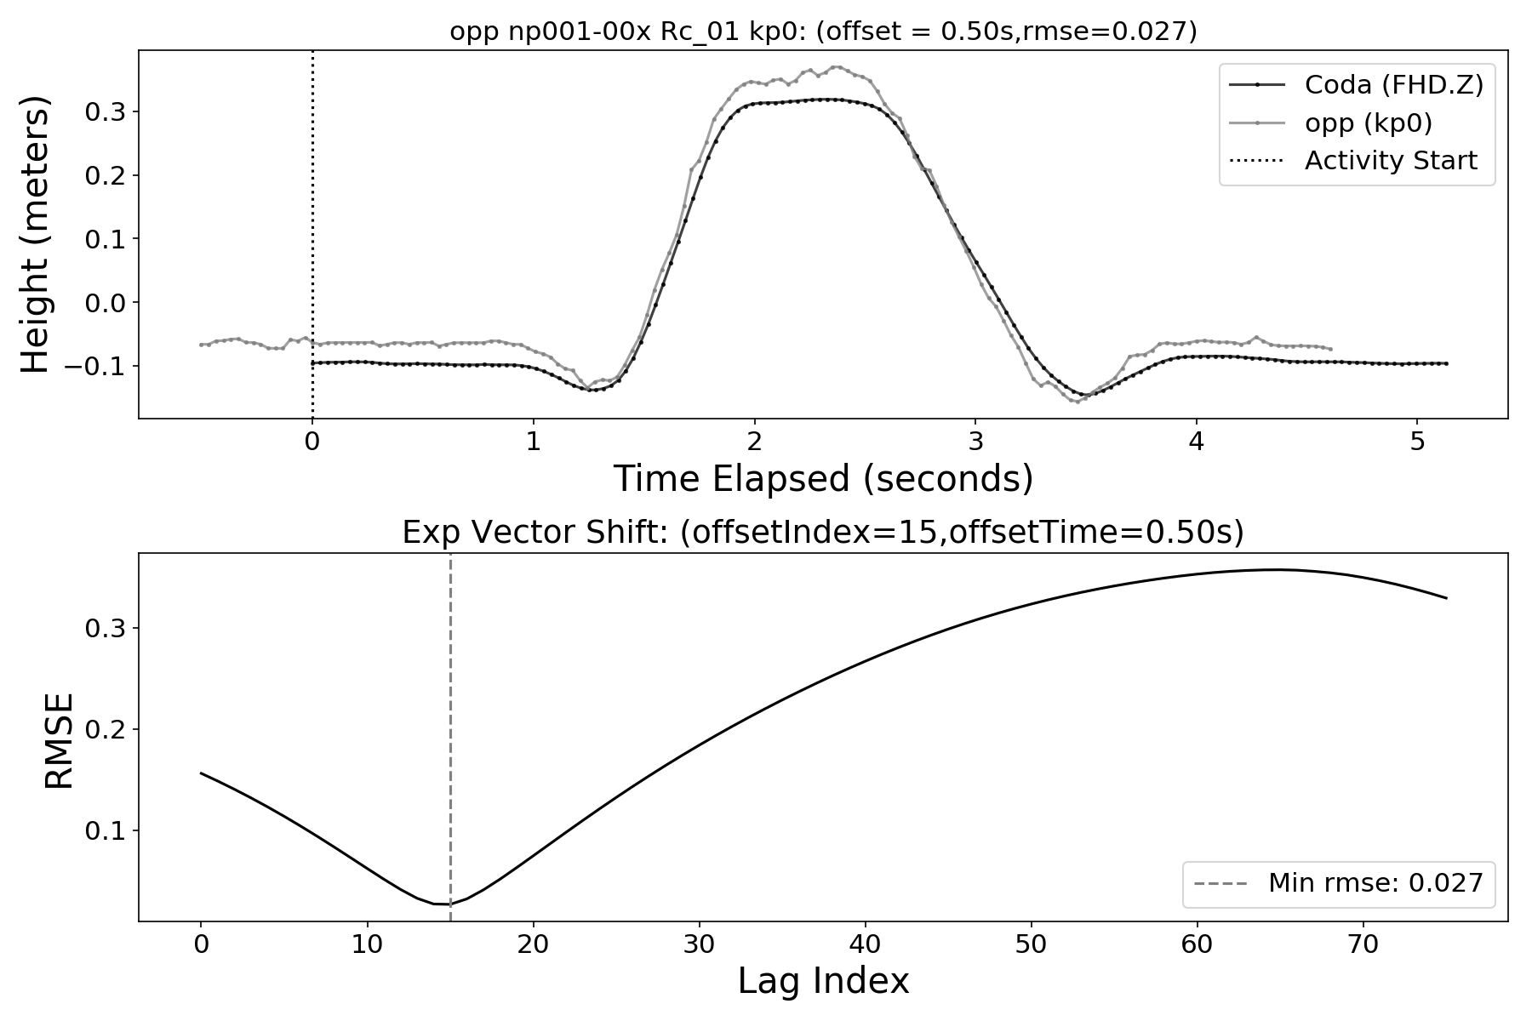
Product-technology
Real World Evidence
Big data - AI
Algorithm development
Direct computation correlation

Slide 2
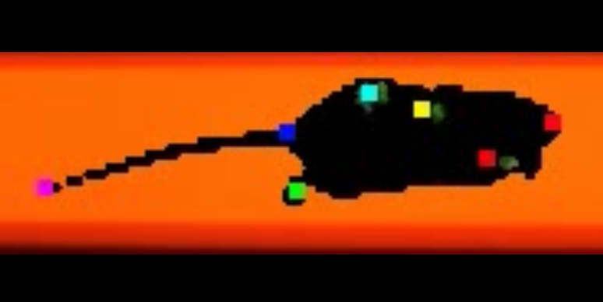
Motion Capturing Videos
Texas A&M Collaborative Research Agreement
Automatic marker-less rodent monitoring system
This CRA with Texas A&M University applies to projects conducted by the labs of Dr. Peter Nghiem, DVM, PhD of the College of Veterinary Medicine & Biomedical Sciences and Dr. Rahul Srinivasan, MBBS, PhD, of the College of Medicine, that would greatly benefit from the ability to quantify motor dysfunction in rat and mouse models by analyzing videos of walking and other motor tasks.
It will allow the creation of a automatic monitoring system to measure movement using cameras and computer algorithms without requiring wearable trackers.
Eventually, the researchers hope to create a simple way to measure changes in motor control in diseases like Parkinson’s or muscular dystrophy.

