Slide 1
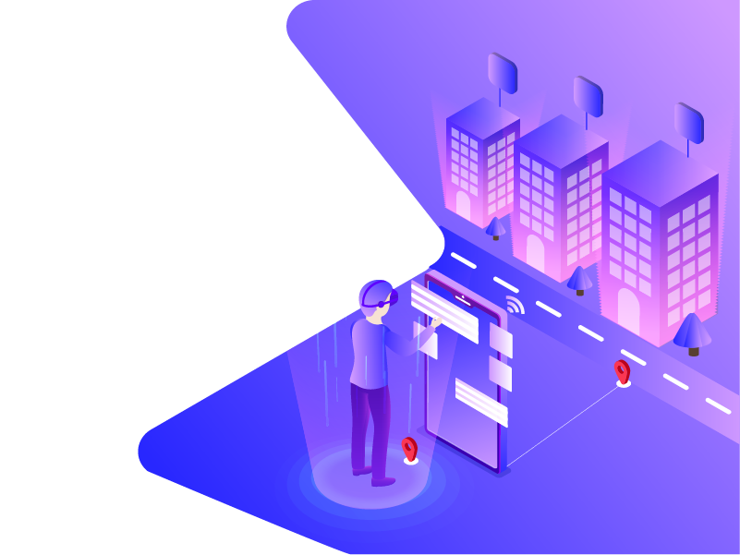
Immersive marketplace for real estate
Jean-Marc Duyckaerts
Founder & CEO
www.nirli.eu
https://www.linkedin.com/in/jmduyckaerts/
0495/588.478
jmduyckaerts@nirli.be

Slide 3
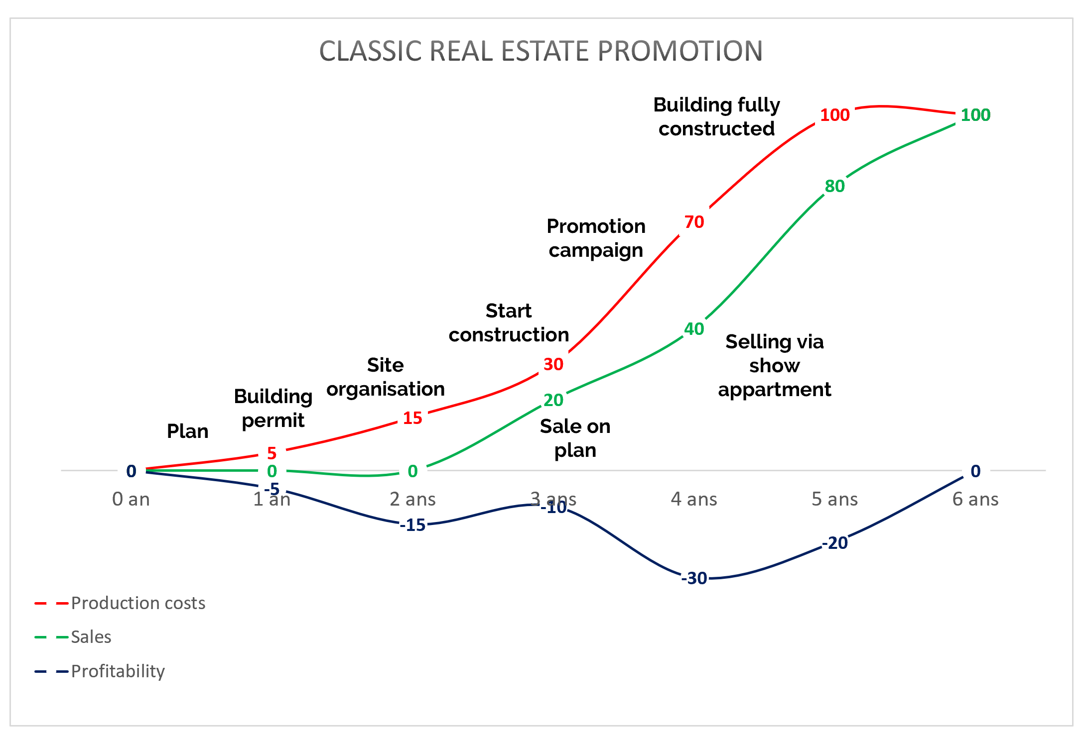
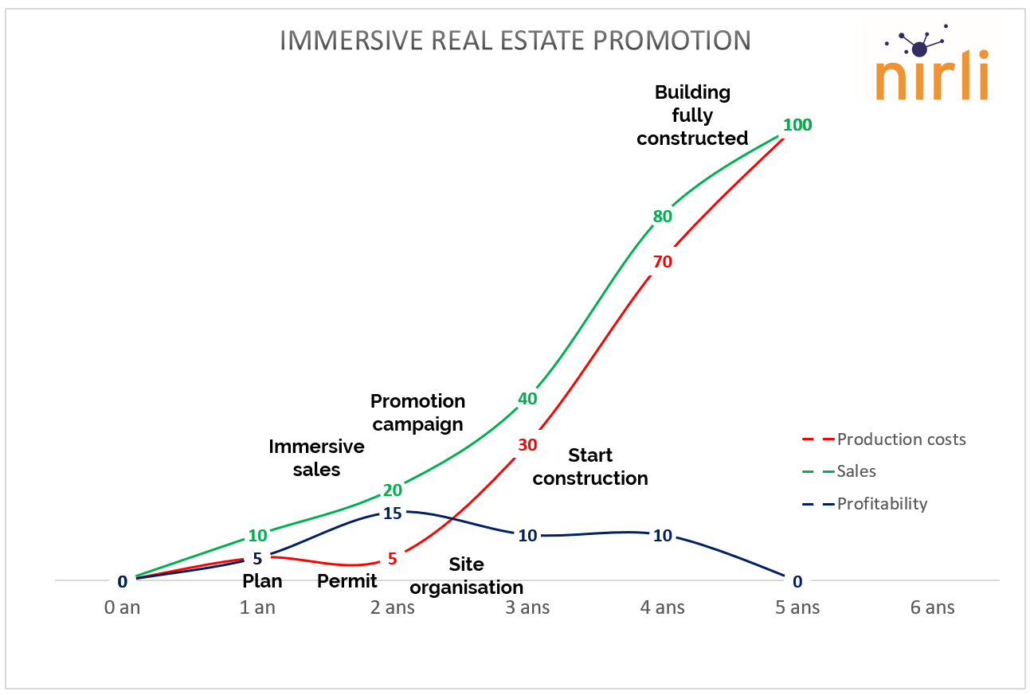
Process
Construction starts after 3 years in order to have a show appartment to boost the sales.
After 4 years, the full building is constructed and customers cannot more customize.
Process
Sales start from the building permit and the buildings are still customizable till the end.
Construction can start after the majority of sales
Financial profitability
Production costs (in red) are always higer than the sales (in green)
Profesionnals are running after their money till the end of the sales (in green)
The real profitability is known and reached at the end (in blue)
Financial profitability
Sales (in green) are always higher than the production costs (in red).
Professionals are managing proactively their financial profitability stage after stage (in blue).

Slide 4
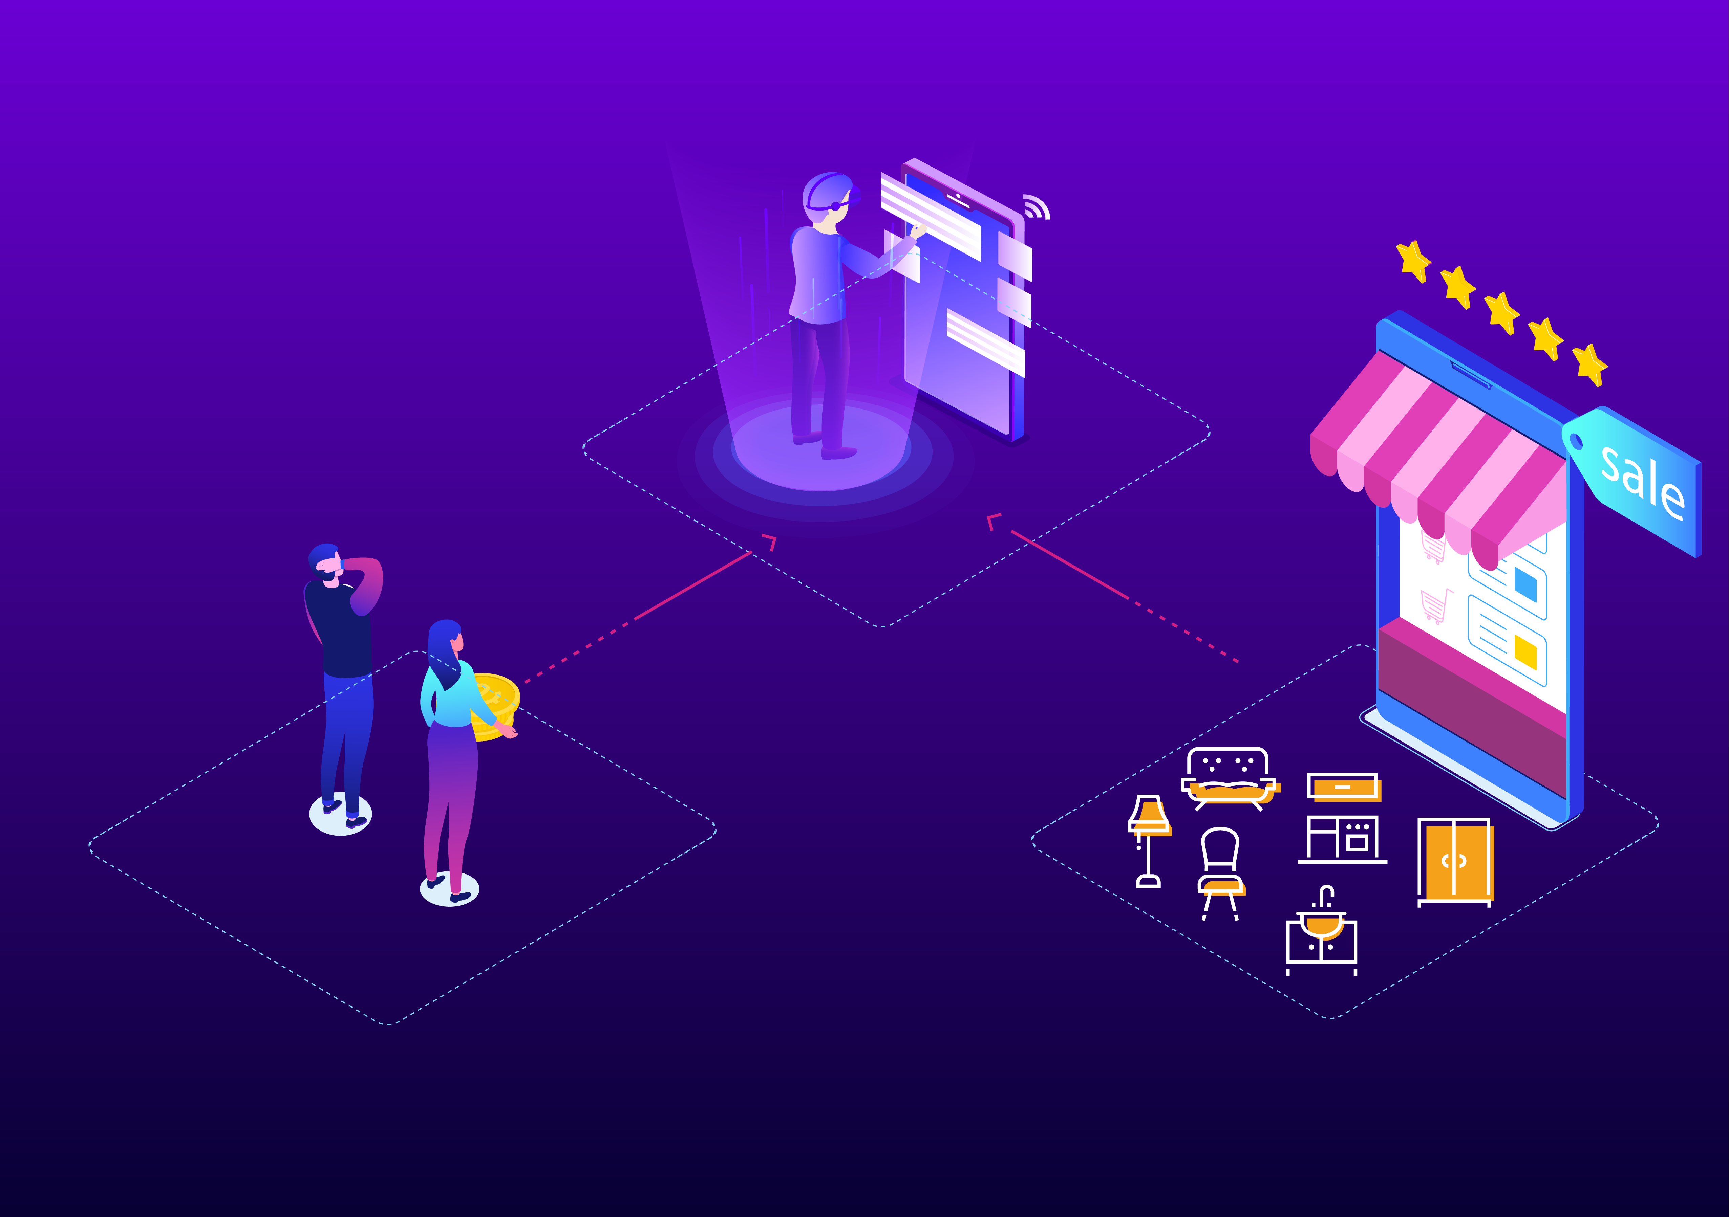
Integrating and creating the right technology and infrastructure to scale
Data
Virtual reality
AI
Internal development

Slide 5
Targeted market: European real estate
320 millions new sqm per year
200 000 agents

Slide 6
Competition
Immersive self-service
Myhabiteo, habx, homebyme
3D studio self-service
IrisVR, Drawbotics, 3state
3D studio
Marketing Agency

Slide 7
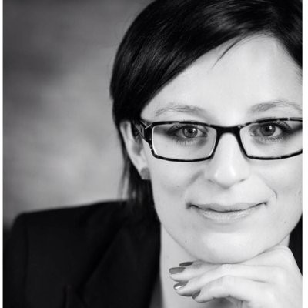
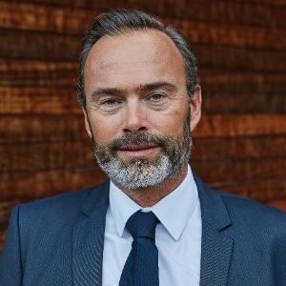
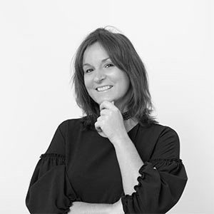
Team: Strong complimentary profiles
Jean-Marc Duyckaerts Founder & CEO
Thomas Morelle Lead Developer
Frédéric Lempereur Business Developer FR
Cyrielle Jacquemart Lead Marketing
Rachel Vandendooren Lead HR
To be engaged (10) Business Developer NL
Sales specialist FR
Sales specialist NL
Marcom specialist
Management assistant
2 IT developers
2 infographists
1 3D project Manager
1 CTO
Antoine Desmaisières
Lead 3D
Cédric Falletta Lead Platform
Notes:
Mix of technical, sales and marketing
We want to strengh the team by employing 11 new persons

Slide 8
Business model
B2B: Promotors, real estate agencies
Model validated: price per sqm 3€, 5€, 10€
Margin: From 41% up to 90%
Average revenue per project: 8000€
Cost of sales to sign a customer: 1500€

Slide 9
Sales and marketing
14 recurring customers
…
Growth by
Signing leaders agencies in regions
Wallonia, Brussels, Luxembourg, second invest countries
Sales representative & CEO events
Product catalog

Slide 10
Success KPI’s
KPI | 6 months | 12 months | 18 months
Customers | 20 | 30 | 40
SQM | 180 000 | 400 000 | 700 000
Margin | 50% | 55% | 65%

Slide 11
Business plan
Revenue
150 000€
570 000€
2 450 000€
3 820 000€
Ebitda
-63 000€
-30 000€
-200 000€
+400 000€
2019
2020
2021
2022

Slide 12
Fundraising
Raised in May 2018
112 500 €
87k € private via crowdfunding
25k € WING
Looking in November 2019
900 000 € (20-30% equity)
450k – Sales development
200k – Marketing
250k – Technology advantages (+ full subsidies DGO6 585k)

Slide 13
Recurrent customers
Attractive margin
Business model validated
Addressing a major sector needing innovation

Slide 14
Immersive marketplace for real estate
Jean-Marc Duyckaerts
Founder & CEO
www.nirli.eu
https://www.linkedin.com/in/jmduyckaerts/
0495/588.478
jmduyckaerts@nirli.be

Slide 15
Additional slides for Q&A

Slide 16
Real Estate pro are facing issues
Most houses sold once demo house built
Struggle to sell first 30% of the project
Take from 36 to 50 months to sell the whole project.

Slide 17
Values
Free up cash flow with by almost 50%
Increase margin through better assessment of options
Premium buying experience

Slide 18
Tangible and easy to understand
Personnalisation in an easy way
Sell as if demo houses are constructed.

Slide 19
Solutions
1
Access to a webplatform to upload 2D plan and manage immersive expériences.
2
Transform their 2D plan to immersive VR expériences.
3
end customers a bidirectional Immersive expériences

Slide 20
Organisation: flexible, horizontal, focus on developing the right technology and infrastructure
Design by pro
Production by freelance
Virtual reality
Real estate agencies, web platform
Nirli is the intermediate between sellers and buyers

Slide 21
Customers
> 130 000 sqm virtualised
1500€
Cost of sales to sign a customer
100%
Satisfaction

Slide 22
They’ve talked about us

Slide 23
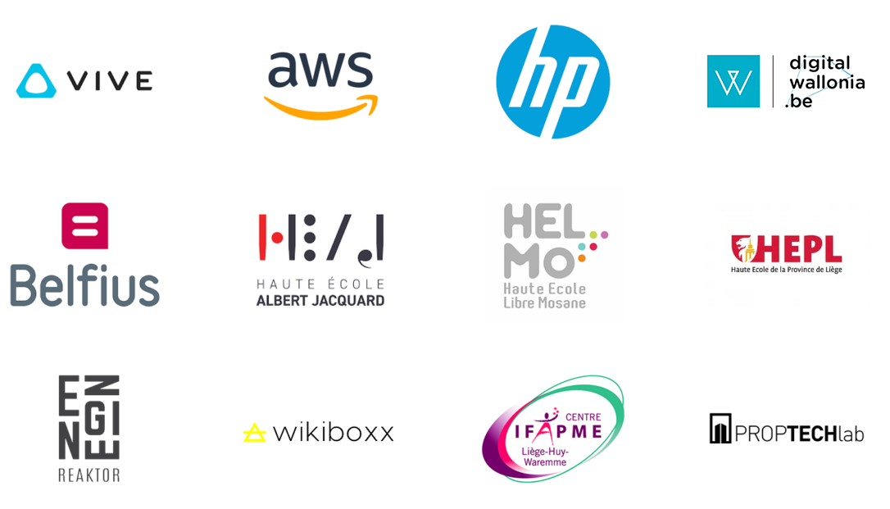
Partnerships

Slide 24
Shareholders – 14/12/2018

Slide 25
Exit possibilities
The goal is to sell the technology and our marketshare by end of 2023 to
An European leader in real estate promotions
A real estate agencies network (leader in Europe or worlwide)
A leader webplatform such as Axel Springer Group
A software development company such as Ubisoft

