Slide 1
Water based process for Delaminating and Deinking surface printed plastic

Slide 2
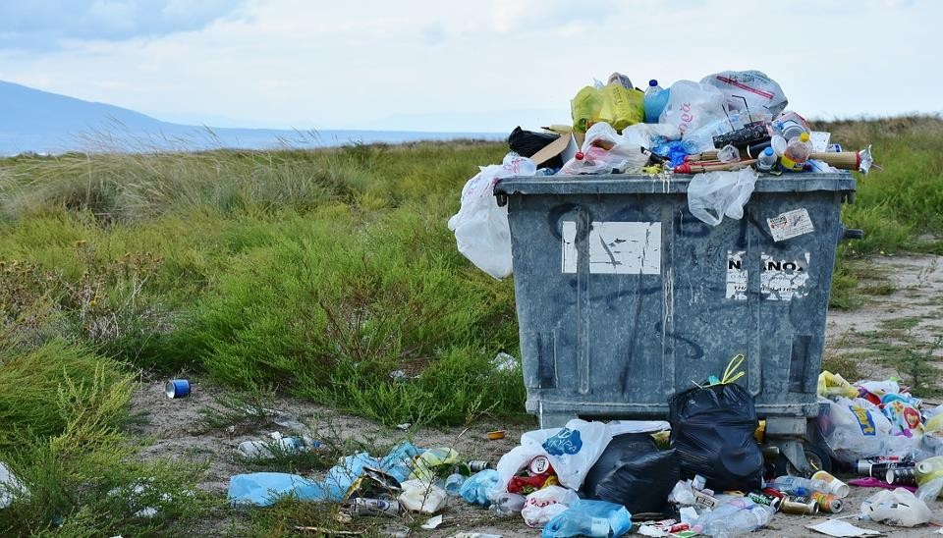
8.3 billion tonnes of plastic produced since 1950
Almost 80% landfilled, incinerated or leaked into the ocean
90,5% of total plastic production has never been recycled
There is not a real recycling. Recycled plastic goes to low-added value applications
It is a “cradle to grave” economy

Slide 3
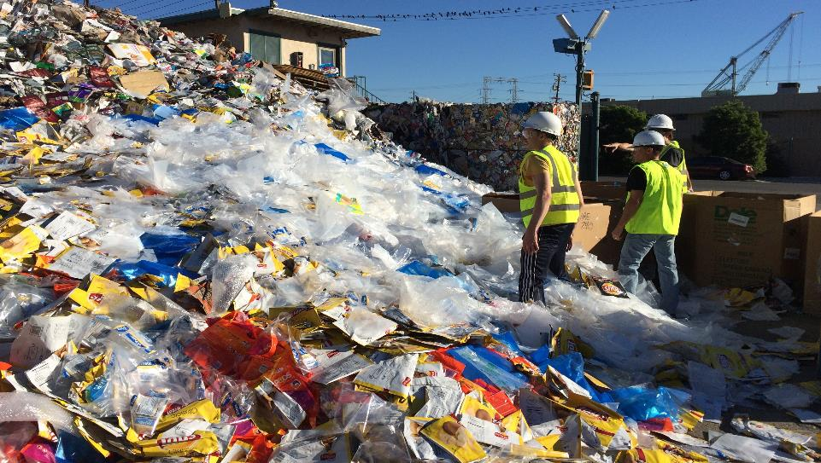
THE PROBLEM
1
Multilayer plastic packaging is not recyclable
Approximately 20% of total flexible packaging production
→ more than 9,6 tonnes of multilayer plastic
40 billion multi-material packages per year (US only)
Each layer requires different temperatures to be recycled
Image obtained from: https://www.materialsrecoveryforthefuture.com/research-results/seeding2-2/

Slide 4
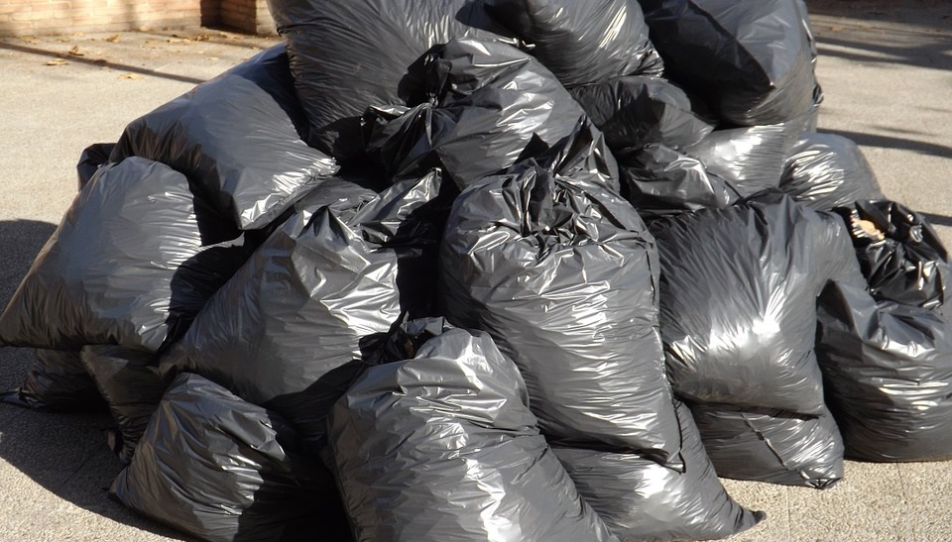
THE PROBLEM
2
Inked recycled plastic goes directly to downcycling
30% of flexible packaging is surface printed
Printed ink spoils the recycled product both visually and in its mechanical properties
Inks/adhesives cannot be removed, recycled plastic can be used only for low added value products

Slide 5
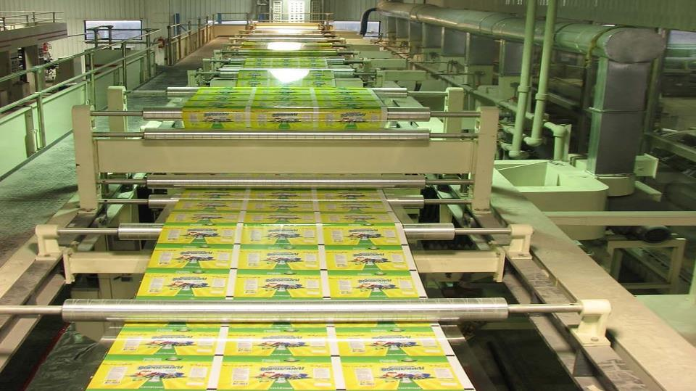
THE PROBLEM
3
10% Industrial production never ends in the market
Failures in the manufacturing process cause 8,8 M tonnes of multilayer and inked plastic that go directly to landfilling before entering in the market

Slide 6
THE SOLUTION
Cadel Deinking has developed an innovative technology able to separate multi-material flexible packaging into its constituent materials (PE / PET). This technology can also remove printed ink from plastic surfaces before they are recycled, obtaining a high value product again.
This technology is a chemical and mechanical recycling process that creates viable material feedstocks for new manufacturing processes from multi-material flexible packaging. Cleaning chemicals with water-based formulations are used in the process; neither solvents nor environmentally hazardous chemicals are used.

Slide 7
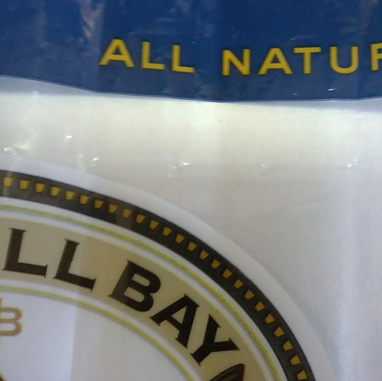
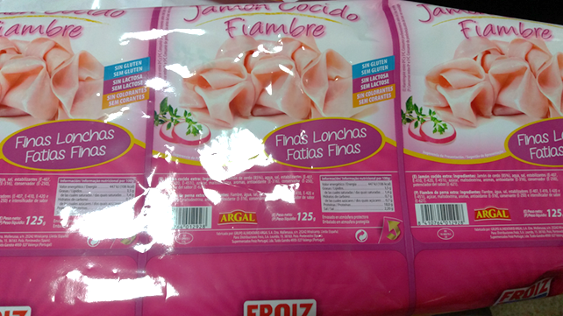
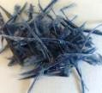
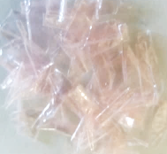
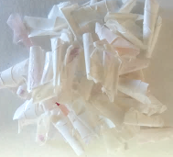
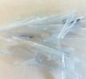
THE SOLUTION
DELAMINATING
DELAMINATING + DEINKING
LABORATORY RESULTS
Polymer A + Polymer B
Polymer A + Polymer B
Polymer A
(PET + ink)
Polymer B
(PE + adhesive)
Polymer A
(PET deinked)
Polymer B
(PE without adhesive)

Slide 8
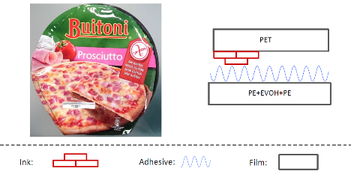
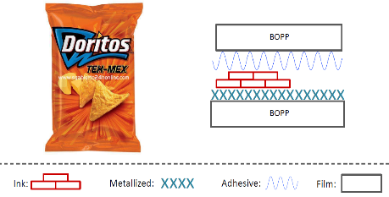
THE SOLUTION
Laminated PET//PE
Metallized BOPP//BOPP
DELAMINATING TECHNOLOGY - APPLICATIONS

Slide 9
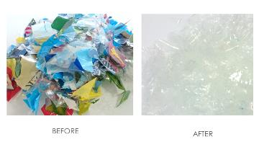
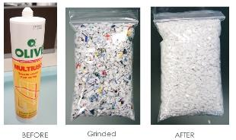
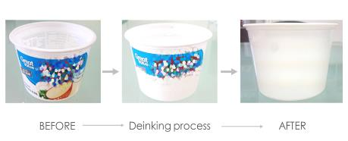
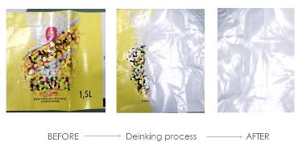
THE SOLUTION
LDPE FILM
RIGID HDPE
DEINKING TECHNOLOGY - APPLICATIONS
PP
BOPP LABEL

Slide 10
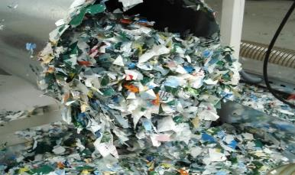
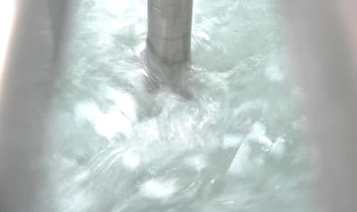
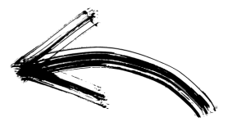
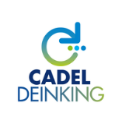
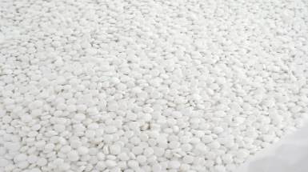
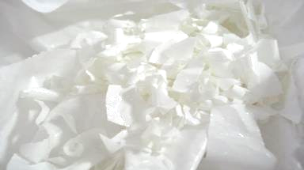
THE SOLUTION
DELAMINATING & DEINKING TECHNOLOGY- THE PROCESS

Slide 11
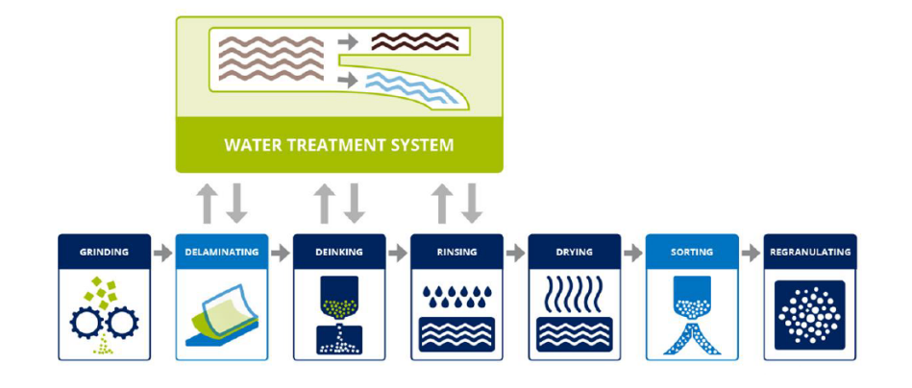
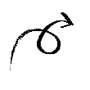
THE SOLUTION
DELAMINATING & DEINKING TECHNOLOGY- THE PROCESS
CLOSED LOOP
Solvent
Free
TRL 4: Validated laboratory tests
TRL 9: Proved in operational environment
Extended to more than 20 countries

Slide 12
THE SOLUTION
DELAMINATING & DEINKING TECHNOLOGY- THE PROCESS
Grinding: Operation executed at the beginning, when the plastic enters the system.
Rinsing: The plastic is centrifuged and rinsed with fresh water to achieve the final quality of the ink-free and process chemicals-free plastic.
Delaminating: Innovative technology to separate the plastic materials in laminated inked packaging film. It is necessary to use different temperatures and additive concentration for each material (PE-PET) during the process.
Drying: The plastic material goes to a new centrifugation step to eliminate any residual moisture.
Sorting: A previous process of classification is necessary to separate the different plastic materials.
Deinking: The milled material goes to the reactors, where it is in contact with a solution based on water-based deinking reagents that removes the ink from the surface of the plastic. After the first wash, the ink emerges from the plastic surface and remains in the aqueous solution.
Regranulating: Once the plastic is dried, it is sent to the extrusion step where the ink-free pellets are generated.

Slide 13
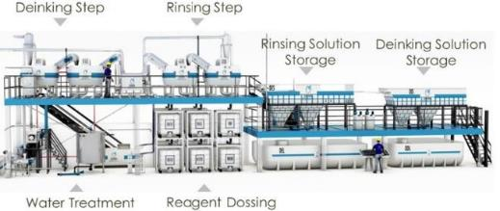
THE SOLUTION
PILOT PLANT
CADEL DEINKING owns a pilot plant in Sant Vicent del Raspeig (Alicante) that can process the material, following all the steps of industrial production.
The next step is to scale the delaminating process → Optimization (time/solvent concentration)
NEW
Delaminating
SCALABLE TECHNOLOGY
https://youtu.be/O793xr7F00s

Slide 14
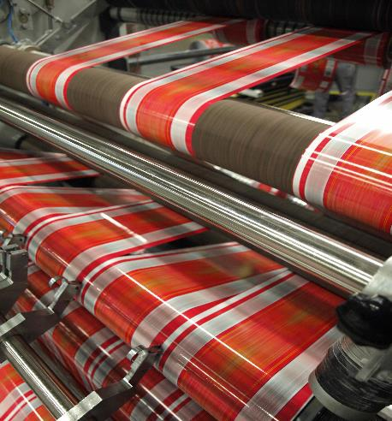
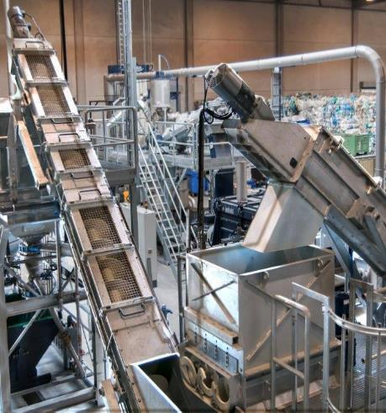
BUSINESS OPPORTUNITY
CONVERTERS
RECYCLERS
TARGET CUSTOMERS
Close to 13,000 companies
Close to 5,000 companies
€280 billion turnover
€10 billion turnover
45MT of plastic production
1,000T of plastic production
2,000T of plastic waste
https://www.planettogether.com/blog/scheduling-in-the-flexible-packaging-industry
https://www.herbold.com/es/erfolgsgeschichte-im-recycling-fuer-post-consumer-und-folienabfaelle-mit-rodepa-plastics-b-v-und-herbold-meckesheim-gmbh/

Slide 15
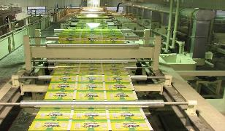
BUSINESS OPPORTUNITY
POTENTIAL MARKET
348,000,000 tonnes of plastic produced worldwide in 2017
Potential market
97.4 MT
Multilayer
Inks and adhesives
Industrial waste
20% of total plastic production
30% of flexible plastic packaging
10% of plastic manutacturing
69.9MT
18.8 MT
6.9MT
1.8 MT
Notes:
PLASTIC PRODUCTION WORLDWIDE: 348MT (2017)
FLEXIBLE PLASTIC PACKAGING → 18% →
MULTILAYER → 20%
INKED

Slide 16
BUSINESS OPPORTUNITY
ECONOMIC ADVANTAGES OF D&D TECHNOLOGY
SAVINGS OF
€500/T
VIRGIN PELLETS COST → €1,200/T
D&D RECYCLED PELLETS COST → €700/T
Decreased carbon footprint 5 times
€350/T
€200/T
€150/T
€700/T
Printed and laminated plastic waste
Delaminating and Deinking
Regranulating
D&D Recycled pellets
595 kgCO2/t plastic
Delaminating process is at laboratory scale. Costs could be slightly higher

Slide 17
BUSINESS OPPORTUNITY
DIRECT SALES
LICENSE AGREEMENTS
BUSINESS MODEL
TURNKEY PROJECTS
TECHNICAL ASSISTANCE
Complete D&D industrial plant
500-1,000kg/h capacity
Engineering & Equipment supply/installation
Technical assistance (SAT) per remote access
24/7 on-line support
Expert advice on operation and maintenance
€1.3M (converters)
€1.7M (recyclers)
€50/year
CHEMICAL REAGENTS
ADDITIONAL SERVICES
Own designed combination of chemicals for delaminating and deinking
Manufactured and distributed by CADEL
Additional technology improvements in new hardware
Implemented at customer’s plant
€180k/year per plant
€50/year

Slide 18
BUSINESS OPPORTUNITY
POTENTIAL BUSINESS
SALES EVOLUTION
BUSINESS MODEL

Slide 19
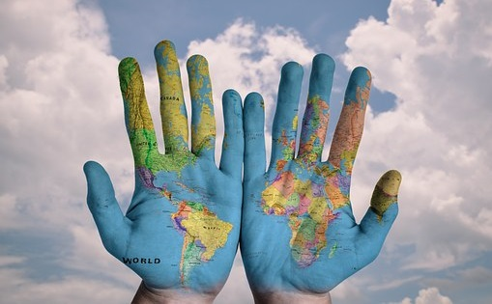
BUSINESS OPPORTUNITY
MARKET FEASIBILITY
200 companies have shown interest in our delaminating and deinking technology
41 Have sent material
31 Industrial tests paid
11 Film tests & validation
FIRST PLANT SOLD!
9 Customers in
advanced negotiations

Slide 20
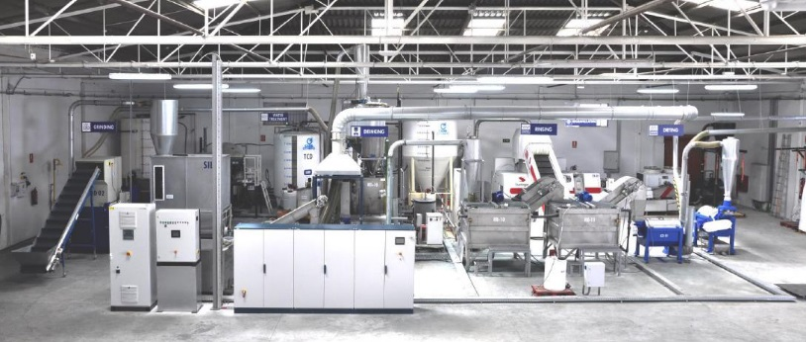
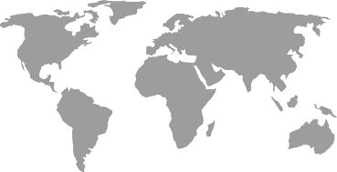
OUR COMPANY
PRESENTATION
CADEL DEINKING is a technological and innovative engineering company located in Alicante, Spain
2014
2017
Foundation
Start of activity
Launch into market
Market positioning
2010
2015
Since the beginning, CADEL has been developing innovative, environmentally friendly and low-cost processes to recycle and reuse plastic waste
The objective is to improve the quality of the plastic products through the most sustainable method

Slide 21
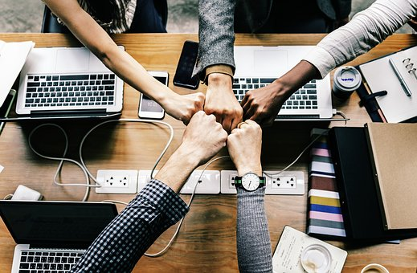
OUR COMPANY
TEAM
CADEL is fundamentally a R&D Company, based on a multidisciplinary, dynamic and motivated human team
Process
Engineering
Automation
and
Control
Technical office
R&D
Electrical
engineering
Documents
2 Business & Financial Managers
2 Industrial Engineers
2 PhDs in Chemical Engineering
1 Industrial Design Engineer
4 Chemical Engineers
1 Electrical Assistant
4 Electrical & Automation Engineers
1 Sales & Marketing Assistant

Slide 22
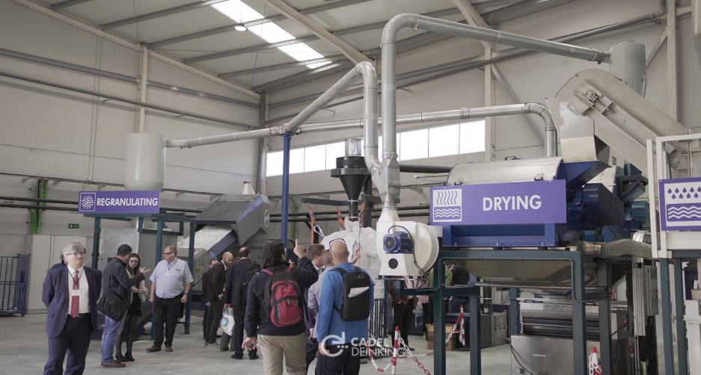
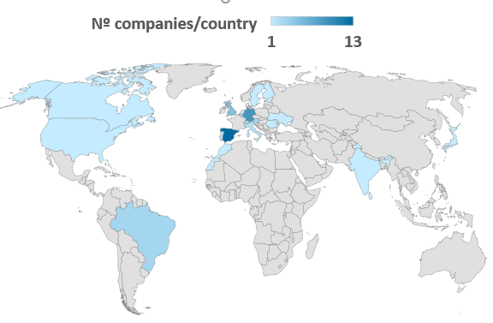
OUR COMPANY
CADEL OPEN DAYS
Last 4th, 5th and 6th December, we celebrated the first Open Days for Delaminating and Deinking technology at CADEL DEINKING facilities. During this event, we demonstrated the operation of a plant, which allowed the visitors to understand the D&D process.
More than 62 companies from 26 different countries around the world attended, showing their interest in the plant. Also high-level speakers showed their vision on circular economy.

Slide 23
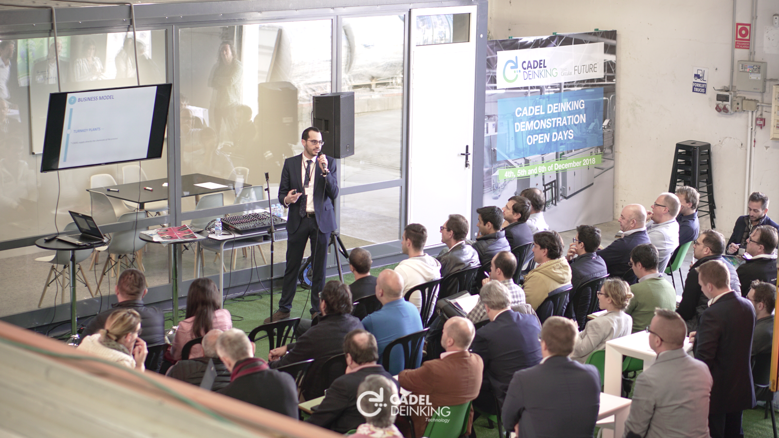
OUR COMPANY
CADEL OPEN DAYS

Slide 24
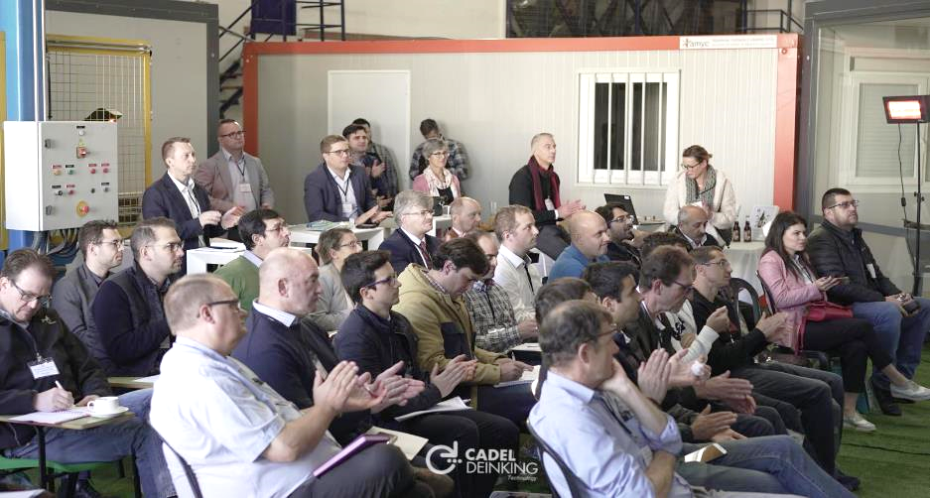
OUR COMPANY
CADEL OPEN DAYS

Slide 25
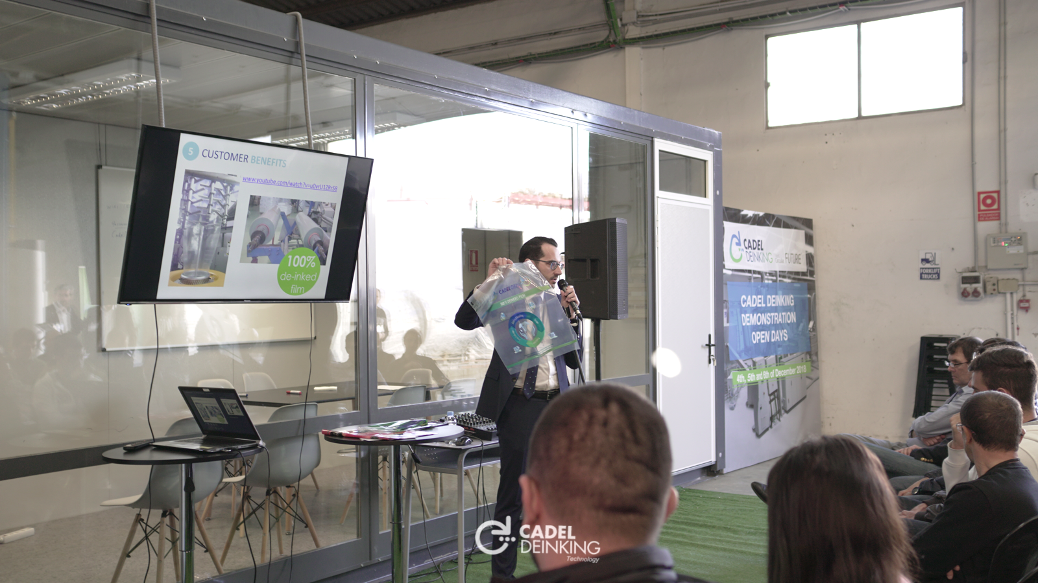
OUR COMPANY
CADEL OPEN DAYS

Slide 26
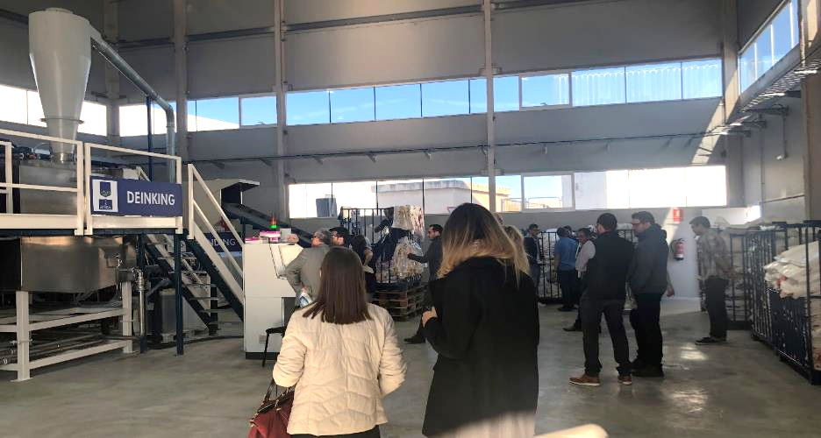
OUR COMPANY
CADEL OPEN DAYS

Slide 27
OUR COMPANY
CADEL OPEN DAYS

Slide 28
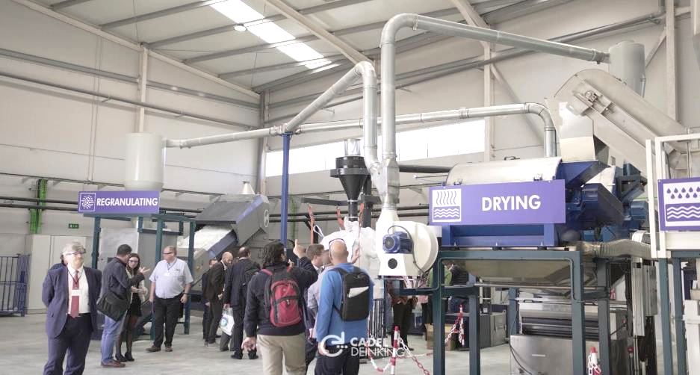
OUR COMPANY
CADEL OPEN DAYS

Slide 29
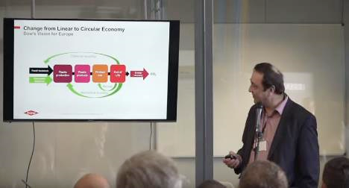
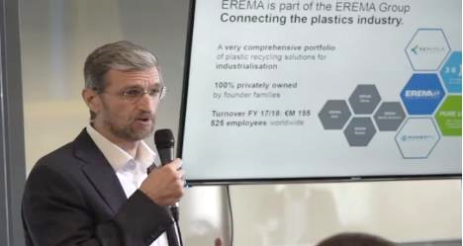
OUR COMPANY
CADEL OPEN DAYS
Andreas Dirnberger from EREMA
Karlheinz Hausmann from Dow DuPont

Slide 30
THANKS FOR YOUR ATTENTION

